Slide 1

Giacomo Inzani, Piacenza, Italy
From images to data: the pipeline

Slide 2
Goal, solution and difficulties
GOAL: develop a pipeline for quantitative measuring:
  how LITAF translocation in the nucleus can be reduced using an inhibitor (SB)
  the amount of LITAF in the nucleus of the cells under a drug in different condition
SOLUTION: implement a pipeline to extract the distribution of the pixels of a selected region amongst different intensities
DIFFICULTIES: segmentation of nuclei and cells (open problem in image analysis field!)

Slide 3
Goal, tools and solution
GOAL: develop a pipeline for quantitative measuring:
  how LITAF translocation in the nucleus can be reduced using an inhibitor (SB)
  the amount of LITAF in the cells (nucleus, cytoplasm) under a drug in different condition
TOOLS: bioinformatics instruments, for a precise and fast approach (tests with CellProfiler and lessons about image analysis by S. Altschuler and L. Wo)
SOLUTION: implement a new, flexible pipeline to extract the distribution of the pixels of a selected region amongst different intensity
DIFFICULTIES: segmentation of nuclei and cells (open problem in image analysis field!)

Slide 4
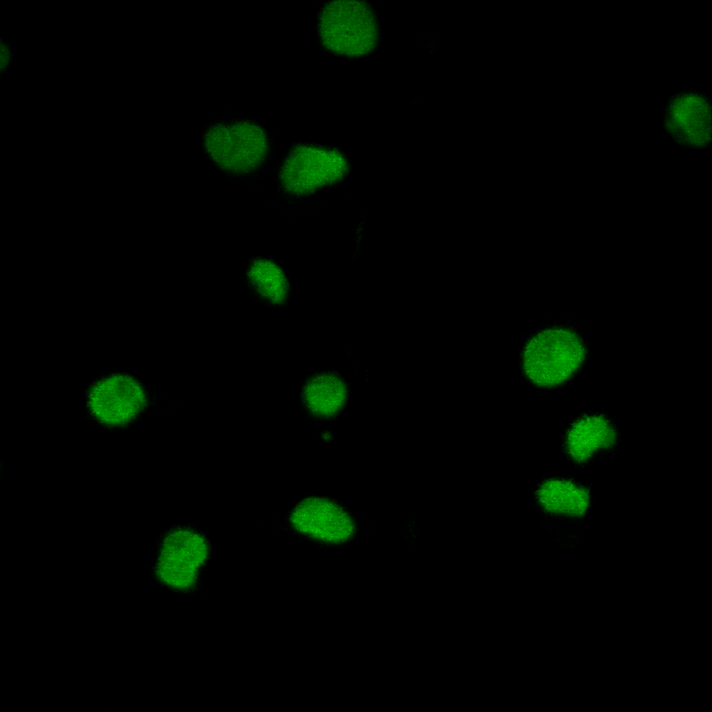
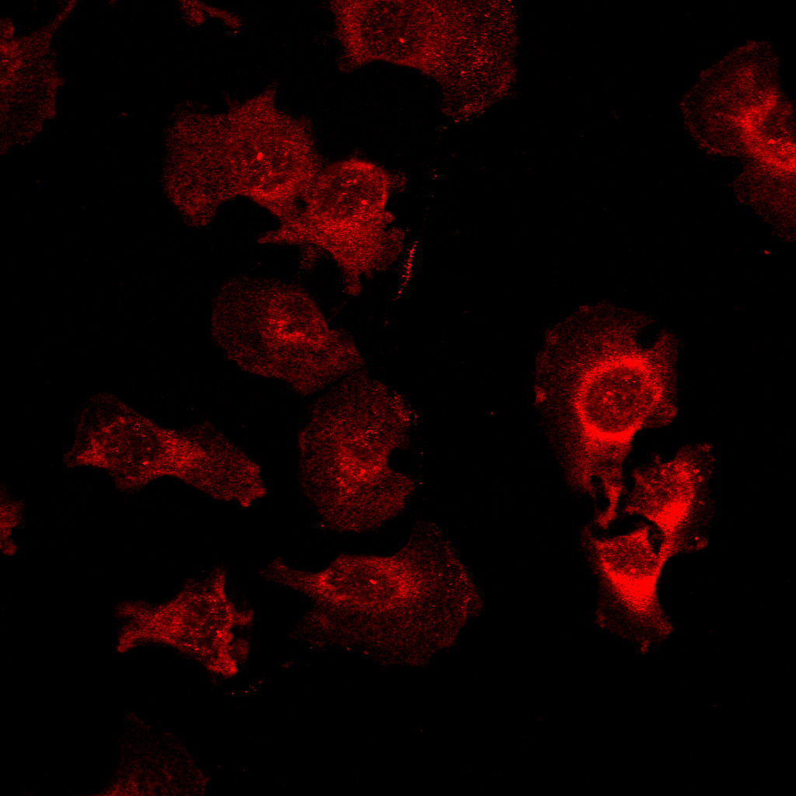
Images
Two channels, 85 images:
  Nuclei channel (white/green), to extract the mask
  LITAF channel (red), to extract the intensities
The nuclei channel (left) and the LITAF channel (right)

Slide 5
Data
Two main datasets:
  Hepatic Stellate
    6 conditions (AC_CTRL, NA_CTRL, NA_1h100LPS, NA_2h100LPS, NA_1h500LPS, NA_2h500LPS)
      6 samples per condition
  LX-2
    6 conditions (2h100LPS, 2h100LPS+SB, 2h500LPS, 2hLPS500+SB, NT)
      11 samples per condition
Two channels per sample:
  Nuclei channel (white/green), to extract the first mask
  LITAF channel (red), to extract the second mask and the intensities
The nuclei channel (left) and the LITAF channel (right) of a sample from LX-2 dataset.

Slide 6
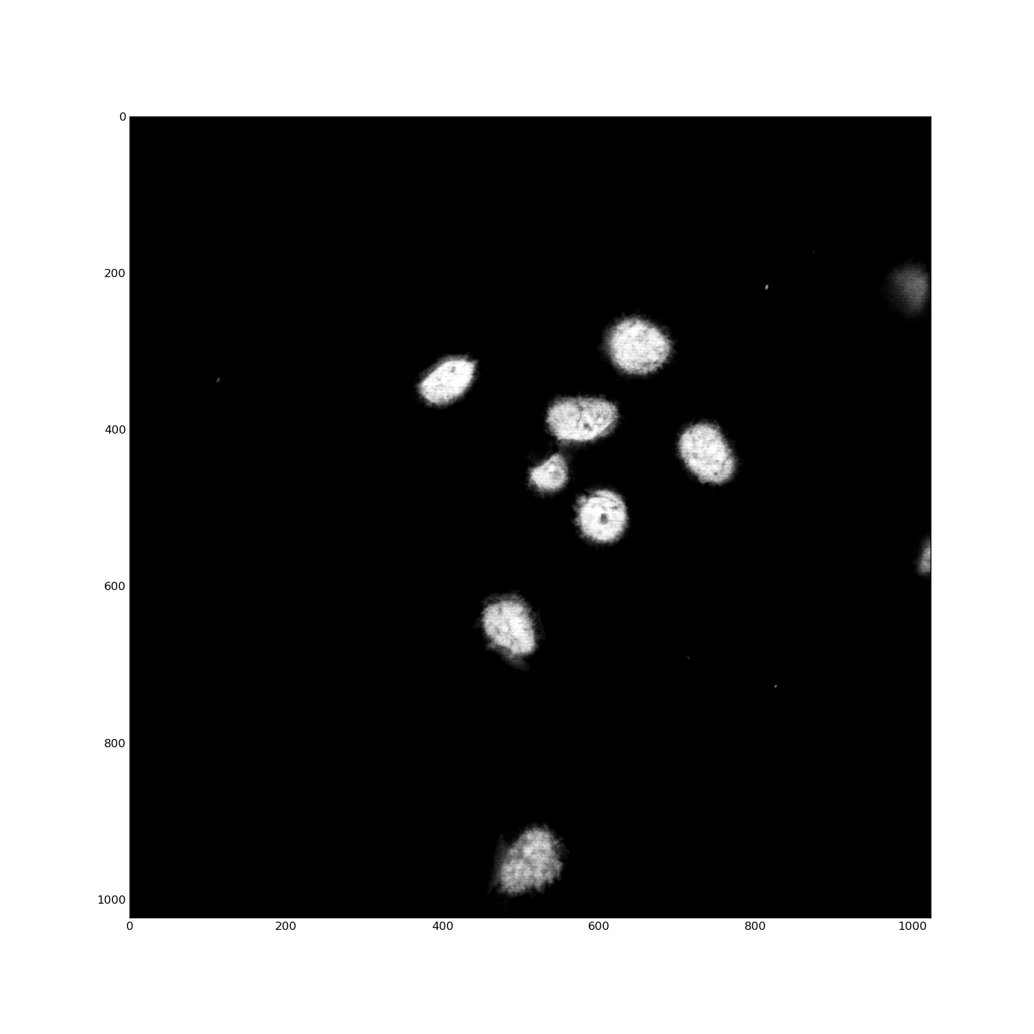
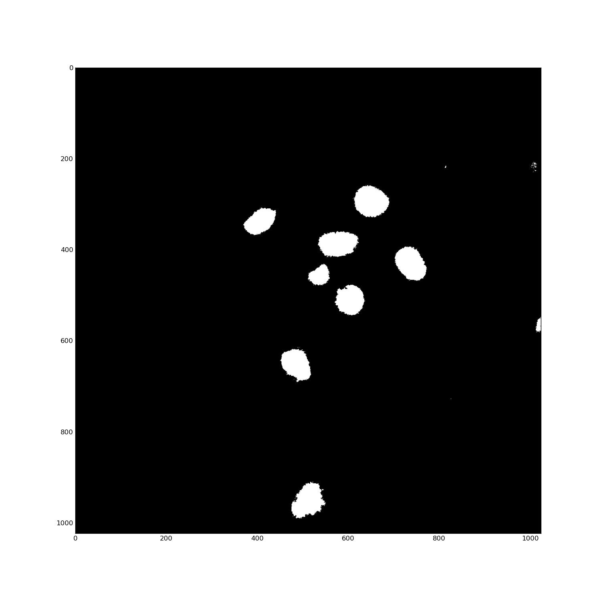
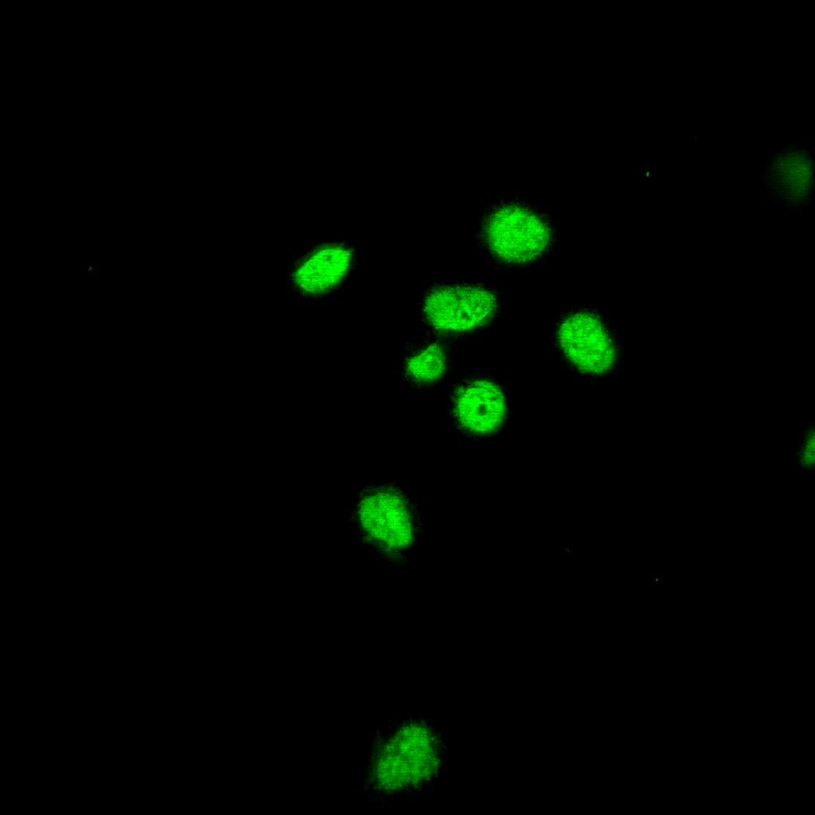
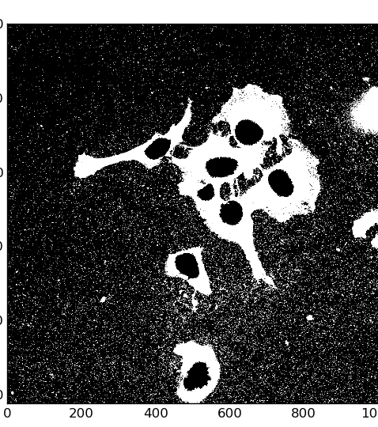
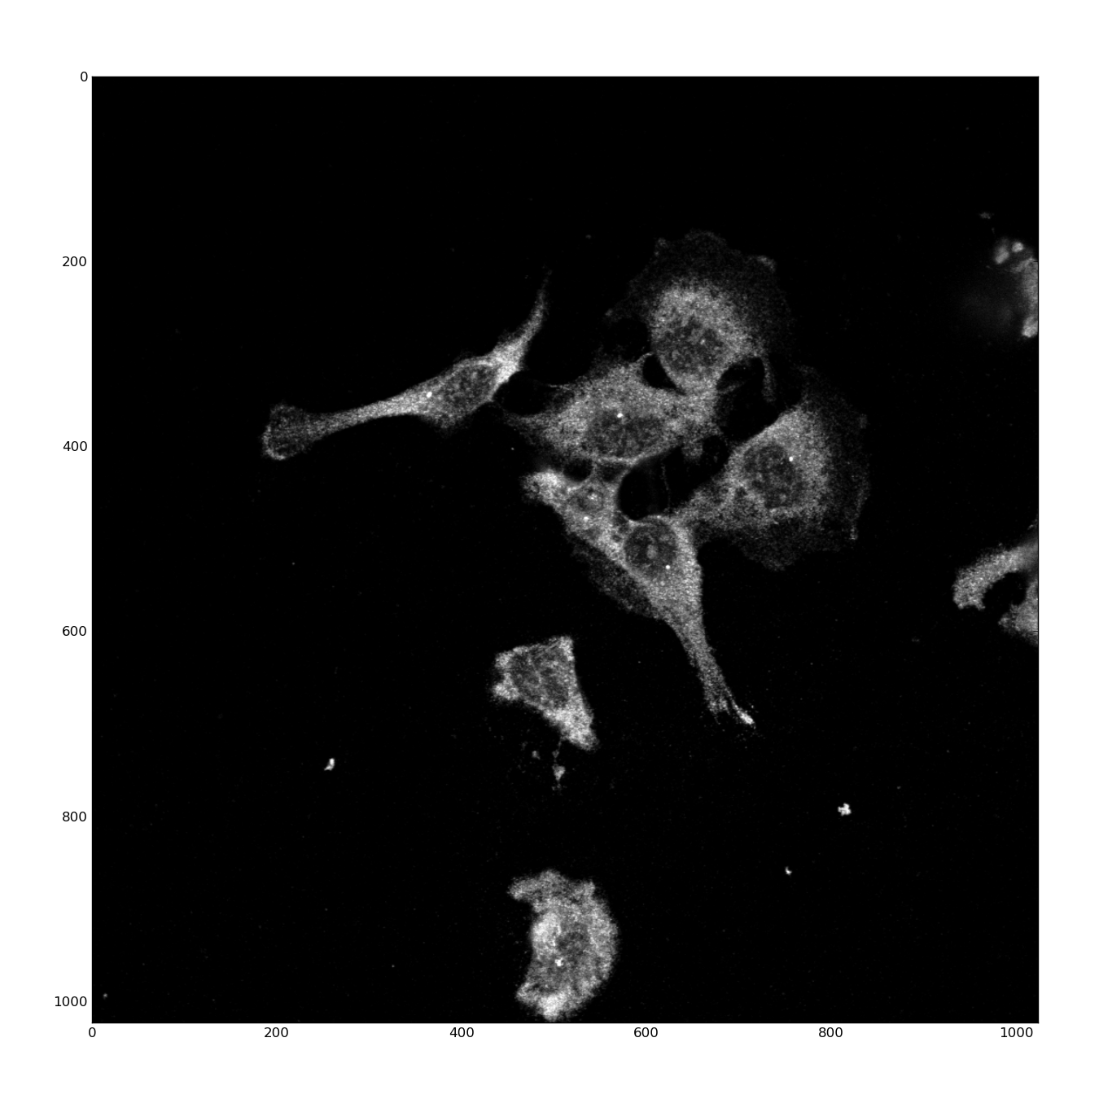
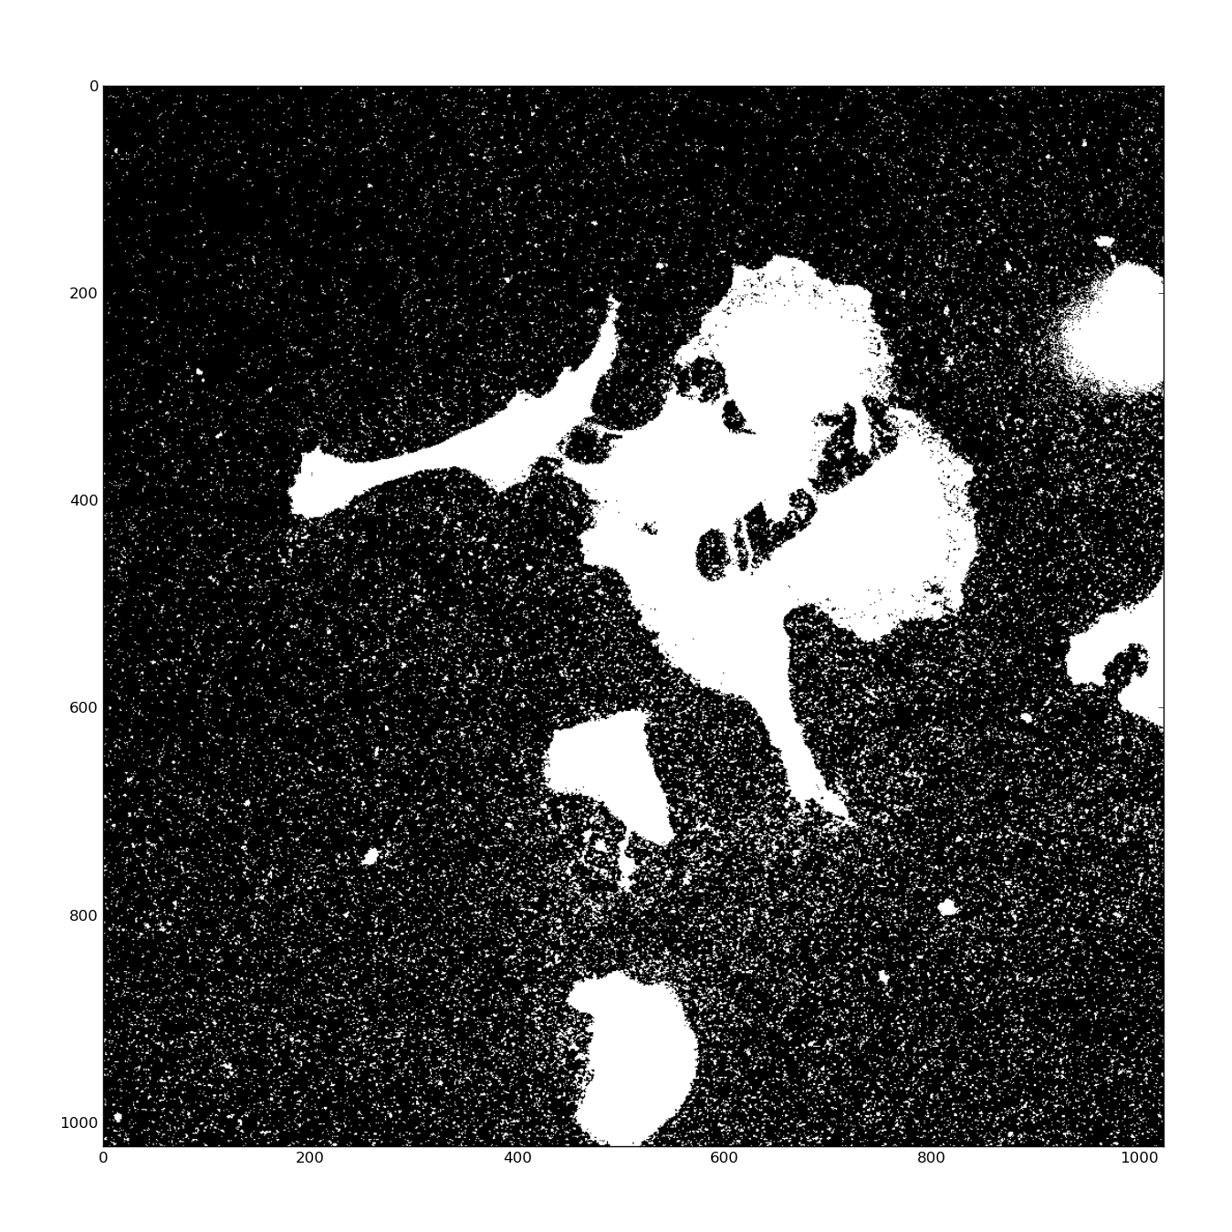
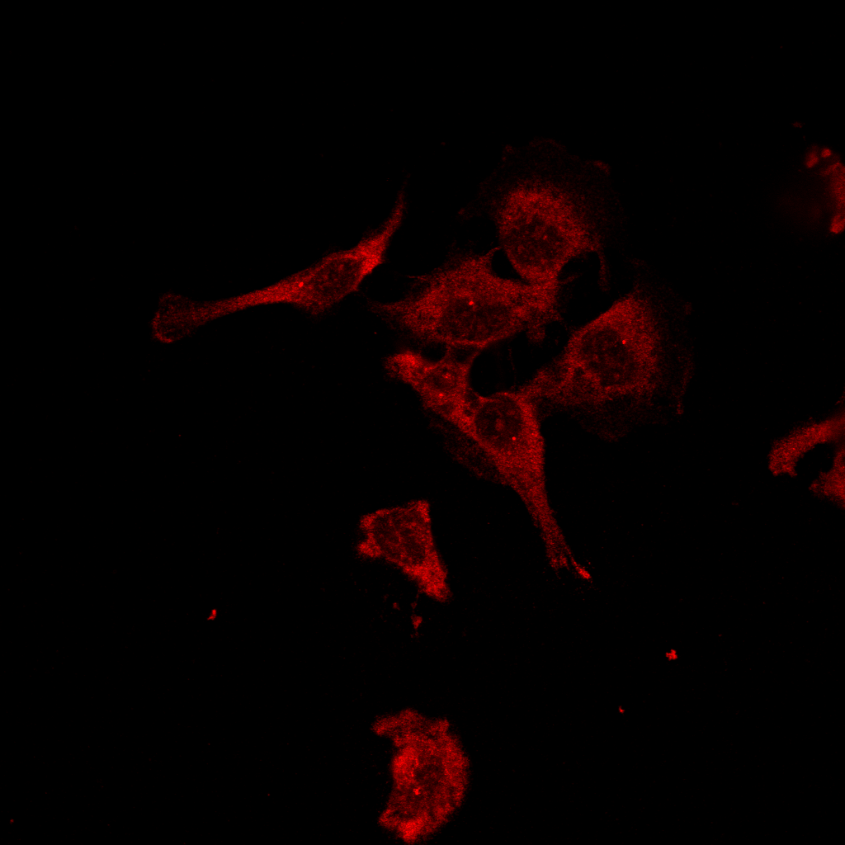
The Pipeline
Nuclei channel
Gray scale nuclei
Mask 1
Mask 3
LITAF channel
Gray scale LITAF
Mask 2

Slide 7
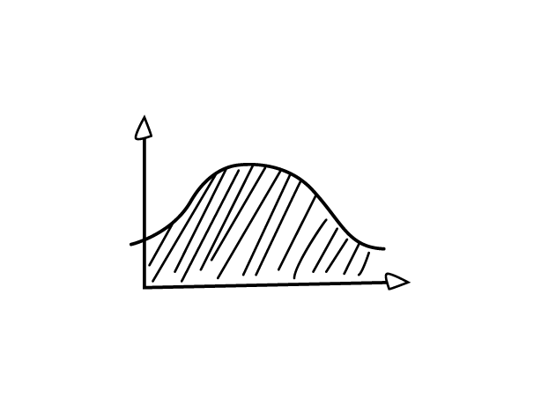
LITAF translocation analysis pipeline
G
Gray
Mask
R
R + Mask

Slide 8
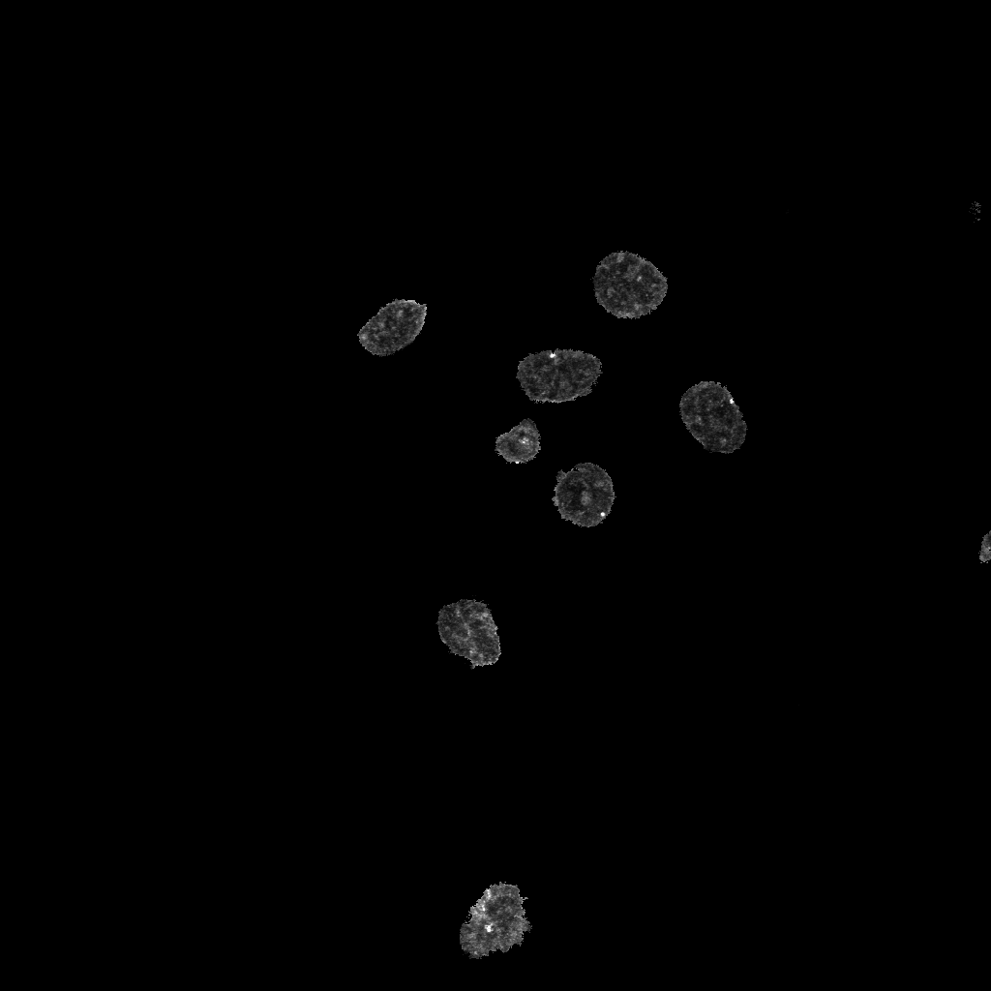
Example
Nuclei channel
Gray scale nuclei
Mask
LITAF channel
Gray scale LITAF
LITAF in the nuclei

Slide 9
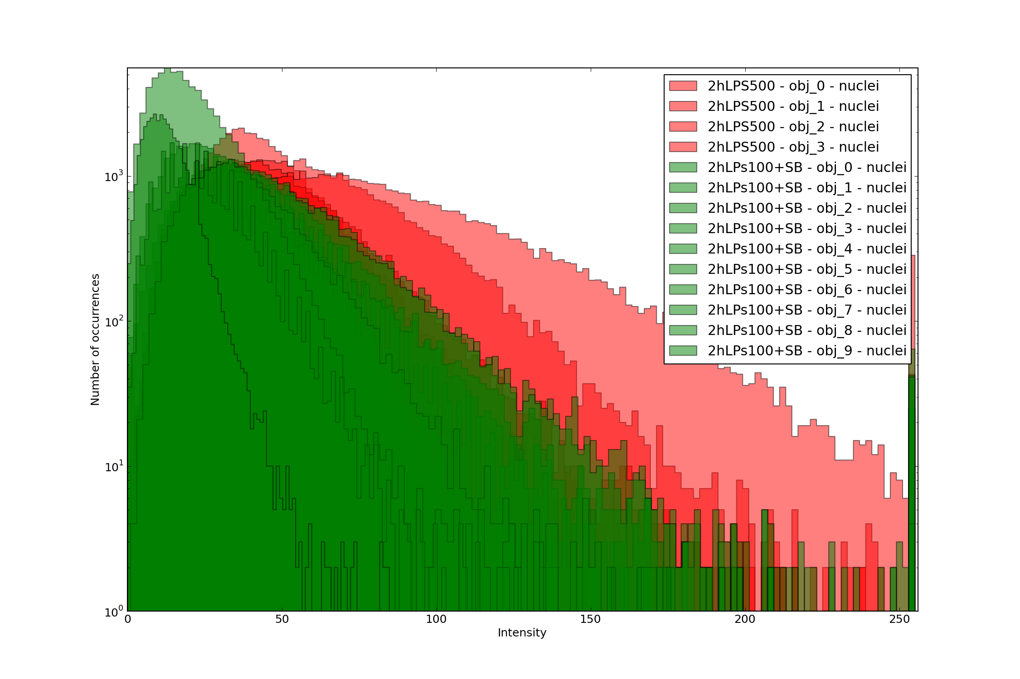
The Pipeline
Nuclei channel
Nuclei mask
LITAF channel
LITAF in the nuclei

Slide 10
The Pipeline
Nuclei channel
Gray scale nuclei
LITAF channel
LITAF in the nuclei

Slide 11
The Pipeline
Nuclei channel
Nuclei mask
Outputs:
1) Histograms
2) Boxplots
3) Tables
LITAF channel
LITAF in the nuclei

Slide 12
The Pipeline
Nuclei channel
Gray scale nuclei
Outputs
LITAF channel
LITAF in the nuclei

Slide 13
The Pipeline
Nuclei channel
Gray scale nuclei
Outputs
1) Histograms
2) Boxplots
3) Tables
LITAF channel
LITAF in the nuclei

Slide 14
The Pipeline
In LITAF channel, the intensity of each pixel represent the different amount of LITAF in that region
PIPELINE:
  Gray scale conversion
  Nuclei selection (Otsu + Fill Holes functions) = Mask 1
  Whole cell selection (Otsu) = Mask 2
  Cytoplasm selection (Mask 2 – Mask 1) = Mask 3
  Using the masks, select the gray scale pixels in the nuclei and in the cytoplasm
  Extract the distributions of pixels in each area previously selected
  Compare the distributions amongst different conditions:
    Histograms
    Boxplots
    p-values

Slide 15
The Pipeline
For each image, we had two channels: the nuclei channel, from which we extracted the masks, and the LITAF channel, on which we applied the masks.
In LITAF channel, the intensity of each pixel represent the different amount of LITAF in that region
PIPELINE:
  Convert the channels to gray scale
  Select the nuclei from the nuclei channel applying an Otsu threshold (selection of the first mask)
  Select the whole cell from the LITAF channel applying an Otsu threshold (second mask)
  Create cytoplasm mask subtracting from the second mask the first
  Apply the masks (cytoplasm and nuclei) to the LITAF channel and select two regions of pixels
  Extract the distributions of pixels in each area previously selected
  Compare the distributions amongst different conditions:
    Histograms
    Boxplots
    p-values

Slide 16
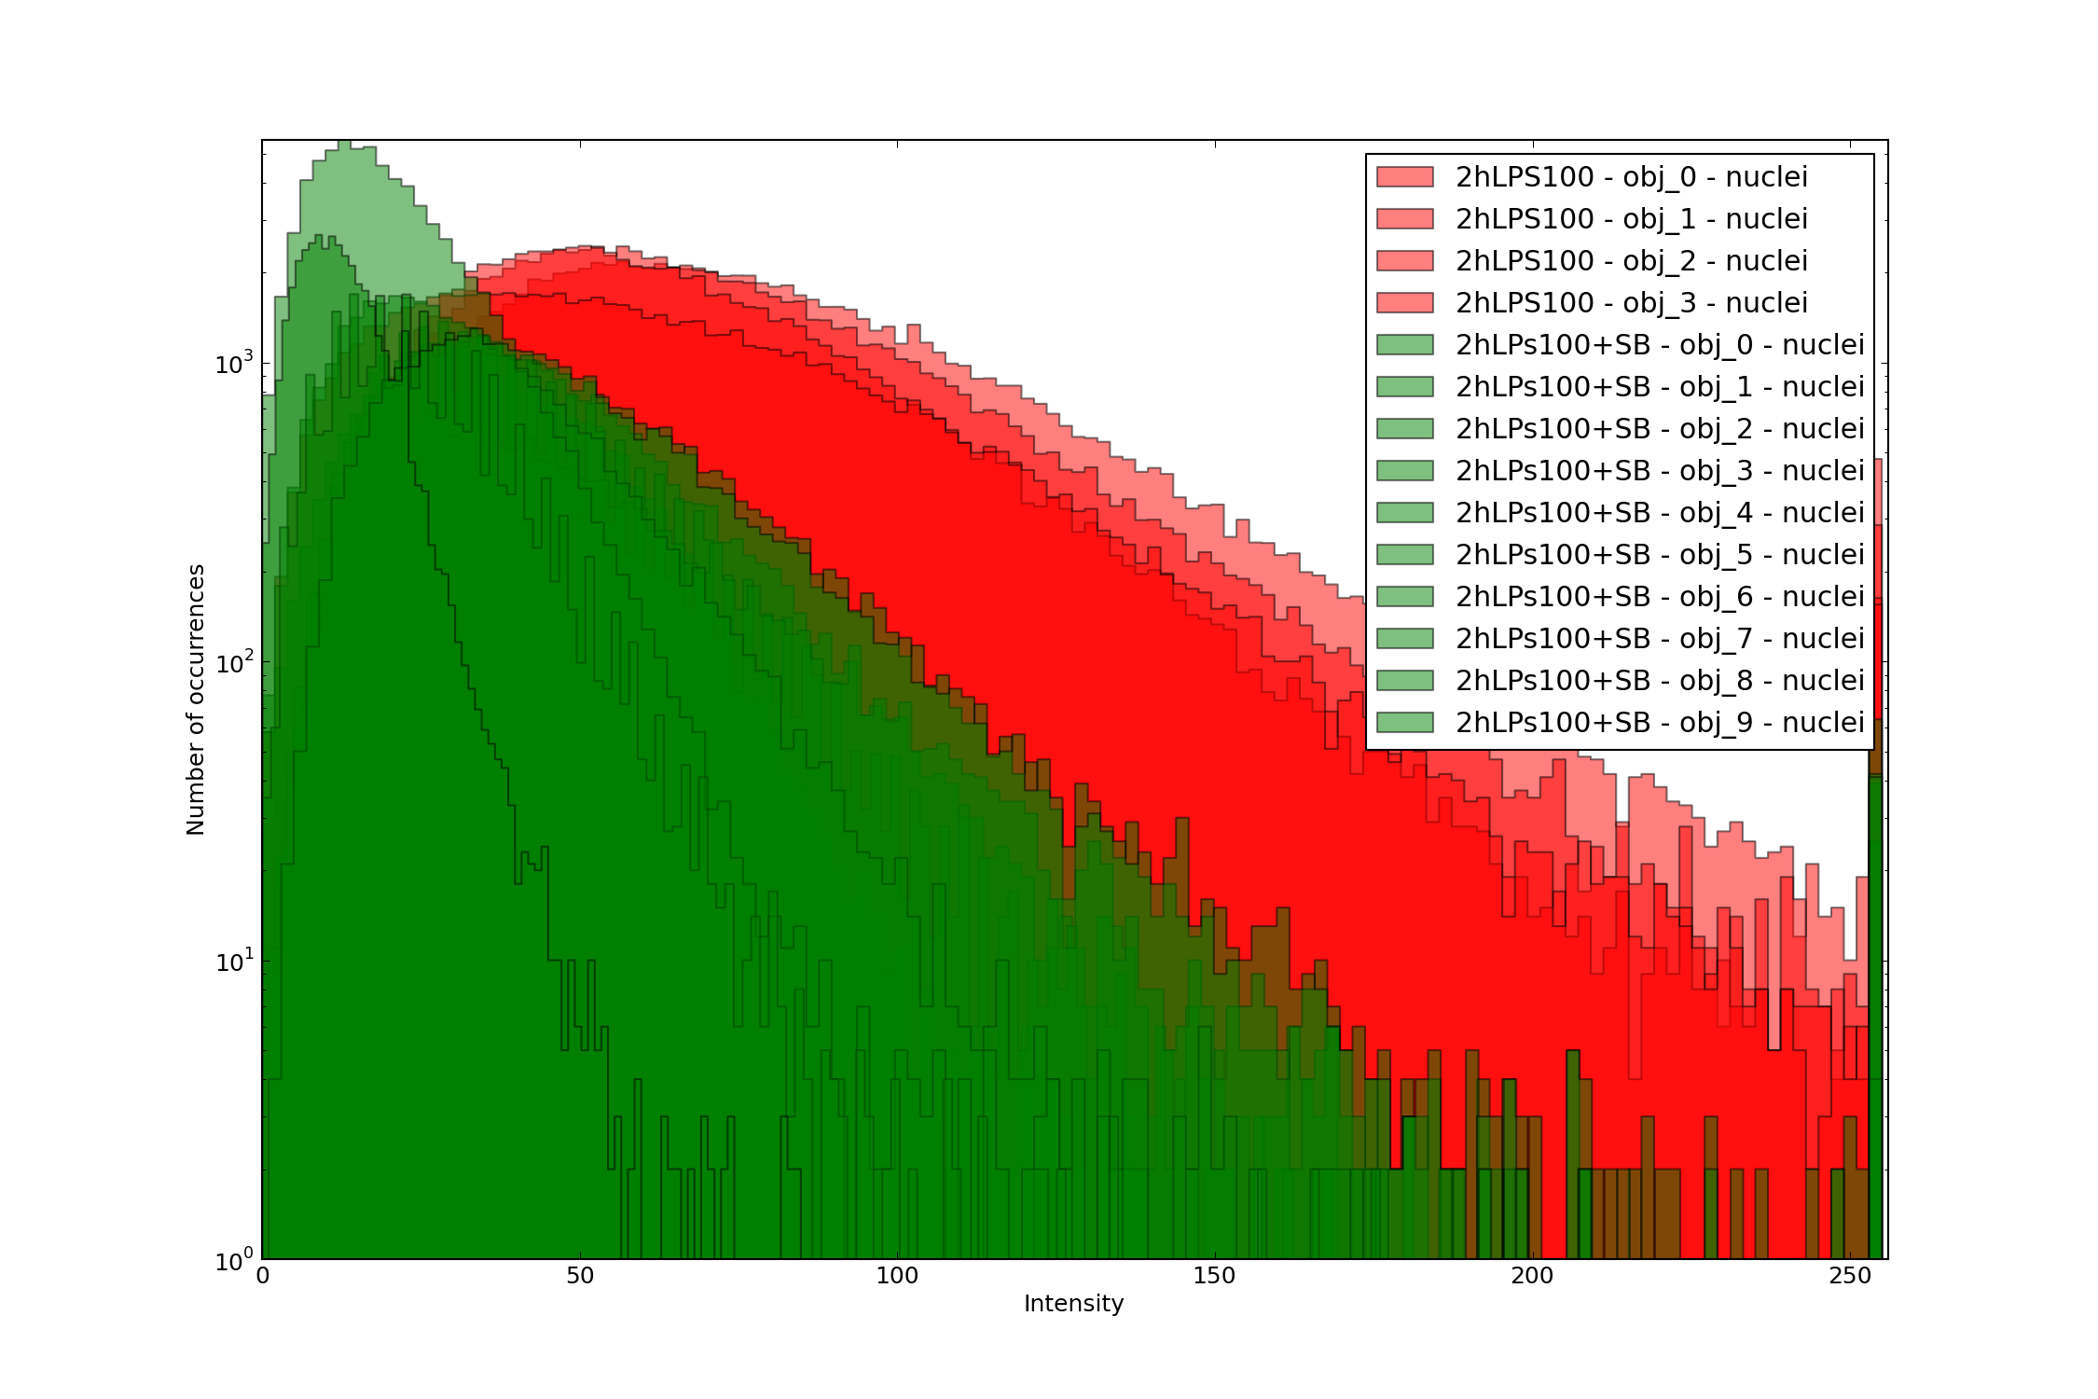
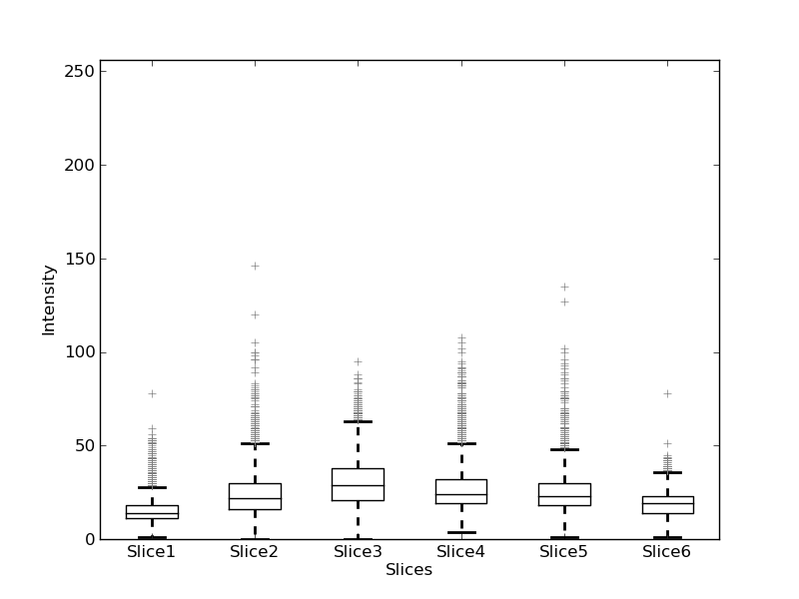
Data visualization
Boxplots:
  Show the number of pixels that lay in a certain range
Histograms:
  Show on x-axis the intensity of the pixels, on the y-axis the number of pixels with an x intensity
P-values:
  Median
  Mean
  Sum
Wilcoxo-Mann-
Whitney test
T-test
Examples of histogram and boxplot

Slide 17
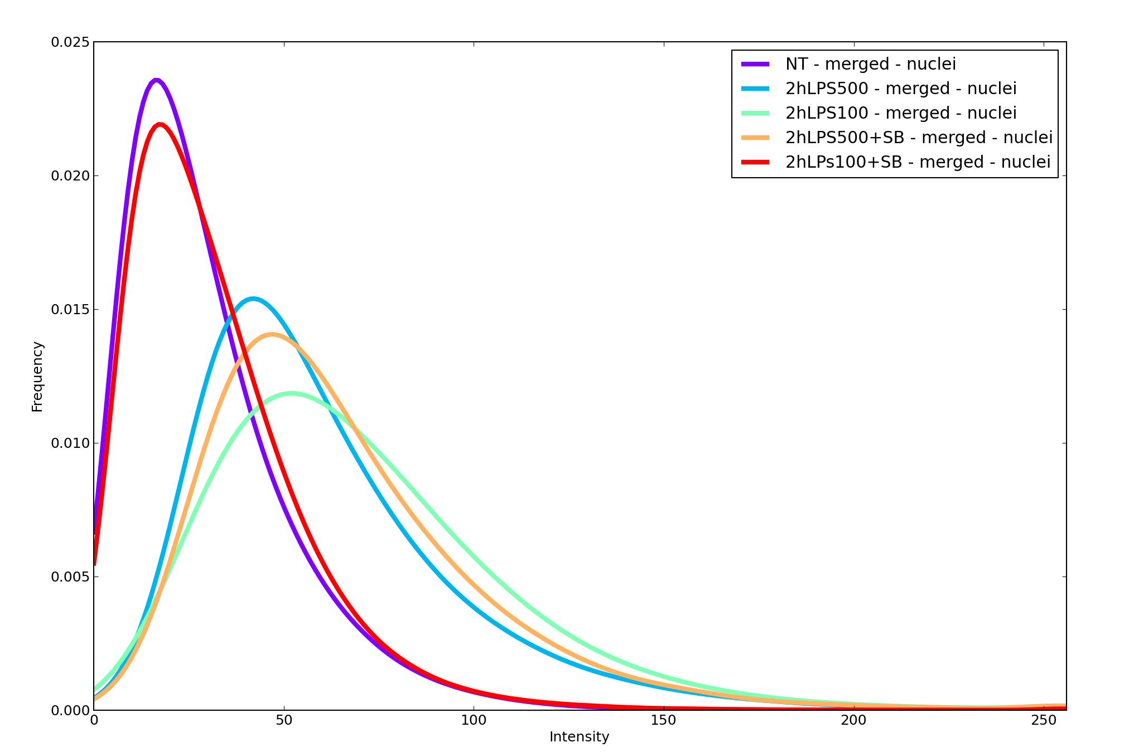
Example

