Slide 1



BETA
Cole Wentzel Michelle Thevenin Jiawei Liao Giacomo Coraluppi Tom Bowler
,

Slide 2

Background
In CE 2045, a giant meteor “Earth-breaker” has been eliminated by
nuclear bomb. However, it decomposes into millions of asteroids and
they are falling to the Earth. You are the pilot of spaceship
“Thunder”. Destroy all the asteroid and protect the Earth!
Glory is on us!

Slide 3
Objective
Protect the Planet
The Planet only has ten life points.
If life points goes to zero, the game is over.
Ensure spaceship survives
The spaceship only has three life points.
Spaceship loses its life point when an asteroid hit it.
Same as the Planet, once life points goes to zero, the game is over.
Try to keep planet and spaceship survives long as you can!

Slide 4
Objects
Spaceship(Thunder)
Has 3 life points
Rotates left or right when player press ‘a’ or ‘d’
Accelerate when player press ‘w’ to move forwards
Able to shoot bullet when player press ‘space’ bar
Asteroids
Two Types of shapes
Randomly spawn
Move to a random destination in a straight line
Get eliminated when it hits spaceship, planet or bullet
Decrease spaceship and planet’s hp by 1 when it hits them

Slide 5

Objects
Earth(planet)
Has 10 life points
Stationary on the left most
Lose life points when asteroids hit it
Bullet
Shot from the spaceship’s head
Goes straight along with spaceship’s direction
Disappear when it hits asteroid

Slide 6
Interaction - Bullet w/ Asteroid
Bullet goes straight alone with spaceship’s direction
When bullet hits the asteroid, it disappears, and the asteroid decomposes into four parts, then it disappears

Slide 7
Interaction- Asteroid w/ Ship
When the asteroid hits the spaceship, it damages some components of the ship and decreases the life points of spaceship by one
(red hearts in the down right corner is decreases by 1)
After the collision, asteroid is destroyed

Slide 8
Interaction- Asteroid w/ Planet
When the asteroid hits the planet, it decreases the life point of the planet by 1(the number on the Earth has been decreased by 1)
Giant collision causes Earth-quake! The Earth vibrates after the collision.
After the collision, the asteroid get destroyed

Slide 9
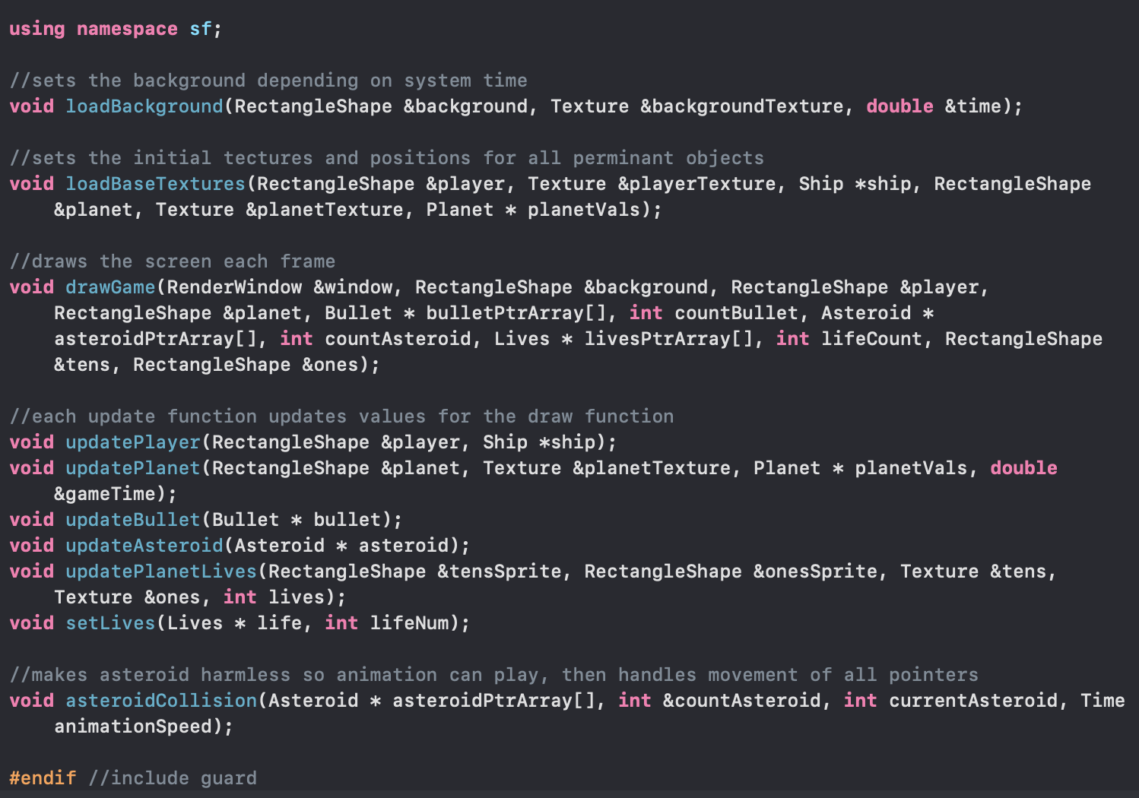
Code for View
loadTextures functions to load
all the graphics for all the objects
E.g background, planet and ship
A Drawfunction to draw the screen for
each frame
Serval update functions to update values
for the draw function, so it updates the display
A setlives function to display the life points
A asteroidCollision to a stop the asteroid
for moving.
Also, the asteroid object is controlled by an array pointers.
When it collides with spaceship or planet, the array of pointers
deletes one pointer and shift one unit forward.

Slide 10
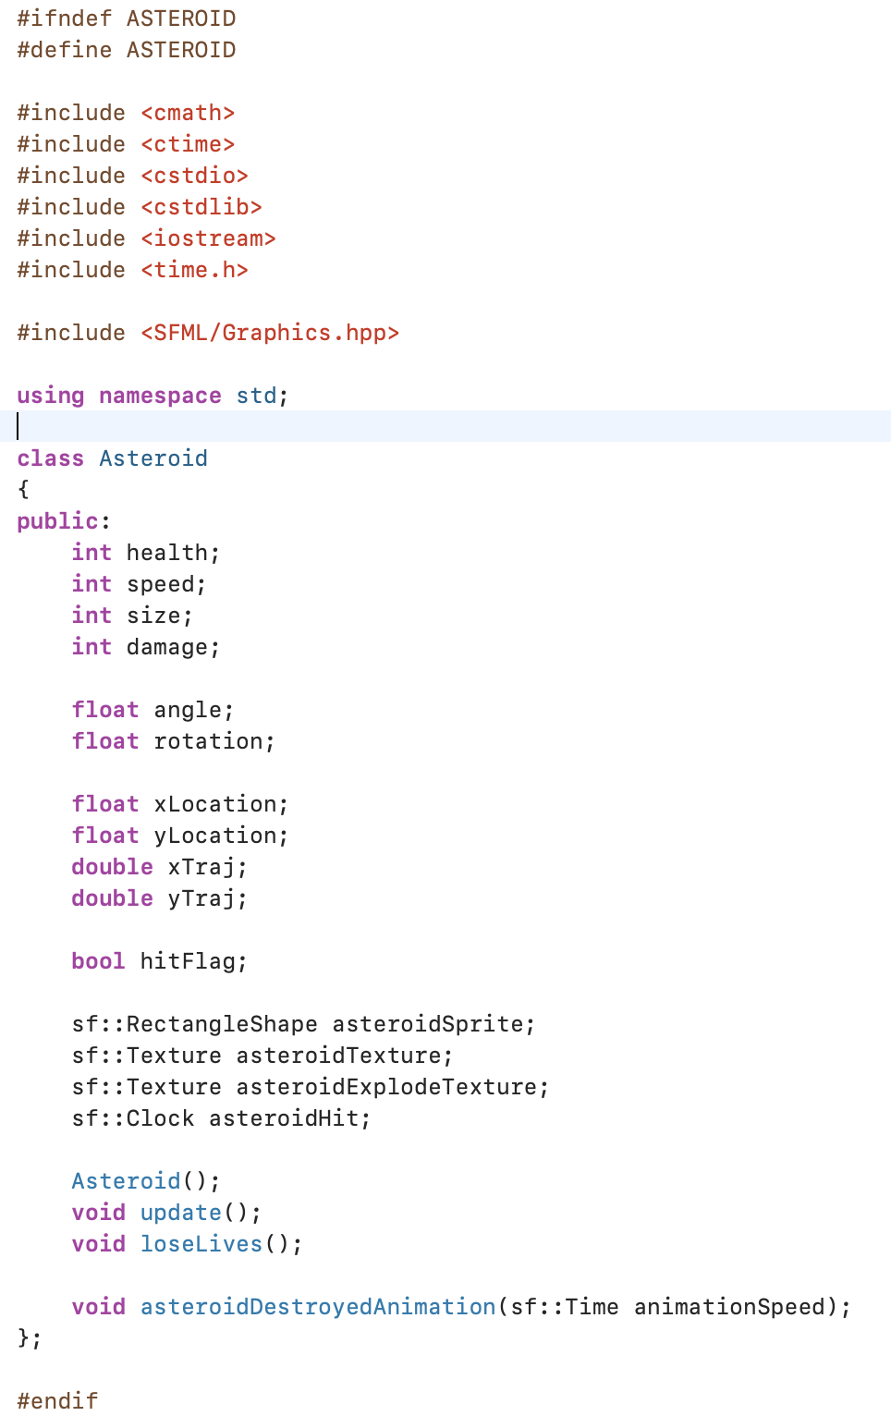
Code for Asteroid
Variables: health(destroyed when it goes to 0),
speed(random), size(random) and damage(constant 1)
Has update function to update its location
Has the loseLives function to detect when it gets destroyed
Has the asteroidDestroyedAnimation function to display
the process of asteroid explosion in two frames.

Slide 11
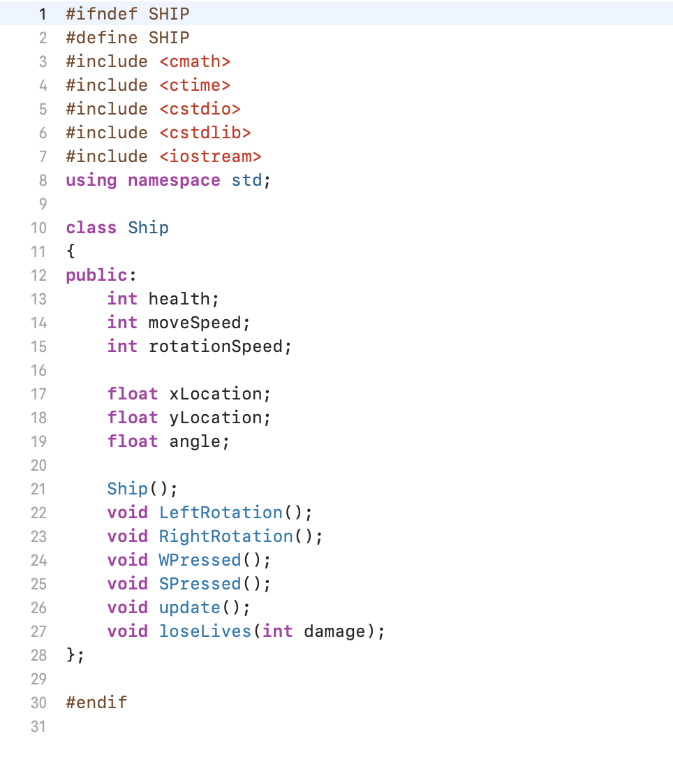
Code for Ship
Variables: health(game ended when it goes to 0),
moveSpeed(constant), rotationSpeed(constant),
angle(initialize to be 90)
Rotation Functions to rotate the ships direction .
It corresponds to the ‘A’ and ’D’ commands to turn
The ship left or right
Same concept applied to the forwards key ‘W’ and
backwards key ‘S’, we use the Wpressed and Spressed
functions to do that
Update function to update the location of the ship
LoseLives function to reduce the spaceship life point
By 1 when it hits the asteroid

Slide 12
https://www.sfml-dev.org/tutorials/2.5/
https://www.sfml-dev.org/documentation/2.5.1/
https://www.shutterstock.com/image-vector/pixel-game-over-computer-screen-170391401

Slide 13

Thank you!

