Slide 1

Methodology
Parametric Approaches
Logistic Classifier
Basic Logistic Regression
Logistic Regression with Backward Variable Selection
Logistic Regression with Shrinkage Method
Naive Bayes
Non-Parametric Approach
K-Nearest Neighbors (KNN)

Slide 2
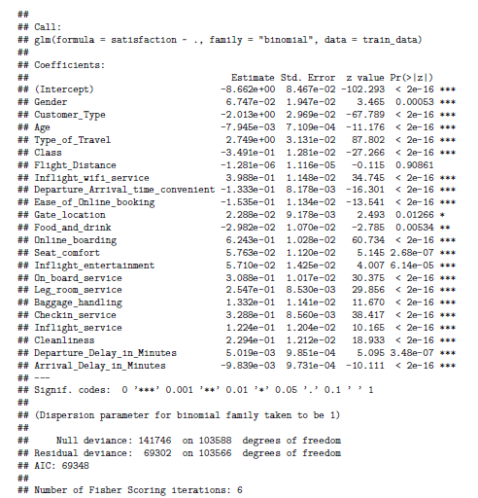
Basic Logistic Regression – Model Output
VIF : 2.045321

Slide 3
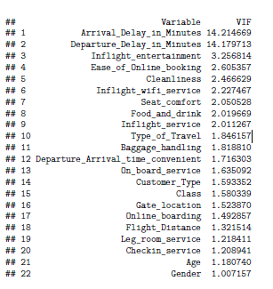
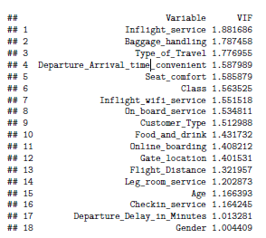
Logistic Regression with Backward Variable Selection VIF Iterations
After 4 iterations

Slide 4
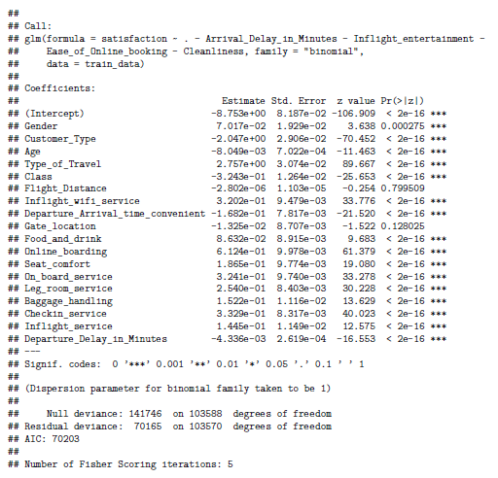
Logistic Regression with Backward Variable Selection Model Output

Slide 5
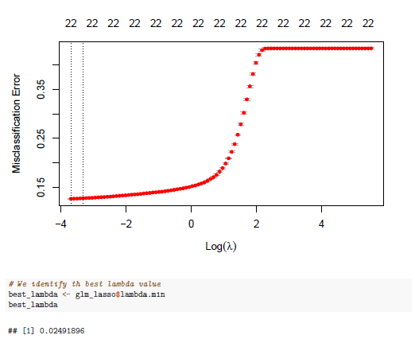
Logistic Regression with Shrinkage Method Lasso Regression

Slide 6
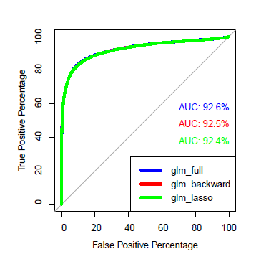
Comparison of Models – ROC CURVE

Slide 7
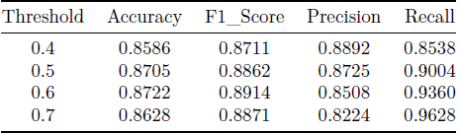
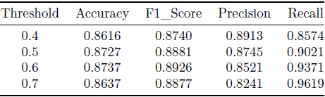
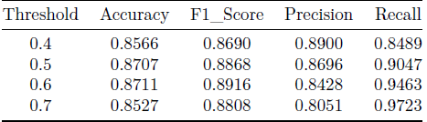

Logistic Regression Model Selection
Basic Logistic Regression
Logistic Regression with Backward Variable Selection
Logistic Regression with Shrinkage Method

Slide 8
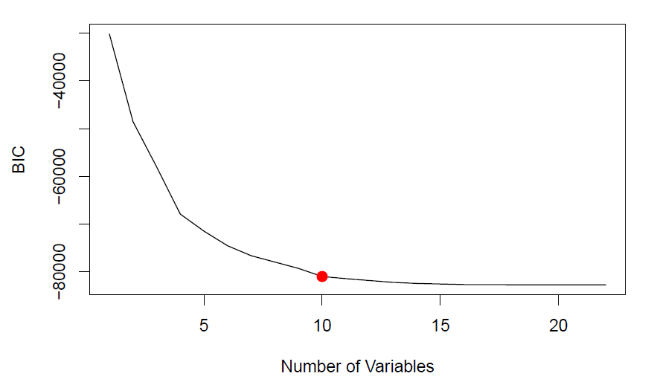
Naïve Bayes
Choose the model with 10 variables

Slide 9
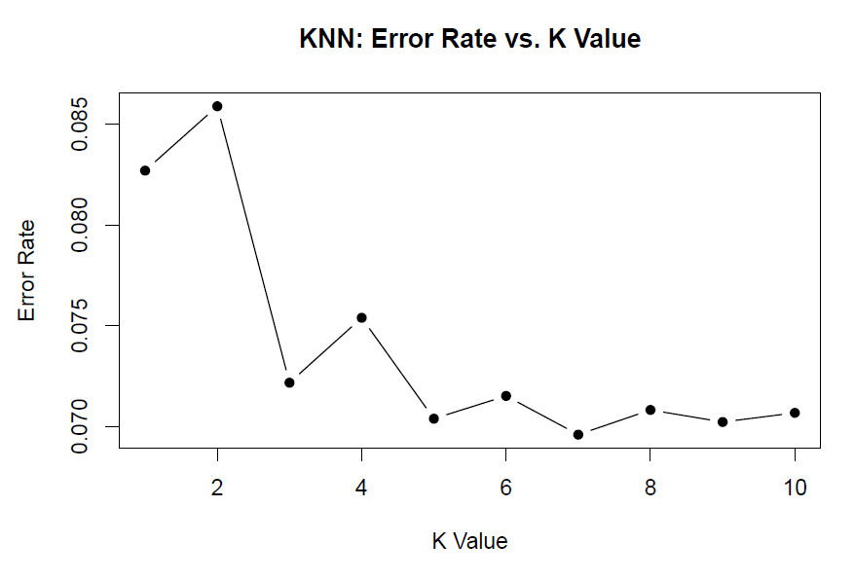
KNN with Cross Validation

Slide 10
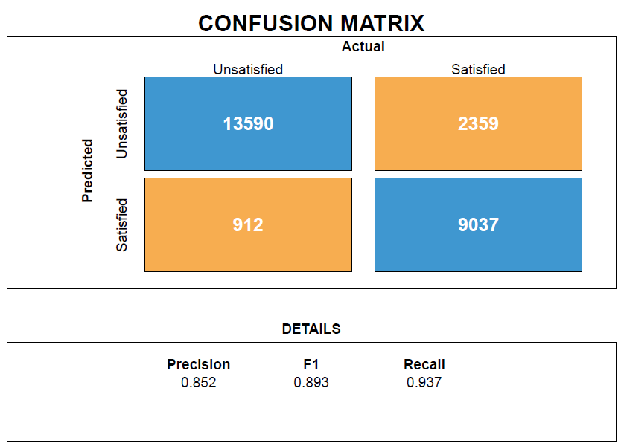
Classification Results – Logistic Regression

Slide 11
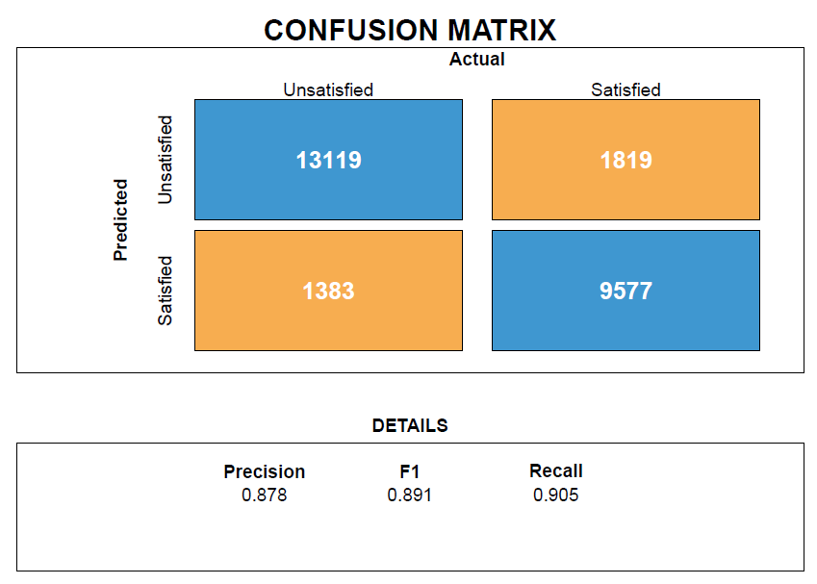
Classification Results – Naïve Bayes

Slide 12

Classification Results - KNN

