Slide 1
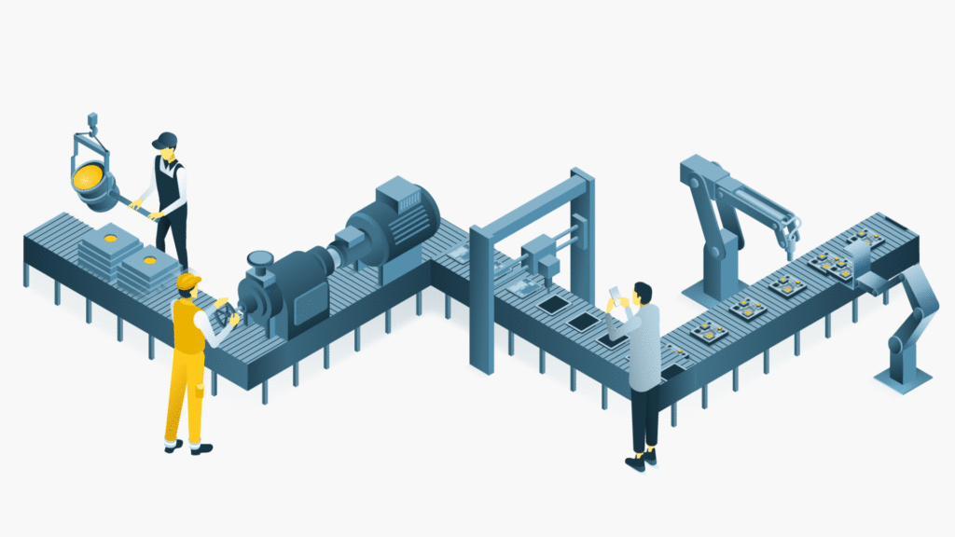
PartInspect
A simulated ROS2 and Gazebo environment for automated quality inspection in manufacturing.

Slide 2

The ACTORS
A CONVEYOR BELT
A VISION SYSTEM (made of 2 cameras alongside the conveyor belt)
A SOLENOID ACTUATOR (which can push objects away)
OBJECTS (cubes and cones)
Good parts (preserved)
Defective parts (rejected)
Notes:
In automation, this kind of solenoid actuator is often called «Reject Solenoid».

Slide 3
SYSTEM OVERVIEW

Slide 4
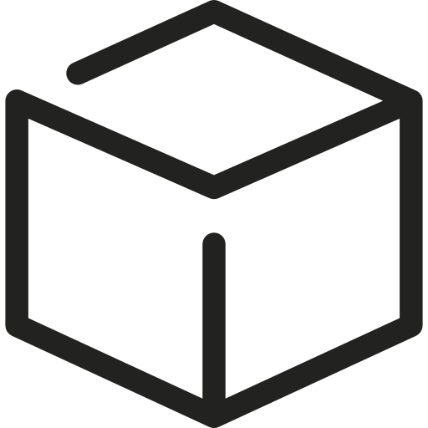
VISION (& CHECK) Node
/camera1/image_raw
/vision/detection_result
/camera2/image_raw
/check/detection_result
VISION Node: detects defective parts and notifies the pusher
CHECK Node: detects defective parts that were not pushed away and notifies the controller
Both nodes receive images from simulated Gazebo cameras
The entire pipeline is applied to a specific Region of Interest (ROI),
to ensure that the object is fully visible in the image
Notes:
Morphological opening cleans the image by deleting isolated pixels.
It is useful especially after a thresholding operation.
The polygon approximation is based on the Douglas-Peucker algorithm, and finds the polygon which contains all the object pixels.
It reduces the image to just the vertices of the borders, so it keeps the shape without considering all the image pixels (reducing the complexity).

Slide 5
PUSHER Node
/vision/detection_result
/config/belt_speed
/gazebo/pusher/cmd_pos
TRACKS MOTION of defective parts (once detected from the vision node)
Actuation time is automatically computed based on the conveyor belt speed
If belt speed changes between detection and actuation, the actuation time changes accordingly
Controls EXTENSION and RETRACTION of a simulated PID-controlled SOLENOID
Retraction happens 500ms after the extension

Slide 6
CONTROLLER Node
/check/detection_result
/config/belt_speed
/gazebo/conveyor_belt/cmd_vel
CONVEYOR BELT controller
Supports variable belt speed values
Defalut belt speed is set 1 m/s
Continuously publishes belt speed to pusher node and commands simulated conveyor belt
Continuous publishing ensures simulation stability and actuation accuracy
Immediately stops if the check node detects a defective part

Slide 7
Other ROS NODES
/gazebo/spawned_objects/odometry
ros_gz_interfaces/srv/DeleteEntity
/camera1/image_raw
CLEANER Node: removes fallen object from the simulation
Invokes a Gazebo service to delete objects
Removal occurs 15 seconds after they reach the ground
DUMMY CAMERA Node: generates fake camera images
Provides a mock interface for a Gazebo camera
Enables system testing without a Gazebo simulation

Slide 8
CONCURRENCY
Notes:
All nodes (a part from the dummy camera node) works at the same frequency: 20 Hz
However, this is not mandatory: controller and pusher can also work at a different frequency.
Dummy camera node generates an image every 2 seconds, so it works at the frequency of 0.5 Hz

