Slide 1
Subject2Image
Evaluating Adaptation Approaches for
Subject-Driven Image Generation
Computer Vision and Cognitive Systems
Sofia Caruso, Giacomo Tessari
Computer Vision and Cognitive Systems

Slide 2
Can AI Learn Your Style Without Forgetting Everything Else?
Introduction
In this work, we systematically evaluate subject-driven personalization across three distinct pipelines, comparing Low-Rank Adaptation (LoRA) and Textual Inversion.
We benchmark all implementations on the standard DreamBooth dataset using a comprehensive suite of quantitative metrics:
CLIP-T
CLIP-I and DINO-I
LPIPS
Experimental results demonstrate that:
LoRA-based weight adaptation significantly outperforms Textual Inversion
The first LoRA pipeline achieves the highest overall performance in subject fidelity and visual preservation

Slide 3
Method and Implementation
3 pipelines:
Generation Only: An unpersonalized generation baseline, used as an anchor to measure the base model’s intrinsic text-prompt alignment without subject adaptation.
LoRA Baseline: A parameter-efficient fine-tuning setup that integrates Low-Rank Adaptation into the DreamBooth framework.
LoRA Custom: An extended variant of the first pipeline, combining LoRA-based weight adaptation with spatial data augmentation on the fine-tuning reference set.
Textual Inversion Custom: A modern adaptation of Textual Inversion scaled to the Stable Diffusion 3.5 architecture, optimizing text embeddings within its multi-encoder prompt space.

Slide 4
Quantitative results
 | CLIP-T ↑ | CLIP-I ↑ | CLIP-I × CLIP-T ↑ | DINO-I ↑ | LPIPS ↓
Generation Only | 0.8953 | 0.61 | 0.5461 | 0.2846 | 0.7919
LoRA Baseline | 0.8678 | 0.6509 | 0.5648 | 0.6303 | 0.7134
LoRA Custom | 0.8723 | 0.6451 | 0.5627 | 0.6252 | 0.7201
TI Custom | 0.8763 | 0.6175 | 0.5411 | 0.3016 | 0.7780

Slide 5
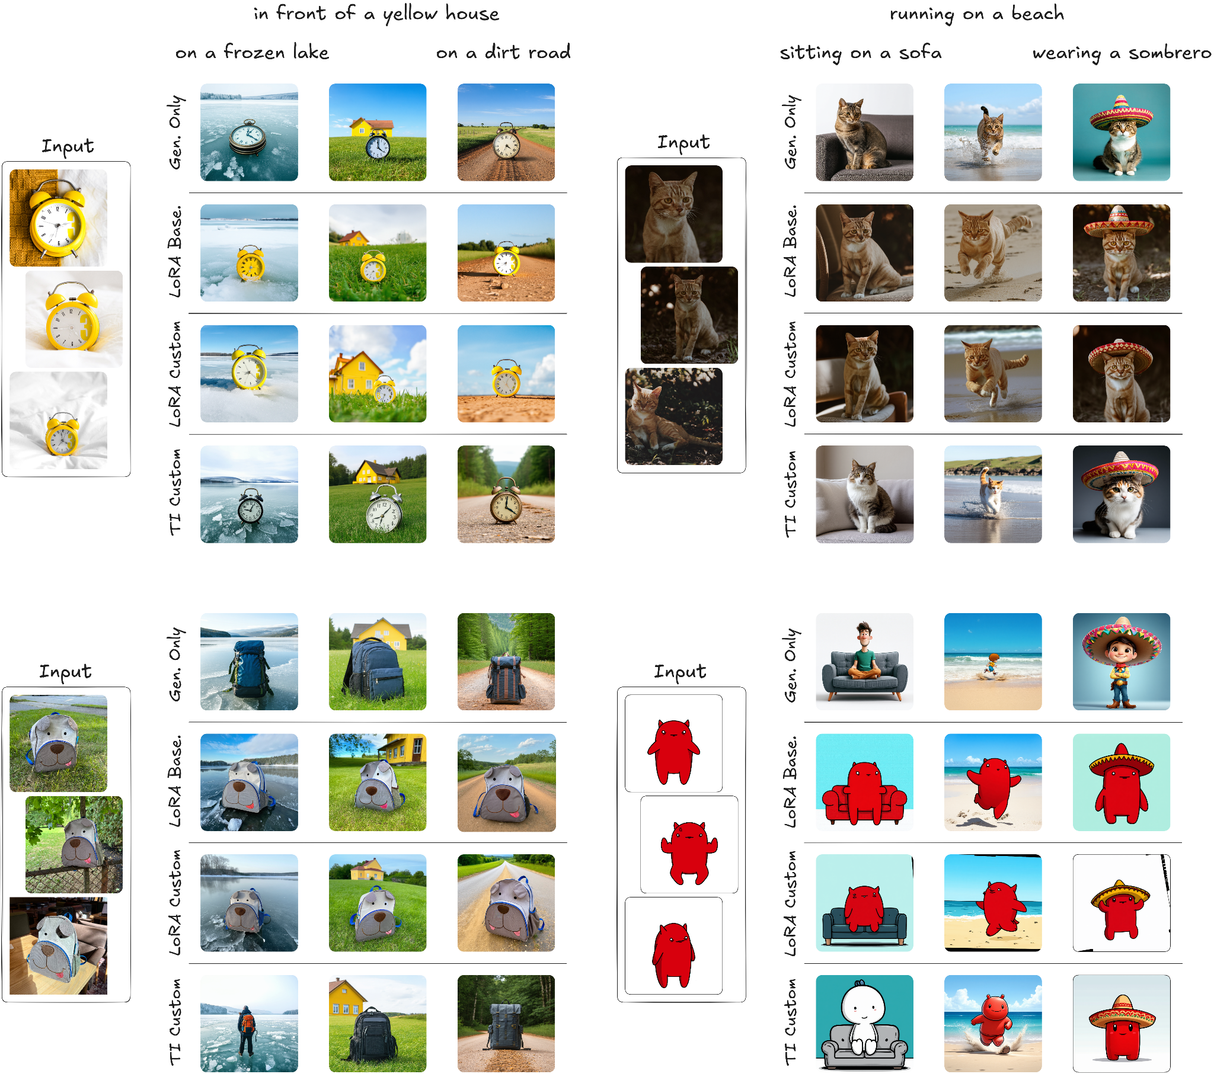
Qualitative results

Slide 6
Qualitative results

Slide 7
Discussion
Weight-Space vs. Text-Space: LoRA fine-tuning demonstrates a fundamental capacity advantage over Textual Inversion to capture complex 3D geometry and fine-grained textures. In contrast, embedding-only optimization lacks the capacity to retain instance details, yielding weak identity preservation.
Effect of Spatial Data Augmentation: Applying spatial transformations like cropping and rotation marginally improves prompt adherence, but degrades subject fidelity. These geometric perturbations disrupt high-frequency pixel alignments essential for reproducing fine details. Moreover, reference data augmentation causes the model to be more prone to overfitting.
Multi-Encoder Complexity: The underperformance of Textual Inversion is largely driven by the architectural complexity of Stable Diffusion 3.5, which integrates a triple text-encoder system with an MM-DiT backbone. Optimizing embeddings alone without fine-tuning the backbone's text stream provides insufficient control to steer generation within practical training limits.

