Slide 1


Testing Continual Learning Methods for defying Forgetting
using dataset CORe50
Studente : Giacomo Telloli
Matricola : 1792451
Tutti i diritti relativi al presente materiale didattico ed al suo contenuto sono riservati a Sapienza e ai suoi autori (o docenti che lo hanno prodotto). È consentito l'uso personale dello stesso da parte dello studente a fini di studio. Ne è vietata nel modo più assoluto la diffusione, duplicazione, cessione, trasmissione, distribuzione a terzi o al pubblico pena le sanzioni applicabili per legge

Slide 2
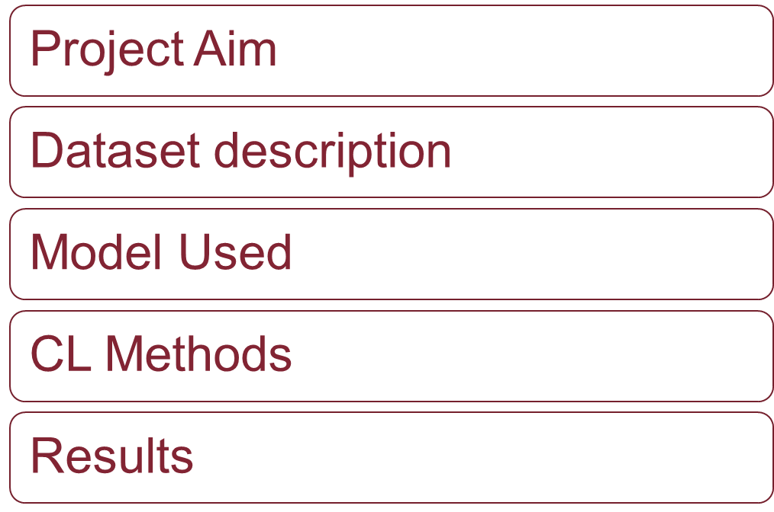
Abstract
Testing Continual Learning Methods for defying Forgetting
Pagina <number>

Slide 3
Project Aim
The aim of this project is to compare different continual learning methods for a classification taks using a simple CNN model as a common structure for the methods and a dataset of images
Testing Continual Learning Methods for defying Forgetting
Pagina <number>

Slide 4
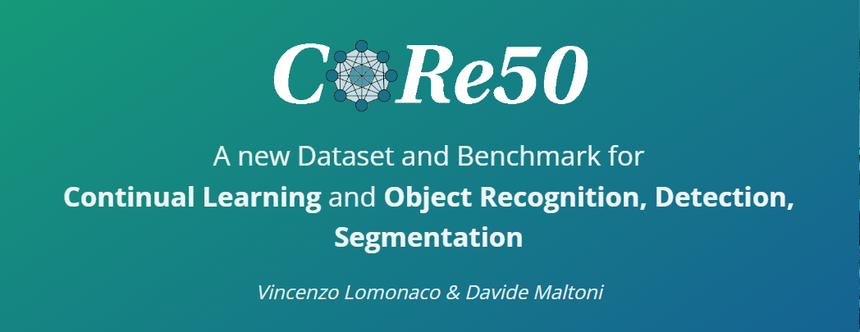
Dataset Description
The dataset used for this task is the CORe50 wich has 10 target classes :
Plug adapters
Mobile phones
Scissors
Light bulbs
Cans
Glasses
Balls
Markers
Cups
Remote controls
The dataset is divided in 11 session of registrations and for each session there are some images of all the 10 objects
Testing Continual Learning Methods for defying Forgetting
Pagina <number>

Slide 5
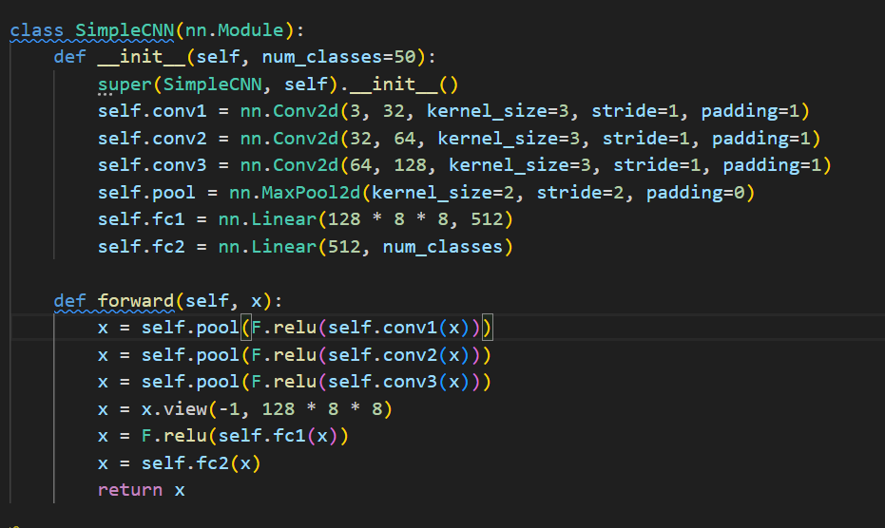
Model Used
I’ve decided to use a simple CNN for the experiments due to the computational complexity of the task and also to see how the algorithms would improve the classification performance of the network in a low complexity scenario
Testing Continual Learning Methods for defying Forgetting
Pagina <number>

Slide 6
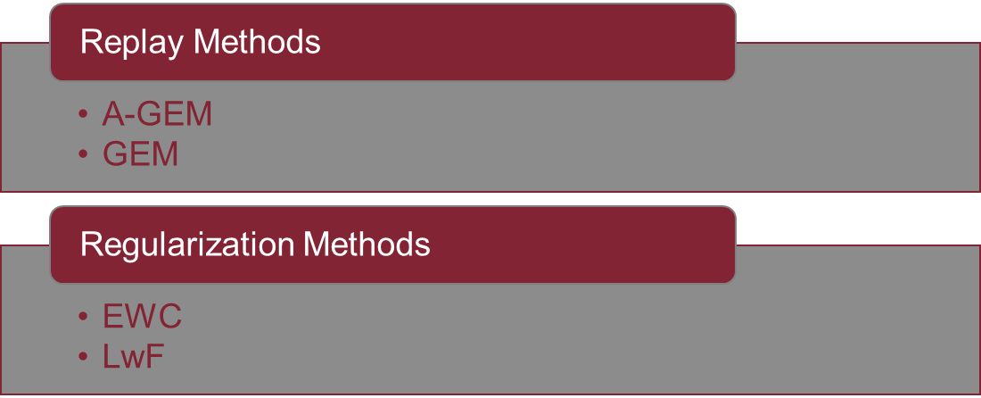
CL Methods
an overview
I’ve decided to study the behaviour of some of the algorithms addressed in (citazione) which belongs to two types of classes:
Testing Continual Learning Methods for defying Forgetting
Pagina <number>

Slide 7
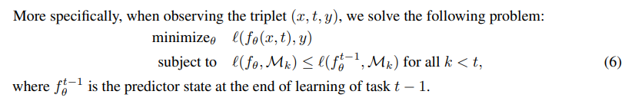
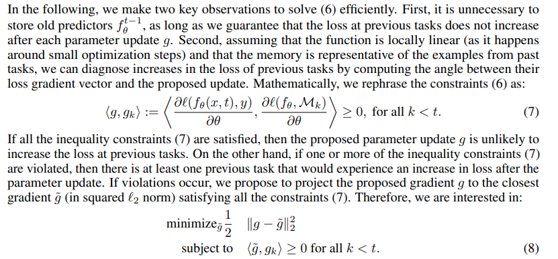
CL Methods
GEM (Gradient Episodic Memory)
It’s a replay method so it means that when the model will learn a new class the algorithm will replay some samples of the previous task
The main feature about this algoritm is that creates a memory to fill in each cicle with relevant examples of the previous classes
Il problema finale è una ottimizzazione quadratica
Testing Continual Learning Methods for defying Forgetting
Pagina <number>

Slide 8
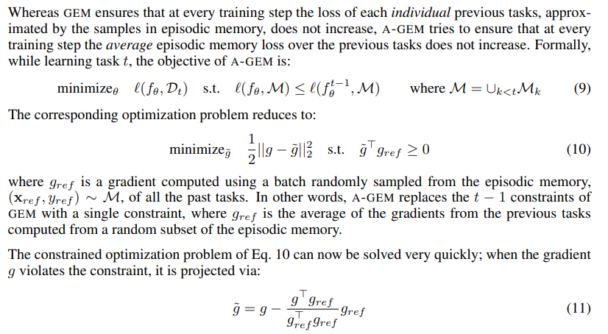
CL Methods
A-GEM (Averaged Gradient Episodic Memory)
It’s mostly like GEM but it has some improvements to make the algorithm work even with large set of data and classes
Testing Continual Learning Methods for defying Forgetting
Pagina <number>

Slide 9
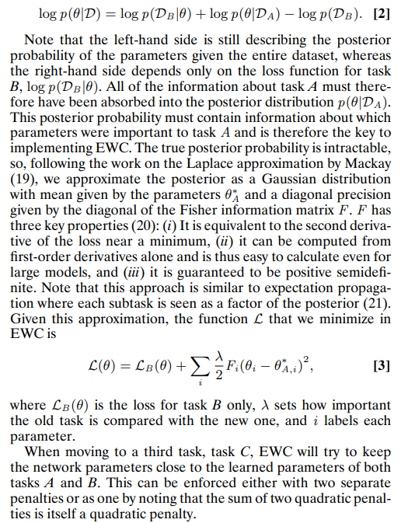
CL Methods
EWC ( Elastic Weight Consolidation )
The main aim is to mimic the reduction of the synaptic plasticity of the synapses that are vital for the previous tasks
To do that we need to identify the weights of the NN that are more relevant for the classification of each specific task
Testing Continual Learning Methods for defying Forgetting
Pagina <number>

Slide 10

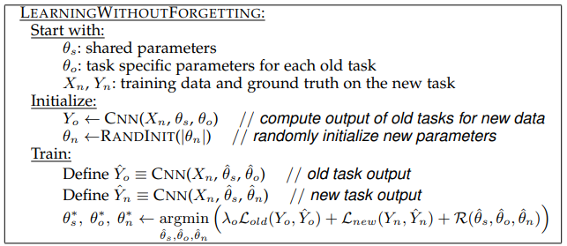
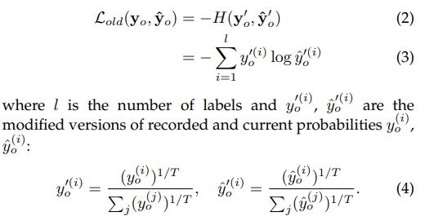
CL Methods
LwF ( Learning without Forgetting )
The main aim is to add new parameters to a network and recompute the old ones in a way to optimize the overall loss
Testing Continual Learning Methods for defying Forgetting
Pagina <number>

Slide 11
Results
Selezionare per scrivere o eliminare il sottotitolo
Testing Continual Learning Methods for defying Forgetting
Pagina <number>

Slide 12
THANK YOU
FOR THE ATTENTION
Testing Continual Learning Methods for defying Forgetting
Pagina <number>

