Slide 1


Solving Robotic Lawn Mowner Problem using
PDDL and IndiGolog
Planning and Reasoning 2024/2025
DIPARTIMENTO DI INGEGNERIA INFORMATICA
AUTOMATICA E GESTIONALE ANTONIO RUBERTI
Giacomo Telloli : 1792451
Tutti i diritti relativi al presente materiale didattico ed al suo contenuto sono riservati a Sapienza e ai suoi autori (o docenti che lo hanno prodotto). È consentito l'uso personale dello stesso da parte dello studente a fini di studio. Ne è vietata nel modo più assoluto la diffusione, duplicazione, cessione, trasmissione, distribuzione a terzi o al pubblico pena le sanzioni applicabili per legge

Slide 2
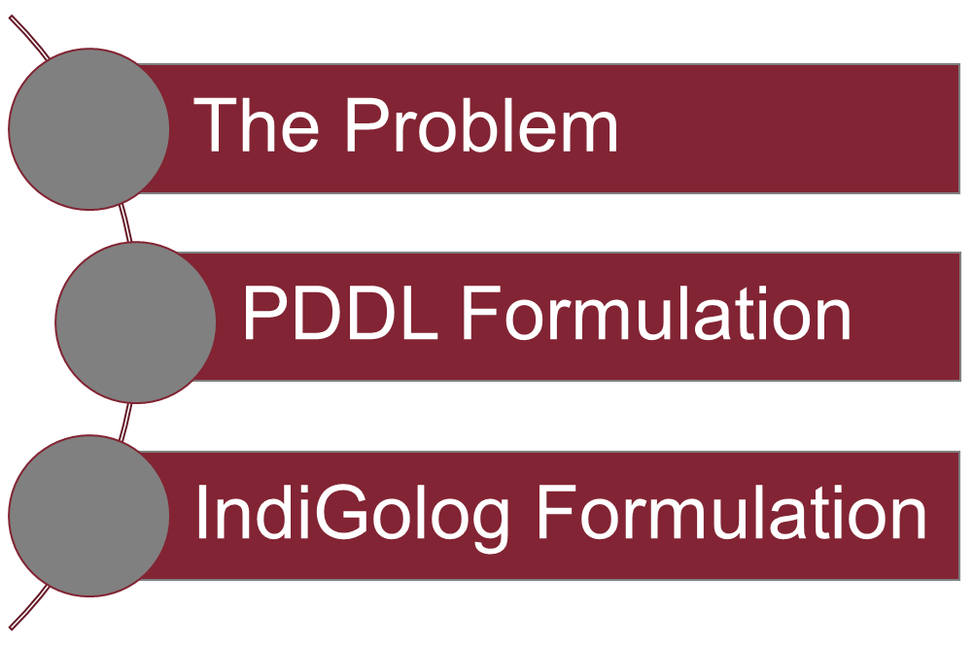
OUTLINE
Solving Robotic Lawn Mowner Problem using
PDDL and IndiGolog
Pagina <number>

Slide 3
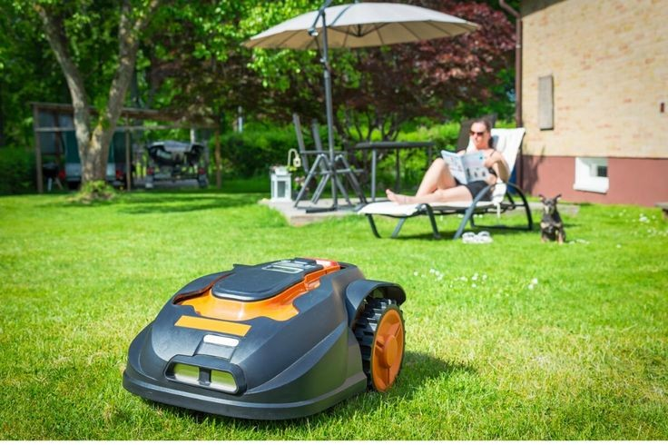
The Problem
The general objective of this problem is to simulate the behaviour of a lawn mowner robot which has to cut all the grass from the garden , avoiding obstacles while finding the most efficient way to solve the problem while keeping a look at his battery state of charge to decide when is better to retire to the charging station.
Solving Robotic Lawn Mowner Problem using
PDDL and IndiGolog
Pagina <number>

Slide 4
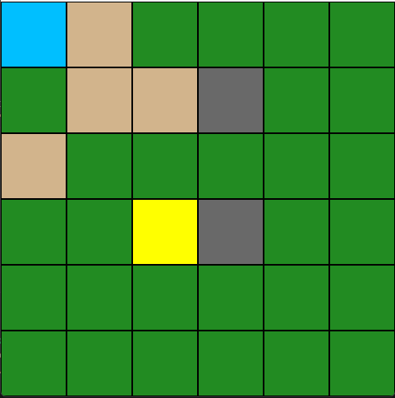
PDDL Formulation
DOMAIN 1 - Description
In this domain the robot has to cut all the grass from a 6x6 map , in which is present an obstacle and the charging station .The battery has 3 predicates that indicates his internal state [High , Middle , Low] , and the battery will discharge from a state to another only when the robot decides to cut the grass.
Solving Robotic Lawn Mowner Problem using
PDDL and IndiGolog
Pagina <number>

Slide 5
PDDL Formulation
DOMAIN 1 – Predicates
First thing first we need to define what are the objects of our domain and what are the relations that holds , like below:
(:types robot cell)
(:predicates
(at ?r - robot ?c - cell)
(has-grass ?c - cell)
(obstacle ?c - cell)
(charging-station ?c - cell)
(adjacent ?from - cell ?to - cell)
(battery-full ?r - robot)
(battery-mid ?r - robot)
(battery-low ?r - robot)
)
Solving Robotic Lawn Mowner Problem using
PDDL and IndiGolog
Pagina <number>

Slide 6
PDDL Formulation
DOMAIN 1 – Actions
Moving to the actions we need different actions for the transitions of from the battery’s state to another for cutting and chaging , and then the basic action for move
(:action move
:parameters (?r - robot ?from - cell ?to - cell)
:precondition (and (at ?r ?from) (adjacent ?from ?to) (not (obstacle ?to)))
:effect (and
(not (at ?r ?from))
(at ?r ?to)
)
)
(:action cut-from-full
:parameters (?r - robot ?c - cell)
:precondition (and (at ?r ?c) (has-grass ?c) (battery-full ?r))
:effect (and
(not (has-grass ?c))
(not (battery-full ?r))
(battery-mid ?r)
)
)
(:action cut-from-mid
:parameters (?r - robot ?c - cell)
:precondition (and (at ?r ?c) (has-grass ?c) (battery-mid ?r))
:effect (and
(not (has-grass ?c))
(not (battery-mid ?r))
(battery-low ?r)
)
)
(:action charge-from-low
:parameters (?r - robot ?c - cell)
:precondition (and (at ?r ?c) (charging-station ?c) (battery-low ?r))
:effect (and
(not (battery-low ?r))
(battery-mid ?r)
)
)
(:action charge-from-mid
:parameters (?r - robot ?c - cell)
:precondition (and (at ?r ?c) (charging-station ?c) (battery-mid ?r))
:effect (and
(not (battery-mid ?r))
(battery-full ?r)
)
)
Solving Robotic Lawn Mowner Problem using
PDDL and IndiGolog
Pagina <number>

Slide 7
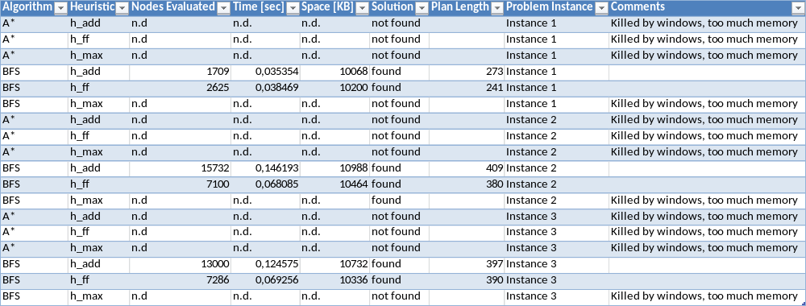
PDDL Formulation
DOMAIN 1 – Problem Instances Formulation & Results
For this domain I’ve defined 3 instances with different obstacle configurations and different chargin station position , and to solve them I’ve used A* and GreedyBFS with h_max , h_add , h_ff as heuristics using fast-downward and these are the results.
Solving Robotic Lawn Mowner Problem using
PDDL and IndiGolog
Pagina <number>

Slide 8
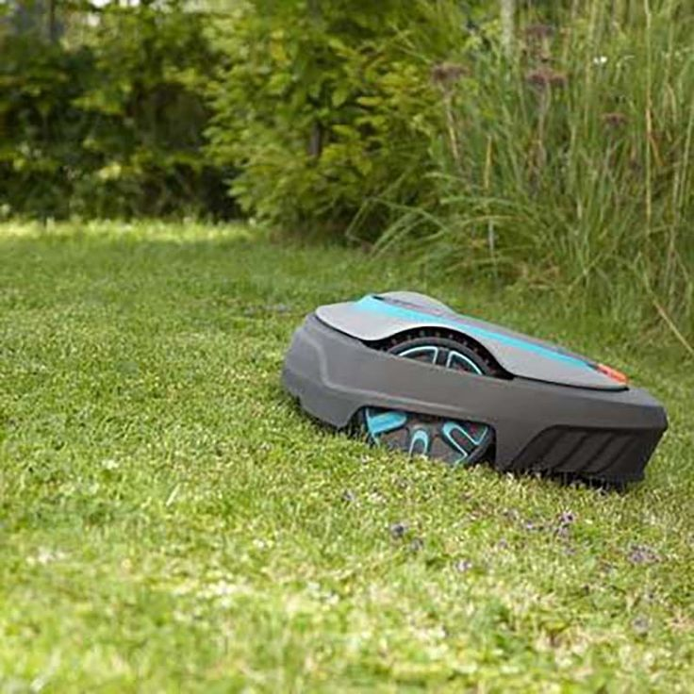
PDDL Formulation
DOMAIN 2 - Description
This domain is similar to the previous one except for the management of the battery state of charge which is managed by a numerical fluent.
Solving Robotic Lawn Mowner Problem using
PDDL and IndiGolog
Pagina <number>

Slide 9
PDDL Formulation
DOMAIN 2 – Predicates & Functions
First thing first we need to define what are the objects of our domain and what are the relations that holds and also the function that connects the robot to his battery level , like below:
(:types robot cell)
(:predicates
(at ?r - robot ?c - cell)
(has-grass ?c - cell)
(obstacle ?c - cell)
(charging-station ?c - cell)
(adjacent ?from - cell ?to - cell)
)
(:functions
(battery-level ?r - robot) - number
)
Solving Robotic Lawn Mowner Problem using
PDDL and IndiGolog
Pagina <number>

Slide 10
PDDL Formulation
DOMAIN 2 – Actions
Moving to the actions we need less action than the domain before:
(:action move
:parameters (?r - robot ?from - cell ?to - cell)
:precondition (and
(at ?r ?from)
(adjacent ?from ?to)
(not (obstacle ?to))
(>= (battery-level ?r) 1)
)
:effect (and
(not (at ?r ?from))
(at ?r ?to)
(decrease (battery-level ?r) 1)
)
)
(:action cut-grass
:parameters (?r - robot ?c - cell)
:precondition (and
(at ?r ?c)
(has-grass ?c)
(>= (battery-level ?r) 2)
)
:effect (and
(not (has-grass ?c))
(decrease (battery-level ?r) 2)
)
)
(:action charge
:parameters (?r - robot ?c - cell)
:precondition (and
(at ?r ?c)
(charging-station ?c)
)
:effect (assign (battery-level ?r) 10)
)
)
Solving Robotic Lawn Mowner Problem using
PDDL and IndiGolog
Pagina <number>

Slide 11
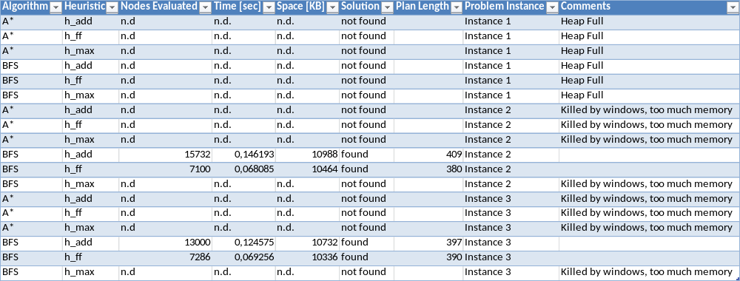
PDDL Formulation
DOMAIN 2 – Problem Instances Formulation & Results
For this domain I’ve defined 3 instances with different obstacle configurations and different chargin station position , and to solve them I’ve used ENHSP (Expressive Numeric Heuristic Search Planner ) with h_max , h_add , h_ff as heuristics using fast-downward and these are the results.
Solving Robotic Lawn Mowner Problem using
PDDL and IndiGolog
Pagina <number>

Slide 12
IndiGolog Formulation
BAT – Description Fluents & Predicates
For this kind of exercise i had to make a slight modification to the problem domain to make an easy representation
/* FLUENTS */
rel_fluent(hasGrass(C)) :- cell(C).
rel_fluent(robotAt(C)) :- cell(C).
fun_fluent(batteryLevel).
rel_fluent(isRaining).
rel_fluent(change_weather).
rel_fluent(some_changes).
/* PREDICATES */
/* define the grass cells */
cell(c11). cell(c12). cell(c13). cell(c14). cell(c15). cell(c16).
cell(c21). cell(c22). cell(c23). cell(c24). cell(c25). cell(c26).
Ecc…
/* define the horizontal bidirectional connections */
connected(c11,c12). connected(c12,c11).
connected(c12,c13). connected(c13,c12).
Ecc…
/* other predicates */
obstacle(c33).
chargingStation(c11).
Solving Robotic Lawn Mowner Problem using
PDDL and IndiGolog
Pagina <number>

Slide 13
IndiGolog Formulation
BAT – Actions
For this kind of exercise i had to make a slight modification to the problem domain to make an easy representation
/* ACTIONS */
/* movement action */
prim_action(move(C1,C2)) :- cell(C1) , cell(C2).
poss(move(C1,C2),
and(and(and(and(robotAt(C1),neg(obstacle(C2))),connected(C1,C2)),batteryLevel > 10),neg(isRaining))
).
/* cutting action */
prim_action(cutGrass(C1)) :- cell(C1).
poss(cutGrass(C1),and(and(and(robotAt(C1),hasGrass(C1)),batteryLevel > 10),neg(isRaining))).
/* return to charging station action */
prim_action(goToCharge) .
poss(goToCharge,or(batteryLevel =< 10,isRaining)).
prim_action(Act) :- exog_action(Act).
poss(Act, true) :- exog_action(Act).
/* EXOGENOUS ACTIONS */
exog_action(toggle_rain).
poss(toggle_rain,
neg(isRaining)
).
Solving Robotic Lawn Mowner Problem using
PDDL and IndiGolog
Pagina <number>

Slide 14
IndiGolog Formulation
BAT – Successor State Axioms
For this kind of exercise i had to make a slight modification to the problem domain to make an easy representation
/* SUCCESSOR STATE AXIOMS */
causes_false(cutGrass,hasGrass,true).
causes_val(cutGrass(_),batteryLevel,N,N is batteryLevel-2).
causes_false(move(C1,_),robotAt(C1),cell(C1)).
causes_true(move(_,C2),robotAt(C2),cell(C2)).
causes_val(move(_,_),batteryLevel,N, N is batteryLevel-1).
causes_true(goToCharge,robotAt(C),chargingStation(C)).
causes_false(goToCharge,robotAt(C2), neg(chargingStation(C2))).
causes_val(goToCharge,batteryLevel,100,true).
causes_true(toggle_rain,isRaining,neg(isRaining)).
causes_false(toggle_rain,isRaining,isRaining).
causes_true(toggle_rain, some_changes, true).
Solving Robotic Lawn Mowner Problem using
PDDL and IndiGolog
Pagina <number>

Slide 15
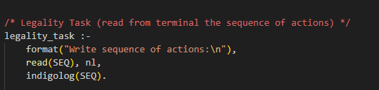
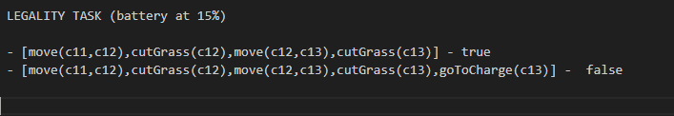
IndiGolog Legality Task
Results
THE PROGRAM
THE RESULT
Solving Robotic Lawn Mowner Problem using
PDDL and IndiGolog
Pagina <number>

Slide 16
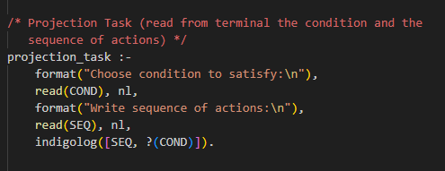
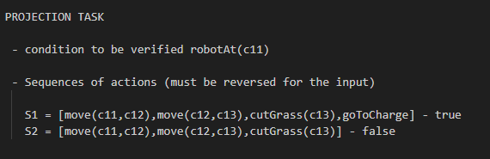
IndiGolog Projection-Task
Results
THE PROGRAM
THE RESULT
Solving Robotic Lawn Mowner Problem using
PDDL and IndiGolog
Pagina <number>

Slide 17
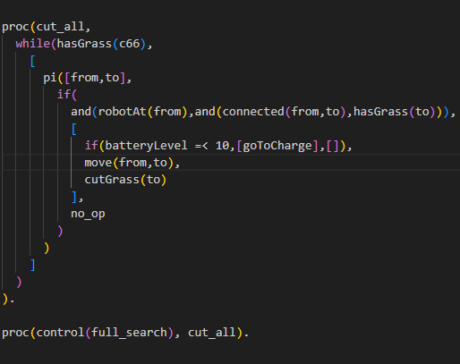
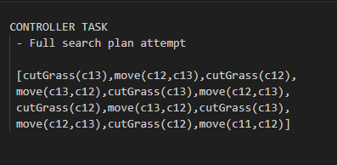
IndiGolog Full-Search Controller
Results
THE PROGRAM
THE RESULT
Solving Robotic Lawn Mowner Problem using
PDDL and IndiGolog
Pagina <number>

Slide 18

THANK YOU FOR THE ATTENTION
Solving Robotic Lawn Mowner Problem using
PDDL and IndiGolog
Pagina <number>

