Slide 1
PhD purpose
Giacomo Ubaldi
<numero>
Giacomo Ubaldi
Notes:
OK in this presentation i want to speak about in vivo monitoring of the dose or of the range in add on therapy what it is about the main methods and research and the first clinical
<numero>

Slide 2




Hadrontherapy
tumor
Sketch of a treatment planning system on brain-located tumor
Hadrontherapy vs radiotherapy:
Finite range
Localized dose profile
Nuclear fragmentation
depth- dose profile for X-rays and charged particles as a beam
<numero>
Notes:
Let's start from the beginning. Radiation therapy represents a way to exploit an external beam of radiation, which delivers energy, or those in a specific region of the human body where there is a tumour in order. To kill the tumour cells, or to limit their proliferation. He, according to the kind of radiation in the beam, the delivery of those is different. Let's consider now the dozer profile. So there is of those in terms of depth in the human body and what are the main differences between radiation therapy. Radiotherapy, the most common one which exploits the X rays and add on therapy. The most promising one which uses charged particles. What we can see is that for add on therapy we have a highest physical selectivity, which means that the highest release of those is a focused in a very specific region. Very close to the range. A end of the charged particle and it is called Brad Pick. So according to the energy given to the BMA, it is possible to have a black pika in the specific region of the tumour. We can say. So add on therapy. Can be two favourable with reference to radiotherapy becausr it's hayastan steepest gradient of those releasing just a region makes the highest spare of entity issues before and after the two rural region. However there are also some limits to the best. Then potentiality of this technique, and they are the range uncertainties in the clinical application of my treatment. So after his planning, it is possible that there are some discrepancy in the range of my beam. There can be shift which means. Chiefs of the black Beak in the entity in the tissues of the human body. In particular, there would be another dozing of tissues after the tumour and then under dozing in the two rural region. The consequence of this are that it is possible. to even create damages of arctic issues more than one than the ones of
<numero>

Slide 3
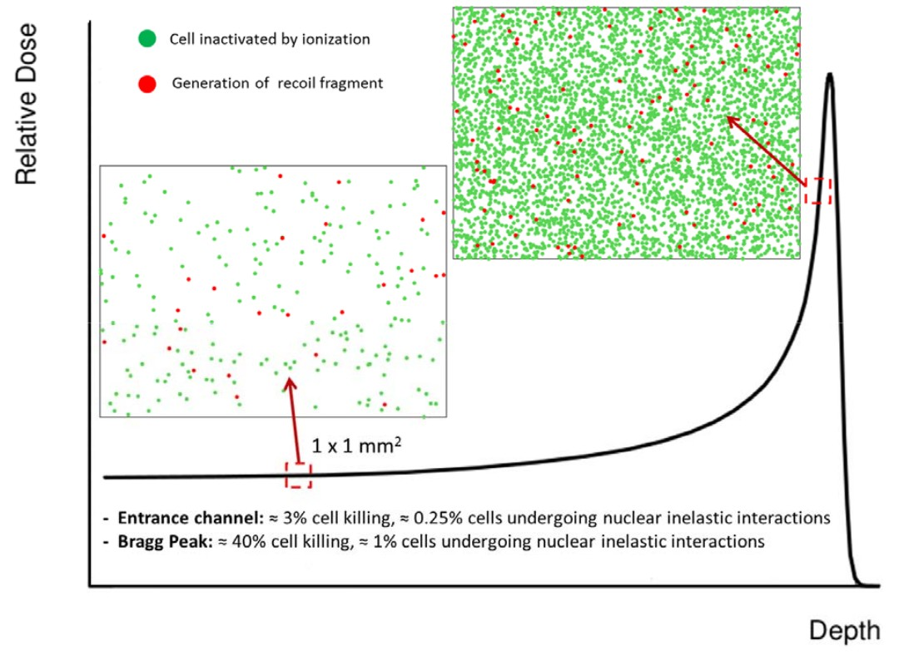


Nuclear Fragmentation
Proton beam:
~ 200 MeV
Damage in all the path
Carbon beam:
~ 400 MeV/u
BEAM
Sketch of Nuclear fragmentation
Damage after the BP
<numero>

Slide 4
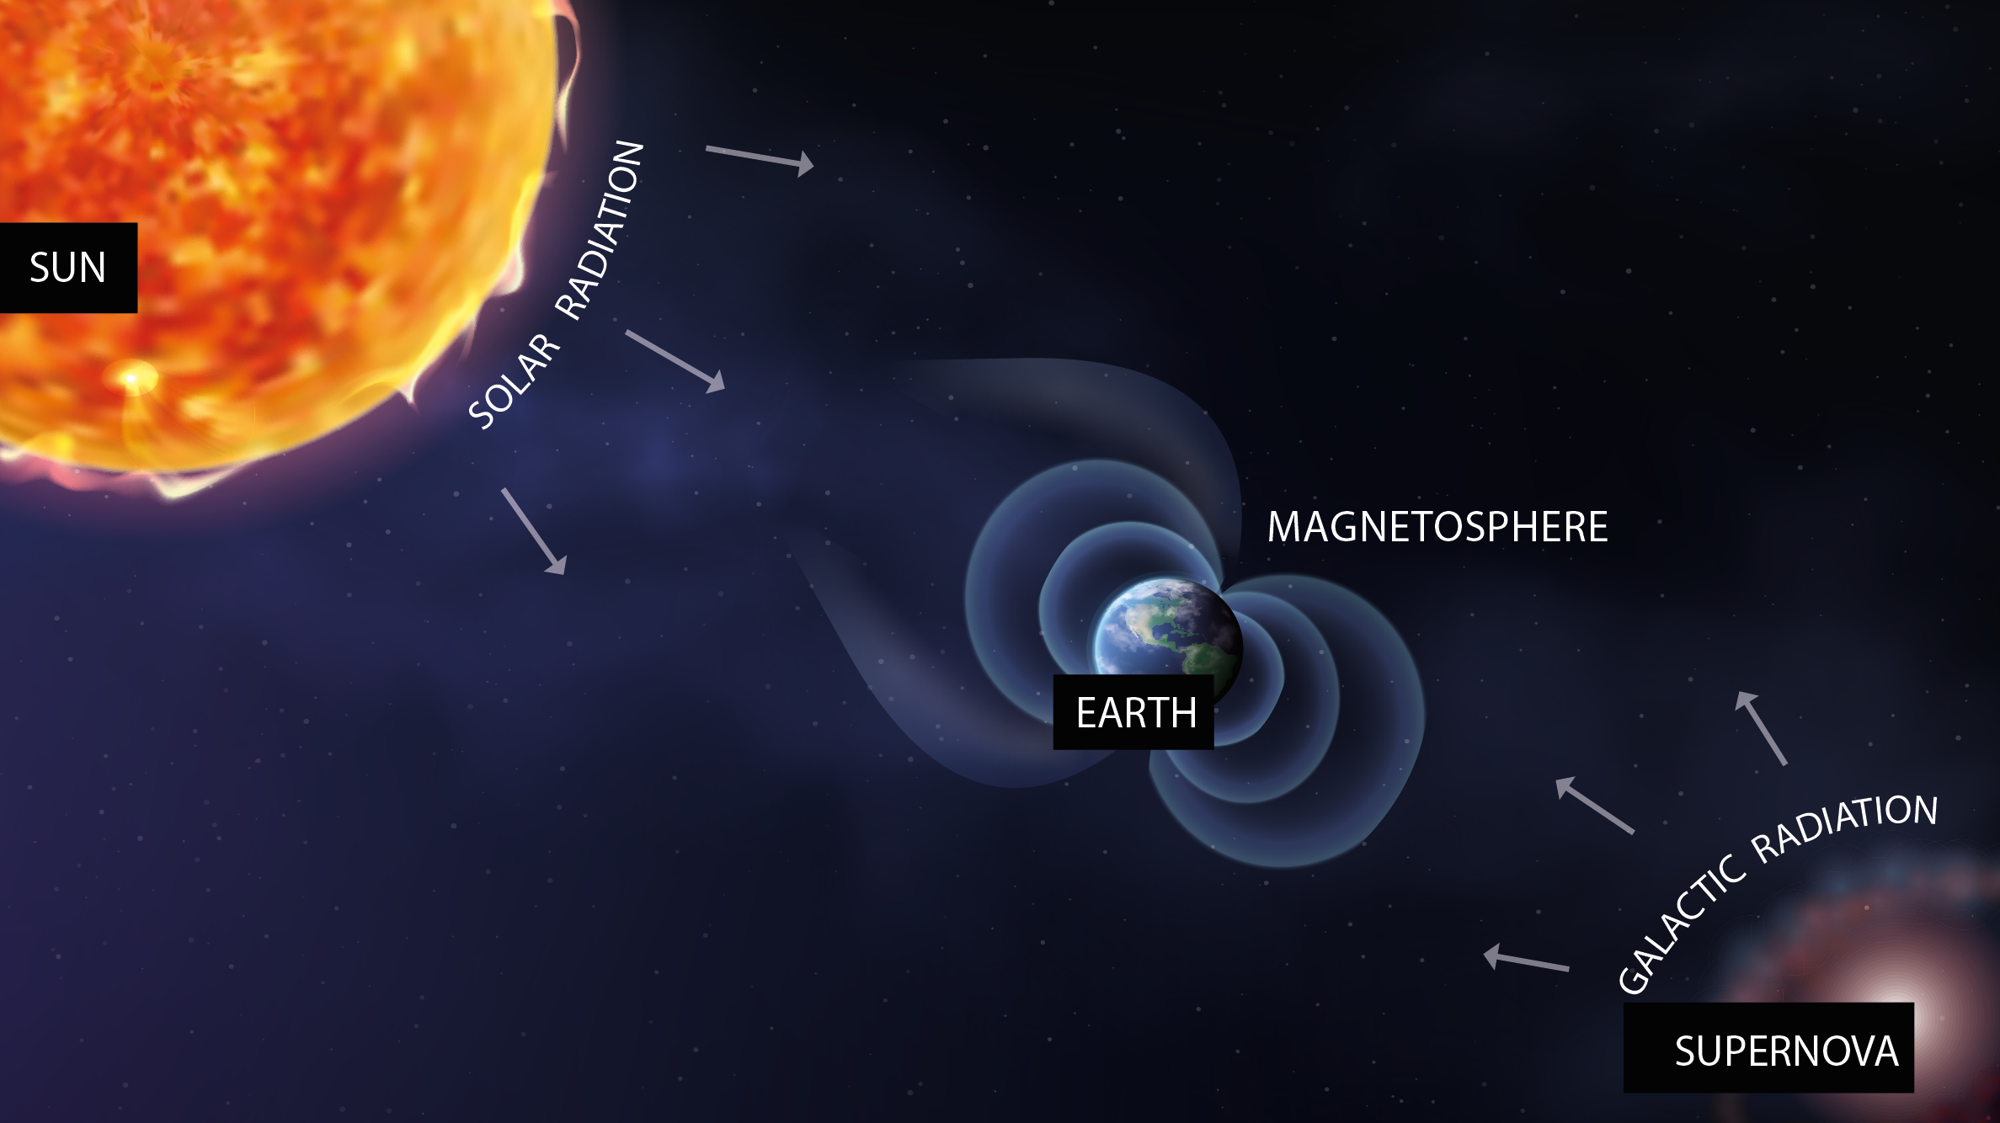
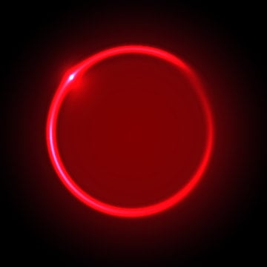

Space radioprotection
MARS
<numero>

Slide 5
Space radioprotection
MARS
SOLAR RADIATION
suddenly
92% p
6% He
2% HZE
E<1 GeV/n
<numero>

Slide 6

Space radioprotection
COSMIC RAYS
constantly
90% p
9% He
1% HZE
0.001 < E < 10¹⁴ GeV/n
<numero>

Slide 7



Space radioprotection
MARS
<numero>

Slide 8
Space radioprotection
MARS
fragmentation
Effects on:
Space craft hull and structure
Shielding
Astronaut’s body
<numero>

Slide 9
Space radioprotection
MARS
fragmentation
Dose equivalent
Dose
Fluence
<numero>

Slide 10



The FOOT experiment
Goal:
double differential nuclear cross sections mesurements with σ < 5%
Fixed target collisions
Beam energies between 200 MeV/u and 700 MeV/u for hadrontherapy and space radioprotection topics
table top setup to be moved according to beam facility availability
Particle identification by measuring all kinematic quantities
BEAM
z
<numero>

Slide 11
The FOOT experiment
Goal:
double differential nuclear cross sections mesurements with σ < 5%
Fixed target collisions
Beam energies between 200 MeV/u and 700 MeV/u for hadrontherapy and space radioprotection topics
table top setup to be moved according to beam facility availability
Particle identification by measuring all kinematic quantities
Target
Beam
monitor
Start Counter
BEAM
z
Pre-target region
Tracking region
<numero>

Slide 12
The FOOT detector
BEAM
z
<numero>

Slide 13
The FOOT detector
Target
Start
Counter
Beam
monitor
BEAM
z
Pre-target region
<numero>

Slide 14
The FOOT detector
Target
Permamet
Magnets
BEAM
z
Vertex
Tracker
Inner
Tracker
Microstrip Silicon
Detector
Tracking region
<numero>

Slide 15
The FOOT detector
Calorimeter
BEAM
z
ToF Wall
Downstream region
<numero>

Slide 16
The FOOT detector
Calorimeter
Target
Permament
Magnets
Start
Counter
Beam
monitor
BEAM
z
Vertex
Tracker
Inner
Tracker
Microstrip Silicon
Detector
ToF Wall
Pre-target region
Tracking region
Downstream region
<numero>

Slide 17


GSI 2021 analysis
¹⁶O 400 MeV/u on 5 mm C target
Real data taken at GSI in 2021
Analysis implemented in SHOE
Partial setup: no tracker, only one module of calorimeter
TW
MSD
BM
VTX
SC
CALO
TG
First preliminary goal:
charge changing angular differential cross section
<numero>

Slide 18

Differential Cross section
<numero>

Slide 19
Differential Cross section
N° of primary
events
N° of scattered
centers
<numero>

Slide 20
Differential Cross section
Yield of all fragments
N° of primary
events
N° of scattered
centers
<numero>

Slide 21
Differential Cross section
Yield of all fragments
N° of primary
events
N° of scattered
centers
Phase space
<numero>

Slide 22
Differential Cross section
Yield of all fragments
efficiency
N° of primary
events
N° of scattered
centers
Phase space
<numero>

Slide 23
Differential Cross section
Yield of all fragments
Background
unfolding
efficiency
N° of primary
events
N° of scattered
centers
Phase space
<numero>

Slide 24
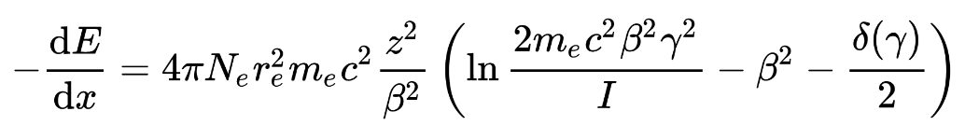

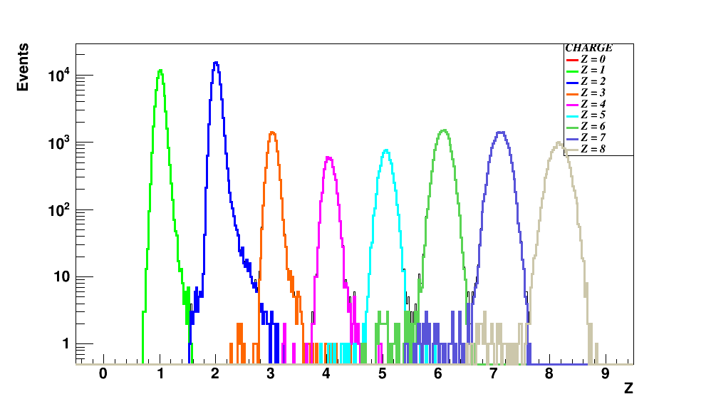
Fragments identification
From Bethe – Bloch formula I can get z:
Infos taken from SC and TW
dE
z=8
z=7
z=6
z=5
z=4
HISTO PURITY?
z=3
z=2
z=1
ToF
Charge discrimination
TW charge reconstruction algo
<numero>

Slide 25
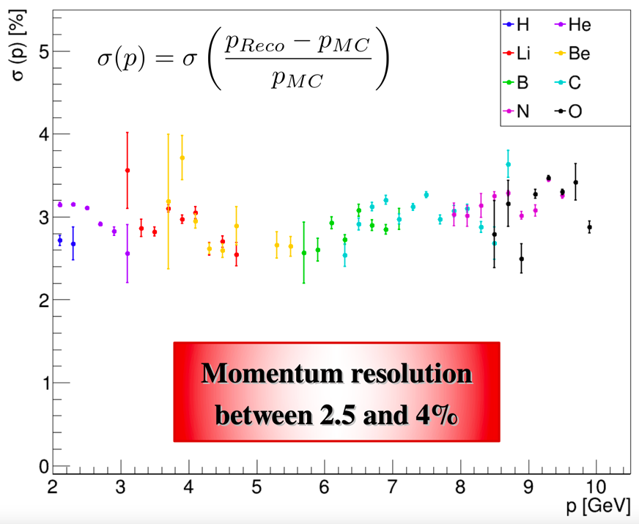


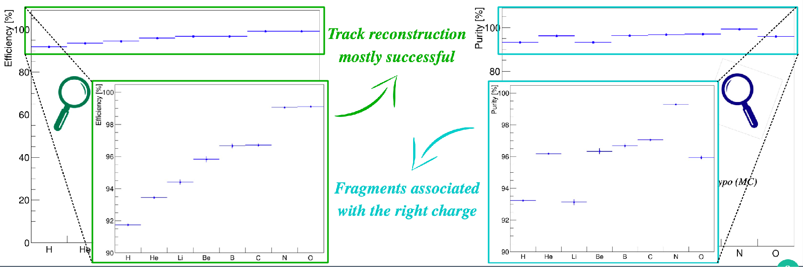
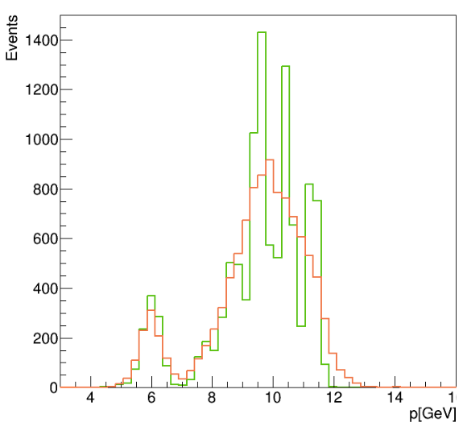
Track reconstruction
TW
MSD
VT
track reconstruction on GSI 2021 data
No B field present
Kalman Filter reconstruction of a track
Start from VT tracklets
Projection to possible planes of IT
KF extrapolation to MSD
KF extrapolation to TW
Fit the track candidates and extract reconstructed quantities: Z, momentum ...
Verde generati
Rosso ricostr
<numero>

Slide 26






Isotopes identification
Mass reconstruction using all FOOT subdetectors:
In our data no tracker and calorimeter → mass measurement only in MC data!
Augmented Lagrangian Method
Aχ 2 = 11.66 ± 0.38
risoluz. 3.2 %
χ 2 < 5
<numero>

Slide 27




Pile-up removal
What it was seen in the last data taking (GSI - CNAO 2021) is that the beam flux is not constant → pile-up events
2 crosses
4 crosses
constant
threshold
discrimination
method
2 crosses
4 crosses
Single projectile
Pileup projectile
Single projectile: 4 crosses
pileup projectile: >4 crosses
<numero>

Slide 28


Pile-up removal
Both minimum bias trigger and trigger fragmentation
Charge
t(ns)
PileUp on 600.000 events ~ 1%
<numero>

Slide 29
Differential Cross section
Info from beam and target
<numero>

Slide 30
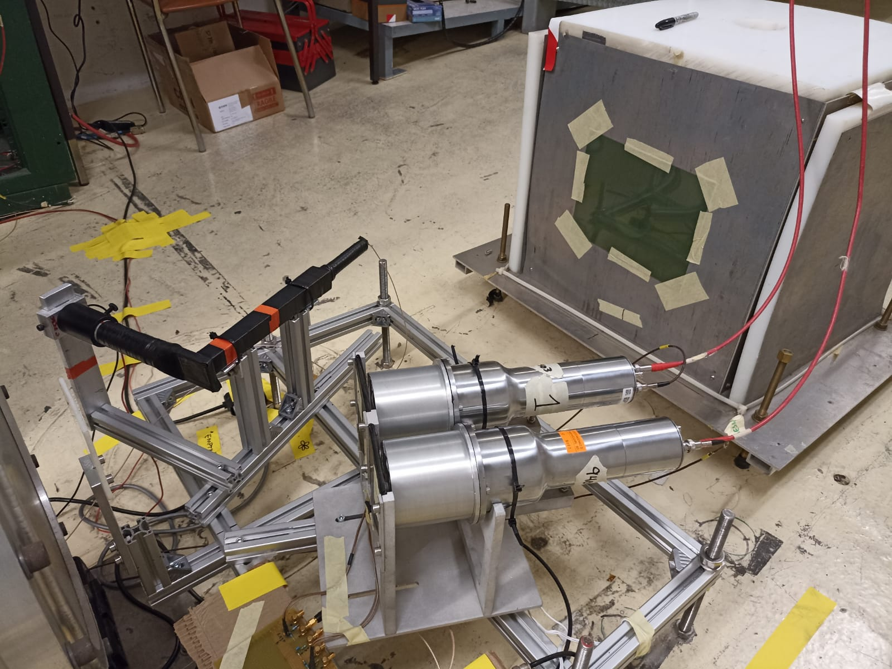
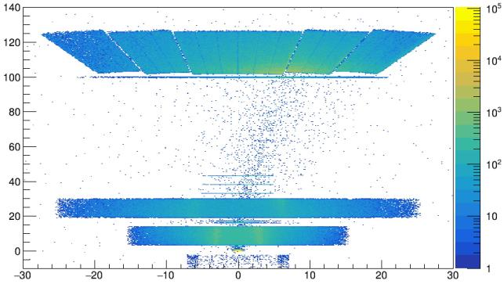
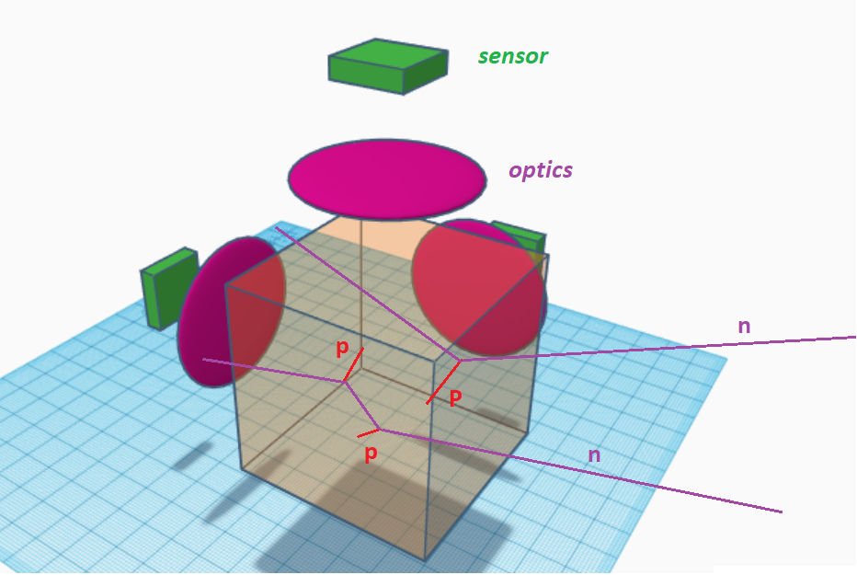
Fast neutrons detectors
High neutron production as a
consequence of fragmentation with detectors
BGO_p
CAL
TW
NIKEs
New purposes:
BC-501A liquid scintillator
BGO Phoswich
MSD
VT + TARGET
recoil-proton track
imaging detector

Slide 31
Future data taking
Foreseen within 2023 – 2024
All the detectors will be present
z
Beam tests for calibration of all detectors togheter
Compact analysis strategy needed
Implementation of neutron detectors in analysis software
Inverse kinematic application

Slide 32
unfolding

Slide 33
efficiency

Slide 34
Binning (in angle)

Slide 35
Total sum up of cross section

Slide 36
Bibliography:
Review:
Proton thepary physics, cap 16 (In Vivo Dose Verification - Katia Parodi )
In vivo proton range verification: a review, Antje-Christin Knopf and Antony Lomax 2013
In vivo range verification in particle therapy - Katia Parodi
In-vivo PET:
Online Irradiation Control by Means of PET, Chapter 31- Fine Fiedler, Daniela Kunath
The INSIDE Project: Innovative Solutions for In-Beam Dosimetry in Hadrontherapy, Marafini, Battistoni
Detection of Interfractional Morphological Changes in Proton Therapy: A Simulation and In Vivo Study With the INSIDE In-Beam PET
Prompt gamma monitoring:
First clinical application of a prompt gamma based in vivo proton range verification system, Christian Richter
Charged particles monitoring:
Design of a new tracking device for on-line beam range monitor in carbon therapy, Traini
Inter‑fractional monitoring of 12 C ions treatments: results from a clinical trial at the CNAO facility, Fischetti

Slide 37
Back up slides
<numero>

Slide 38
SHOE

Slide 39
Inverse kinematics
<numero>

Slide 40
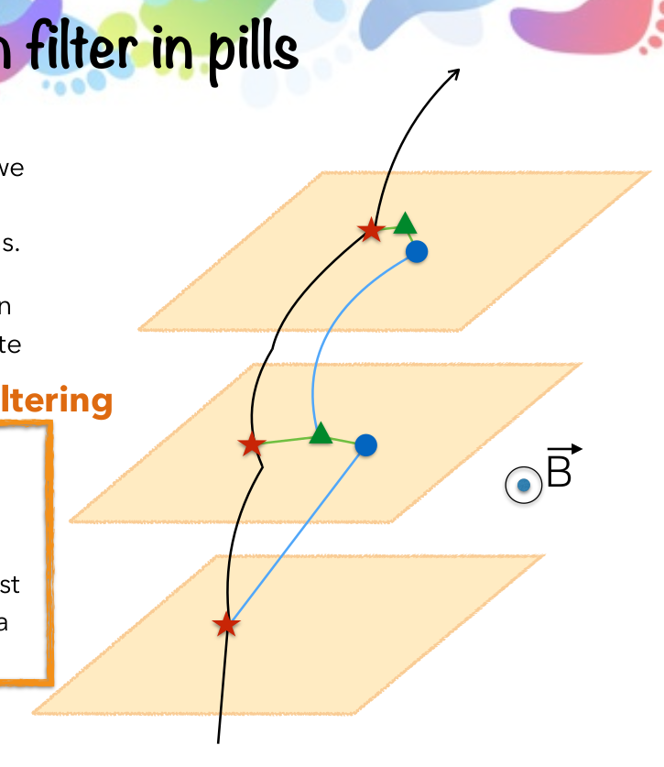
Kalman filter in pills
1. Take an ideal particle in vacuum. If we
add air + detector layers, trajectory
changes due to M.S. and energy loss.
2. We’ll see some measurement hits on
the detector layers (considering finite
detector uncertainty).
Filtering
3. Propagate the first hit to the next
layer. Propagator Matrix F.
4. Find the best compromise between
the propagated point and the closest
hit on the 2 nd layer. Use a Chi2 and a
Projection Matrix H.
5. Iterate 3 and 4 for the next layers.
<numero>

Slide 41
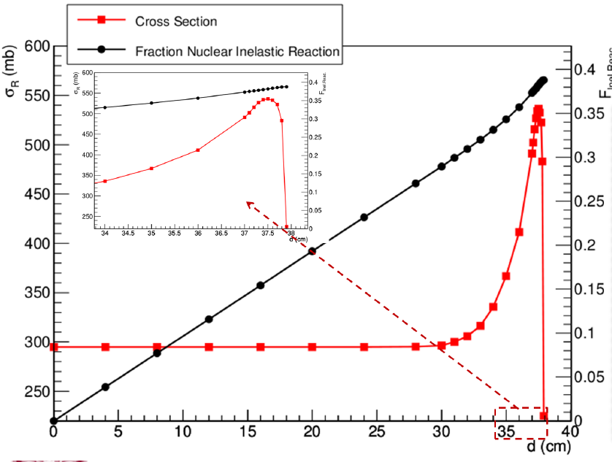
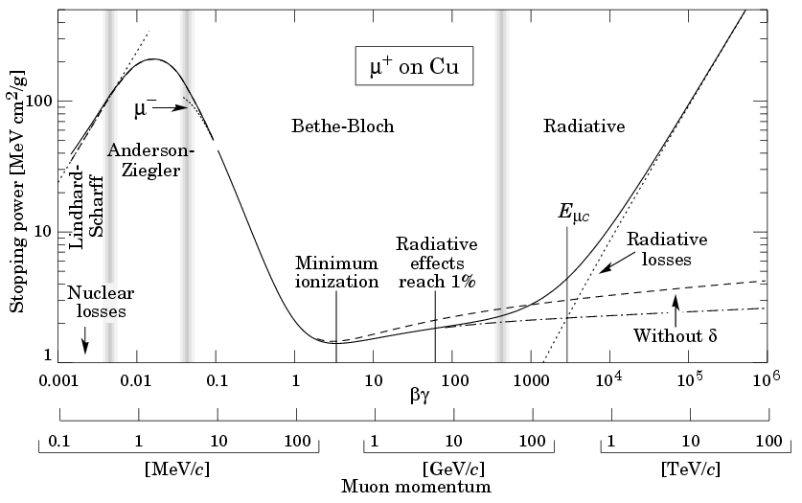
Bethe Bloch vs nuclear cross section
<numero>

