Slide 1
PhD Programme in Physics of the University of Bologna
38th Cycle
Thesis description presentation
“Measurements of nuclear fragmentation differential cross section in an energy range between 200 MeV/n and 400 MeV/n at the FOOT experiment”
Candidate: Giacomo Ubaldi
28/06/2022
Notes:
OK in this presentation i want to speak about in vivo monitoring of the dose or of the range in add on therapy what it is about the main methods and research and the first clinical
<numero>

Slide 2

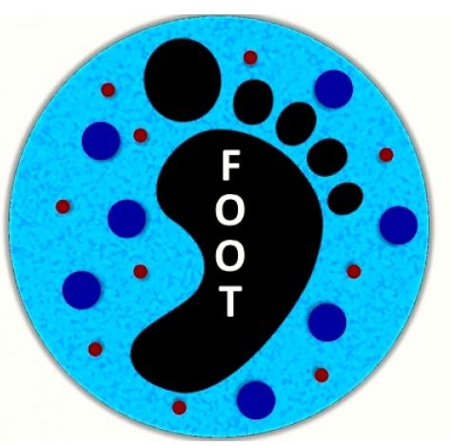

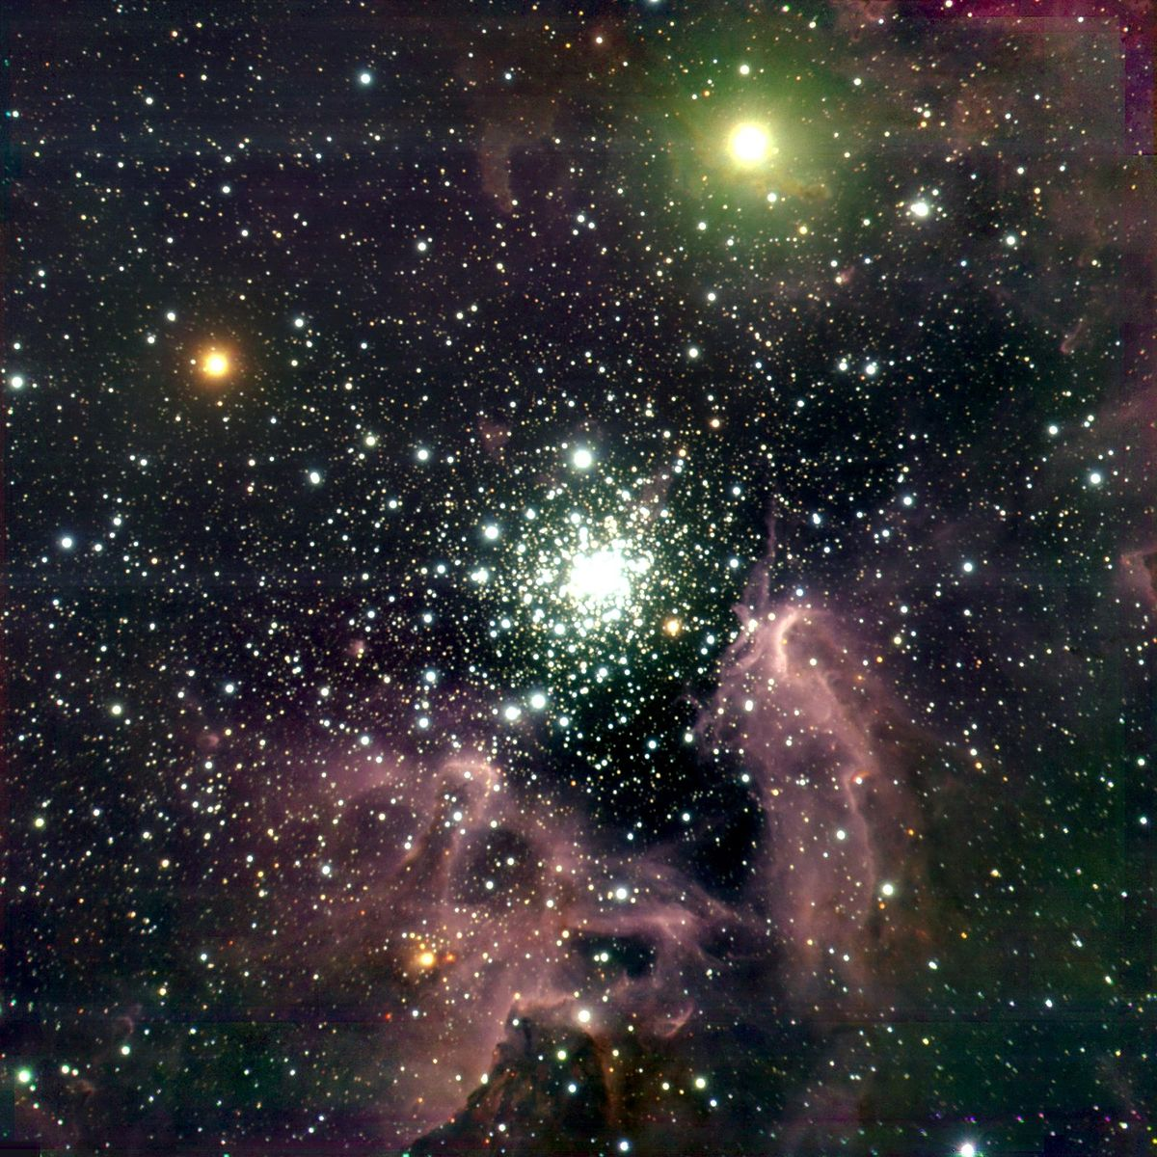


The FOOT experiment
hadrontherapy
Space radioprotection
1/9

Slide 3
The FOOT experiment
hadrontherapy
Space radioprotection
Fragmentation!
1/9

Slide 4
The FOOT experiment
hadrontherapy
Space radioprotection
SPEs
Fragmentation!
GCRs
1/9

Slide 5
The FOOT experiment
Goal:
double differential projectile and target nuclear cross sections mesurements with σ < 5%
Fixed target collisions
Beam energies between 200 MeV/u and 700 MeV/u for hadrontherapy and space radioprotection topics
table top setup to be moved according to beam facility availability
Particle identification by measuring all kinematic quantities
SPEs
Fragmentation!
GCRs
1/9

Slide 6


GSI 2021 analysis
¹⁶O 400 MeV/u on 5 mm C target
Real data taken at GSI in 2021
Analysis implemented in SHOE
Partial setup: no tracker, only one module of calorimeter
TW
MSD
BM
VTX
z
SC
CALO
TG
First preliminary goal:
charge changing angular differential cross section
2/9

Slide 7

Differential cross section
3/9

Slide 8

Fragment identification
TW charge reconstruction algorithm
dE
z=8
z=7
z=6
z=5
z=4
z=3
z=2
z=1
ToF (ns)
MC data
4/9

Slide 9
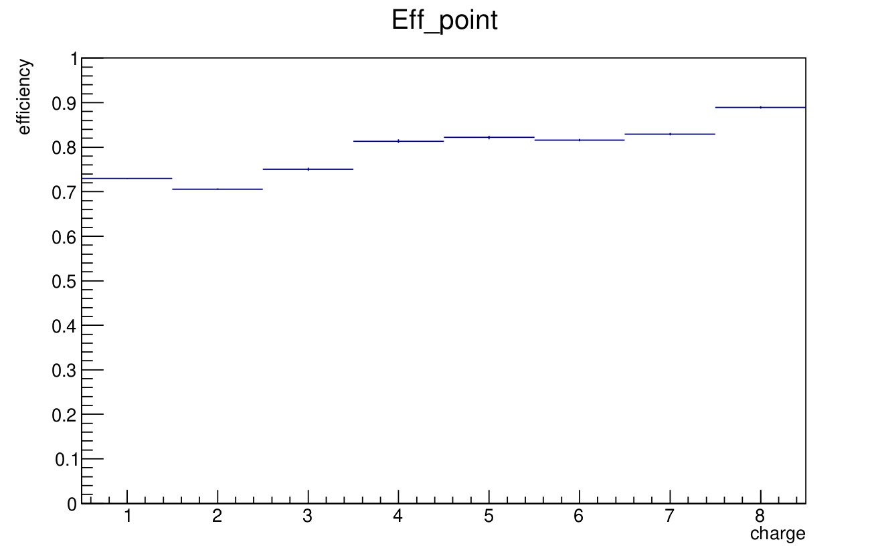
Fragment identification
TW charge reconstruction algorithm
dE
z=8
z=7
z=6
z=5
z=4
z=3
z=2
z=1
ToF (ns)
charge reconstruction efficiency
MC data
4/9

Slide 10

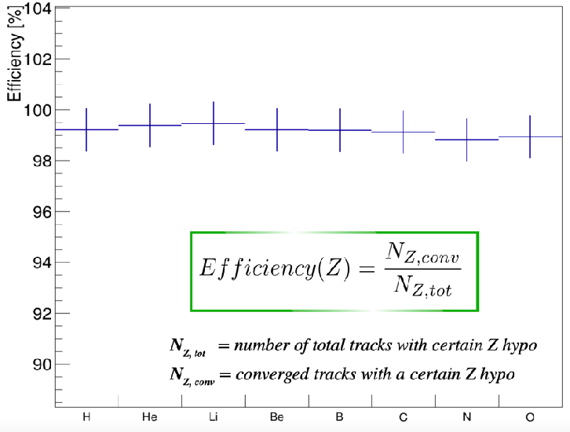
Track reconstruction
Kalman Filter reconstruction of a track
TW
MSD
VT
Track reconstruction efficiency
MC data
5/9

Slide 11




Isotope identification
Mass reconstruction using all FOOT subdetectors:
MC data
6/9

Slide 12




Isotope identification
Augmented Lagrangian Method
Minimization of
where
MC data
Es. A = 12
A_{ALM} = 11.66 ± 0.38
A/σ_{A} = 3.2 %
χ 2 < 5
6/9

Slide 13




Pile-up removal
constant threshold discrimination method
4 crosses
4 crosses
pileup projectile: >4 crosses
Pile-up rejection ~ 1%
Real data
7/9

Slide 14
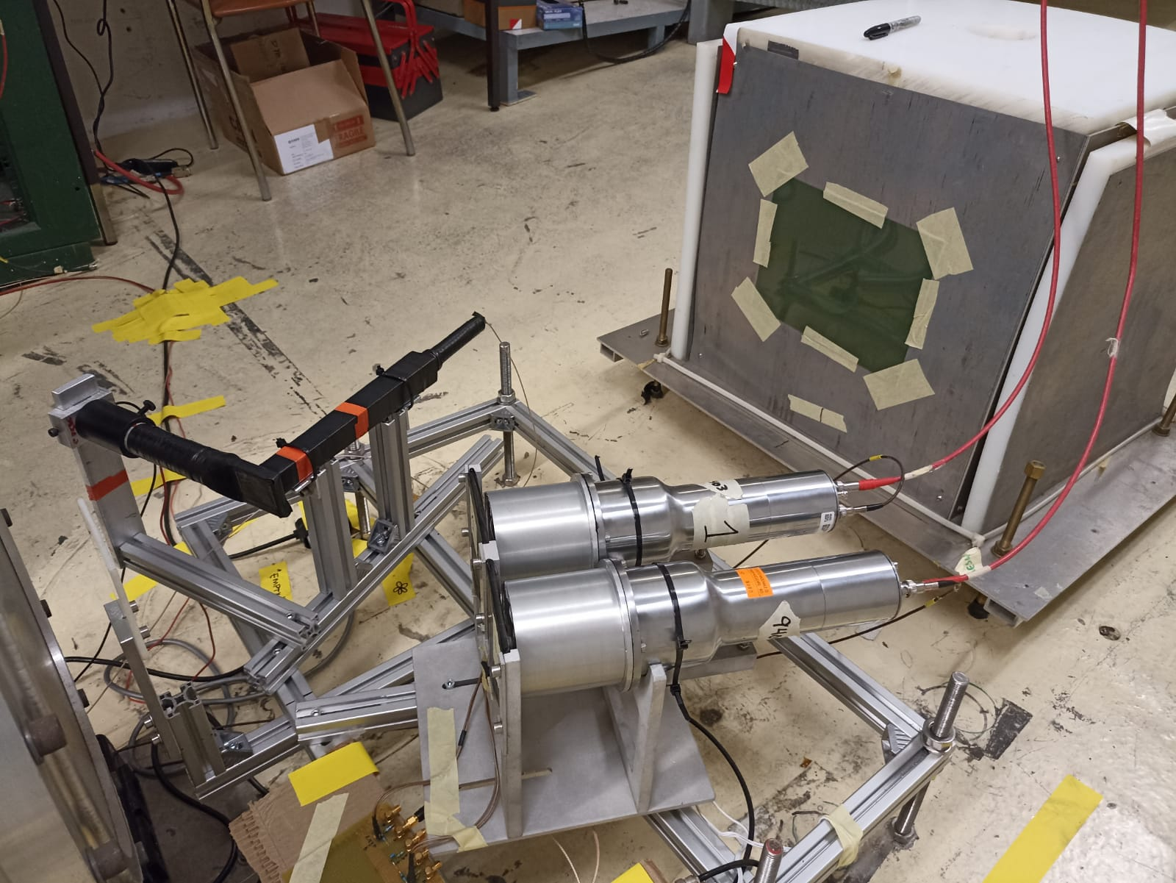
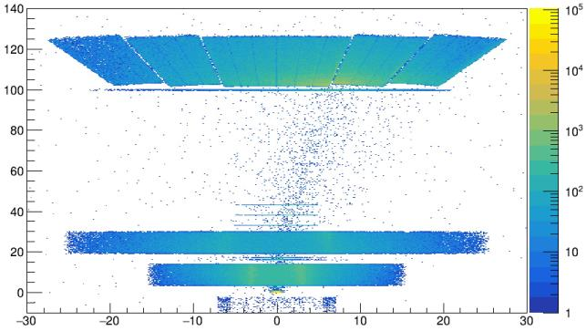
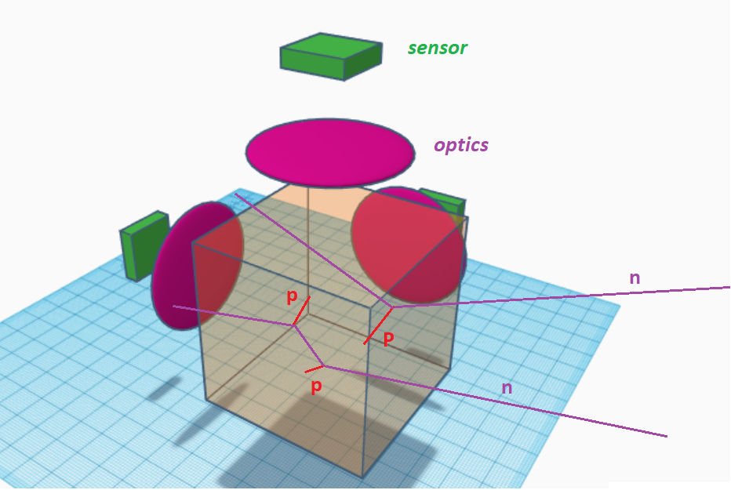
Fast neutrons detectors
High neutron production as a
consequence of fragmentation with detectors
BGO_p
CAL
TW
NIKEs
Purpose to
Add neutron
detectors:
BC-501A liquid scintillator
BGO Phoswich
MSD
VT + TARGET
recoil-proton track
imaging detector
8/9

Slide 15
Future data taking
Foreseen within 2023 – 2024
All detectors will be present
z
Beam tests for calibration of all detectors togheter
Compact analysis strategy needed
Implementation of neutron detectors in analysis software
Inverse kinematic application
9/9

Slide 16
Back up slides

Slide 17


Hadrontherapy
tumor
Sketch of a treatment planning system on brain-located tumor
Hadrontherapy vs radiotherapy:
Finite range
Localized dose profile
Nuclear fragmentation
depth- dose profile for X-rays and charged particles as a beam
<numero>
Notes:
Let's start from the beginning. Radiation therapy represents a way to exploit an external beam of radiation, which delivers energy, or those in a specific region of the human body where there is a tumour in order. To kill the tumour cells, or to limit their proliferation. He, according to the kind of radiation in the beam, the delivery of those is different. Let's consider now the dozer profile. So there is of those in terms of depth in the human body and what are the main differences between radiation therapy. Radiotherapy, the most common one which exploits the X rays and add on therapy. The most promising one which uses charged particles. What we can see is that for add on therapy we have a highest physical selectivity, which means that the highest release of those is a focused in a very specific region. Very close to the range. A end of the charged particle and it is called Brad Pick. So according to the energy given to the BMA, it is possible to have a black pika in the specific region of the tumour. We can say. So add on therapy. Can be two favourable with reference to radiotherapy becausr it's hayastan steepest gradient of those releasing just a region makes the highest spare of entity issues before and after the two rural region. However there are also some limits to the best. Then potentiality of this technique, and they are the range uncertainties in the clinical application of my treatment. So after his planning, it is possible that there are some discrepancy in the range of my beam. There can be shift which means. Chiefs of the black Beak in the entity in the tissues of the human body. In particular, there would be another dozing of tissues after the tumour and then under dozing in the two rural region. The consequence of this are that it is possible. to even create damages of arctic issues more than one than the ones of
<numero>

Slide 18

Space radioprotection
Dose equivalent
Dose
Fluence
Particles contribution in
Fluence, dose and equivalent dose
GCR fluence

Slide 19
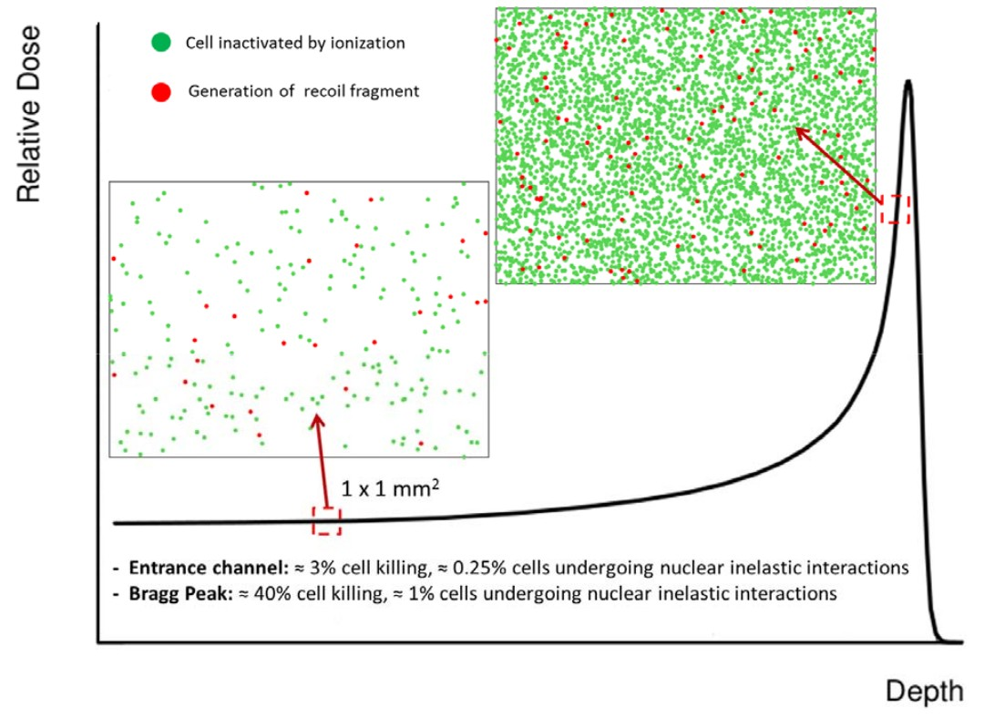


Nuclear Fragmentation
Proton beam:
~ 200 MeV
Damage in all the path
Carbon beam:
~ 400 MeV/u
BEAM
Sketch of Nuclear fragmentation
Damage after the BP

Slide 20
The FOOT detector
Calorimeter
Target
Permament
Magnets
Start
Counter
Beam
monitor
BEAM
z
Vertex
Tracker
Inner
Tracker
Microstrip Silicon
Detector
ToF Wall
Pre-target region
Tracking region
Downstream region

Slide 21
Differential Cross section
Yield of all fragments
Background
unfolding
efficiency
N° of primary
events
N° of scattered
centers
Phase space

Slide 22
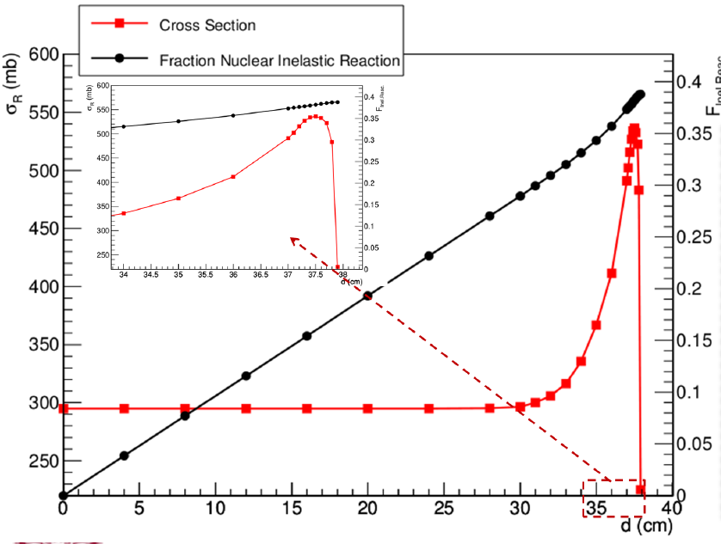
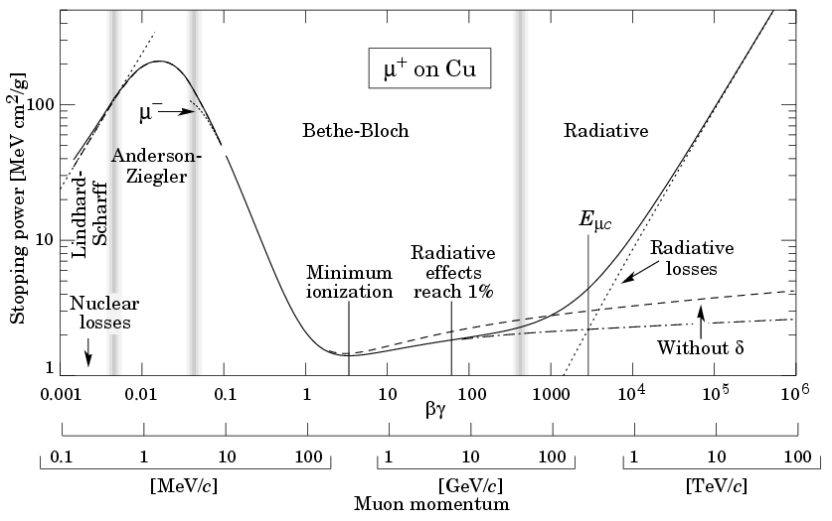
Bethe Bloch vs nuclear cross section

Slide 23
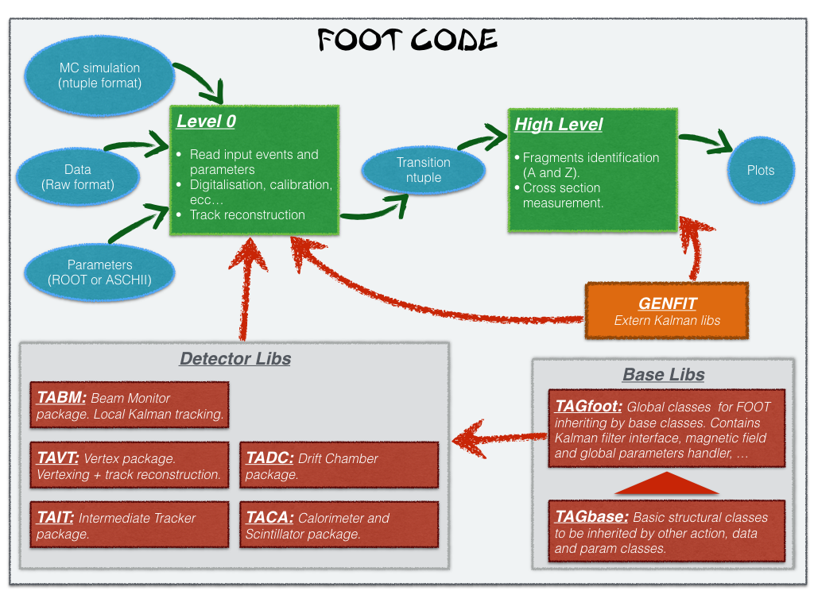
SHOE organization

Slide 24

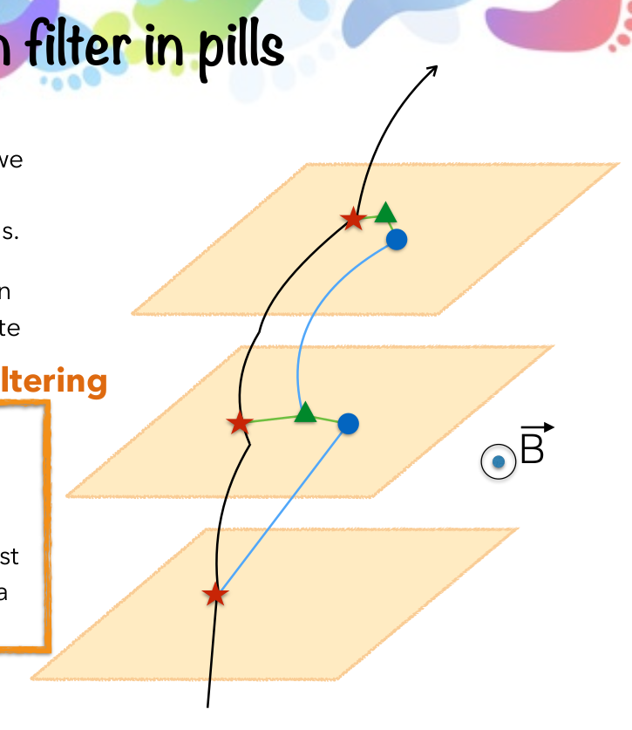
Kalman filter in pills
1. Take an ideal particle in vacuum. If we
add air + detector layers, trajectory
changes due to M.S. and energy loss.
2. We’ll see some measurement hits on
the detector layers (considering finite
detector uncertainty).
Filtering
3. Propagate the first hit to the next
layer. Propagator Matrix F.
4. Find the best compromise between
the propagated point and the closest
hit on the 2 nd layer. Use a Chi2 and a
Projection Matrix H.
5. Iterate 3 and 4 for the next layers.
Kalman Filter reconstruction of a track
Start from VT tracklets
Projection to possible planes of IT
KF extrapolation to MSD
KF extrapolation to TW
Fit the track candidates and extract reconstructed quantities: Z, momentum ...

Slide 25
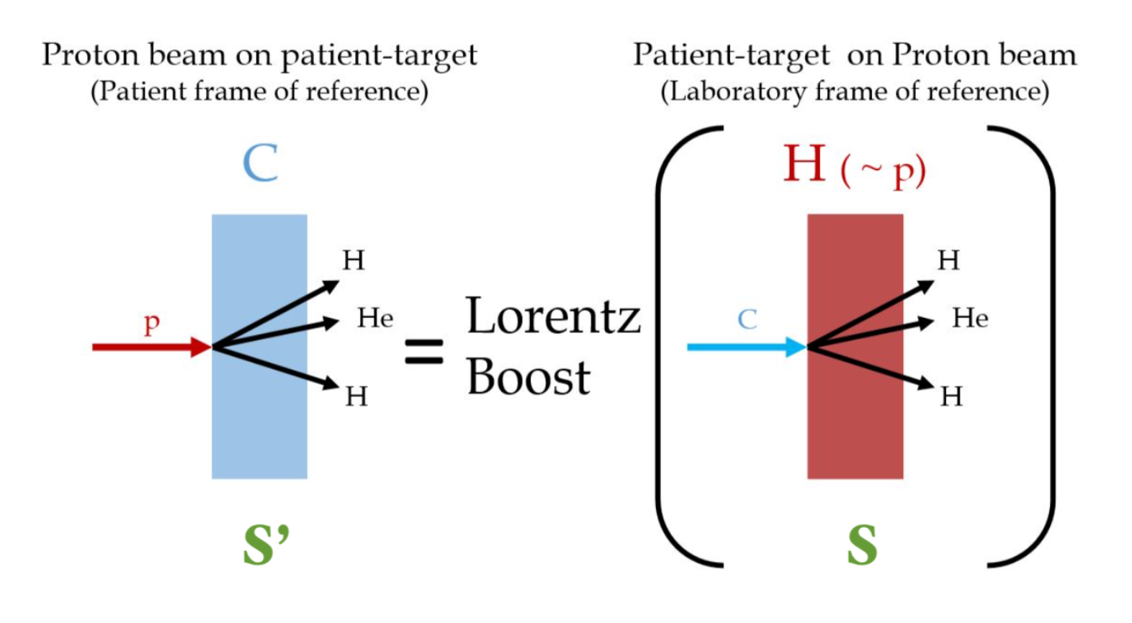
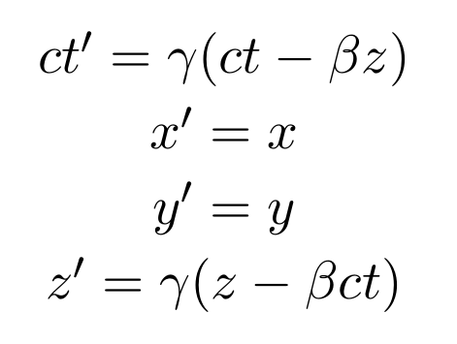
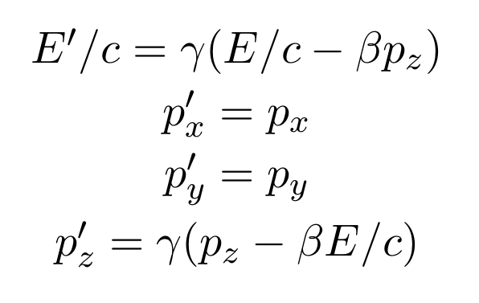
Inverse kinematics

