Slide 1



Neutron detectors characterization @ n_TOF
S. Colombi, A. Manna, C. Massimi, M. Marafini,
R. Spighi, M. Villa, R. Zarrella (and M. Bon… maybe?)

Slide 2



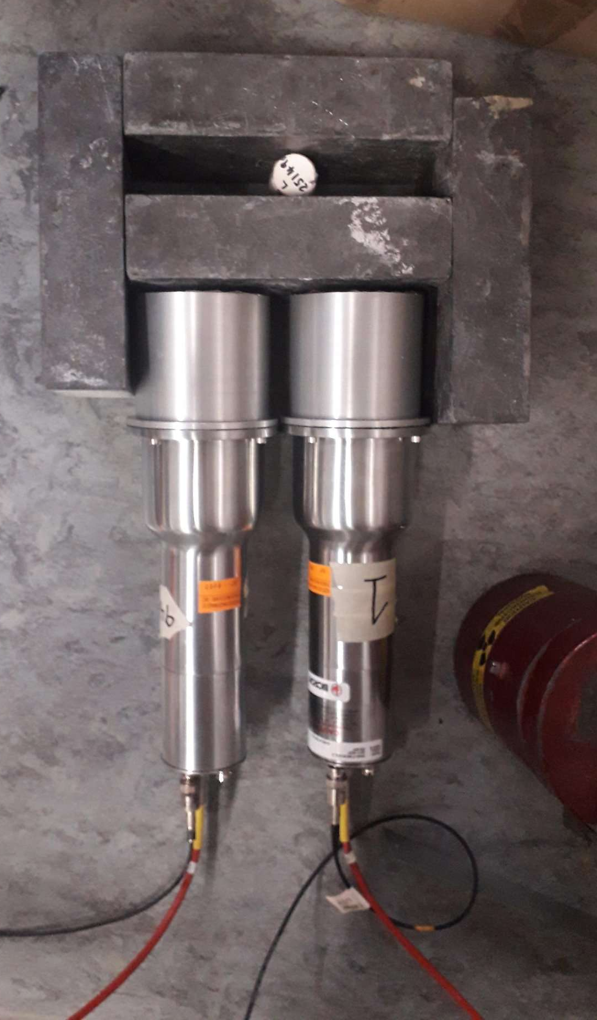
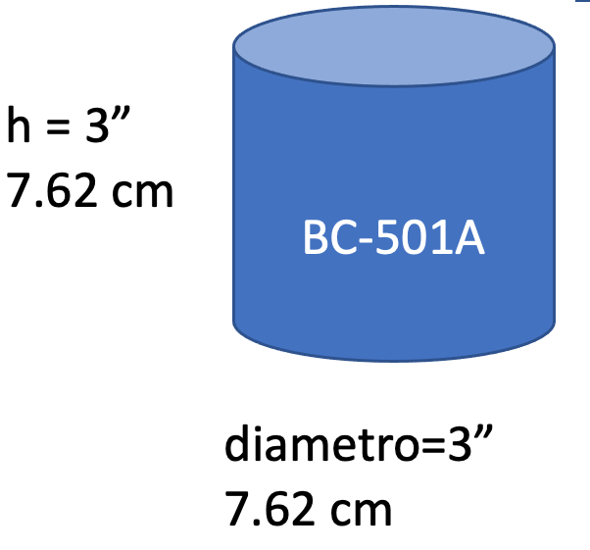
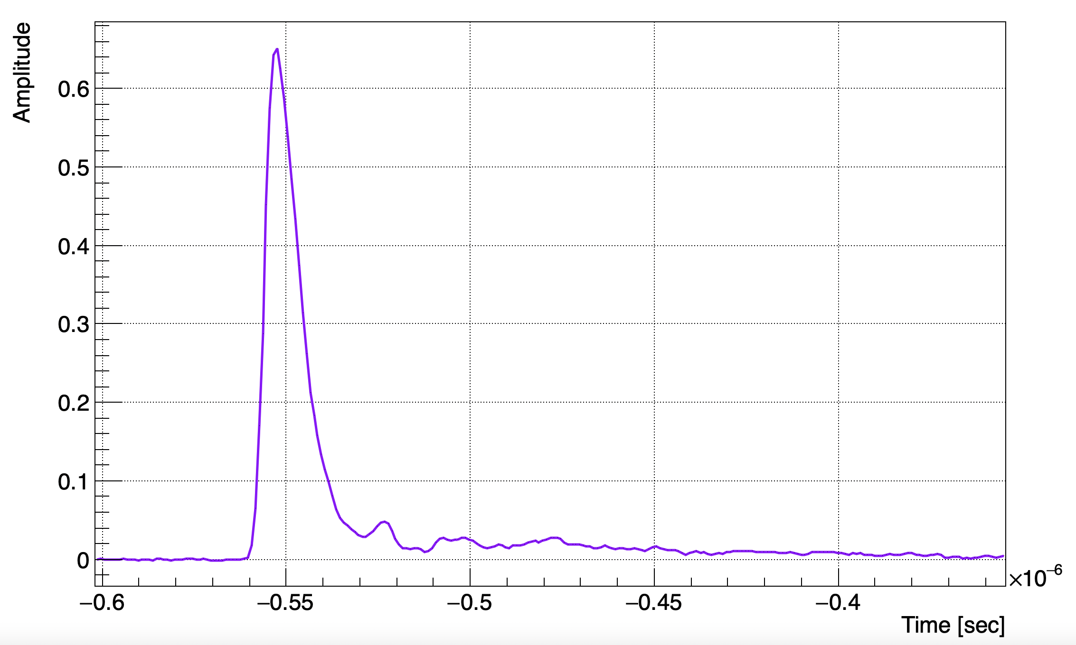
Neutron detectors
Nike - NE213/BC-501A → liquid scintillator:
Very good time resolution (~3ns RT)
Good n/γ discrimination
Decay Time components 3.16, 32.3 & 270 ns
+ VETO (EJ-200) readout by SiPMs
2

Slide 3
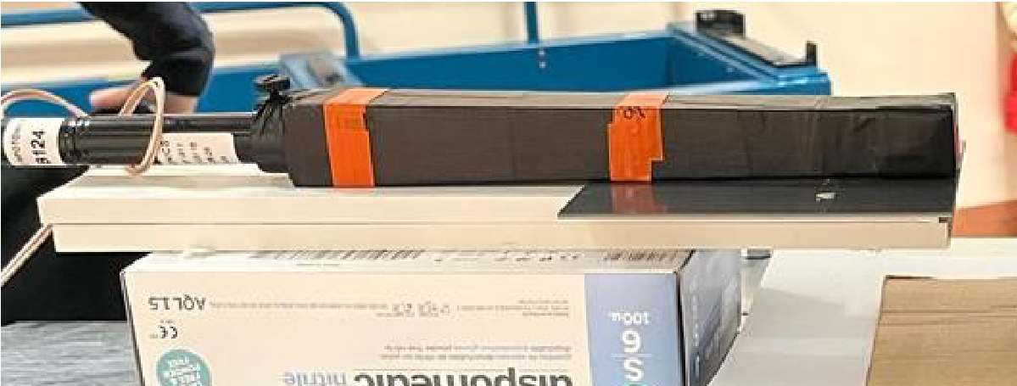
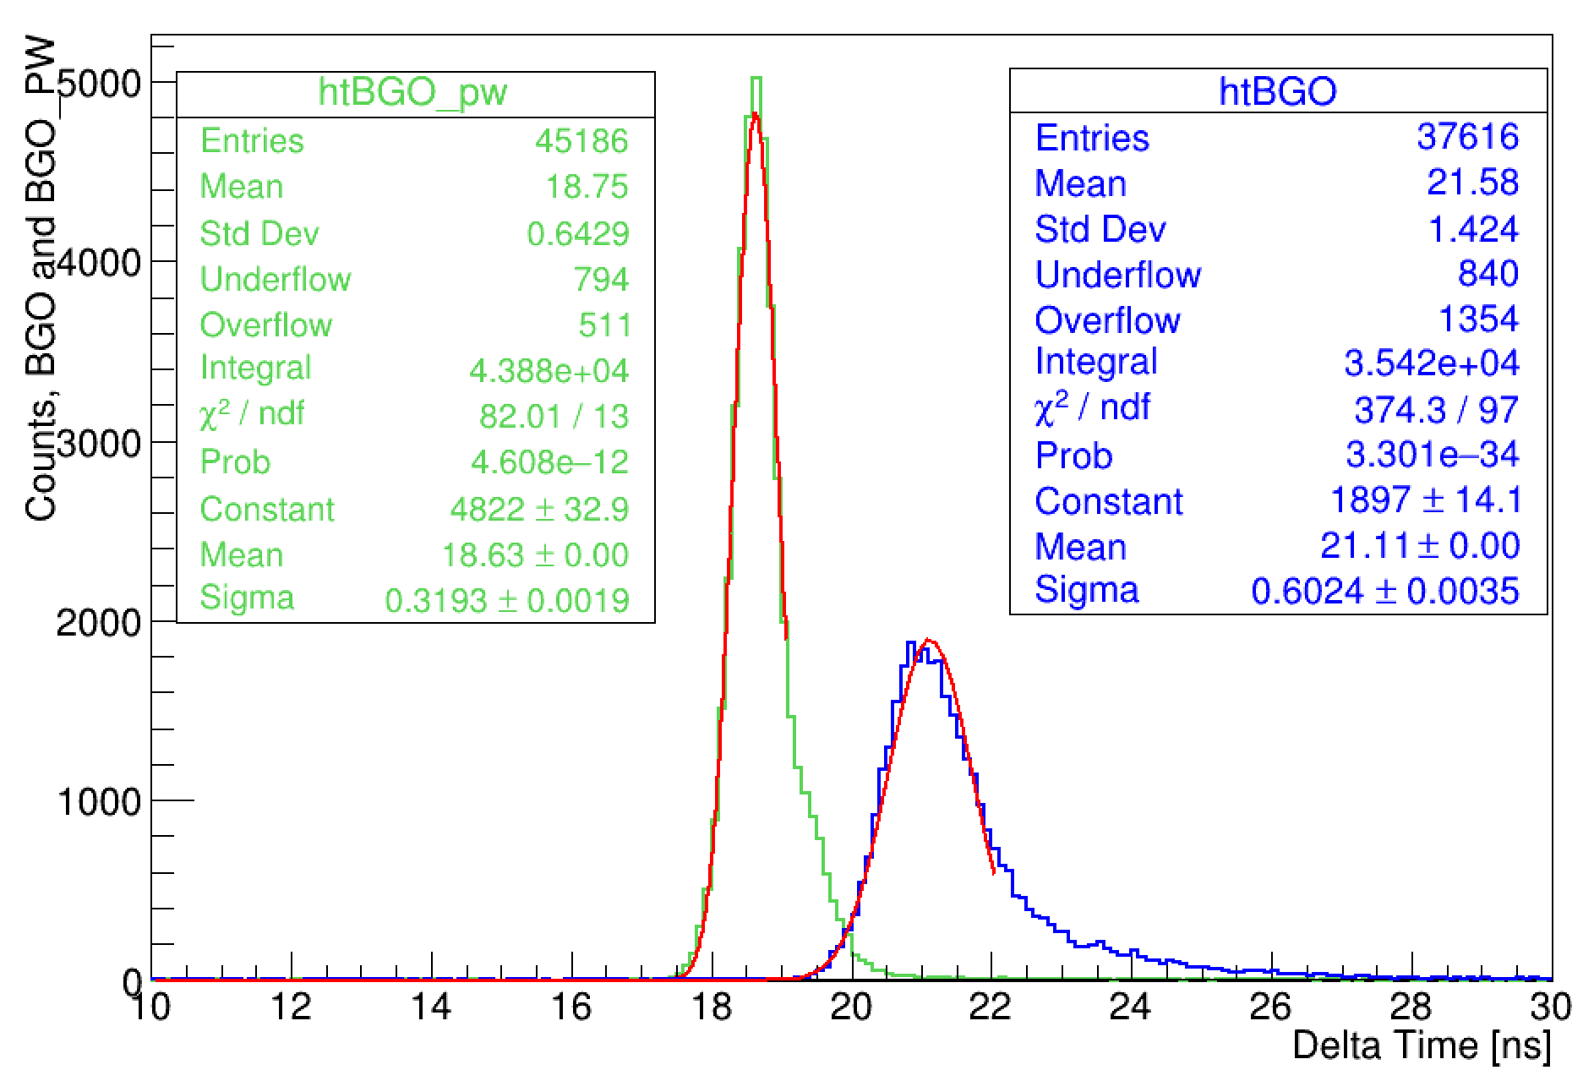
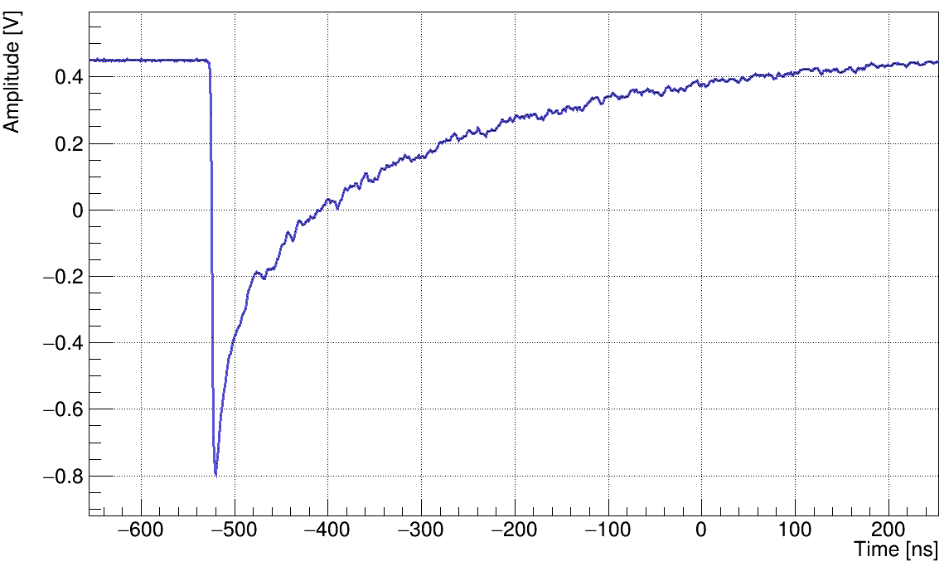
Neutron detectors
Phoswich: BGO crystals + EJ232
Particle identification
Possible Calorimeter upgrade
+ VETO (EJ-204) readout w/ PMT
A1: 2.4x2.4 cm²
A2: 3.3 x 3.3 cm²
h: 24 cm
3

Slide 4
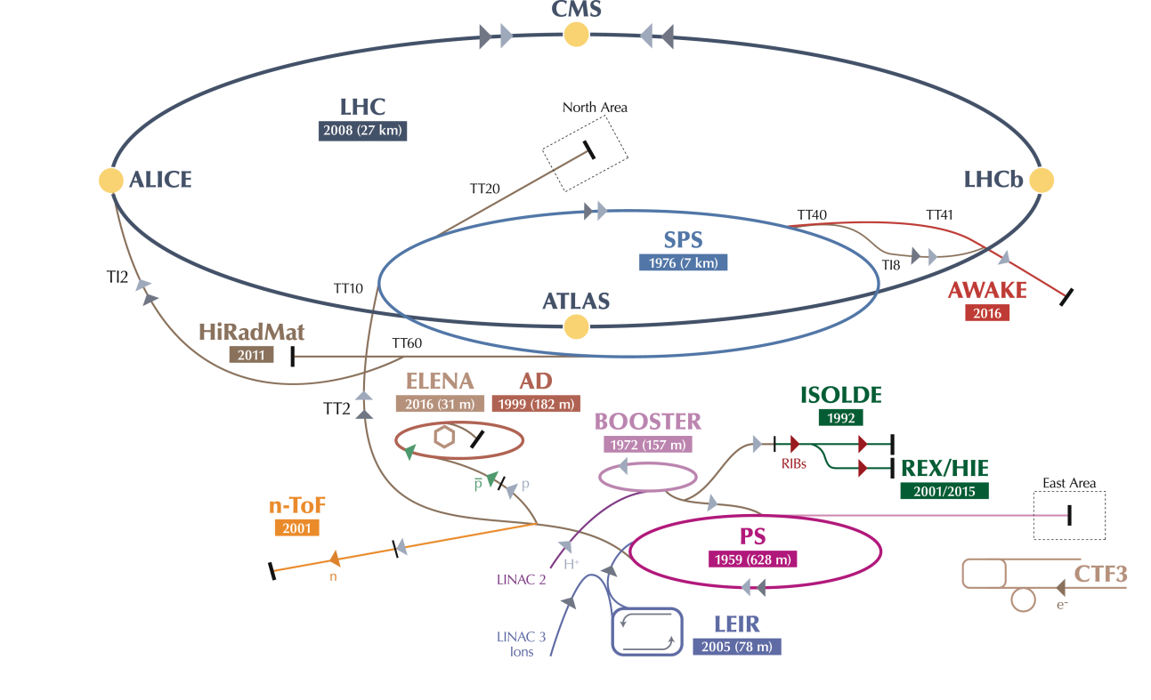

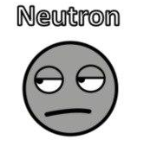
n_TOF @ CERN
Proton beam
20 GeV/c p from PS
7 ns bunch length
Min. 1.2s btw bunches
n_TOF
4
Courtesy of A. Mengoni

Slide 5
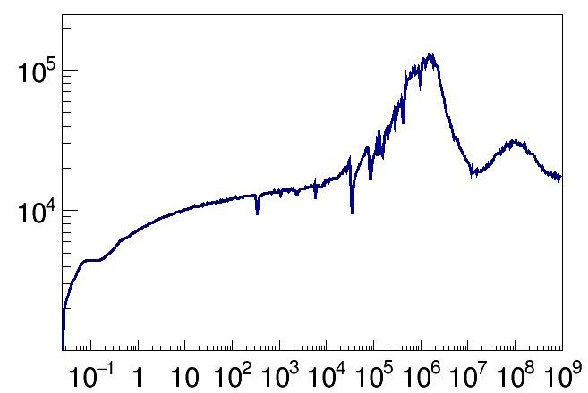
Neutron flux @ n_TOF
High neutron flux
7x10¹² p → 10¹⁵ n
Wide energy range
Neutron Flux [EdΦ/dE/Pulse]
Thermal – up to 1 GeV
High energy resolution → TOF
EAR1 →185 m flight path
ΔE/E 10⁻⁵ - 10⁻³
5
Neutron energy [eV]

Slide 6
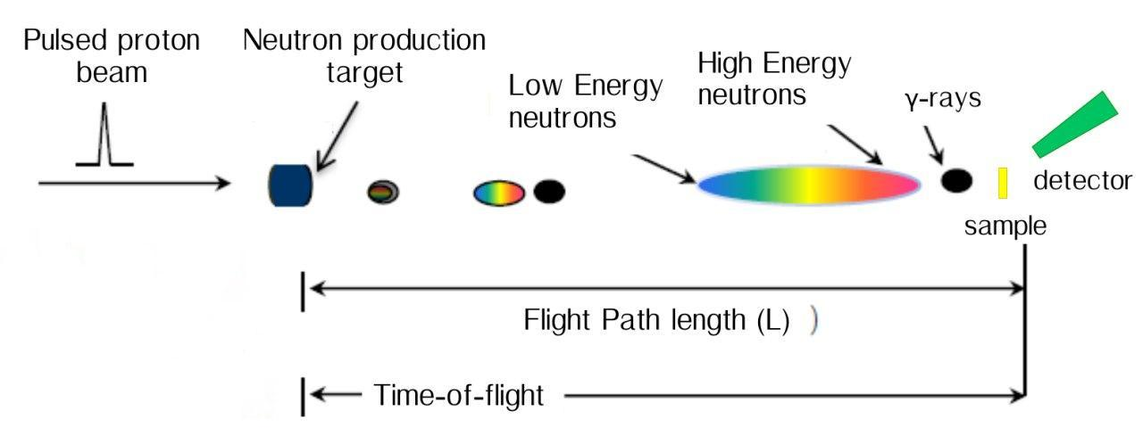
TOF - Energy conversion
Energy (MeV) TOF(μs)
1 13.8
10 3.94
50 1.46
100 0.89
150 0.65
200 0.51
250 0.42
300 0.36
400 0.27
500 0.21
1000 0.10
6

Slide 7
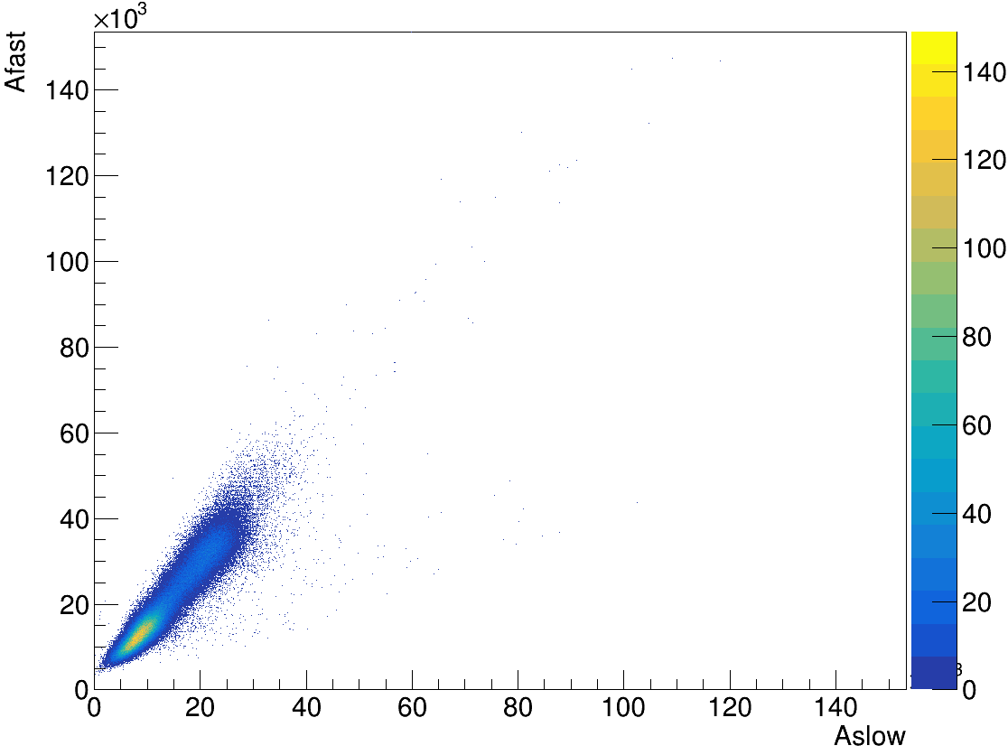
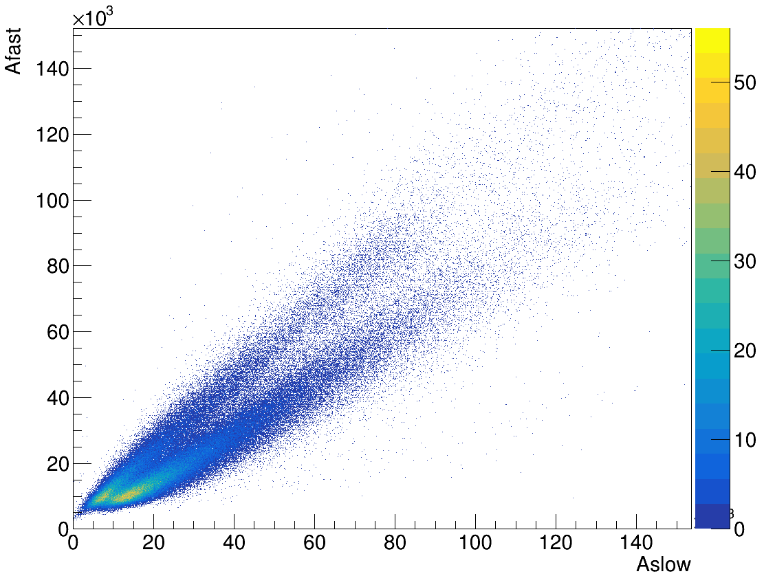
Detector characterization
1) Am-Be/⁸⁸Y sources for preliminary particle identification (n-γ) studies
NIKE1
⁸⁸Y
AmBe + Pb
PRELIMINARY
PRELIMINARY
7

Slide 8
Detector characterization
1) Am-Be/⁸⁸Y sources for preliminary particle identification (n-γ) studies
2) Neutron efficiency studied with neutron beam
a) Detectors on the neutron beam line (n-γ)
10 MeV – 1 GeV: 100000 neutron/bunch
n
Dump
8

Slide 9

Detector characterization
1) Am-Be/⁸⁸Y sources for preliminary particle identification (n-γ) studies
2) Neutron efficiency studied with neutron beam
a) Detectors on the neutron beam line (n-γ)
b) PE-C targets on the beam line and detectors (+ vetos) at a fixed angle (25°)
10 MeV – 1 GeV: 100000 neutron/bunch
n
Dump
n
Dump
Exploit the n-p scattering reaction to measure the detectors efficiency
n, p
9

Slide 10

Detector characterization
sample
BGO Phoswich
15 cm
Beam
dump
Beam
pipe
θ = 25°
θ = 25°
30 cm
Detected neutron
Incident neutron
(TOF)
Scattering angle
BC-501As
Detector d [cm] δ(cos²θ ) [%]
NIKE 30 10-13 → ±11
BGO 15 7-8 → ±7
10

Slide 11
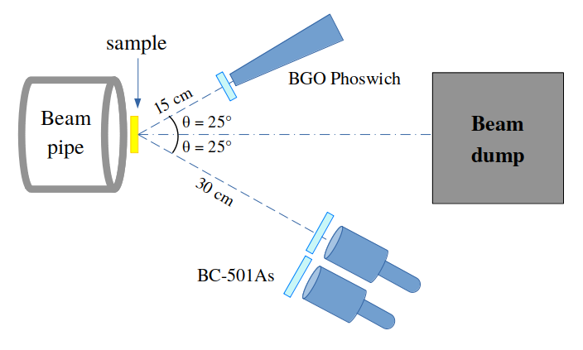
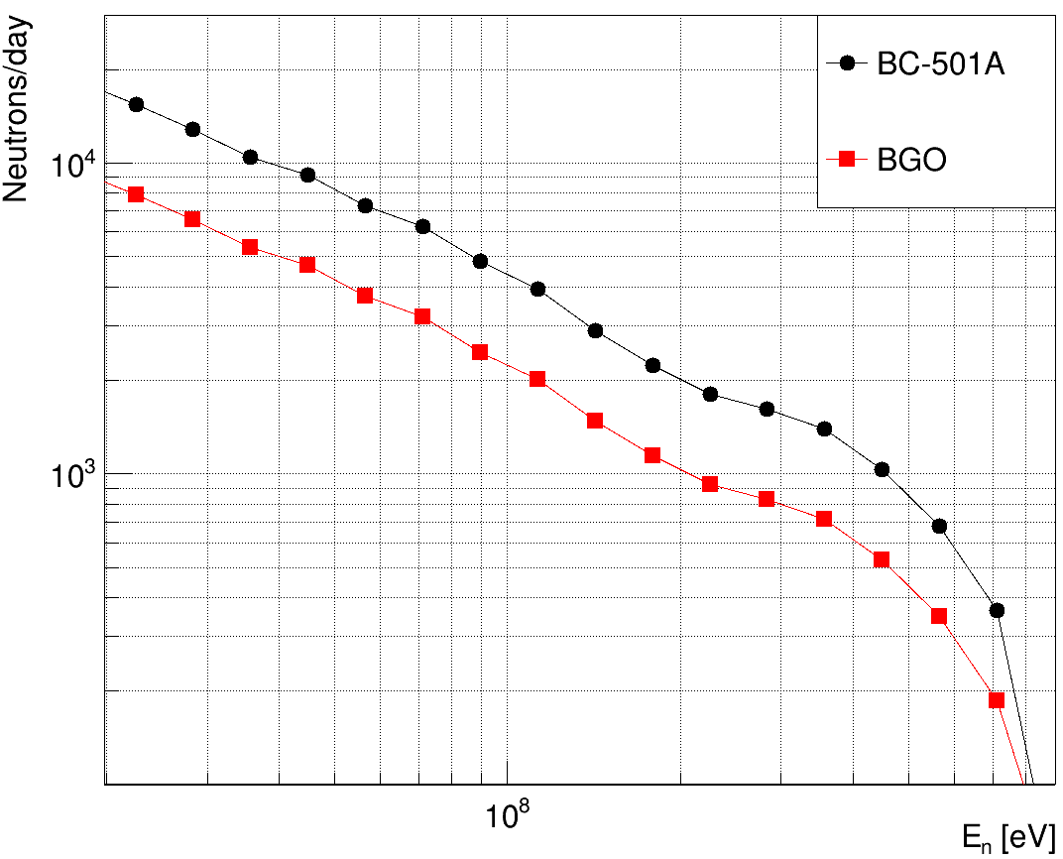
Detector characterization
n_{H} ≈ 0.04 at/barn
1 bunch every 6 s
10 bins/decade
8-10% energy bin resolution
Neutrons from
n-p at 25°
11

Slide 12
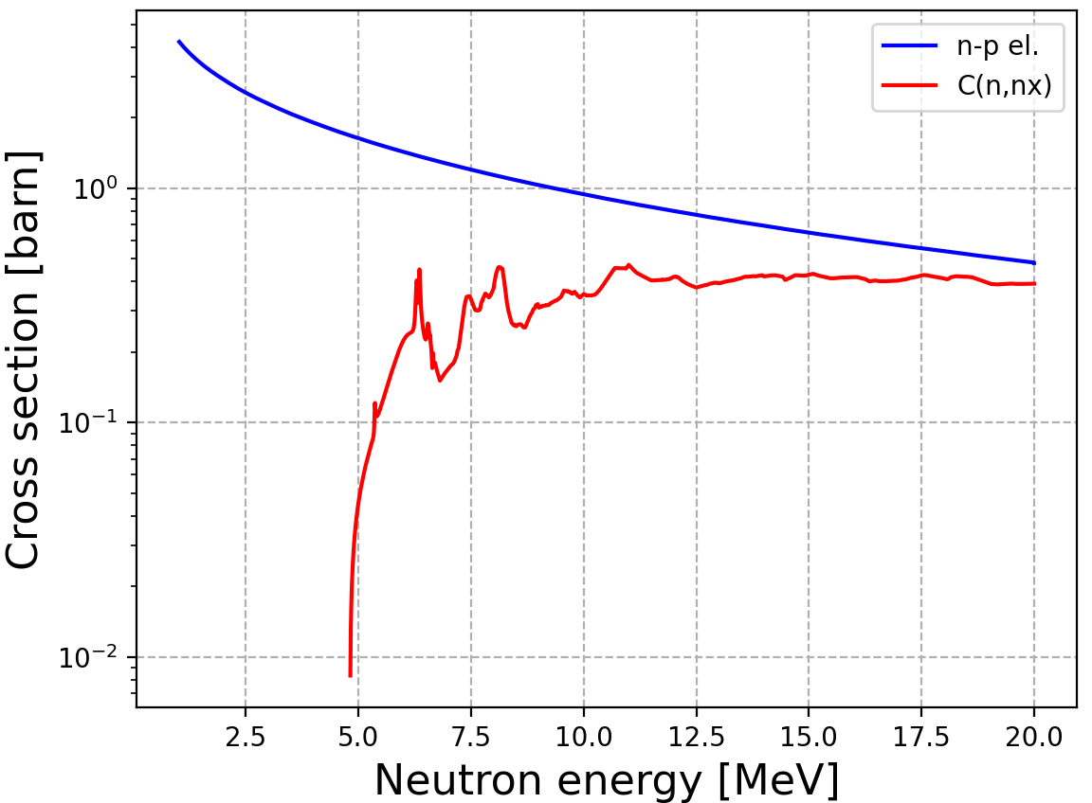
Detector characterization
PROBLEM: PE sample
Need to subtract the C contribution
OBJECTIVE
Neutron detection efficiency with
maximum statistical uncertainty
at the level of 5%
SOLUTION: 1 month PE 5mm + 1 month C 2.5mm
12

Slide 13
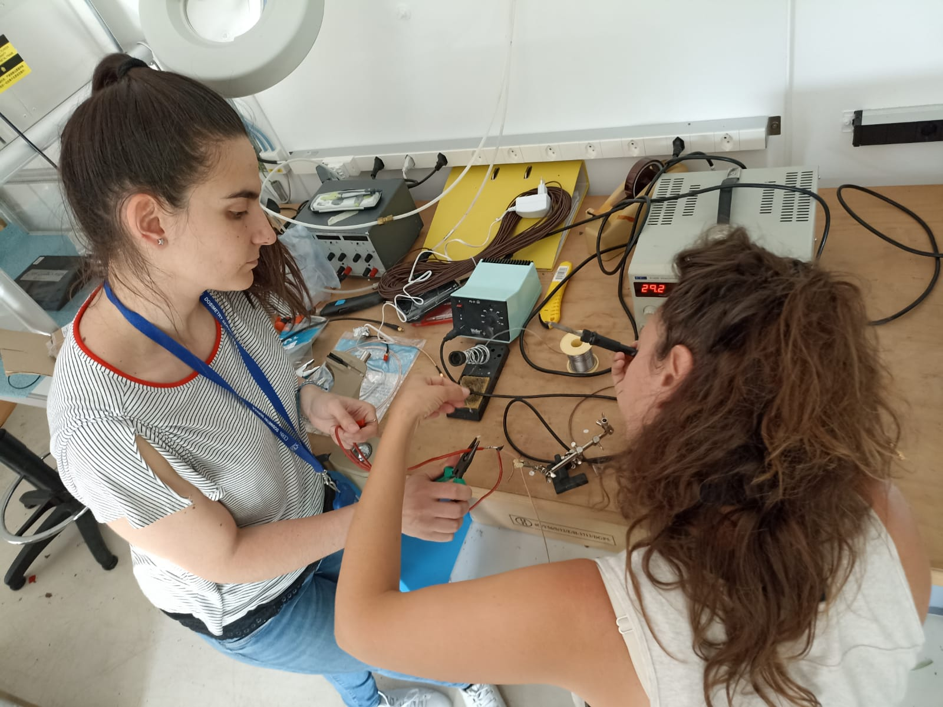
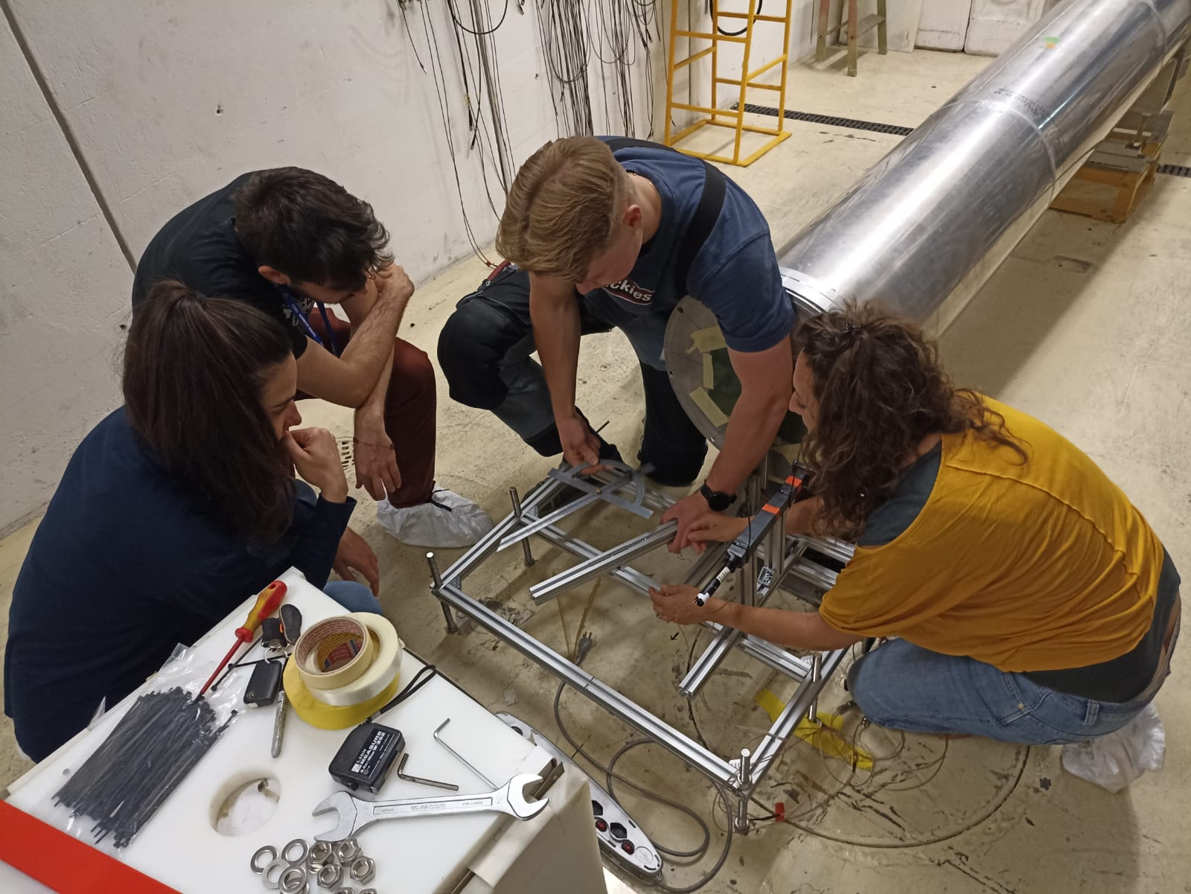
Setup
Setup mounting:
All detectors + VETOs tested in LAB
Detector support provided by n_TOF
technical staff
Many thanks to Michela
(and Marco)!
13

Slide 14
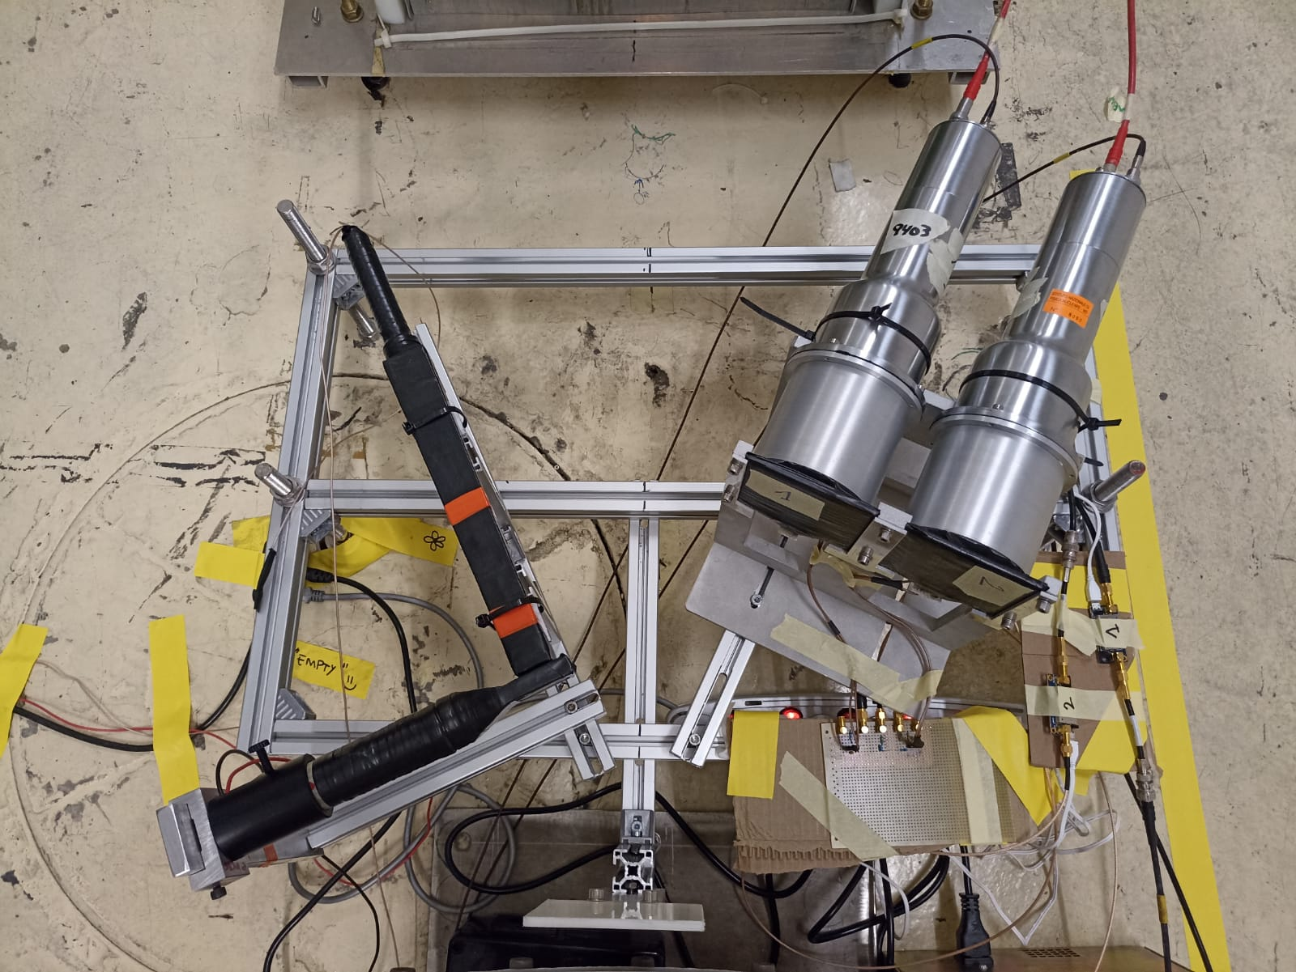
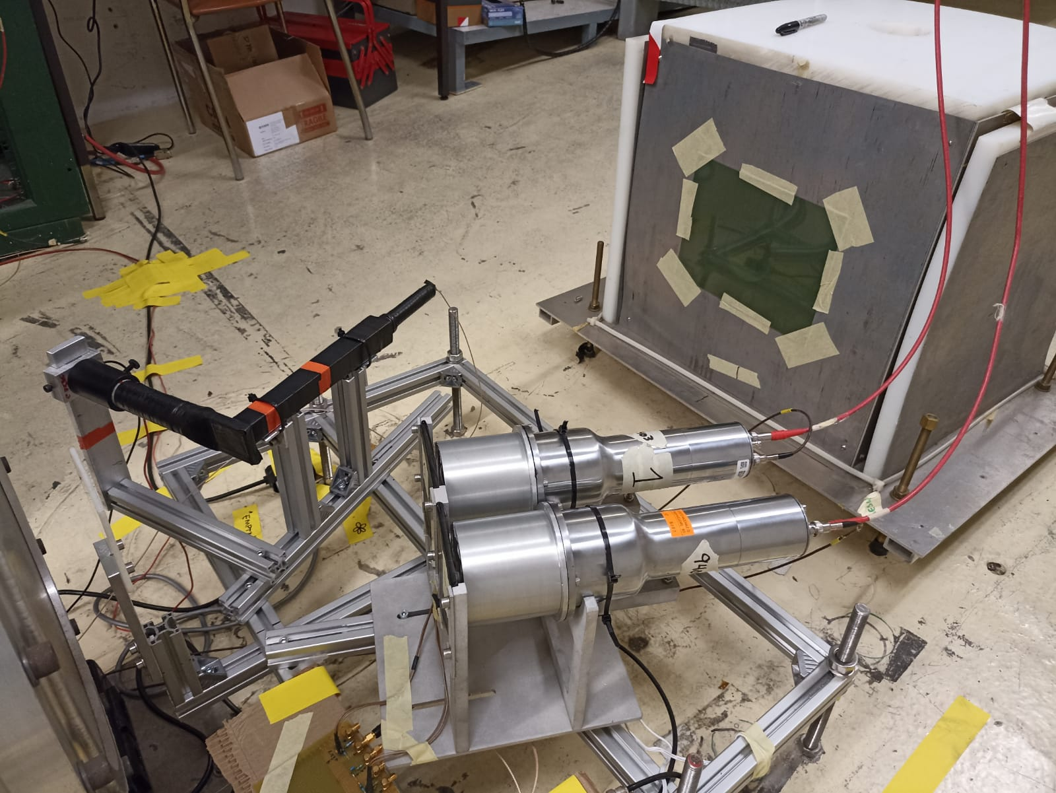
Setup
NIKEs
BGO_pw
BGO_pw
Target
NIKEs
Run started on 17th May!!
14

Slide 15
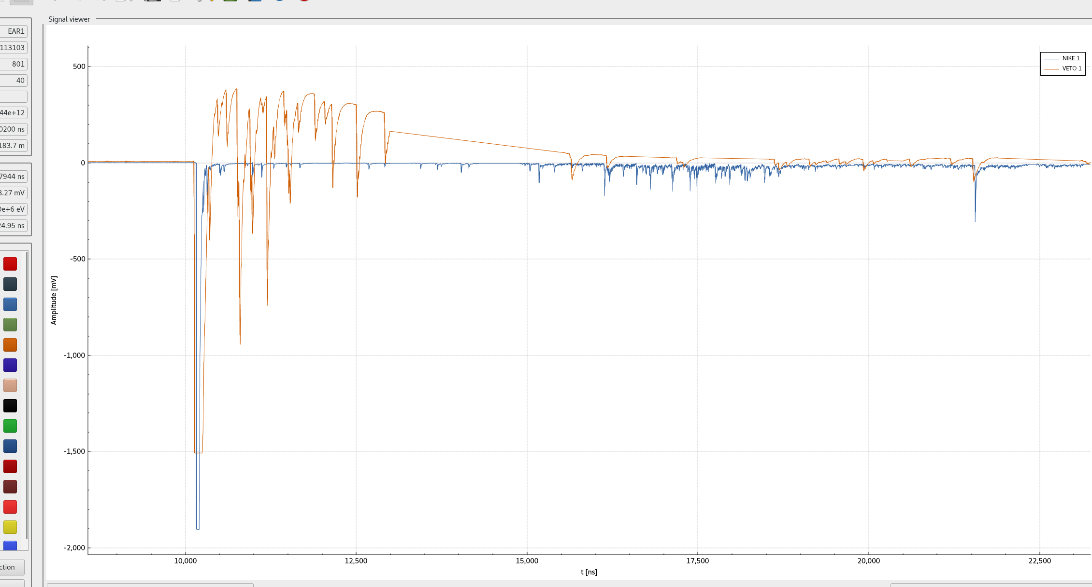
Signals: NIKE1 + VETO1
γ-flash
10 MeV
2 MeV
100 MeV
15
500 MeV

Slide 16
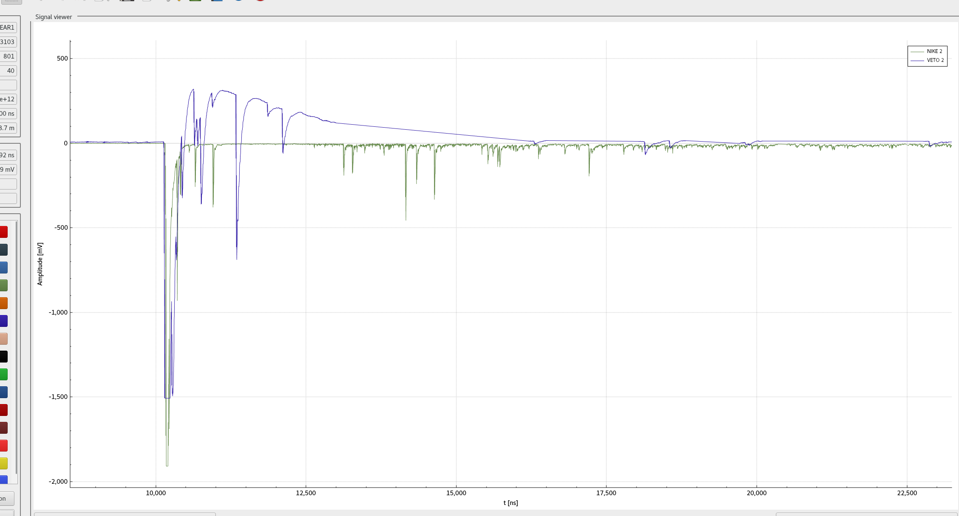
Signals: NIKE2 + VETO2
γ-flash
10 MeV
2 MeV
100 MeV
16
500 MeV

Slide 17
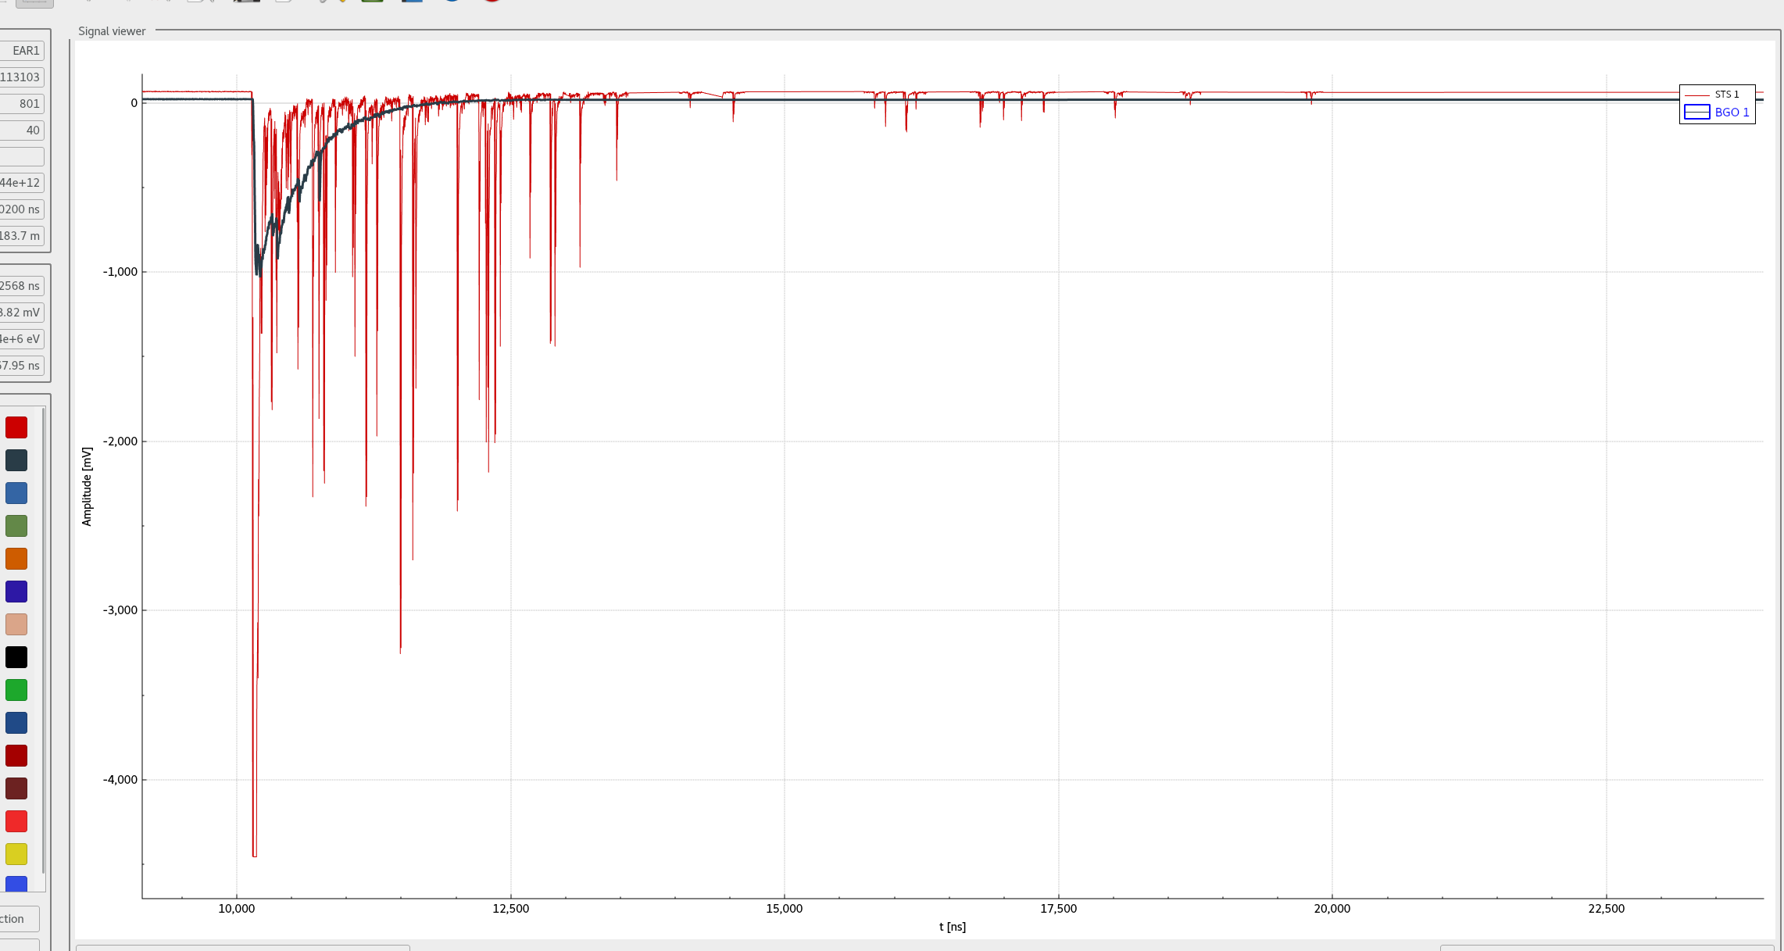
Signals: BGO + STS
γ-flash
10 MeV
2 MeV
100 MeV
17
500 MeV

Slide 18
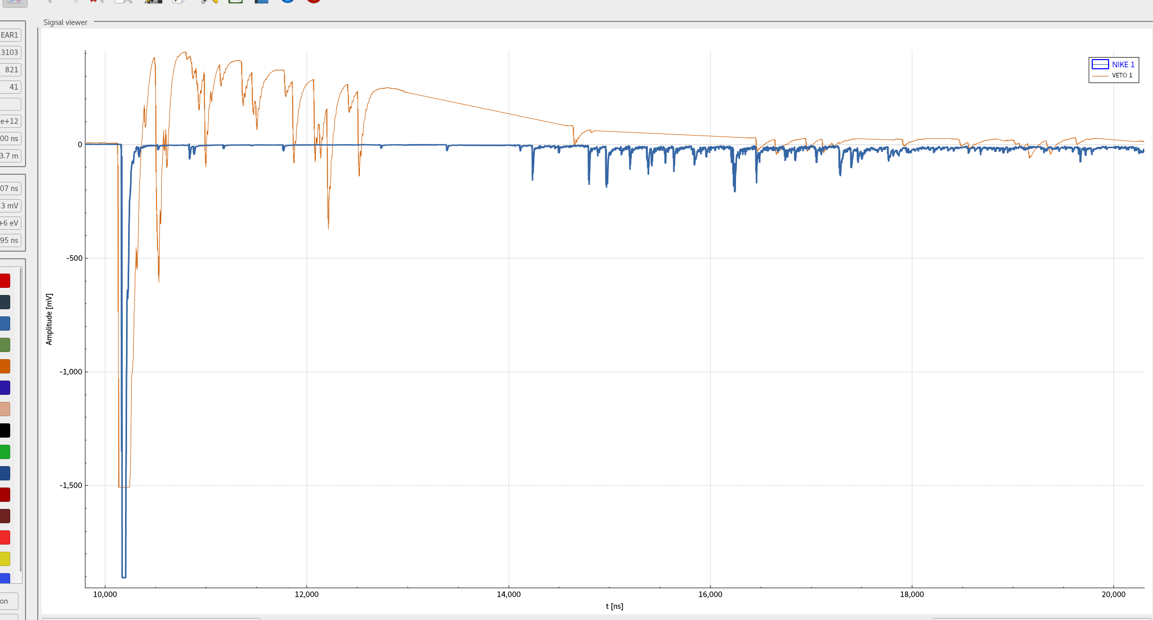
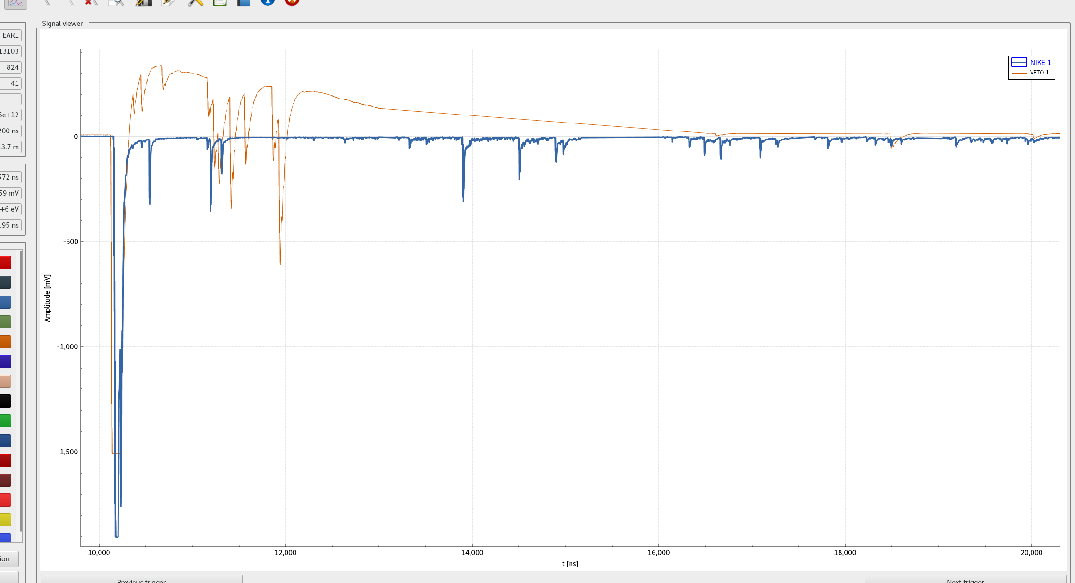
Signals: Gain issue (NIKEs)
NIKEs show different gain btw dedicated and parasitic proton bunches near the γ-flash
Dedicated
bunch (8E12)
Parasitic
bunch (3E12)
PMT recovery
2mm PE target
Move back
18

Slide 19
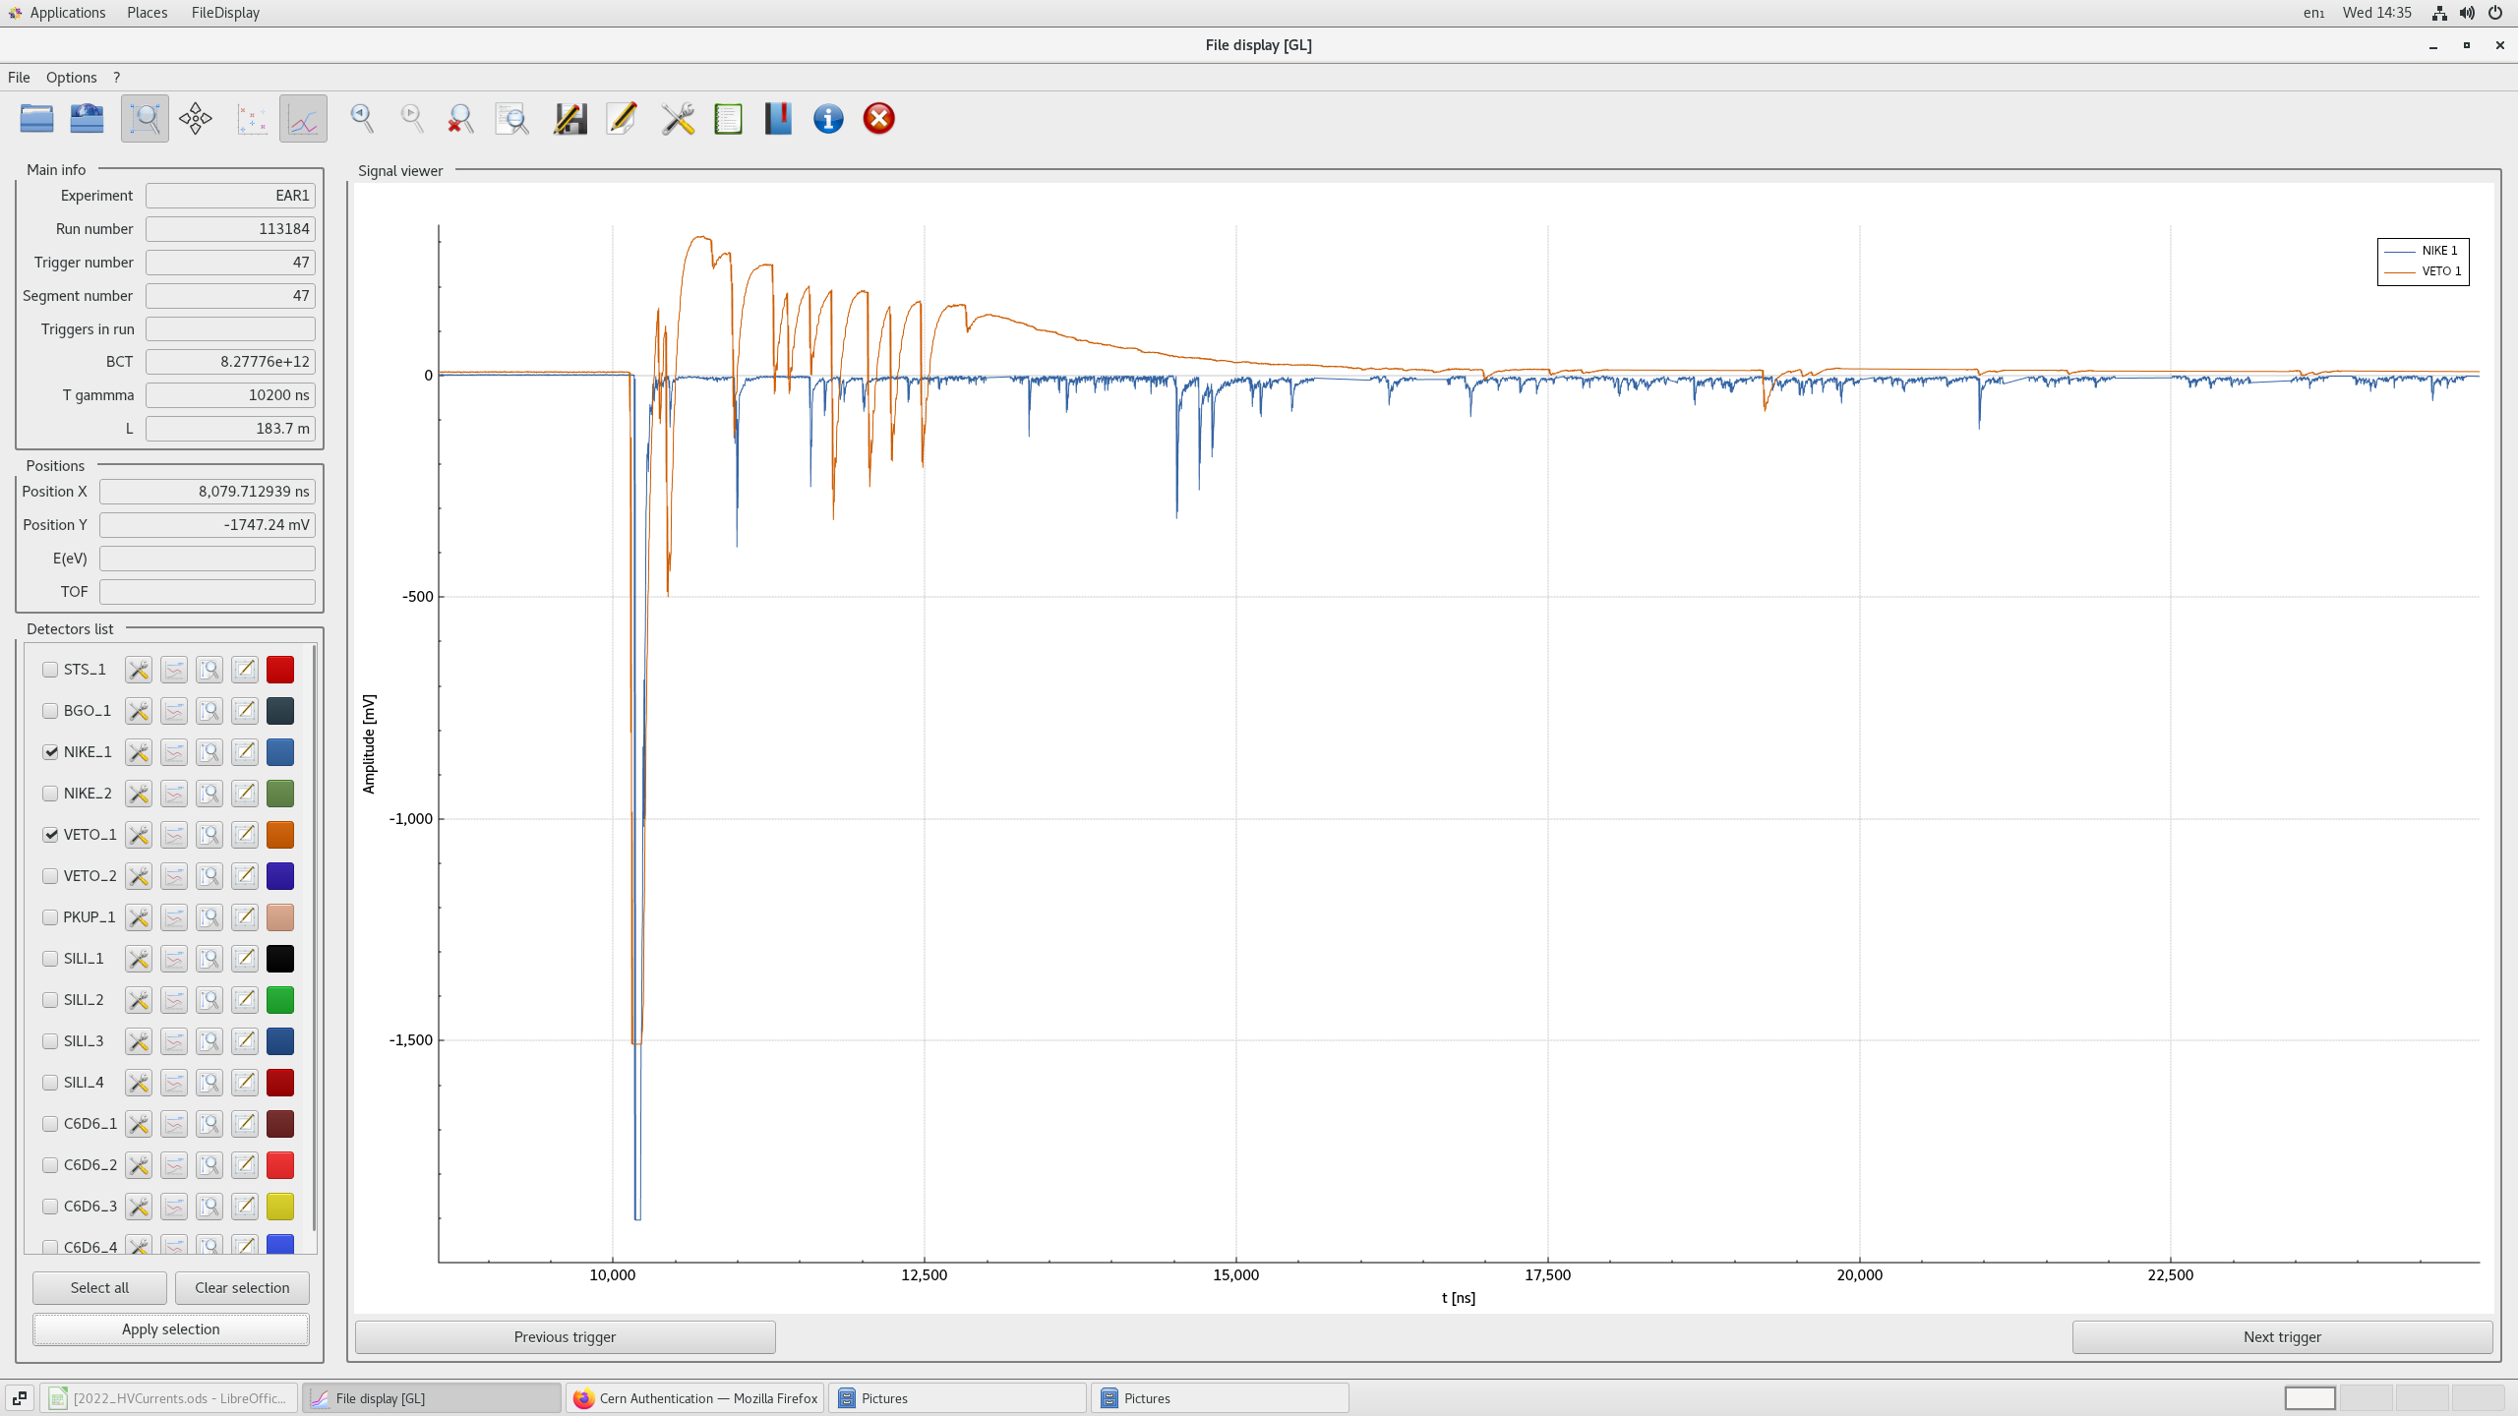
Signals: Gain issue
Slight improvement
of the response!
19

Slide 20
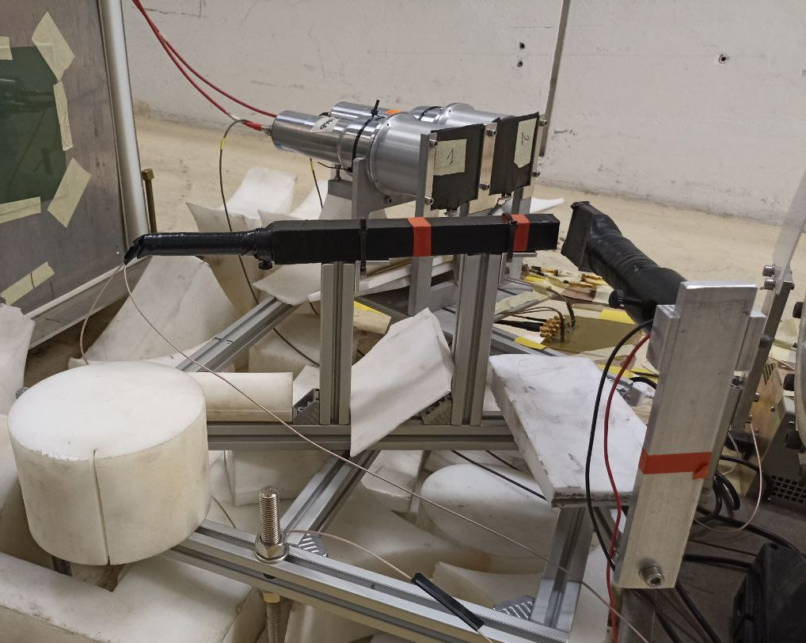
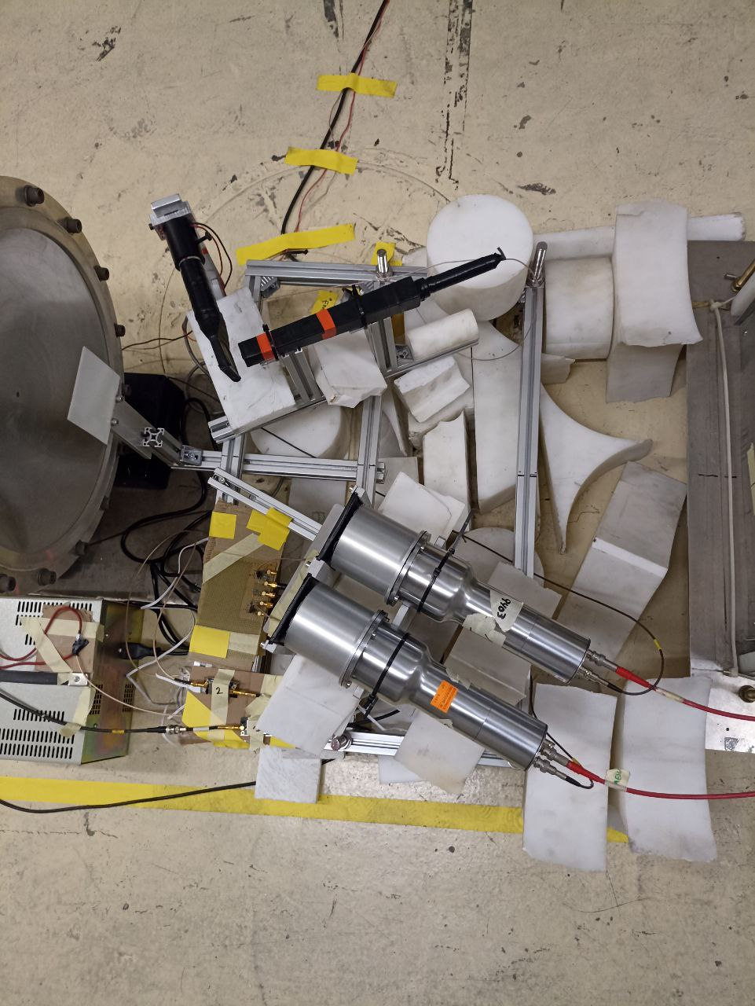
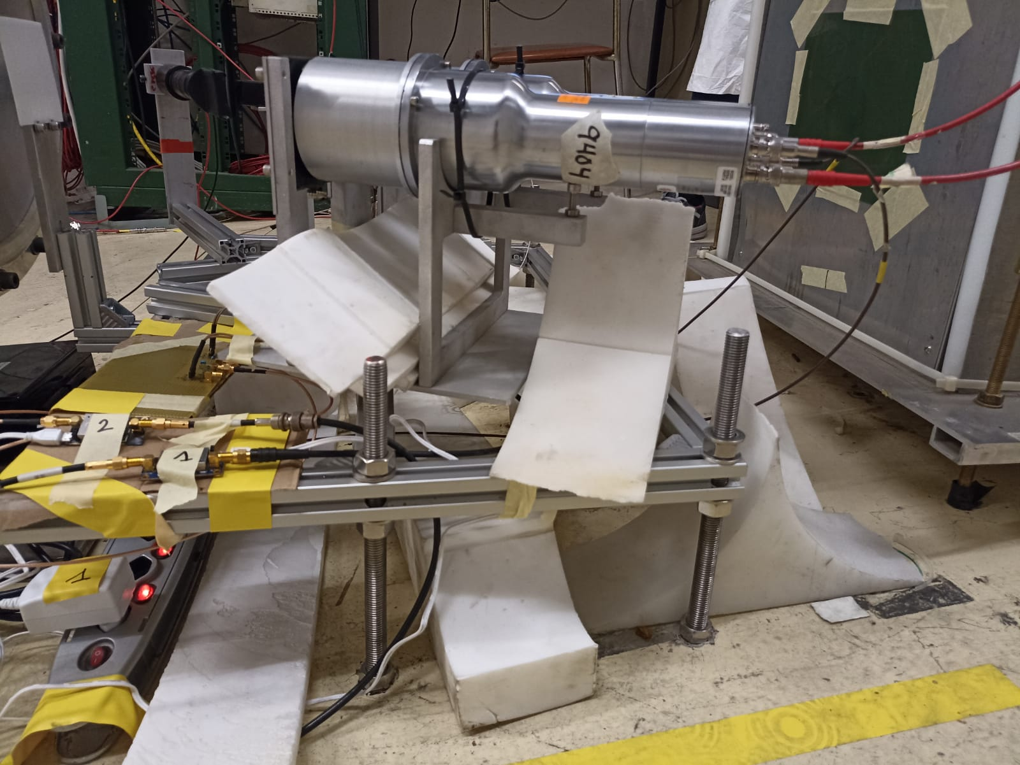
Setup: shielding from background
Many people concerned w/ background from scattered neutrons
Added PE and boron- doped PE blocks to shield from the floor
Impact still to be evaluated!
20

Slide 21

Conclusions
New FOOT neutron detectors under study at n_TOF
Particle discrimination capabilities with radioactive sources
Neutron detection efficiency with neutron beam
~ 2 months total acquisition time foreseen
(1 month PE + 1 month C)
First beam on 17th May!!
First analysis results incoming as soon as possible!
21

Slide 22
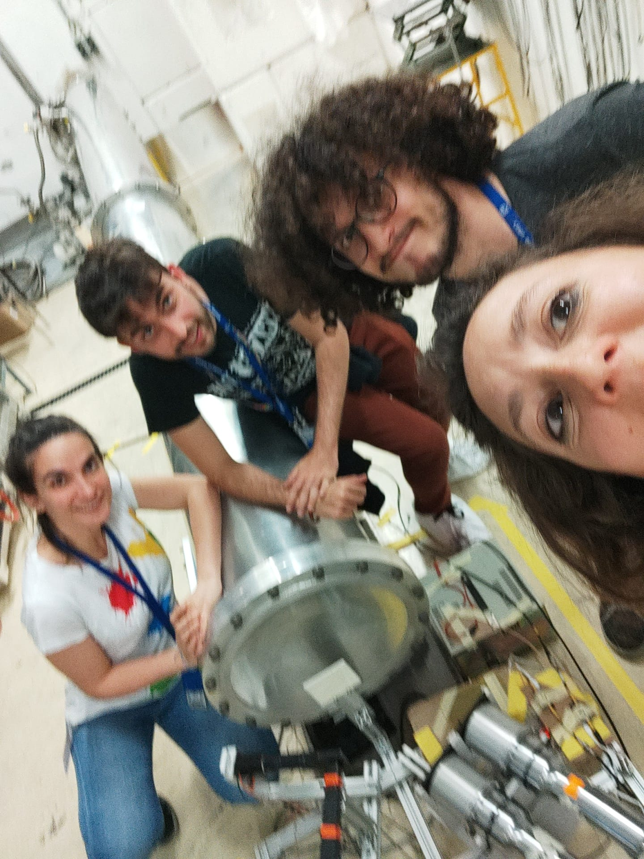

Thank you for your attention

Slide 23
Backup slides

Slide 24
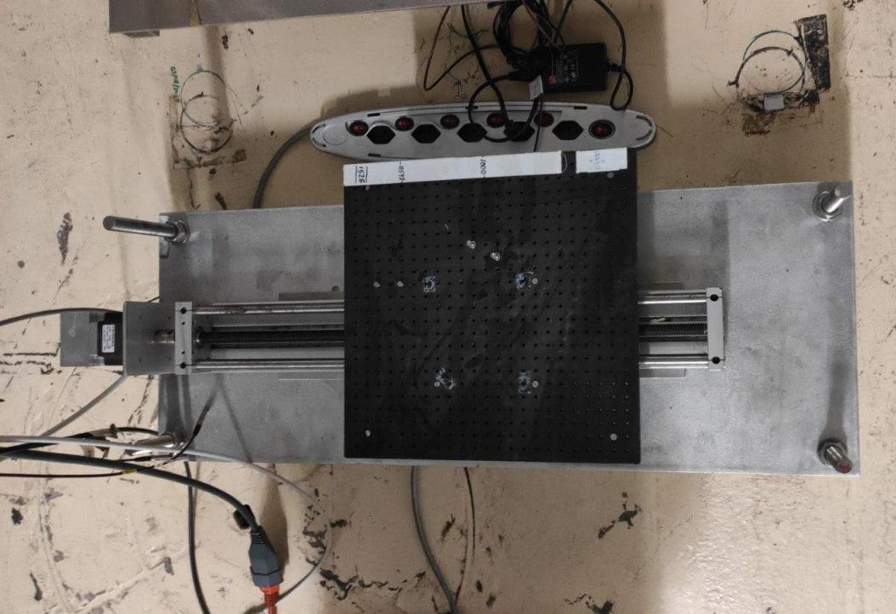
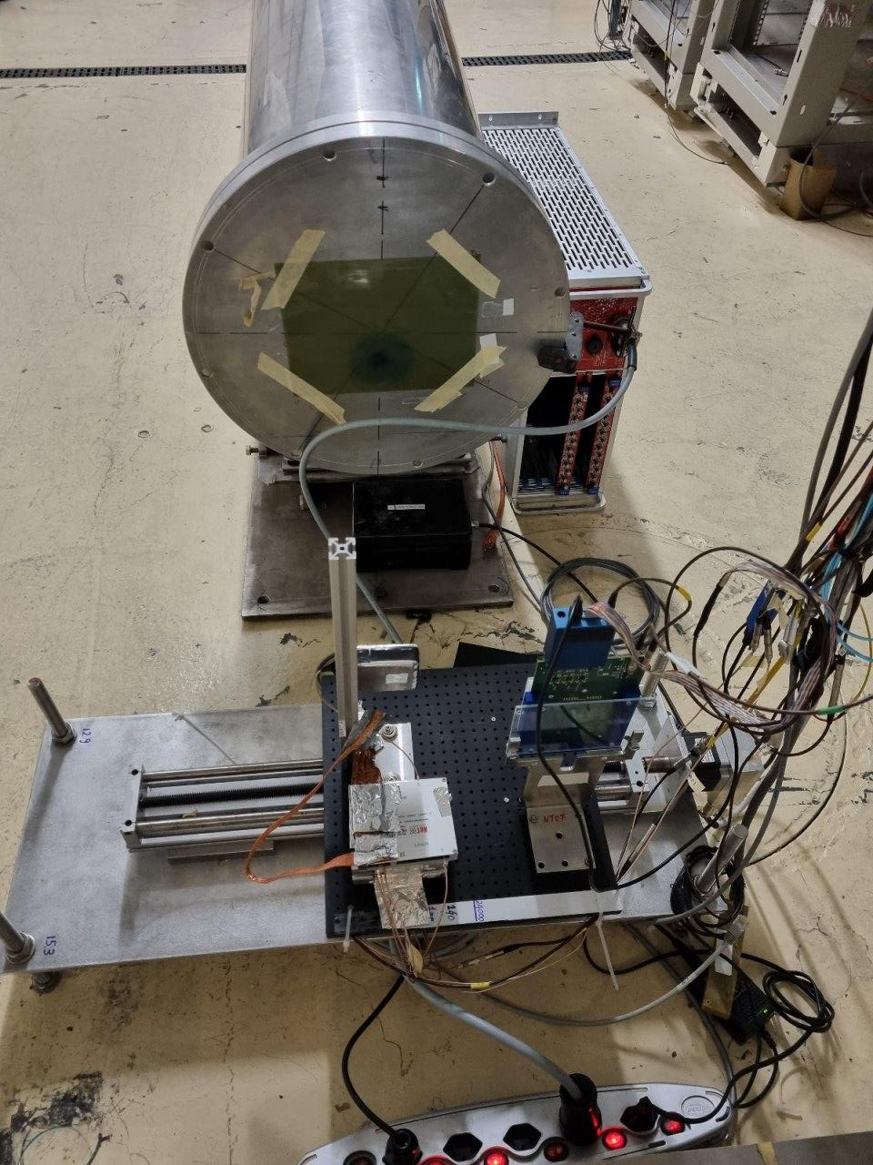
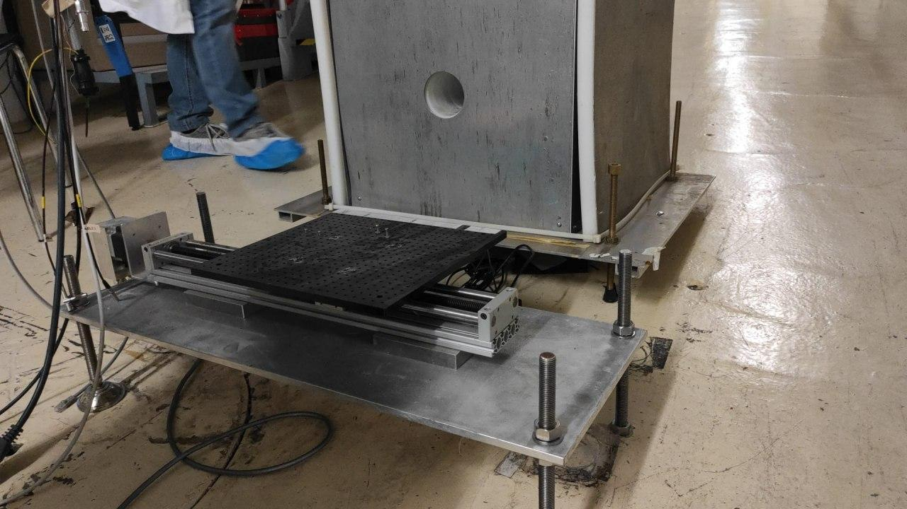
Beam dump

