Slide 1




The FOOT experiment:
A first measurement of nuclear fragmentation cross-sections for hadrontherapy
Giacomo Ubaldi
  Università di Bologna
  INFN Bologna
108° Congresso Nazionale SIF, Milano
15/09/2022

Slide 2






Hadrontherapy
tumor
Hadrontherapy vs radiotherapy:
Finite range
Localized dose profile
Spare of healthy tissues
Nuclear Fragmentation
1
108° Congresso Nazionale SIF, Milano
Giacomo Ubaldi

Slide 3

The FOOT experiment
Goal:
double differential nuclear cross section measurements with uncertainty < 5%
Fixed target collisions
Beam energies between 200 MeV/u and 700 MeV/u for hadrontherapy and space radioprotection topics
table top setup to be moved according to beam facility availability
z
BEAM
2
108° Congresso Nazionale SIF, Milano
Giacomo Ubaldi

Slide 4
The FOOT experiment
Goal:
double differential nuclear cross sections mesurements with uncertainty < 5%
Particle identification by measuring all kinematic quantities
Beam
monitor
Target
Start Counter
z
BEAM
Pre-target region
2
108° Congresso Nazionale SIF, Milano
Giacomo Ubaldi

Slide 5
The FOOT experiment
Goal:
double differential nuclear cross sections mesurements with uncertainty < 5%
Particle identification by measuring all kinematic quantities
Vertex
Tracker
Inner
Tracker
Microstrip Silicon
Detector
z
BEAM
Permanent
Magnets
Tracking region
2
108° Congresso Nazionale SIF, Milano
Giacomo Ubaldi

Slide 6
The FOOT experiment
Goal:
double differential nuclear cross sections mesurements with uncertainty < 5%
Particle identification by measuring all kinematic quantities
ToF Wall
Calorimeter
z
BEAM
Downstream region
2
108° Congresso Nazionale SIF, Milano
Giacomo Ubaldi

Slide 7


GSI 2021 Analysis
Data-taking at GSI (Darmstadt, Germany) in 2021
¹⁶O 400 MeV/u on 5 mm C target
Partial setup: no magnet, only one module of calorimeter
TW
MSD
BM
VTX
SC
CALO
TG
Specific goal:
Elemental (charge differential) fragmentation cross section
Angular differential cross section in charge
3
108° Congresso Nazionale SIF, Milano
Giacomo Ubaldi

Slide 8
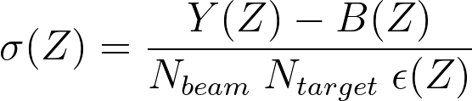
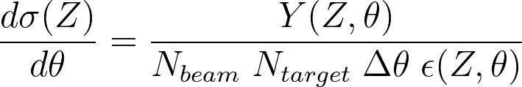
Analysis procedure
To compute elemental cross-section:
Starting from MC dataset to study Background and Efficiency from true values
4
108° Congresso Nazionale SIF, Milano
Giacomo Ubaldi
108° Congresso Nazionale SIF, Milano

Slide 9
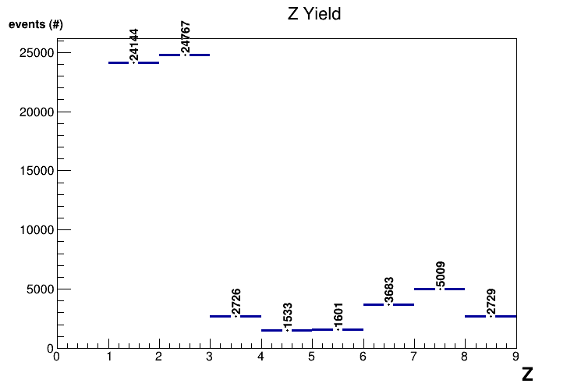
Analysis procedure
To compute elemental cross-section:
Yield of Z obtained from reconstructed tracks
    Exploiting charge reconstruction algorithm
    Exploiting tracking reconstruction algorithm
    Simulating a “trigger” in order to consider
    only fragments
5
108° Congresso Nazionale SIF, Milano
Giacomo Ubaldi

Slide 10
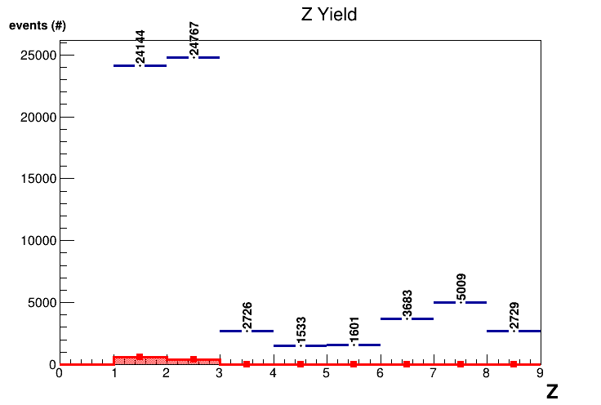
Analysis procedure
To compute elemental cross-section:
Background obtained from MC cuts on:
    Charge algorithm mis-reconstruction
    Tracking algorithm mis-reconstruction
    Trigger mis-reconstruction
6
108° Congresso Nazionale SIF, Milano
Giacomo Ubaldi

Slide 11
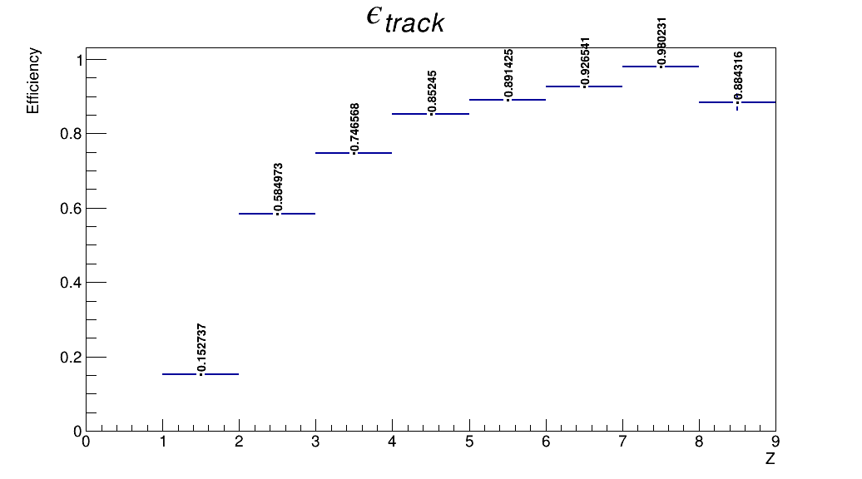
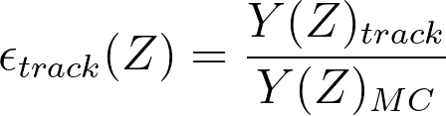
Analysis procedure
To compute elemental cross-section:
Efficiency obtained as:
where track is obtained by tracking algorithm
MC particles are from the generated simulation
7
108° Congresso Nazionale SIF, Milano
Giacomo Ubaldi

Slide 12
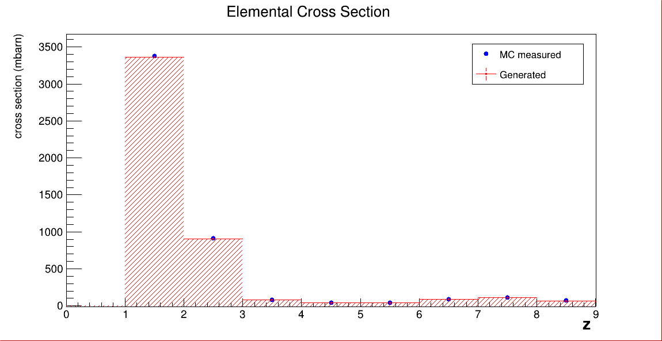
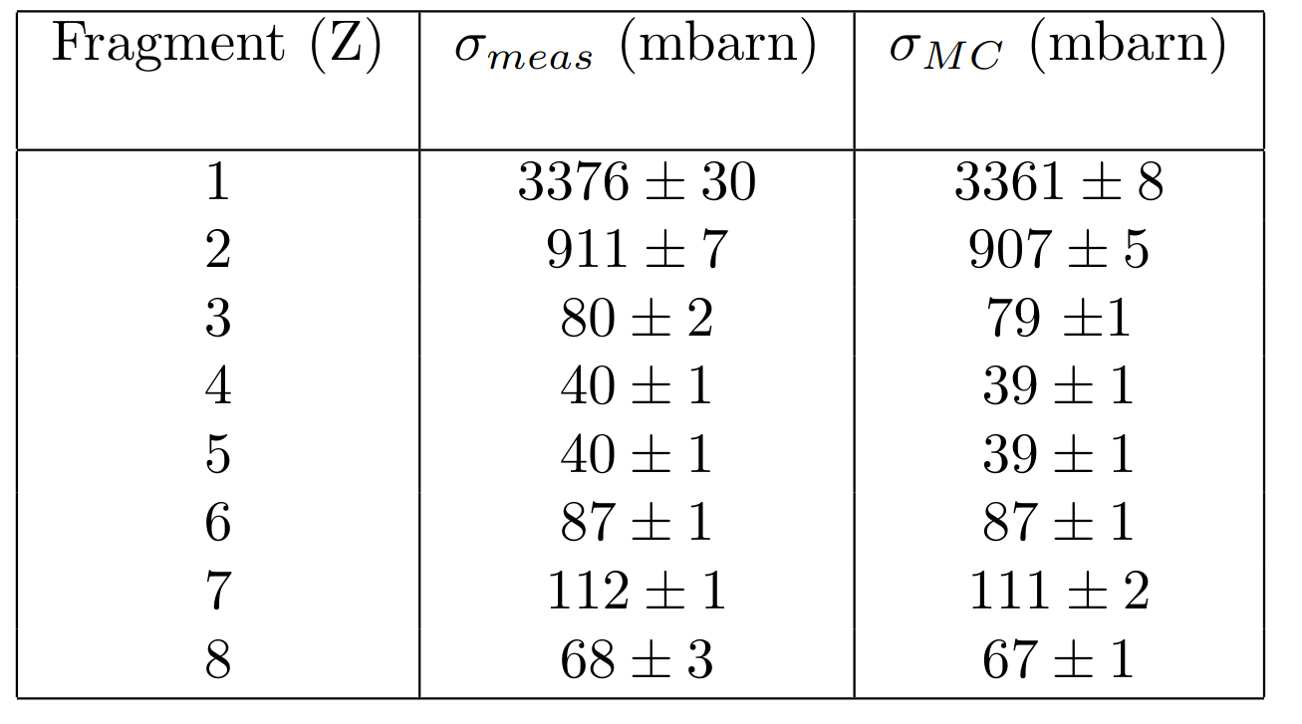
Elemental fragmentation cross-section
Smeared MC dataset used as Yield
Statistical uncertainties only
Z
H
He
Li
Be
B
C
N
O
8
108° Congresso Nazionale SIF, Milano
Giacomo Ubaldi
108° Congresso Nazionale SIF, Milano 15/09/2022

Slide 13
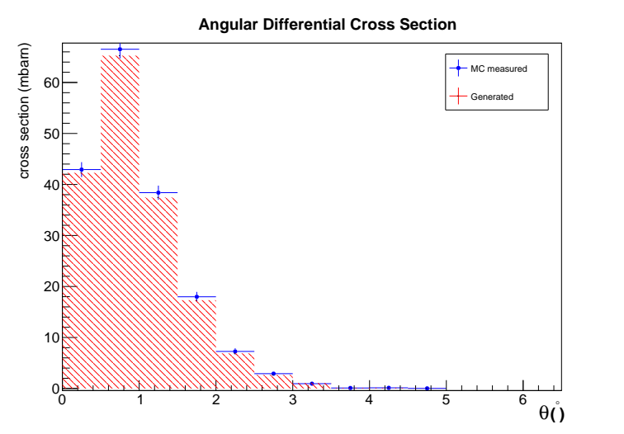
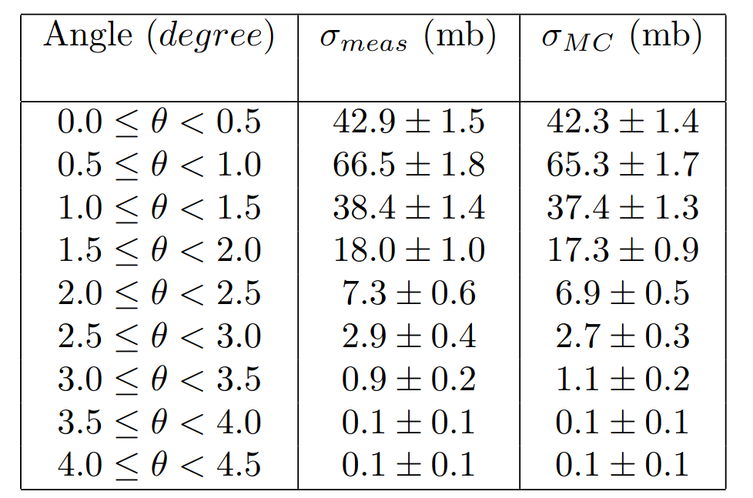
Angular differential cross-section
An analogous procedure has been followed to obtain angular differential cross section:
Z=6
Differential cross section (mb / degree)
θ (degree)
9
108° Congresso Nazionale SIF, Milano
Giacomo Ubaldi

Slide 14
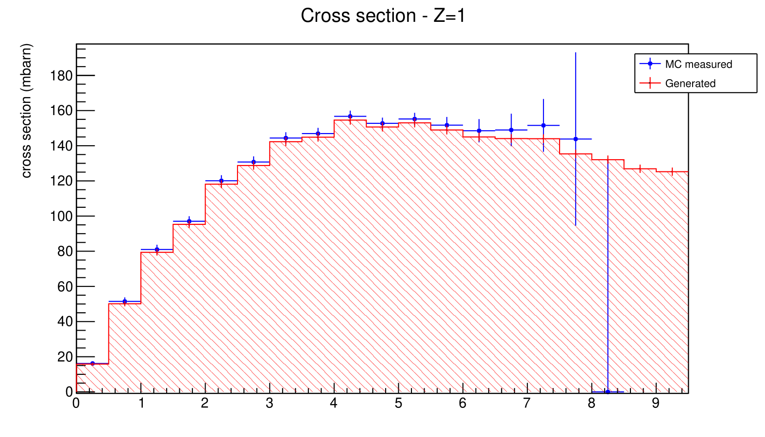
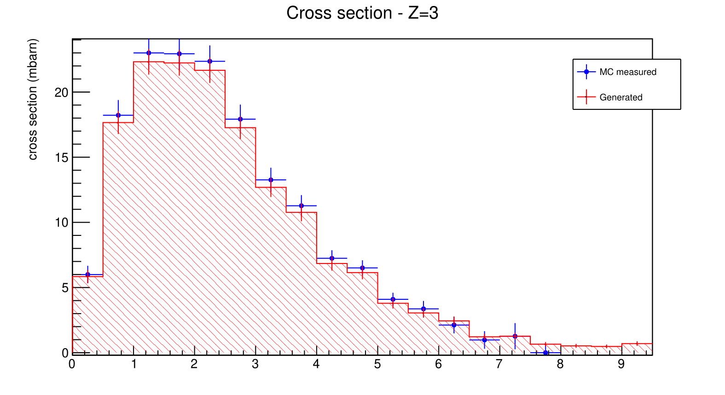
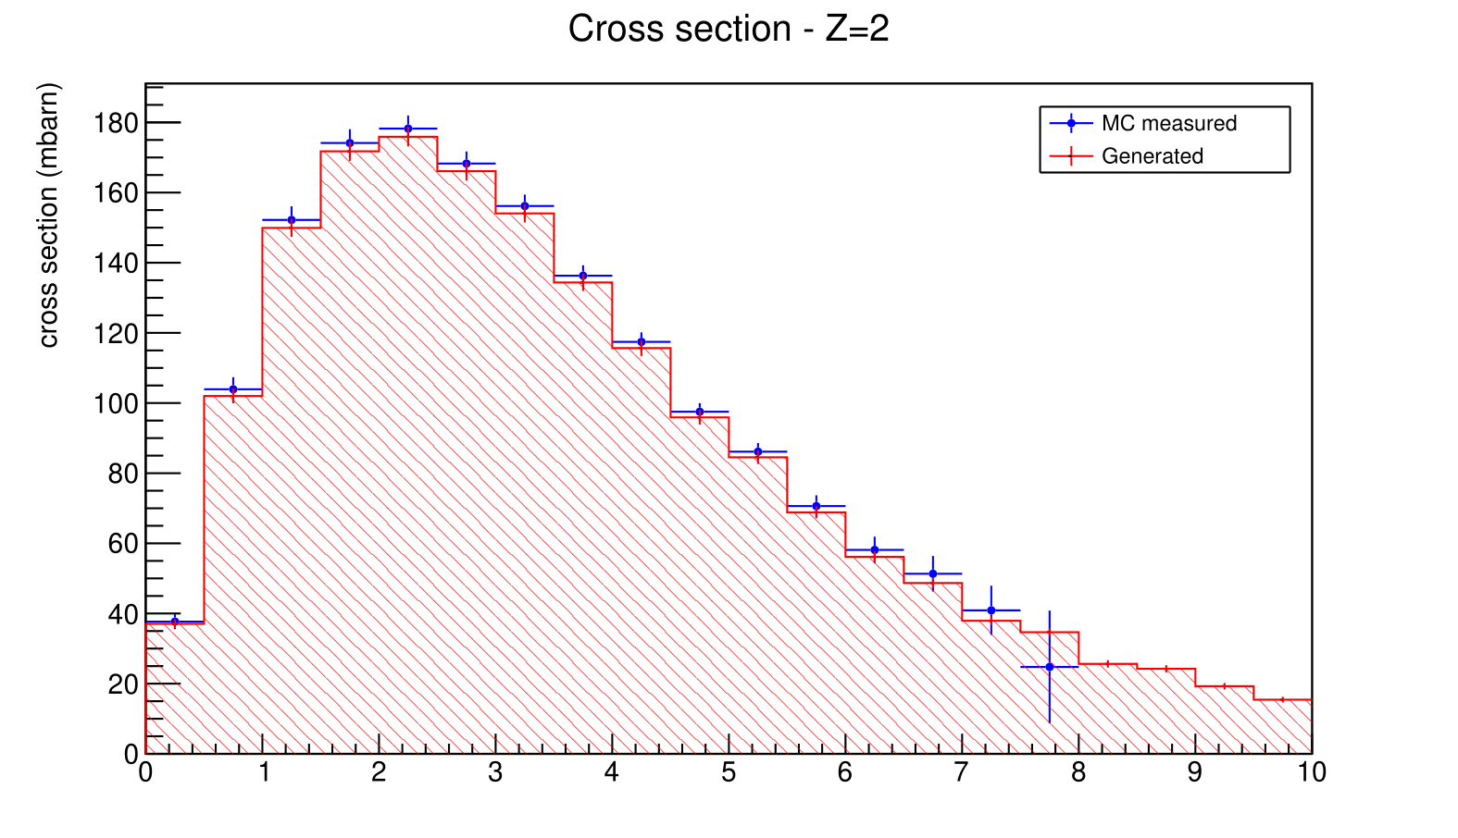
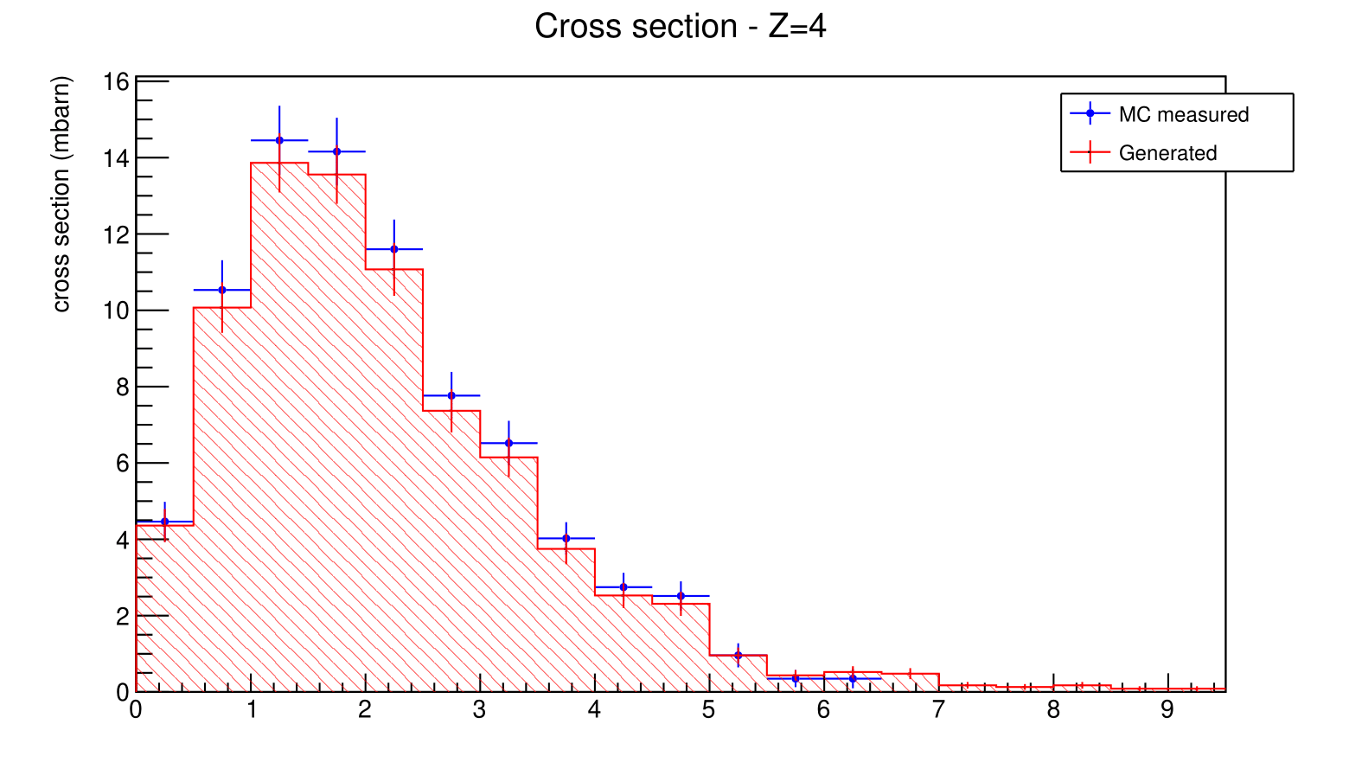
Angular differential cross-section
Z=1
Differential cross section (mb / degree)
Z=3
Differential cross section (mb / degree)
Differential cross section (mb / degree)
θ (degree)
θ (degree)
Z=2
Z=4
Differential cross section (mb / degree)
Differential cross section (mb / degree)
10
θ (degree)
θ (degree)
θ (°)

Slide 15
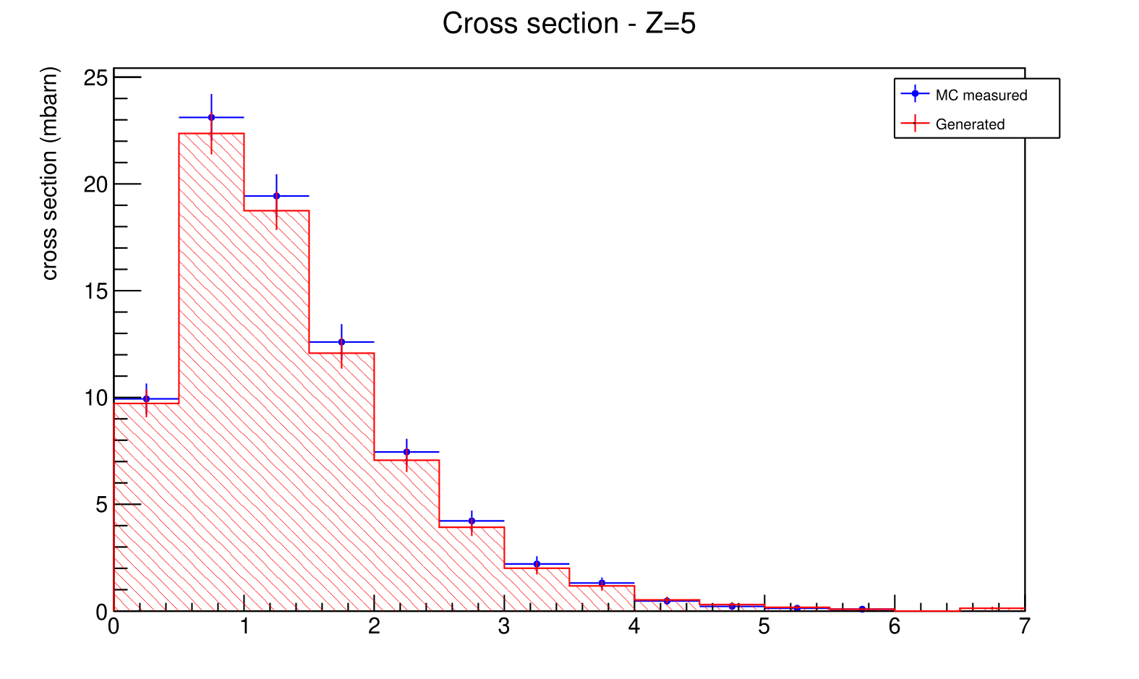
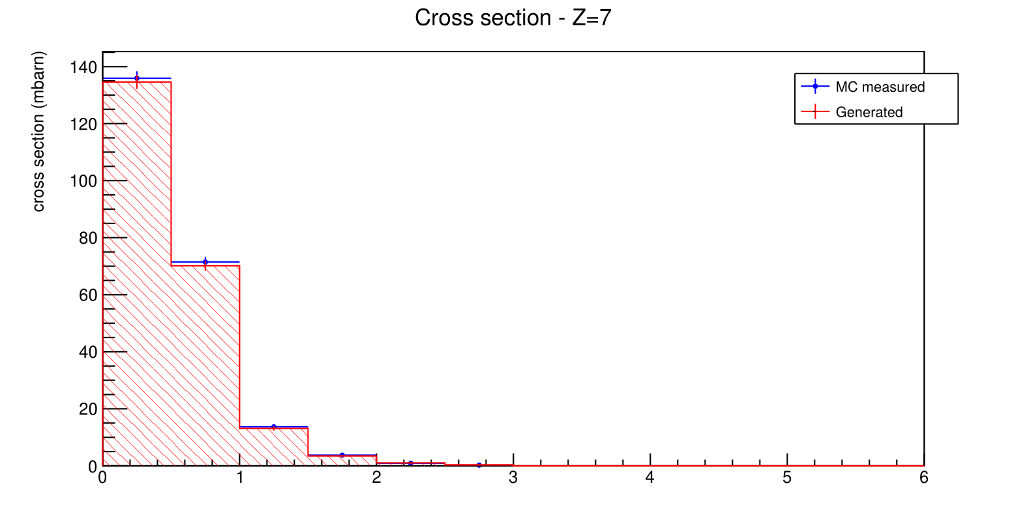
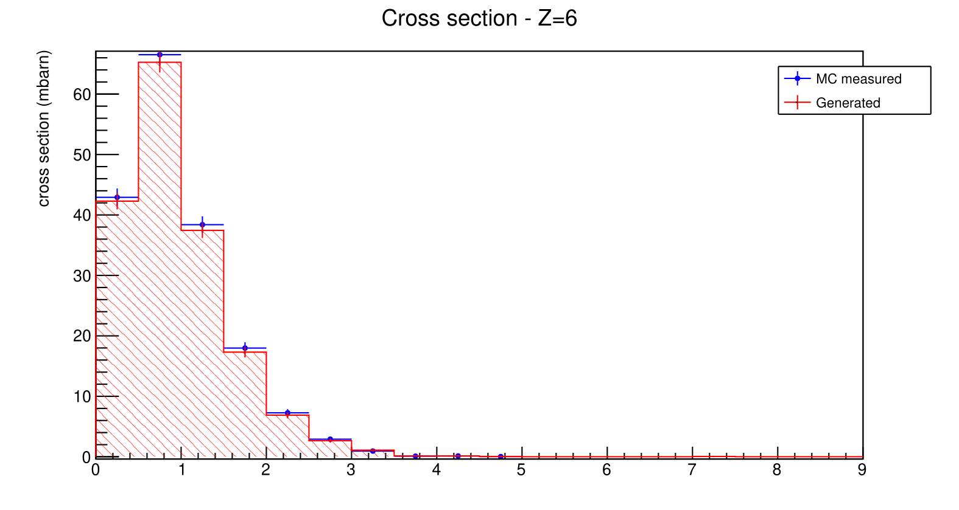
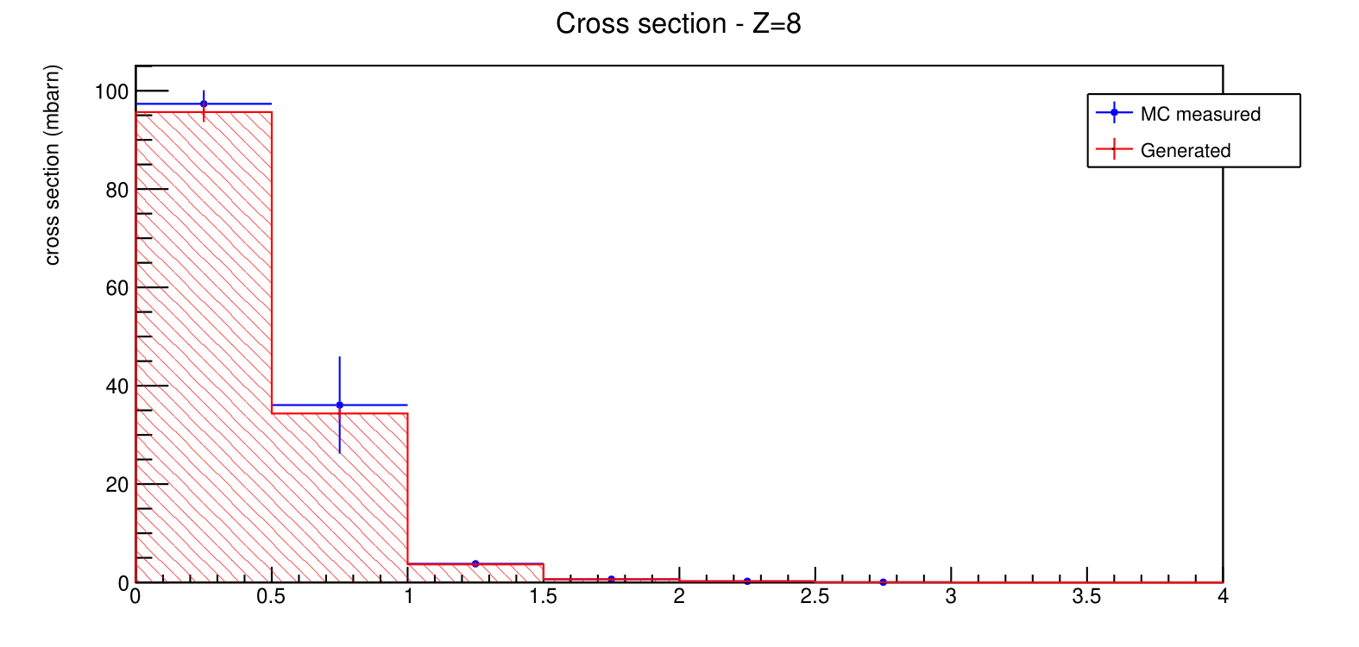
Angular differential cross-section
Z=5
Z=5
Z=7
Differential cross section (mb / degree)
Differential cross section (mb / degree)
θ (degree)
θ (degree)
Z=6
Z=8
Differential cross section (mb / degree)
Differential cross section (mb / degree)
11
θ (degree)
θ (degree)

Slide 16

Conclusions
First preliminary results of cross sections based on MC events with a solid closure test
Study of background sources, corrections and efficiencies on MC level
Low impact of statistic fluctuations
To do:
Preliminary systematics uncertainties
Including unfolding to correct for migrations
Process real data
Evaluating cross section differential also in kinematic energy and in mass
Repeat the same steps for ¹⁶O 200 MeV/u
Thank you for the attention!
12
108° Congresso Nazionale SIF, Milano
Giacomo Ubaldi

