Slide 1

ANALYSIS OF FRAGMENTATION CROSS SECTIONS
OF GSI 2021 DATA
FOR THE FOOT EXPERIMENT
Alma Mater Studiorum - Università di Bologna
Submitted by:
Giacomo Ubaldi
Supervisor:
Prof. Matteo Franchini
Co-supervisors:
Dr. Riccardo Ridolfi
Dr. Roberto Zarrella
28/10/2022

Slide 2


Hadrontherapy
1
108° Congresso Nazionale SIF, Milano
Giacomo Ubaldi
15

Slide 3


Hadrontherapy
tumor
Hadrontherapy vs radiotherapy:
Finite range
Localized dose profile
Spare of healthy tissues
1
Giacomo Ubaldi
15

Slide 4

Hadrontherapy
tumor
Hadrontherapy vs radiotherapy:
Finite range
Localized dose profile
Spare of healthy tissues
1
Giacomo Ubaldi
15

Slide 5

Hadrontherapy
tumor
Hadrontherapy vs radiotherapy:
Finite range
Localized dose profile
Spare of healthy tissues
Nuclear Fragmentation
1
Giacomo Ubaldi
15

Slide 6


The FOOT experiment
Goal:
double differential nuclear cross section measurements with uncertainty < 5%
Fixed target collisions
Beam energies between 200 MeV/u and 700 MeV/u for hadrontherapy and space radioprotection topics
table top setup to be moved according to beam facility availability
z
BEAM
2
Giacomo Ubaldi
15

Slide 7
The FOOT experiment
Goal:
double differential nuclear cross sections mesurements with uncertainty < 5%
Particle identification by measuring all kinematic quantities
Beam
monitor
Target
Start Counter
z
BEAM
Pre-target region
2
Giacomo Ubaldi
15

Slide 8
The FOOT experiment
Goal:
double differential nuclear cross sections mesurements with uncertainty < 5%
Particle identification by measuring all kinematic quantities
Vertex
Tracker
Inner
Tracker
Microstrip Silicon
Detector
z
BEAM
Permanent
Magnets
Tracking region
2
Giacomo Ubaldi
15

Slide 9
The FOOT experiment
Goal:
double differential nuclear cross sections mesurements with uncertainty < 5%
Particle identification by measuring all kinematic quantities
ToF Wall
Calorimeter
z
BEAM
Downstream region
2
Giacomo Ubaldi
15

Slide 10


GSI 2021 Analysis
Data-taking at GSI (Darmstadt, Germany) in 2021
¹⁶O 400 MeV/u on 5 mm C target
Partial setup: no magnet, only one module of calorimeter
TW
MSD
BM
VTX
SC
CALO
TG
Specific goal:
Elemental (charge differential) fragmentation cross section
Angular differential cross section in charge
3
Giacomo Ubaldi
15

Slide 11
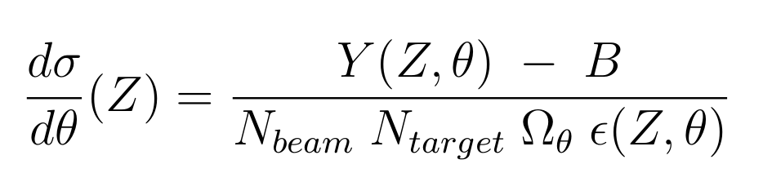
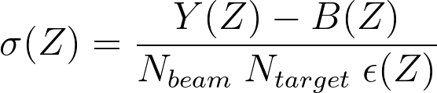
Analysis procedure
To compute elemental cross section and angular differential cross section:
Starting from a MC dataset of 10⁶ events generated by FLUKA to simulate detectors and beams
of GSI 2021 campaign.
4
Giacomo Ubaldi

Slide 12
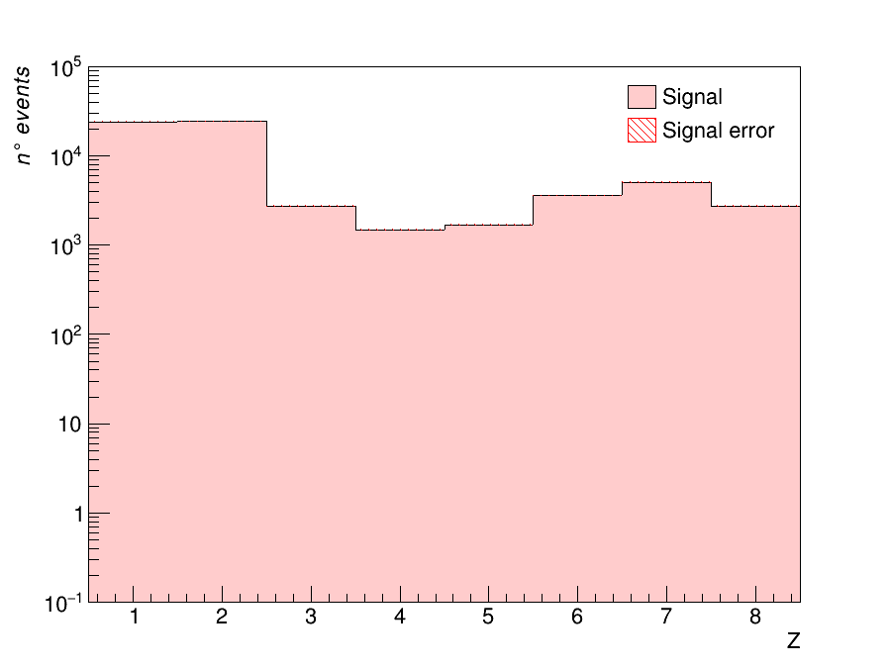
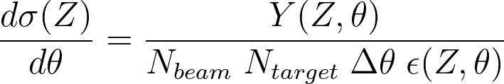
Analysis procedure
Z yield of all fragments
2) Yield of Z obtained from reconstructed tracks
    Exploiting charge reconstruction algorithm
    Exploiting tracking reconstruction algorithm
    Simulating a “trigger” in order to consider
    only fragments
5
Giacomo Ubaldi

Slide 13
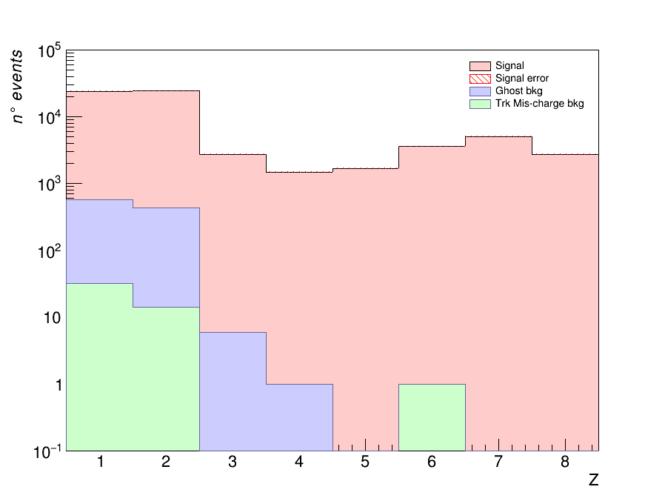
Analysis procedure
Z yield of all fragments
Z yield and Bkg sources
3) Background obtained from MC cuts on:
    Charge algorithm mis-reconstruction
    Tracking algorithm mis-reconstructio
5
Giacomo Ubaldi

Slide 14
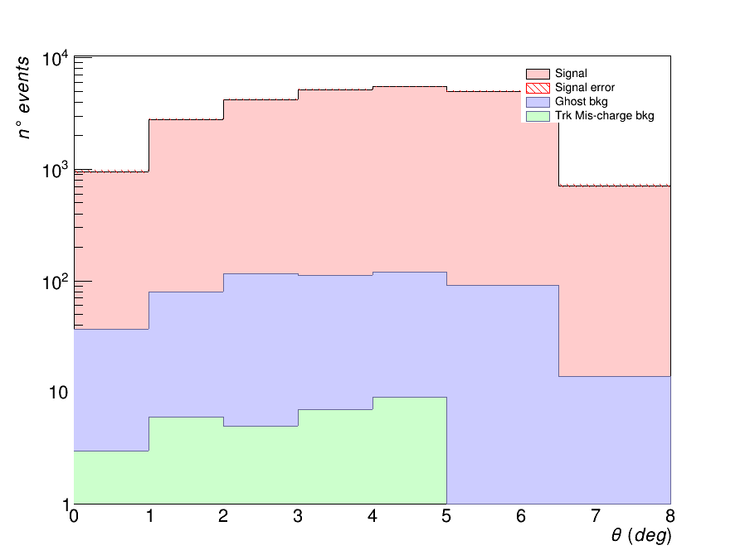
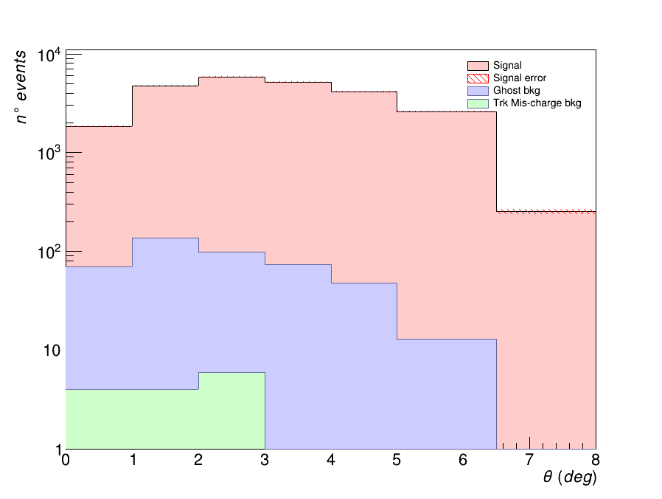
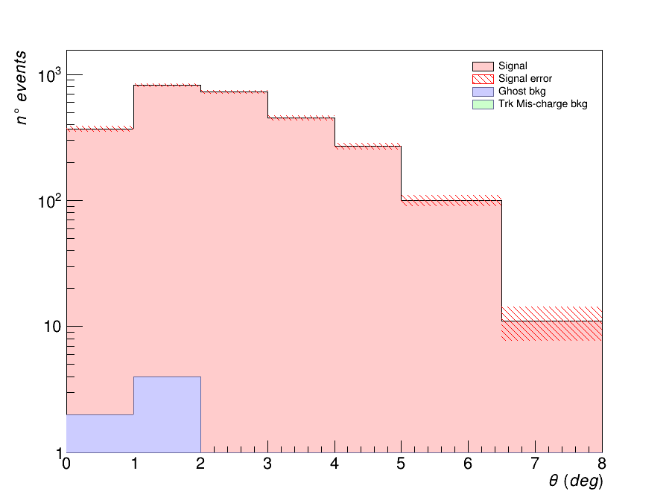
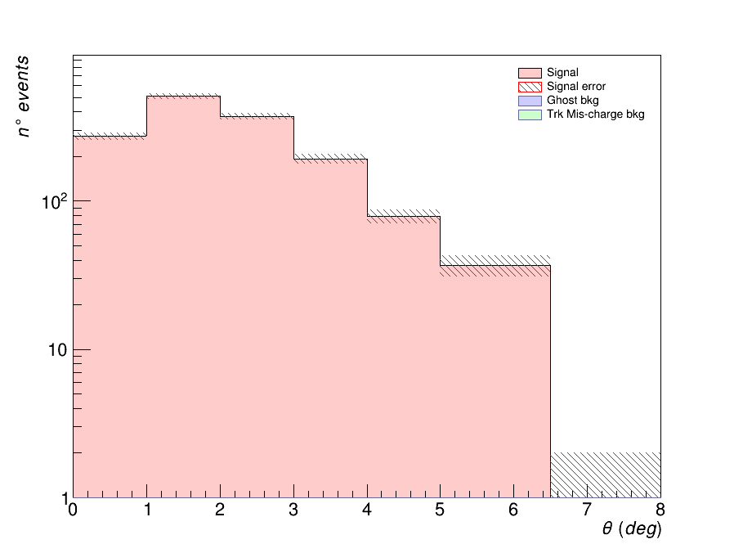
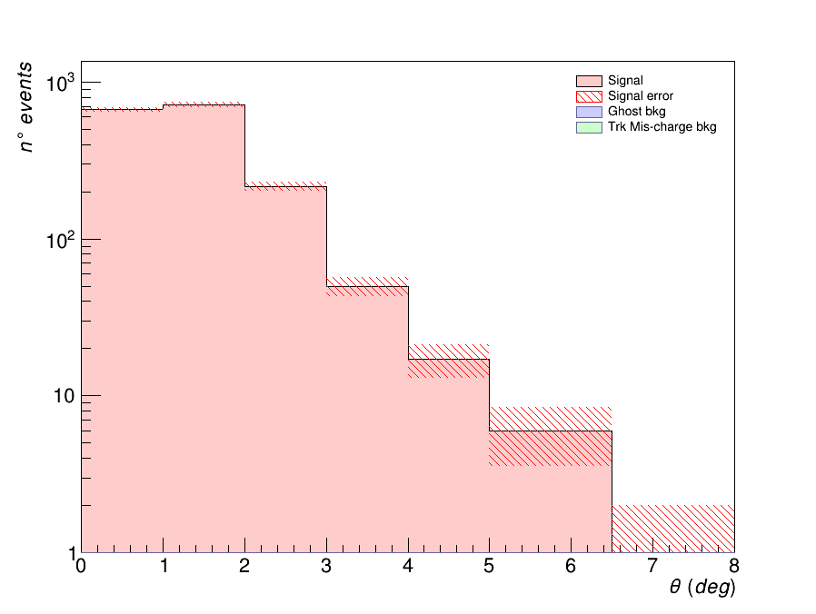
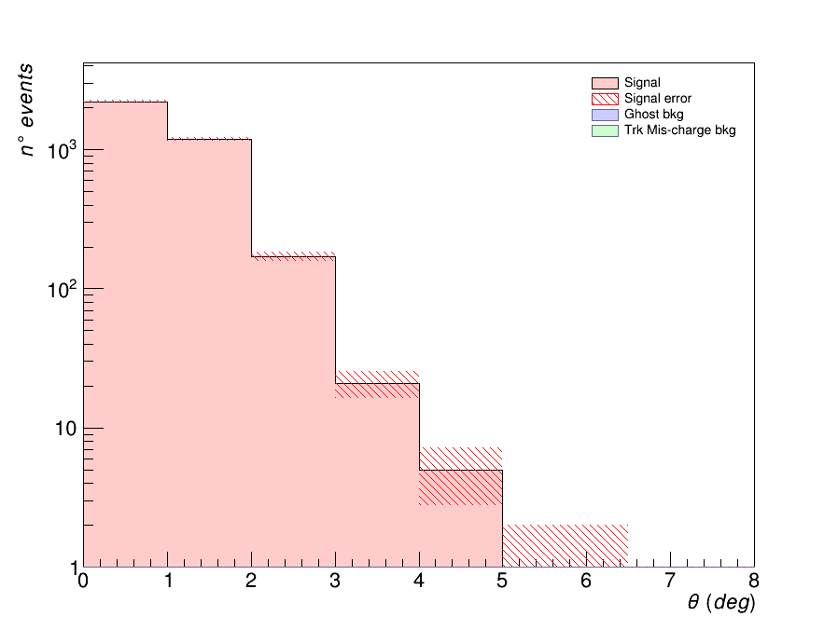
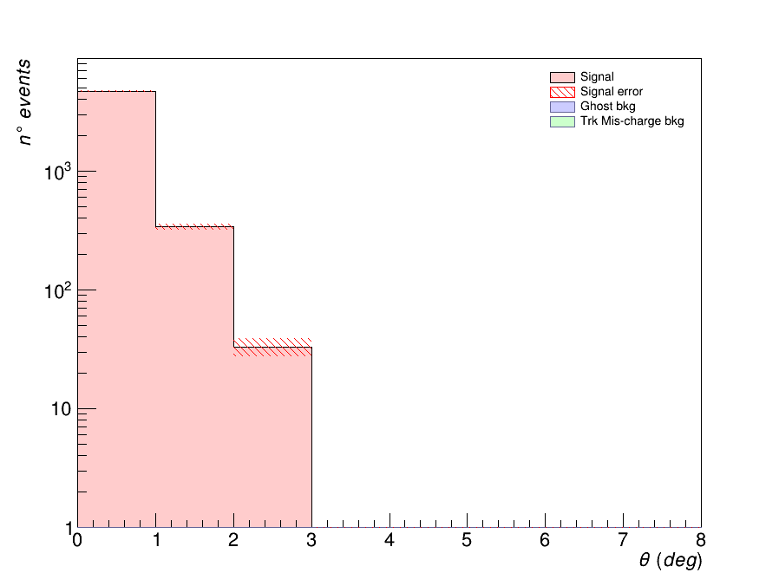
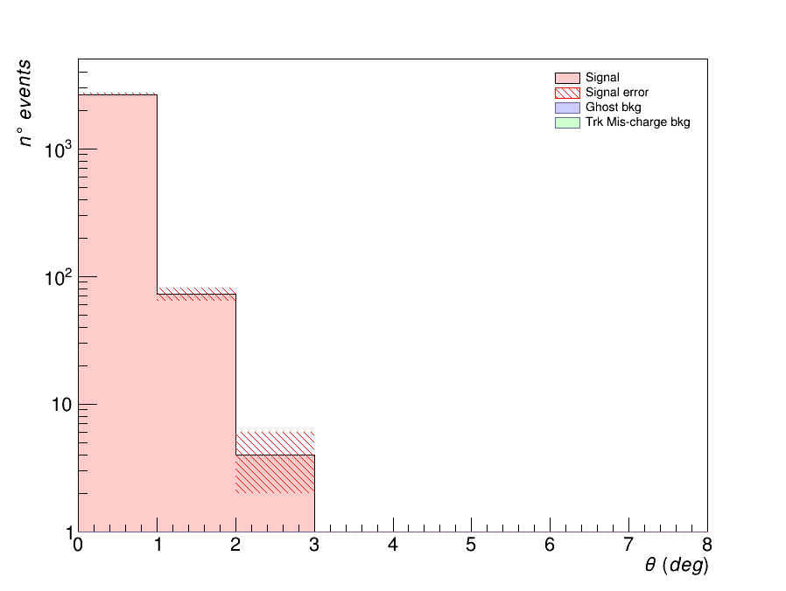
Analysis procedure
5

Slide 15
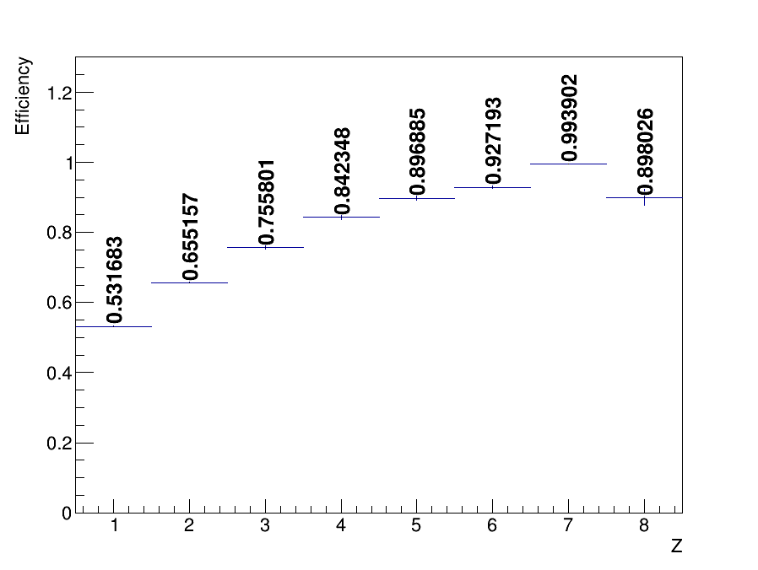
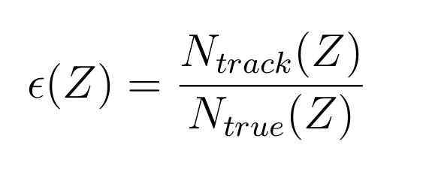
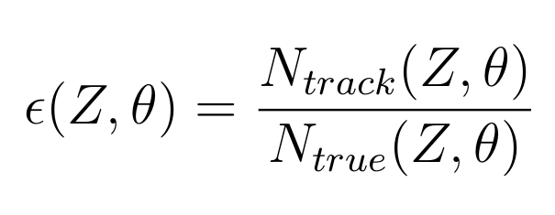
Analysis procedure
Fiducial Track efficiency
4) Track efficiency obtained as:
where track is obtained by tracking algorithm
MC particles are from the generated simulation
7
Giacomo Ubaldi

Slide 16
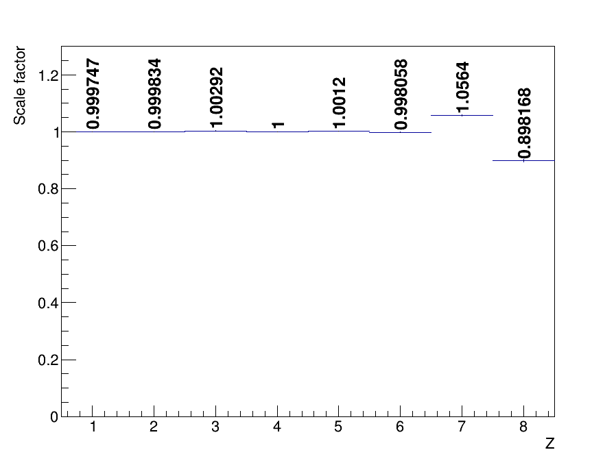
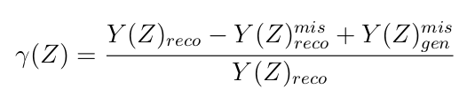
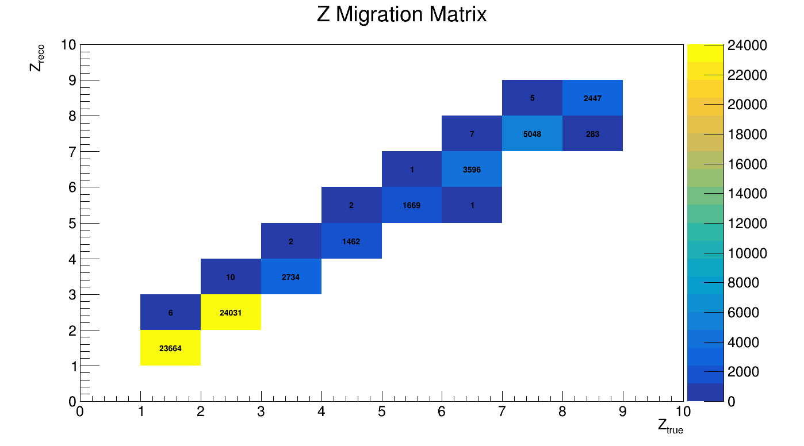
Analysis procedure
4) Migration matrix correction as scale factor:
Scale factor
7
Giacomo Ubaldi

Slide 17
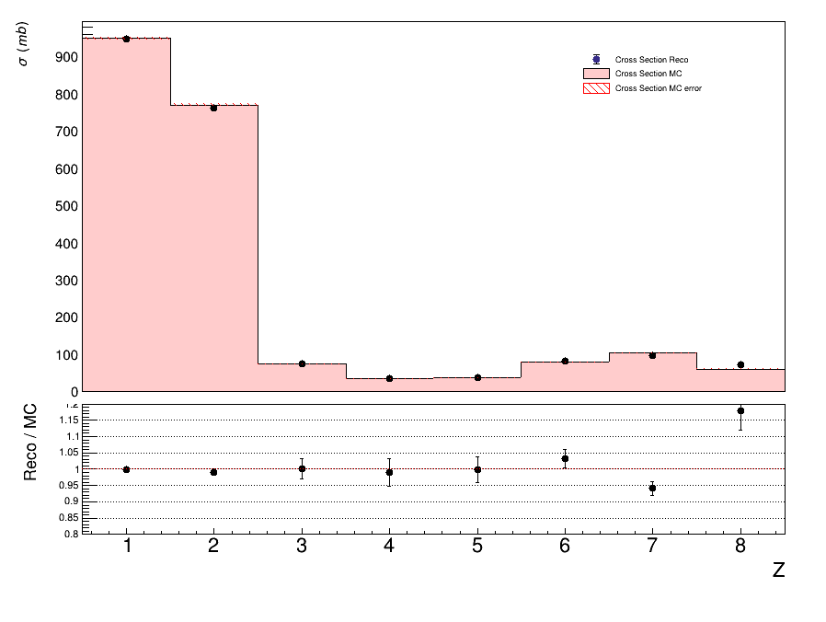
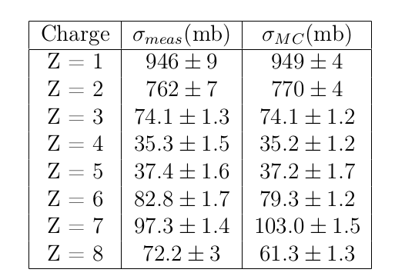
Analysis procedure
4) MC cross section measurement (fiducial θ<8°)
7
Giacomo Ubaldi

Slide 18
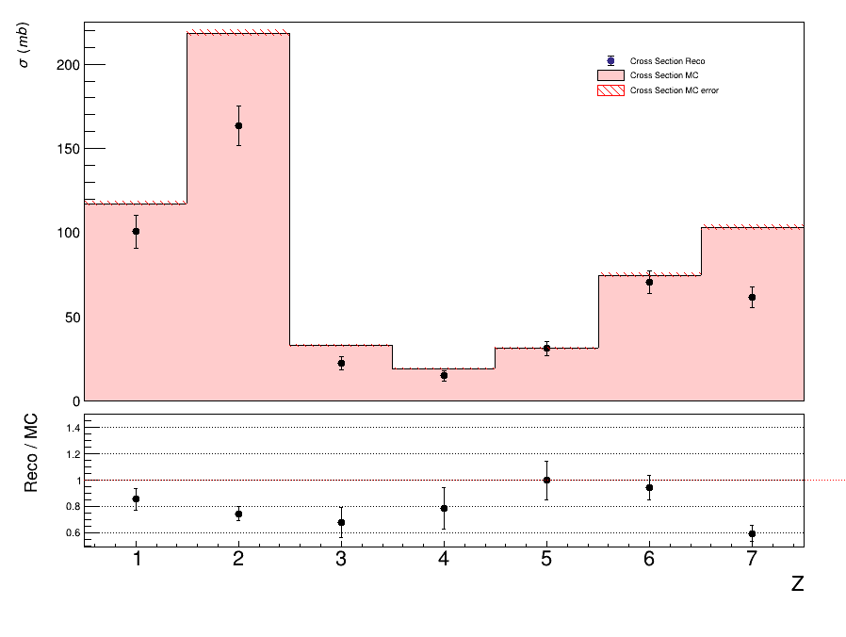
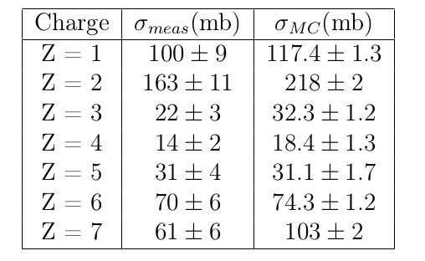
Analysis procedure
4) experimental cross section measurement (fiducial θ<2.5°)
7
Giacomo Ubaldi

Slide 19

Conclusions
First preliminary results of cross sections based on MC events with a solid closure test
Study of background sources, corrections and efficiencies on MC level
Low impact of statistic fluctuations
To do:
Preliminary systematics uncertainties
Including unfolding to correct for migrations
Process real data
Evaluating cross section differential also in kinematic energy and in mass
Repeat the same steps for ¹⁶O 200 MeV/u
Thank you for the attention!
12
Giacomo Ubaldi

Slide 20
Backup slides

Slide 21


Nuclear fragmentation
Proton beam:
~ 200 MeV
Target fragments:
Short range
High energy impact in entrance channel
Carbon beam:
Projectile fragments:
Longer range than beam
Dose beyond the Bragg peak
~ 400 MeV/u
15

Slide 22
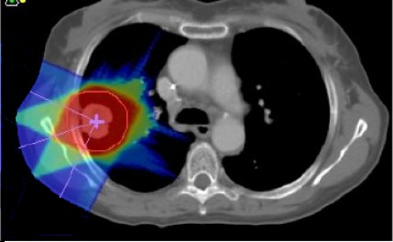

Nuclear fragmentation
Proton beam:
~ 200 MeV
Carbon beam:
Projectile fragments:
Longer range than beam
Dose beyond the Bragg peak
~ 400 MeV/u
nuclear cross section
mesurements needed
15

Slide 23

GSI 2021 Analysis
Data-taking at GSI (Darmstadt, Germany) in 2021
¹⁶O 400 MeV/u and 200 MeV/u on 5 mm C target
Partial setup: no tracker, only one module of calorimeter
Specific goal:
Elemental (charge differential) fragmentation cross section
Angular charge double differential cross section
15

Slide 24
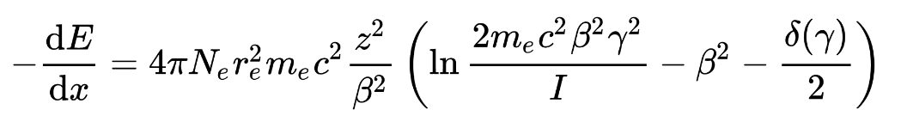

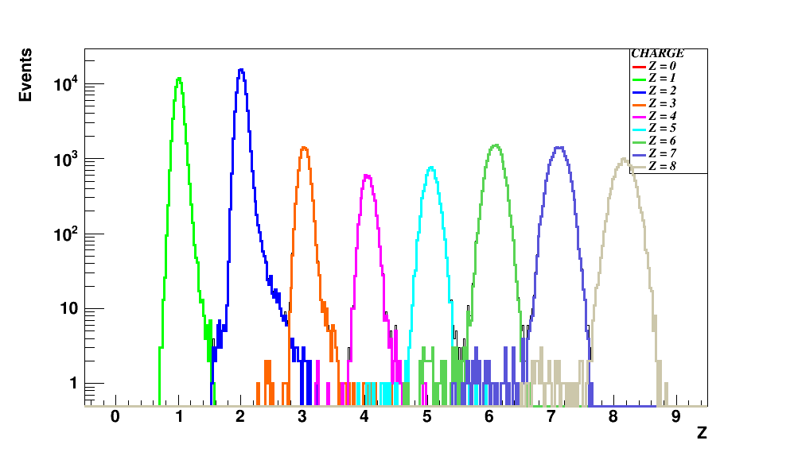
Fragments identification
From Bethe – Bloch formula I can get z:
Infos taken from SC and TW
dE
z=8
z=7
z=6
z=5
z=4
z=3
z=2
z=1
ToF
Charge discrimination
TW charge reconstruction algo

Slide 25
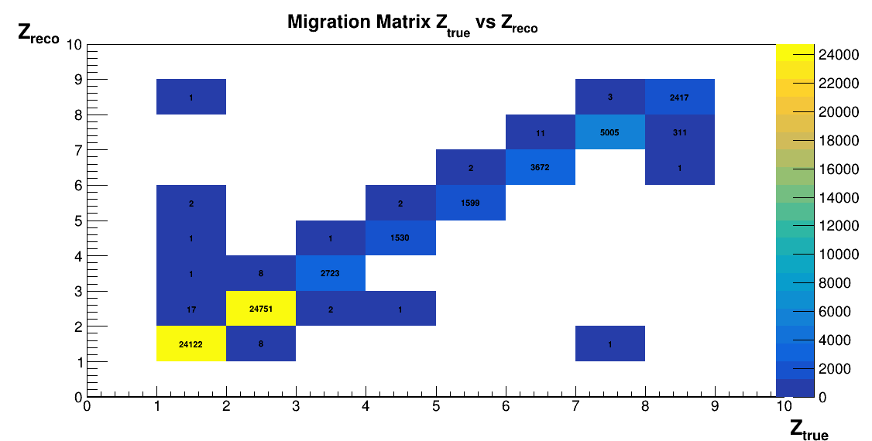
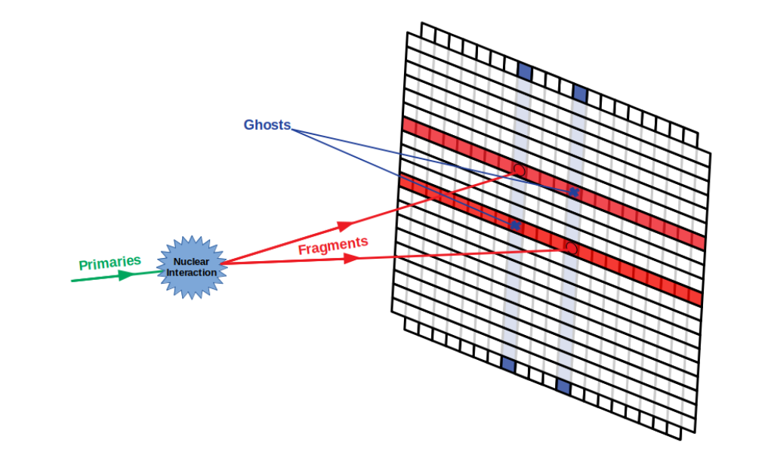
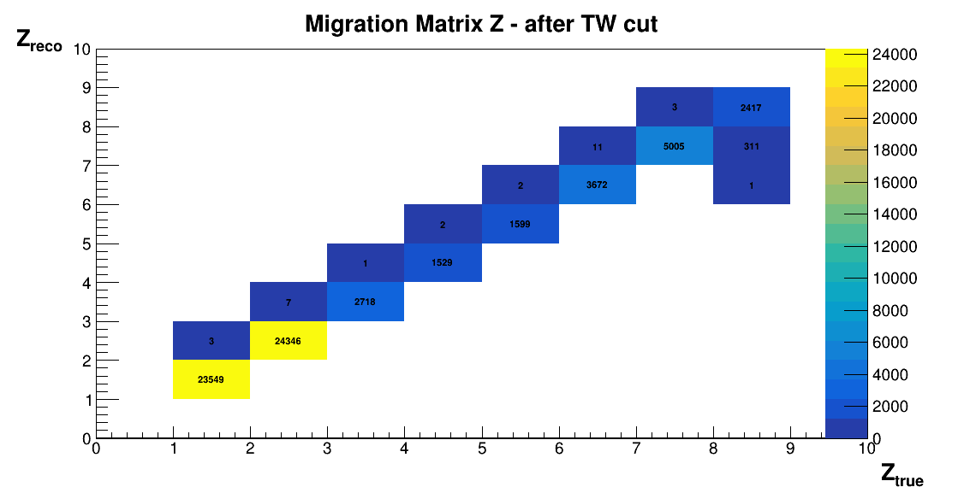
Track reconstruction, TW systematics
It is possible that every bar layer of the TW is hitted by more than a fragment at the same time:
multiple hits / ghost hits systematics
TW
Applying TW cut:

Slide 26


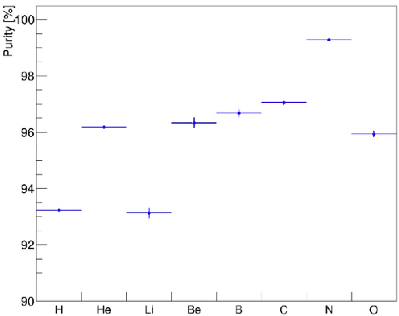
Track reconstruction
TW
MSD
VT
track reconstruction on GSI 2021 data
No B field present
Kalman Filter reconstruction of a track
Start from VT tracklets
Projection to possible planes of IT
KF extrapolation to MSD
KF extrapolation to TW
Fit the track candidates and extract reconstructed quantities: Z, momentum ...

Slide 27
Reconstruction, Track Algo
Another source of systematics can be the way points are collected in a track
In the best scenario, all points belong to the same particle:
Reconstructed track:
x
x
x
x
x
x
x
x

Slide 28
Reconstruction, Track Algo
However, due to the presence of a lot of secondary fragmentation, some points can belong to other particles.
Reconstructed track:
x
x
x
x
x
x
x
x
Wrong points collected in the track
The McId of the track is given by the most present particle in the collection
However, if the TWPoint is of another particle → its McId is different
→ filter out all the tracks in which McId_{track} ≠ McId_{TWPoint}

Slide 29
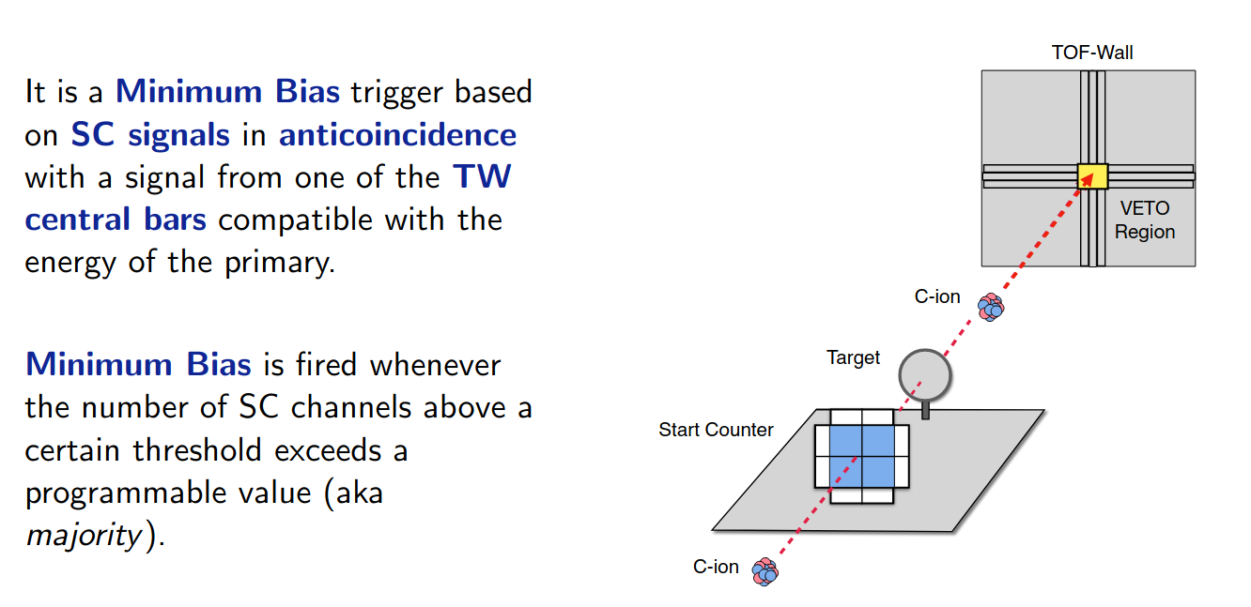
Trigger Simulation
Fragment Trigger is fired every time Minimum Bias condition on TW is not verified

Slide 30
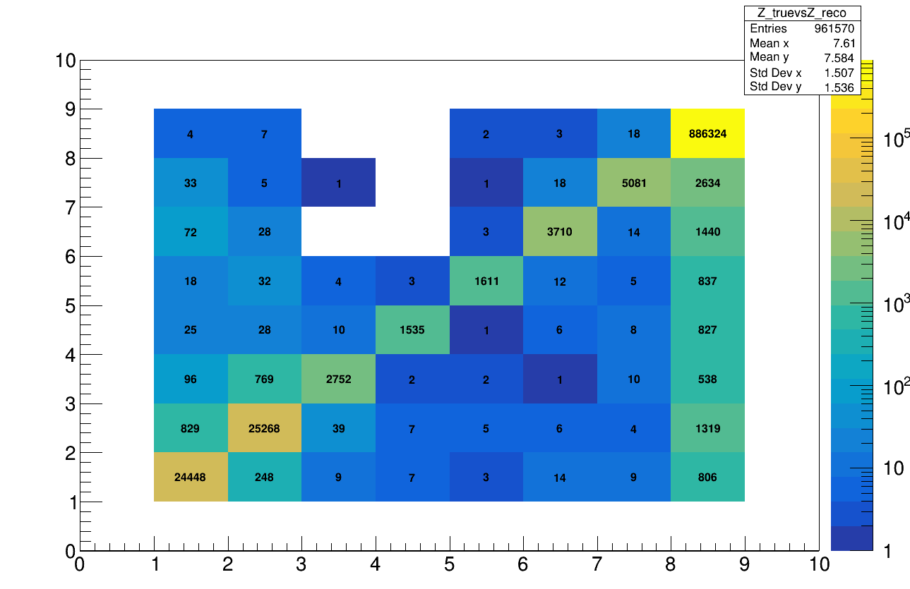
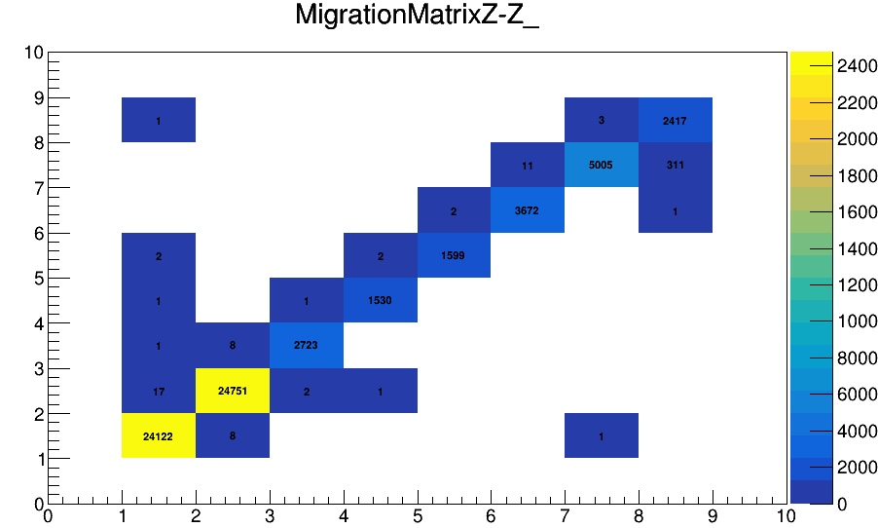
Trigger Simulation
Applying Trigger cut:
Main source of mis-reconstruction is given by O due to its high statistics

Slide 31




Pile-up removal
What it was seen in the last data taking (GSI - CNAO 2021) is that the beam flux is not constant → pile-up events
2 crosses
4 crosses
constant
threshold
discrimination
method
2 crosses
4 crosses
Single projectile
Pileup projectile
Single projectile: 4 crosses
pileup projectile: >4 crosses

Slide 32


Pile-up removal
Both minimum bias trigger and trigger fragmentation
Charge
t(ns)
t(ns)
PileUp on 600.000 events ~ 1%

Slide 33






Isotopes identification
Mass reconstruction using all FOOT subdetectors:
In our data no tracker and calorimeter → mass measurement only in MC data!
Augmented Lagrangian Method
Aχ 2 = 11.66 ± 0.38
risoluz. 3.2 %
χ 2 < 5

Slide 34
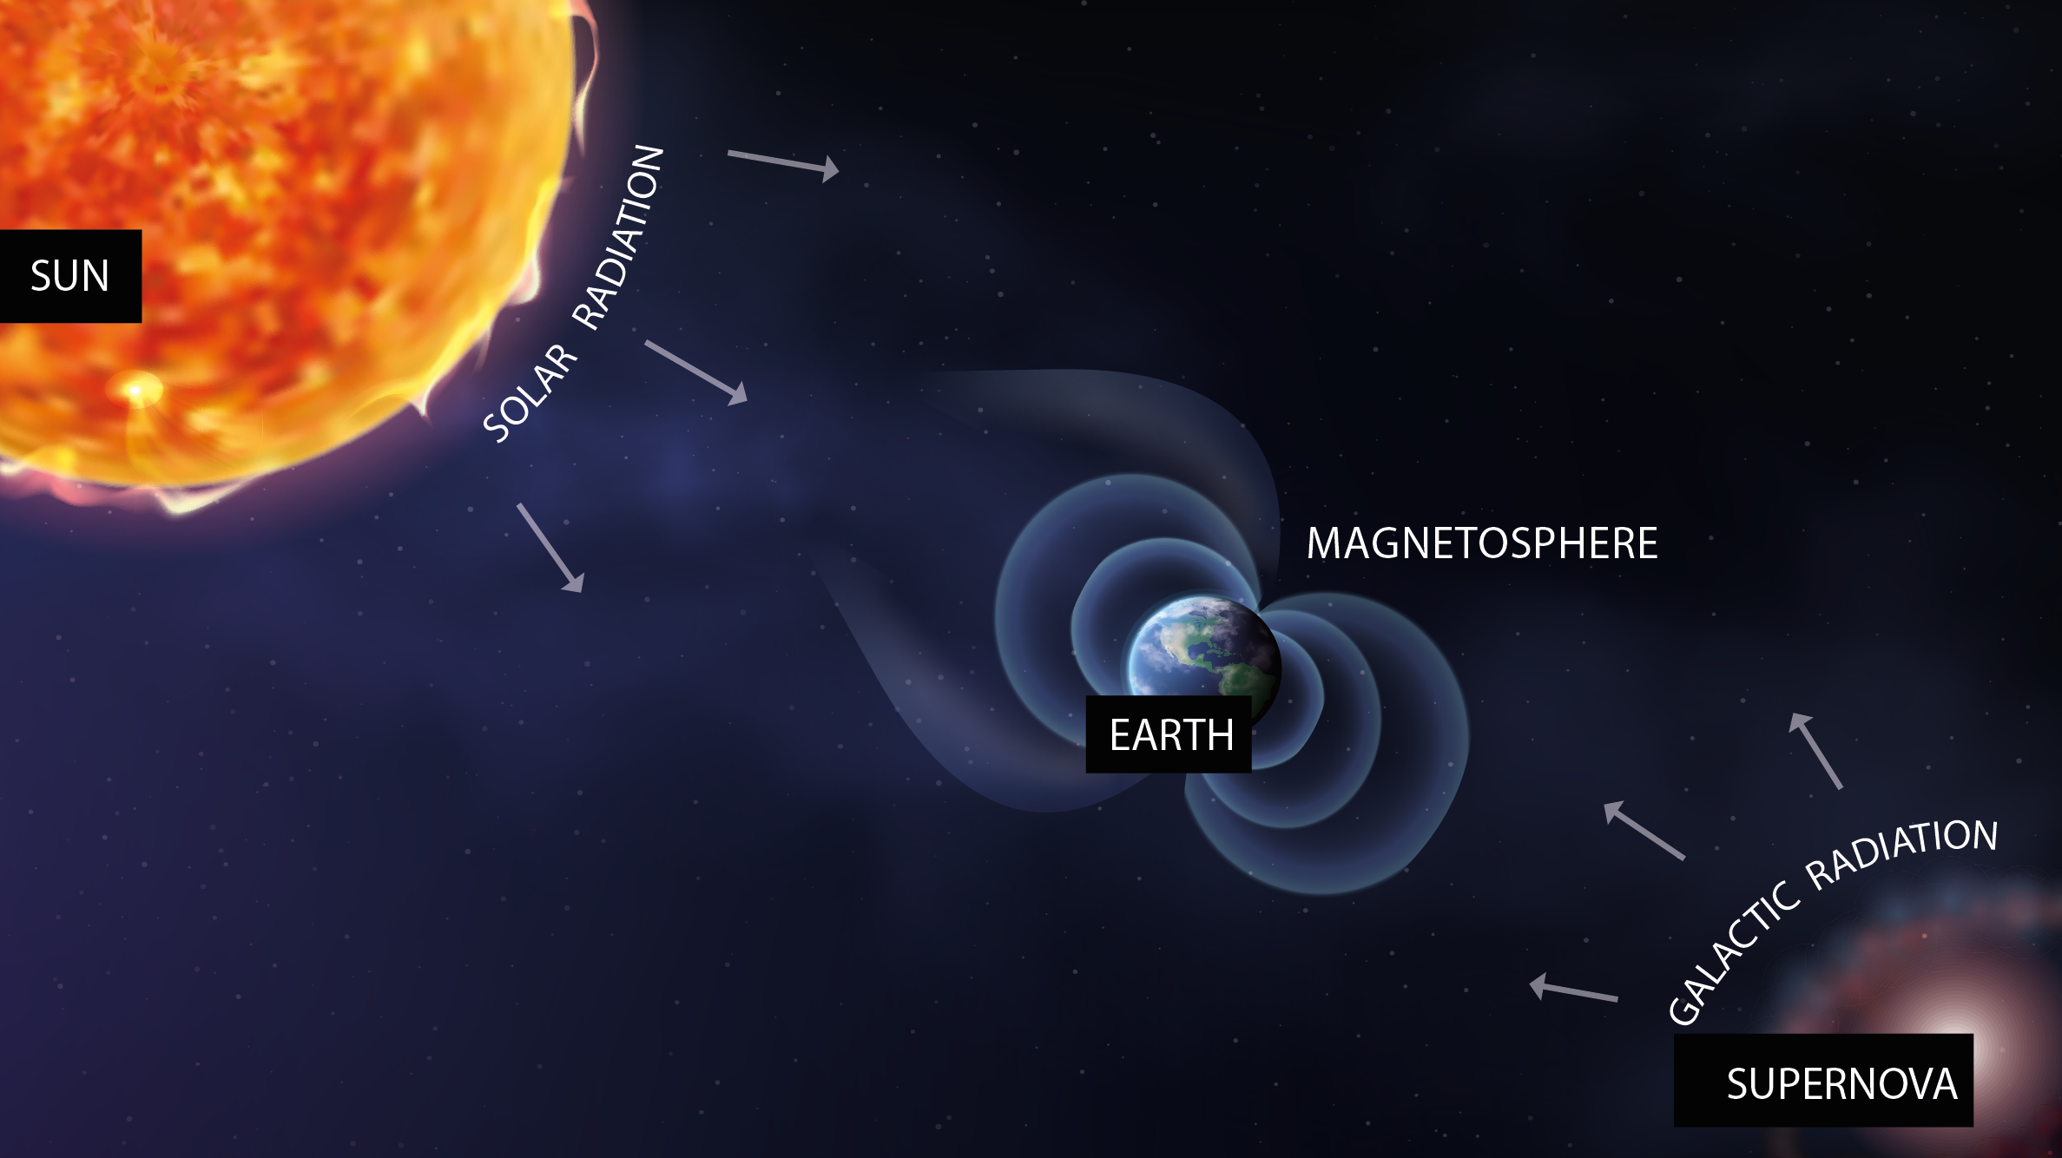
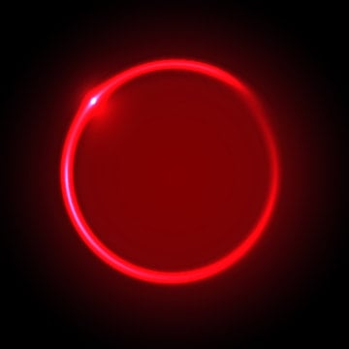

Space radioprotection
MARS

Slide 35
Space radioprotection
MARS
SOLAR RADIATION
suddenly
92% p
6% He
2% HZE
E<1 GeV/n

Slide 36

Space radioprotection
COSMIC RAYS
constantly
90% p
9% He
1% HZE
0.001 < E < 10¹⁴ GeV/n

Slide 37



Space radioprotection
MARS

Slide 38
Space radioprotection
MARS
fragmentation
Effects on:
- Space craft hull and structure
- Shielding
- Astronaut’s body

Slide 39
Space radioprotection
MARS
fragmentation
Dose equivalent
Dose
Fluence

