Slide 1

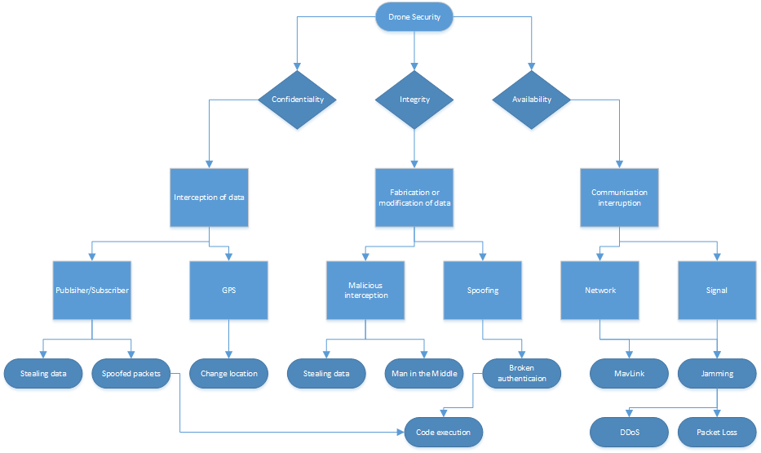
Security For robotics
Why is this Important?
The Team:
THE PROBLEM WITH ROS
The overarching issue with ROS from a security standpoint is that ROS was never designed to be secure. ROS was designed to basically be a application layer on top of your preferred operating system with some package support; not a full fledged operating system in and of itself. Adding things like built in security would just bloat the install and make it infeasible for some users running on limited hardware. As such ROS runs with the assumption that it should do whatever it is told without question, which leaves room for all sorts of attacks; it is just a matter what you want to make ROS due and how. As such, our research on threats can be broadly divided into 3 categories: attacks assuming some malignant actor managed to get into the system/ROS, attacks that “pollute” the communication channels to cause unintended actions, and attacks to get into the system itself via some communication channel.
THREAT MODEL
A threat model was created to visualize the attack vectors of a ROS drone. It serves as a roadmap for the research and can be looked back on at any time to see where each specific vulnerability falls. In the model below one can see that it is organized as a tree, with the three main branches being the three components of the CIA triad. This consists of Confidentiality, Integrity, and Accessibility. This way one can look at our threat model, decide if their concern is one of confidentiality, integrity, or availability, and examine then examine the vulnerabilities in that category. Not every area from the threat model was successful, some were not possible to breach, but it’s still good to acknowledge that they are still likely targets.
Researching and Exploiting Vulnerabilities in ROS Drones
RESEARCH DESIGN
This project is designed like any traditional research project. It follows scientific methodology and is data driven, to draw empirical conclusions. You can see our threat model in the section to the left, which is the base framework for research decisions. Wherever we had the best starting point (i.e. the most preexisting data) was what we worked to exploit first. The aim was to exploit whatever vulnerability we were working on in the most logical and effective way. As much data as possible was gathered, meaning there is wide variety of data and that data is different for each class of attack. This made drawing any overarching final conclusions difficult, as well as defining which exploits are the most severe. Failure Mode Effects Analysis (FMEA) is a procedure used in a variety of fields which creates an empirical system for testing and logging any failures, which does gave us some overarching numbers. Somewhat akin to risk analysis, FMEA involves defining severity, occurrence, and detection rating scales, usually from 1 to 10.After these scales have been defined one can use them to calculate a risk priority number (RPN) and a criticality number with which the found failures can be mathematically ranked in order of importance. These we've ranked and compared to created our findings. You can see this represented in the chart below.
OUR FINDINGS
If a malicious actor has access to ROS, and can load his/her own packages, he/she can do whatever he/she wants to the underlying OS/Drone Furthermore, unless the drone owner took specific care, it is not that hard to break into ROS in a wide variety of ways (TBD)If the wireless signal the drone is on is unprotected or weakly protected, it is mostly a matter of getting past that. (TBD)The underlying Drone OS setups tend to use published default user/passwords for root that can be looked up or guessed. (TBD)Wired drones are more difficult but also very rare. Security by obscurity. Radio signals can also be used, along with sending bad/tampered input to the drone’s sensors if applicable (TBD)
Team Photo
WHO WE ARE
We are a group of students interested in cybersecurity, guided by our client’s graduate research project.
Client:
Vedanth Narayanan
narayave@oregonstate.edu
Team Members:
Emily Longman
longmane@oregonstate.edu
Dominic Giacoppe
giacopped@oregonstate.edu
Zach Rogers
rogersza@oregonstate.edu
WHERE IT GOES FROM HERE
We hope that this research will be continued and expanded upon not only by our client in his thesis, but also by other members of the security and robotics communities. The more that is done in this field, the better all future robotics can be, without being a huge security threat.
Infographic
TESTING METHODS
Capturing communication data between the user flying the drone, and the drone itself, will allow us to reverse engineer the communication protocols being used. Being able to capture that data also presents the possibility of doing a Man-In-The-Middle (MITM) like attack, enabling an attacker to intercept and spoof commands being sent to the drone in real time. In order to capture this data, we need hardware that can receive RF on the 2.4Ghz and 900Mhz band. There are many, many options out there, some of which can be quite costly. Since the primary method of communication is through the 2.4 Ghz band, we can use a standard wireless radio that can run in promiscuous mode. Promiscuous Mode enables us to capture wireless packets without associating with an access point. With this, we can use the Aircrack-NG suite of wireless auditing tools to attack the wireless communication channel that the drone uses. With these tools we will be able to capture communication between the drone and the drone ground control station, allowing us to leverage that data to develop drone attack methods, relating to our communications threat model.
Notes:
If tri-fold mounting at SMS – make sure no text or image is in-between the two vertical guide lines; this space will be cut away. To view the vertical guide lines: Select “View” from the main menu, select “Guides” from the pull down menu, and lastly select “Static Guides”.

