Slide 1
Security for Robotics
Capstone fall progress report
Emily Longman, Zach Rogers, & Dominic Giacoppe

Slide 2
Introduction
Research project
Focus on documenting security vulnerabilities in devices running ROS, specifically drones
Document as much data as possible
Make it academically valuable
If we can, patch some of our exploits
Potentially contribute those patches to the SROS project \cite
Notes:
Brief description of project, somewhat akin to a verbal abstract

Slide 3
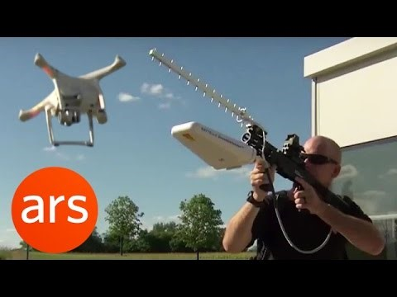
Why are we doing this?

Slide 4
Research
Methods and design

Slide 5
Preexisting Research
IoT Security: Ongoing Challenges and Research Opportunities ^{[1]}
Distributed denial of service attack. ^{[2]}
Security threat analysis and exemplary attack to track persons ^{[3]}
We will gather data of our own to further this

Slide 6
Focus on Failure Modes
Failure Modes and Effects Analysis (FMEA) ^{[4]}
Similar to risk assessment
Can be applied to a range of things
Defines a rating scale for severity, occurrence, and detection
These can then calculate a risk priority number (RPN) and a criticality number which allow mathematical ordering of failures
Gives us analogous data to compare across the diverse sectors of the threat models

Slide 7
Threat Modeling
Provides a roadmap and a visualization of the system
Defines most critical sectors, giving us a good starting point
Not every portion will be successful, or even used
Provides a quick viewpoint of what we’re researching
Three separate threat models
OS, hardware, and communication channels
Using Adam Shostack’s guide ^{[5]}

Slide 8
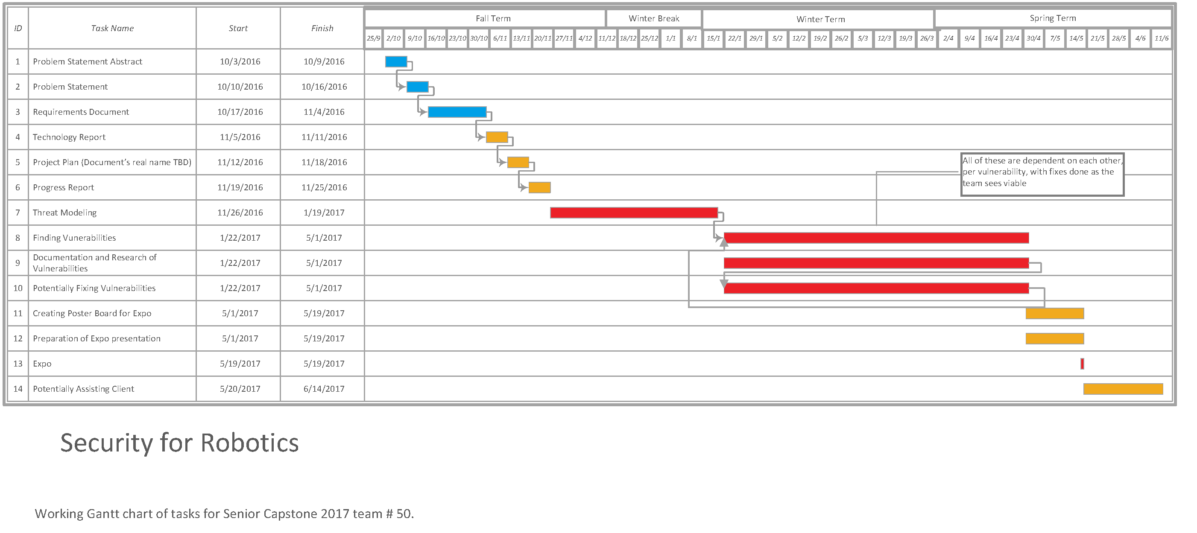
Research cycle
We will follow our threat models and iterate through each promising vulnerability in this manner

Slide 9
Retrospective
The work we did to get here

Slide 10
The Past 10 Weeks
Week 0-3
Picked project.
Met with client (V) and his clients (Professor Bobba and resident crypto-expert Jesse) and discussed basic requirements
Got input on our probable path going forward, possible avenues of research.
Got settled in to the course as a whole, got to know each other's schedules

Slide 11
The Past 10 Weeks Cont.
Weeks 4-7
Were introduced to threat modeling, decided on using ROS, looked into SROS as a possible alternative.
Draft of problem statement, requirements document
Discussed current state of project with clientele
Got to see the drones, they need some changing and one needs some components re-soldered.
Tech review started, but confusion about requirements for it led to some delays,
Should have consulted with professors earlier about our direction on it.

Slide 12
The Past 10 Weeks Cont.
Week 8-Now
In trying to finish the tech doc 2 of us got sick and it ran behind despite our best efforts,
Along with midterms catching up to us, including Vee, which didn't help
Tech doc did get finished after team meeting, although it was slightly late
After some research, we discovered that our particular drone board setup might not support SROS
TCP/UDP issues, SROS only supports UDP TLS encryption, but drone control software uses TCP
We also finished the design doc after consulting with our professors earlier this time.
Now, we are on to our final week, our progress paper is written, and this is the last thing we need to do.

Slide 13
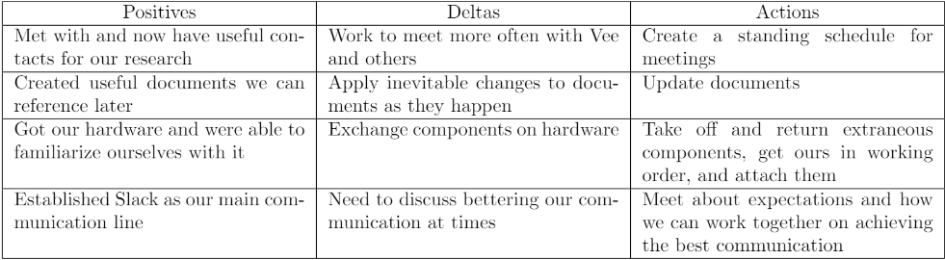
retrospective
A quick glance at what was notable about the term, and how we want to improve for next term

Slide 14
Stumbling Blocks
Our 2 major failures were:
1. Maintaining team communications. Particularly during midterms season, as not only are the 3 of us students, but Vee as well, all progress and communication halted during that period while we scrambled to prepare for exams. This lead to our tech doc being late, which is inexcusable.
2. Acquiring extra instruction with respect to class assignments. Since our project is research focused, many of the assignments given in class are less relevant to our work. As such, we need to be more proactive about asking for further instruction from our professors for what exactly we need to do.

Slide 15
Future Changes
Maintain a Consistent Meeting Schedule
For Winter and Spring Term, we aim to ensure that we are meeting at least once a week.
Regular Check-ins with Professors
We plan to meet with professors and our client much earlier to discuss concerns regarding assignments and deadlines.

Slide 16
Looking Ahead
Over Winter Break We Will
Get our drones operational
Includes getting ROS running on our BeagleBone, and interface with our PixHawk cape
Seeing if SROS is something we can use moving forward
Start our Threat Modeling
Will allow us to get a head start to Winter term

Slide 17
References
[1] Zhang, Zhi-Kai, et al. "IoT security: ongoing challenges and research opportunities." IEEE, 2014.
[2] S. Sharma, S. Garg, A. Karodiya, and H. Gupta, “Distributed denial of service attack.”
[3] Samland, Fred, et al. "AR. Drone: security threat analysis and exemplary attack to track persons." 2012.
[4] ASQ. Failure mode effects analysis. [Online]. Available: http://asq.org/learn-about-quality/process-analysis-tools/overview/fmea.html
[5] A. Shostack, Threat Modeling, Designing for Security. Indianapolis, Indiana: John Wiley and Sons, Inc, 2014.

