Slide 1
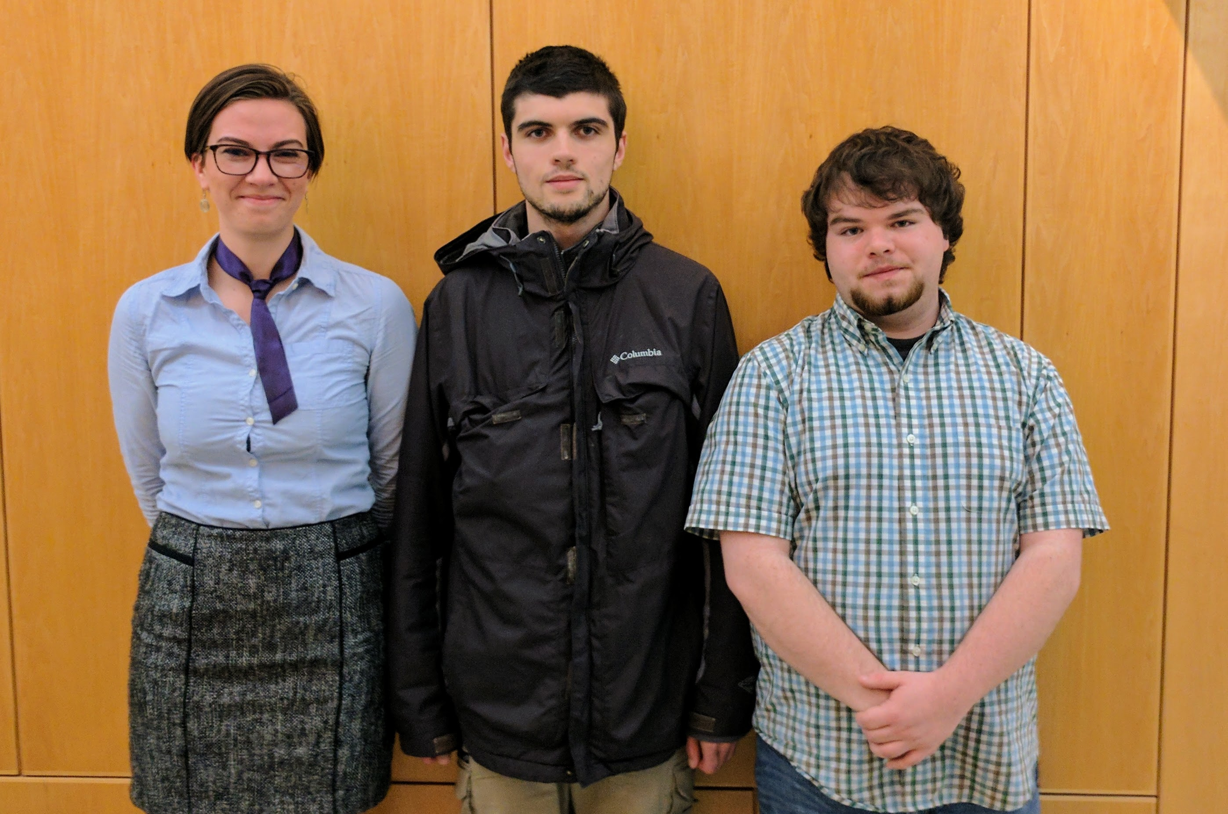
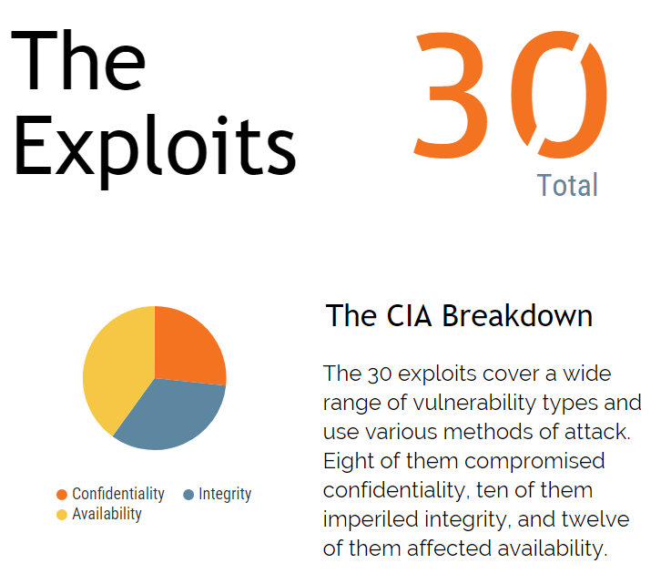
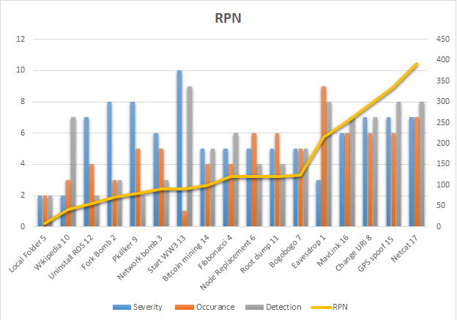
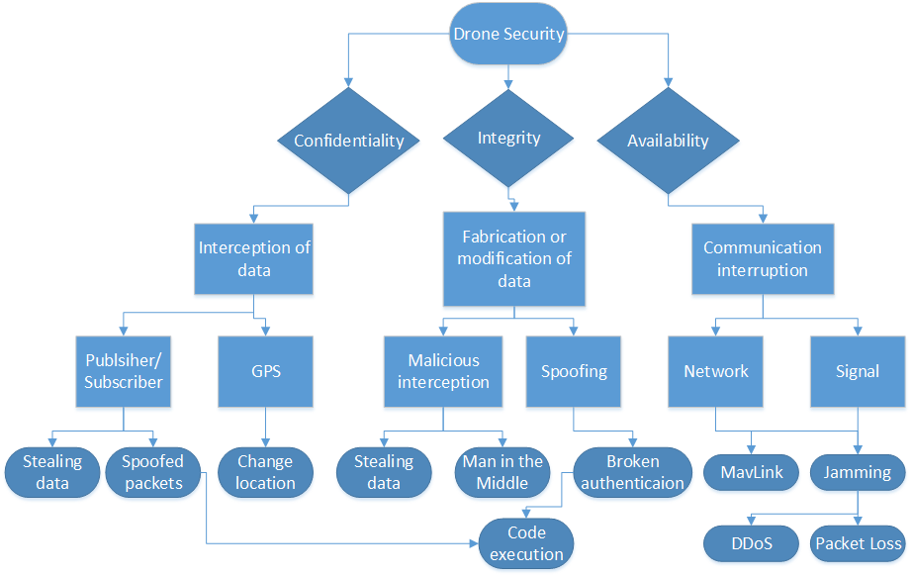
SECURITY FOR ROBOTICS
Why is this Important?
The Team:
THE PROBLEM WITH ROS
The Robotic Operating System (ROS) has a lot of problems from a security standpoint due to being middleware. Middleware does not typically focus on security because it needs to be lightweight.
Without any specific security measures taken, there is room for all manner of attacks. To try to tackle them, the vulnerabilities were broken into three categories:
Those affecting the confidentiality of data
Those affecting the integrity of data
Those affecting the availability of data
CREATION OF A THREAT MODEL
A threat model was created to visualize the three categories. It serves as a roadmap for the research and can be looked back on at any time. The model below in Figure 1 is organized as a tree, with the three main branches being the three components of the CIA triad (Confidentiality, Integrity, and Availability). This way one can look at our threat model, decide if their concern is one of confidentiality, integrity, or availability, then examine the vulnerabilities in that category.
Not every area from the threat model was successful, some were not possible to breach, but it’s still good to acknowledge that they are still likely targets.
Researching Vulnerabilities in the Robotic Operating System
RESEARCH DESIGN
The project aims to find exploits for whichever vulnerabilities seem most the most open. This means first doing some research to locate the best starting points. Because each exploit is unique it is difficult to draw final conclusions as well as define which exploits are the most severe.
Failure Mode Effects Analysis (FMEA) is a procedure used in a variety of fields which creates an empirical system for testing and logging any failures, which can be applied to all of our attacks. Somewhat akin to risk analysis, FMEA involves defining severity, occurrence, and detection rating scales, usually from 1 to 10. After these scales have been defined one can use them to calculate a risk priority number (RPN) and a criticality number with which the found failures can be ranked in order of importance. You can see this represented in figure 2 below.
As for the sort of exploits created in this project, there was a variety of paths covered. Some examples of these attacks are:
Man in the Middle
Spoofing
Broken Authentication
Denial of Service
Resource Consumption
Data Stealing
NOTABLE PROOF OF CONCEPTS
Lack of Authentication
Remote control over ROS
Package Installation
Process Communication (Publisher/Subscriber Model)
Fuzzing of Subscribers
Data Capture of Publishers
ROS Bag Replay Attack
Sensor Spoofing
Denial of Service
Bogo Sorting
Bitcoin Mining
WHO WE ARE
We are a group of students interested in cybersecurity, guided by our client’s graduate research project.
Team Members:
Emily Longman
longmane@oregonstate.edu
Dominic Giacoppe
giacopped@oregonstate.edu
Zach Rogers
rogersza@oregonstate.edu
WHERE IT GOES FROM HERE
We hope that this research will be continued and expanded upon not only by our client in his thesis, but also by other members of the security and robotics communities. The more that is done in this field, the better all future robotics can be, without being a huge security threat.
Client:
Vedanth Narayanan
narayave@oregonstate.edu
Figure 3: View at a glance of which areas of security our work affects
OUR FINDINGS
Just as suspected, ROS has wide range of vulnerabilities that this project exploits with a success rate of nearly 100%. Most of these exploits involved either entering the system via the publisher/subscriber system that ROS uses to communicate, or demonstrated what malicious actions could take place on the system once inside. In figure 3 above is a visualization summing up the numbers in our research.
We also found that our project evolved as we went along. We had initially intended to do more hardware based attacks, but they proved to be too cumbersome and difficult to generalize. There are also a board range of physical attacks ranging anywhere from an EMP type gun to an eagle taking down an airborne drone.
Figure 2: This chart shows that the RPN is a more meaningful number than the others alone
Figure 1: The three pathways of ROS vulnerabilities and how they can be exploited
Notes:
If tri-fold mounting at SMS – make sure no text or image is in-between the two vertical guide lines; this space will be cut away. To view the vertical guide lines: Select “View” from the main menu, select “Guides” from the pull down menu, and lastly select “Static Guides”.

