Slide 1
Security for Robotics
Capstone fall progress report
Emily Longman, Zach Rogers, & Dominic Giacoppe

Slide 2
Introduction
Research project
Focus on documenting security vulnerabilities in devices running ROS, specifically drones
Document as much data as possible
Make it academically valuable
If we can, patch some of our exploits
Potentially contribute those patches to the SROS project \cite
Notes:
Brief description of project, somewhat akin to a verbal abstract
<number>

Slide 3
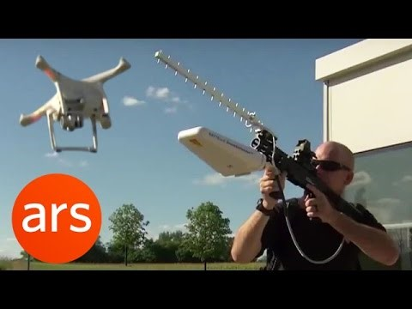
Why are we doing this?

Slide 4
Research
Methods and design

Slide 5
Preexisting Research
Add links to some articles and describe
We will gather data of our own to further this

Slide 6
Focus on Failure Modes
Add info from section in design doc about this

Slide 7
Threat Modeling
Add info from threat modeling section of Design Doc

Slide 8
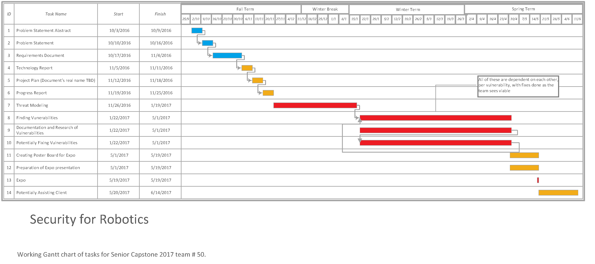
Research cycle
We will follow our threat models and iterate through each promising vulnerability in this manner

Slide 9
Retrospective
The work we did to get here

Slide 10
The Past 10 Weeks
Week 0-3:
The first few weeks of this course were spent analyzing which projects we wanted, who we would be working with, and how we wanted to initially approach our given problem. It was somewhat of an adjustment period to the course and the next nine months. The calm before the storm essentially. These weeks also provided us with an opportunity to prepare for all the technical writing and research we were about to do. We also got some input from some research professors, which helped us to refine the goals of the project.

Slide 11
The Past 10 Weeks Cont.
Week 4:
During this week we continued our work on getting the project better defined and potentially revising our problem statement. We also got to have a great meeting with Rakesh, our security professor and Vee's advisor, and Jesse, a crypto expert, who gave us some really cool professional insight into what we could potentially focus on. We know that we'll be making threat models to design our approach, based on Adam Shostack's textbook on them.
We've mostly confirmed that we're using ROS at this point, and we have some ideas about ways to attack it, but nothing has really been solidified yet. Being that we are using ROS though, we do already have some vulnerabilities that we can look at, as ROS has some out of the box. We gained the hope to be able to contribute to the SROS project, but we weren't sure it will be usable for us.

Slide 12
The Past 10 Weeks Cont.
Week 5:
This week we finished up our revised Problem Statement document, and also spent a lot of time trying to work out our requirements document to get our first draft submitted.
We were able to meet briefly with our client to check in and make sure everyone was on the same page with regards to the requirements document.
After finishing up some formatting and polishing it came together well.

Slide 13
The Past 10 Weeks Cont.
Week 6:
Despite our solid first draft we still scrambled to pull together our final version of the requirements document, mainly because it was a little bit unnatural for a research project.
There was still so much ambiguity that it seemed like we were pulling at straws and making wild guesses as to what we need.
As for the hardware we do now actually have our drones but we need to do some surgery on them and re-solder a component on one of the PixHawk boards that Sam broke.

Slide 14
The Past 10 Weeks Cont.
Week 7:
This week we made some rough sections for the tech review, but it was really difficult for us to figure out enough of them that make sense to do a tech review on.
The majority of our project is based around the research lifestyle and ROS, but outside of that we didn't have a ton to talk about.
We hoped to have a more specific view of what we were doing that we could come back to and better define.

Slide 15
The Past 10 Weeks Cont.
Week 8:
Things were a bit of a struggle this week and not a lot got done.
Two of us were sick, so it was mostly just each person trying to finish their tech doc sections.
A lot of other classes got chaotic this week too, so we were definitely not as focused as we needed to be.

Slide 16
The Past 10 Weeks Cont.
Week 9:
This week was a short one with the holiday, and was spent trying to catch up on the tech doc that two of us failed to complete by the deadline. We talked with both professors about it and they had useful pointers, but it still seemed like such a stretch when writing it.
We met to discuss how we are going to finish the tech doc, along with further debating some technical aspects of the project, most specifically for me whether or not we will be using SROS or not, and if our board can support the latest version of ROS. We were also starting to think about the design doc coming up the next week and the end of term assignments.

Slide 17
The Past 10 Weeks Cont.
Week 10:
This was the last week of classes and we focused quite a lot of our effort into making the best design document we could.
We were all happy with the outcome, and it was probably the most useful of the documents we wrote written this term.
It would have been nice to have a little more time to add a better literature review section per Kirsten's suggestion, but we can still add those to our revision at the beginning of next term.

Slide 18
retrospective
A quick glance at what was notable about the term, and how we want to improve for next term

Slide 19
Stumbling Blocks
Our 2 major failures were:
1. Maintaining team communications.
Particularly during midterms season, as not only are the 3 of us students, but Vee as well, all progress and communication halted during that period while we scrambled to prepare for exams. This lead to our tech doc being late, which is inexcusable.
2. Acquiring extra instruction with respect to class assignments.
Since our project is research focused, many of the assignments given in class are less relevant to our work. As such, we need to be more proactive about asking for further instruction from our professors for what exactly we need to do.

Slide 20
Future Changes
Correlating to our stumbling blocks from the last slide:
1. Maintaining consistent team meetings.
The following terms, we aim to ensure that we are meeting at least once a week for at least an hour to discuss our current work and next steps. The time and day on this is TBD until we see our class and work schedules for next term, however.
2. Regular check-ins with our professors
The following terms, when assignments come up that we have concerns with, we aim to try to meet with our professors and address those concerns as soon as possible.

Slide 21
Looking Ahead
Over winter break we aim to, at the very least, get our drone operational. Our Drone OS section in our design document contains details on the actual steps involved. We also endeavor to do some reading on threat modeling and ROS to better prepare for winter term.

