Slide 1

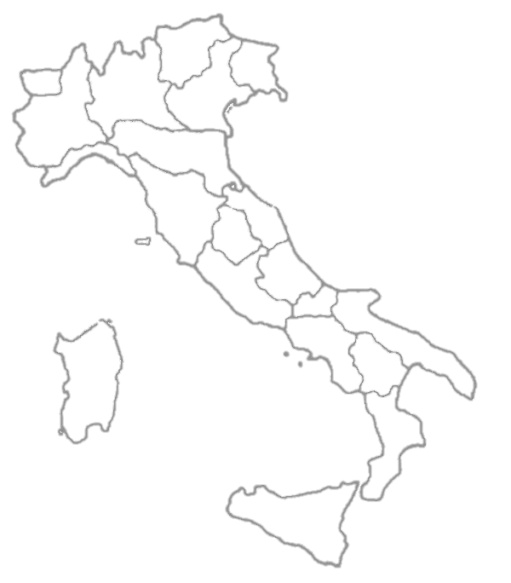

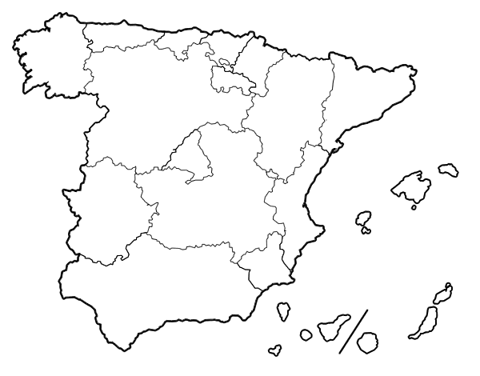
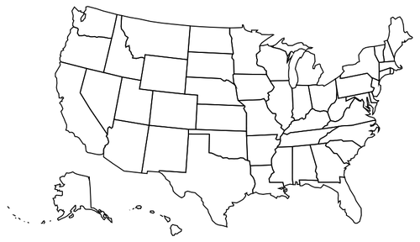
Covid-19
Data Analysis
in Distributed Datasets
Data Mining project
Master Degree in Computer Engineering
Giada Anastasi

Slide 2





Project goals
Analyze data from different datasets and then compare results of these analysis with the result obtained analyzing the dataset with all these data.
2 scenarios
Cases data subset
.
.
.
Global results
Hospital data subset
Global results
Regions subsets
Partial results
Tests data subset
Partial results
Giada Anastasi

Slide 3
1st Scenario - Preprocessing
Converted date in double with python library dates from matplotlib
Converted string name of regions in integer region_code
All null value replaced with 0
Giada Anastasi

Slide 4

1st Scenario
Goal:
Analysis of different dataset containing different data
22 subsets
Data | Codice regione | Codice provincia | Totale casi
Giada Anastasi

Slide 5

1st Scenario
Goal:
Analysis of different dataset containing different data
19 susbets
Fecha | Cod_ine | Num casos | Num casos prueba pcr | Num casos prueba test ac | Num casos pruebas otras | Num casos prueba desconocida
Giada Anastasi

Slide 6

1st Scenario
Goal:
Analysis of different dataset containing different data
56 susbets
Date | State | Death | Hospitalized | In ICU Cumulative | negative | On ventilator cumulative | positive | recovered | Total test results | Total test viral
Giada Anastasi

Slide 7
1st Scenario - Implementation
DB Manager 1
Count vector, Sum vector
cluster vector
.
.
.
Server
Partition 1
Global object- centroid vector
centroids
DB Manager N
Partition N
MAPPER
COMBINER
REDUCER
Giada Anastasi

Slide 8
1st Scenario - Implementation
∑
elem in cluster
new centroid for cluster =
Count elem in cluster
Stopping criteria:
Vector_q is the vector with cluster centroid for each object
(i)
(i+1)
vector_q
= vector_q
Giada Anastasi

Slide 9
1st Scenario - Results
ROUND | Iterations, time
1 | 29, 0:05:19 | 39, 0:19:03 | 30, 0:57:03
2 | 23, 0:04:17 | 54, 0:26:25 | 32, 0:49:43
3 | 24, 0:04:45 | 37, 0:18:01 | 29, 0:44:51
4 | 31, 0:05:54 | 57, 0:27:07 | 34, 0:52:37
5 | 33, 0:06:07 | 34, 0:16:07 | 30, 0:56:53
6 | 19, 0:03:39 | 38, 0:18:11 | 34, 0:50:06
7 | 34, 0:06:37 | 41, 0:19:19 | 31, 0:42:30
8 | 33, 0:06:29 | 41, 0:19:16 | 17, 0:22:27
9 | 35, 0:06:45 | 39, 0:18:36 | 35, 0:44:33
10 | 21, 0:04:01 | 34, 0:16:19 | 28, 0:36:04
Giada Anastasi

Slide 10
1st Scenario - Results
For all this tests same number of objects in same clusters for partitioned and global dataset
Same execution time for partitioned dataset and whole dataset
 | Iterations, time
MEAN | 29, 0:05:00 | 40, 0:19:00 | 30, 0:45:00
Giada Anastasi

Slide 11
2nd Scenario - Preprocessing
Converted date in double with python library dates from matplotlib
Converted string name of regions in integer region_code
All null value replaced with 0
Giada Anastasi

Slide 12
2nd Scenario
Goal:
Analysis of different dataset containing different informations about the same objects
Fecha | Cod_ine | Num casos | Num casos prueba pcr | Num casos prueba test ac | Num casos pruebas otras | Num casos prueba desconocida
Hospitalizados | UCI | Fallecidos | altas
PCR | Test anticuerpos | Otros tests | Total pruebas | Positivos asintomaticos
Giada Anastasi

Slide 13
2nd Scenario - Implementation
DB Manager 1
Count vector, Sum vector
cluster vector
.
.
.
Server
DB Manager 2
Global object- centroid vector
centroids
DB Manager 3
Giada Anastasi

Slide 14



2nd Scenario - Implementation
For each database:
where
Then server computes the new centroids:
Giada Anastasi

Slide 15
2nd Scenario - Implementation
Stopping criteria:
Vector_q is the vector with cluster centroid for each object
(i)
(i+1)
vector_q
== vector_q
Giada Anastasi

Slide 16
2nd Scenario - Results
ROUND | Iterations, time
1 | 40, 0:35:08
2 | 40, 0:34:46
3 | 38, 0:32:56
4 | 36, 0:32:05
5 | 54, 0:47:08
6 | 38, 0:33:02
7 | 36, 0:31:22
8 | 38, 0:33:05
9 | 38, 0:33:01
10 | 54, 0:47:07
Giada Anastasi

Slide 17
2nd Scenario - Results
Same number of objects in same clusters for partitioned and global dataset
Bad execution time for partitioned dataset
Higher increasement of execution time in partitioned dataset with the increasement of number of clusters
Giada Anastasi

Slide 18
Conclusions
Objects in partitioned datasets are classified correctly because the final result is the same obtained for the entire dataset
Allow us to parallelize operations on different partitions dataset
Allow us to guarantee privacy because only partial results are shared by server and data manager
Giada Anastasi

Slide 19
Questions ?
Giada Anastasi

