Slide 1
BATTLECAPSTONE PROJECT: THE BATTLE OF THE NEIGHBORHOODS
Open A Coffee Shop In Ho Chi Minh City
NGUYEN TAN HUY
March 17, 2020

Slide 2
Using data location find out the best place open a new coffee shop in HCMC
Problems:
There are 23 districts and 324 wards in HCMC with millions of coffee shop venues.
Are there opportunity for my company to open a new coffee shop in this area?
Where is a good place?

Slide 3
DATA ACQUISITION AND DATA CLEANING
Scraped data from Wikipedia. Create tabular data include : District Code, District Name, Acreage, Population for each district.
Download data from official Ho Chi Minh City government website. Create tabular data include: Ward Code, Ward Name, District Name, Province/City Name.
Getting coordinate from google map each wards and district.
Combine two data frames into one data frame.
Getting venues using foursquare API with three categories for each ward: coffee shop venues, short term venues, long term venues categories. Getting categories character from foursquare doc.
Create one data frame contain : District Code, District Name, Ward Code, Ward Name, Acreage, Population, Longitude and Latitude each ward.

Slide 4
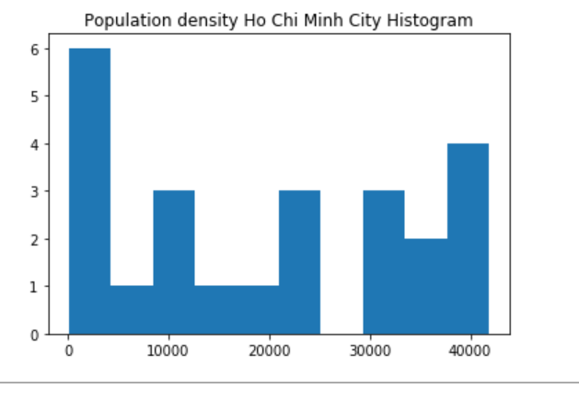
Population Density in HCMC
Low density : < 10000 persons per acreage (KM²)
Average density : between 10000 and 30000 persons acreage (KM²)
High density : > 30000 persons acreage (KM²)

Slide 5
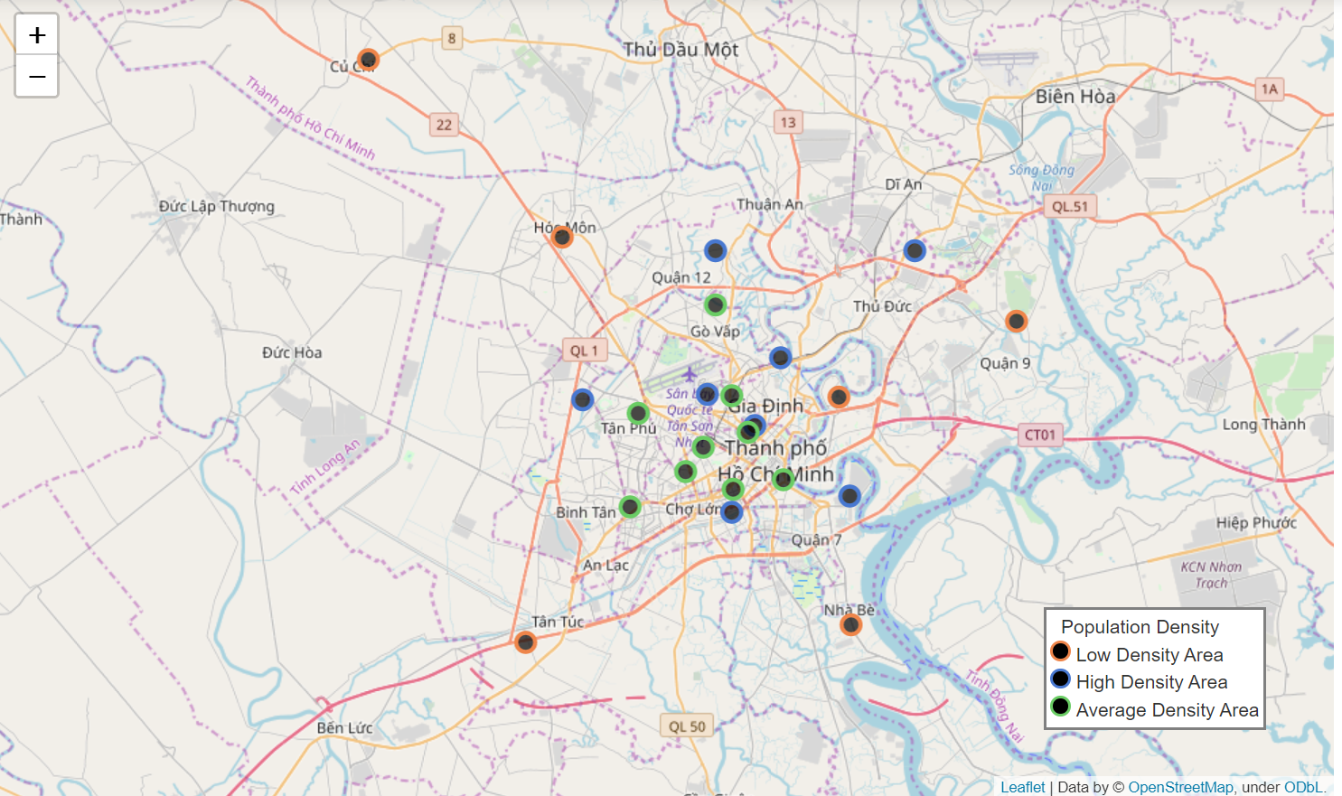
Population Density in HCMC
Open new coffee shop in HCMC downtown which is average and high population density

Slide 6
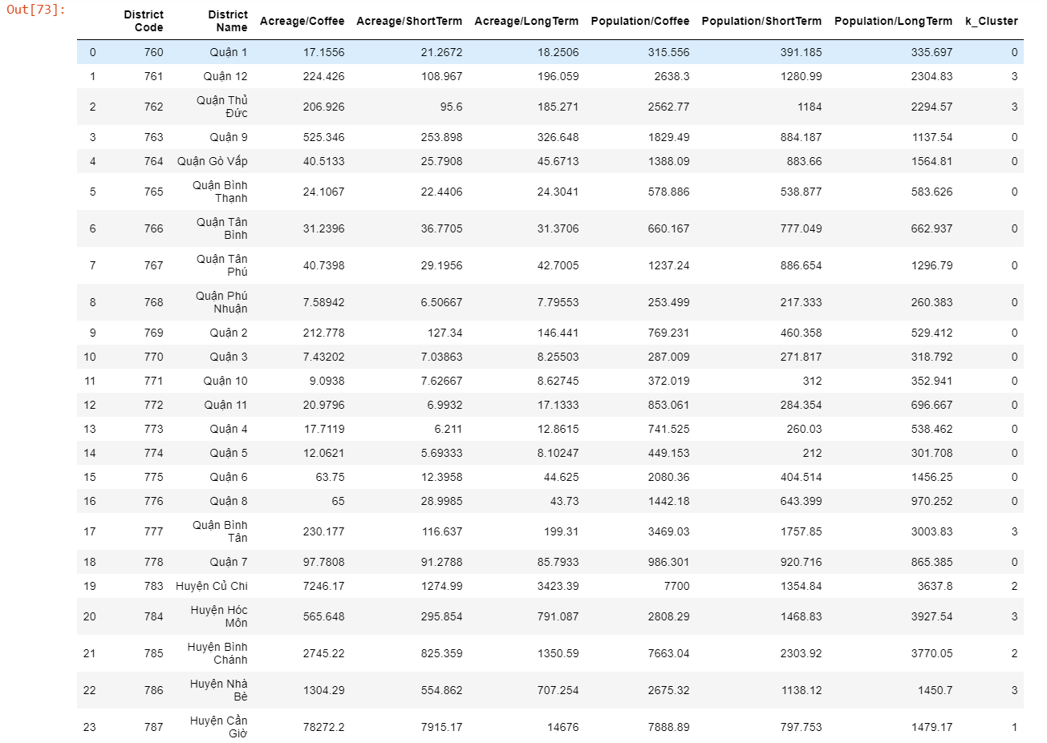
Find the best place to open a new coffee shop
Using Kmean to cluster our district with 4 cluster param.
We can easily observe that cluster number 0 with low number of Acreage per venues and low number of Population per venues. This means we have many venues in this cluster. Removed cluster number 0 from data frame.

Slide 7
Find the best place to open a new coffee shop
Cluster Wards in remaining district.
Using Kmean with 3 cluster param.
Analyze and find the best place.

Slide 8
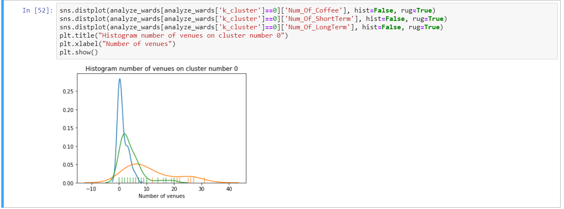
Find the best place to open a new coffee shop
Low number of venues. Removed this ward cluster from dataframe

Slide 9
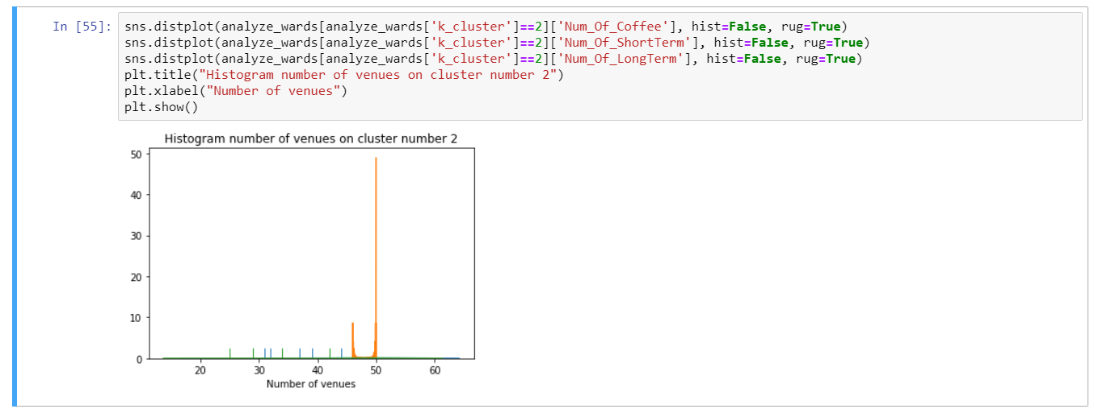
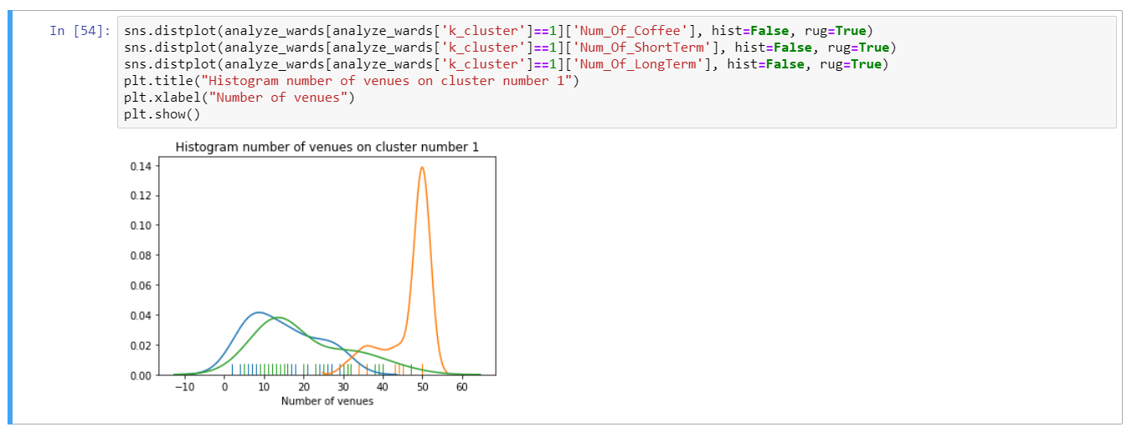
High number of venues. Keep this cluster

Slide 10
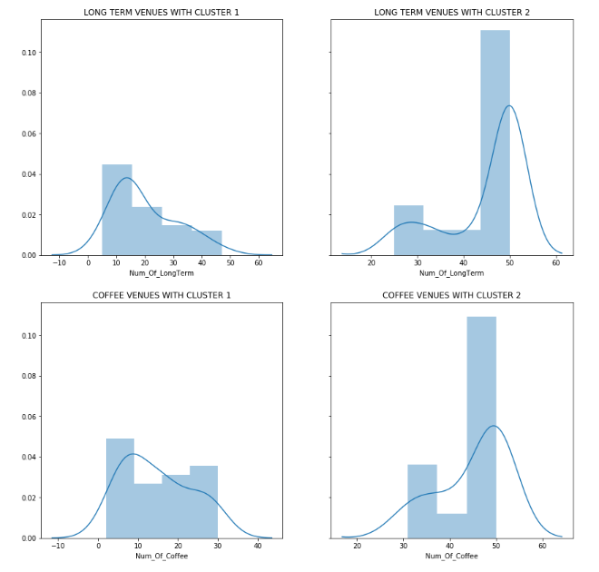
Analyze wards in the remaining cluster.
Conclusion: Cluster number 1 with low number of long term venues than cluster number 2. We also have low number of coffee shops in cluster number 1 than cluster number 2. So we will choose cluster number 1 with low competitors but only choose the wards with high number of long term venues in this cluster (higher than 30 venues).

Slide 11
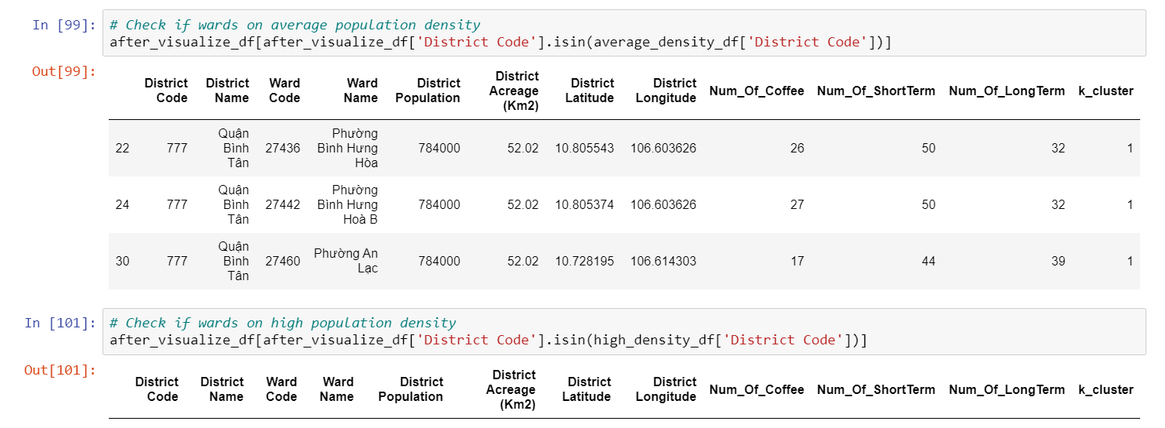
Discussion and Results
We have three wards after visualization and filter which are in the average population density

Slide 12
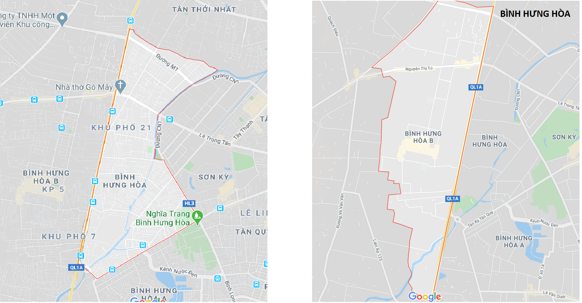
Discussion and Results
Two wards are in the same district and same area, separated by a road.
But they are far from Ho Chi Minh downtown.
And we have more coffee shop venues on these 2 wards (26 and 27 coffee shop venues).
So we will not choose these 2 wards to open a new coffee shop.

Slide 13
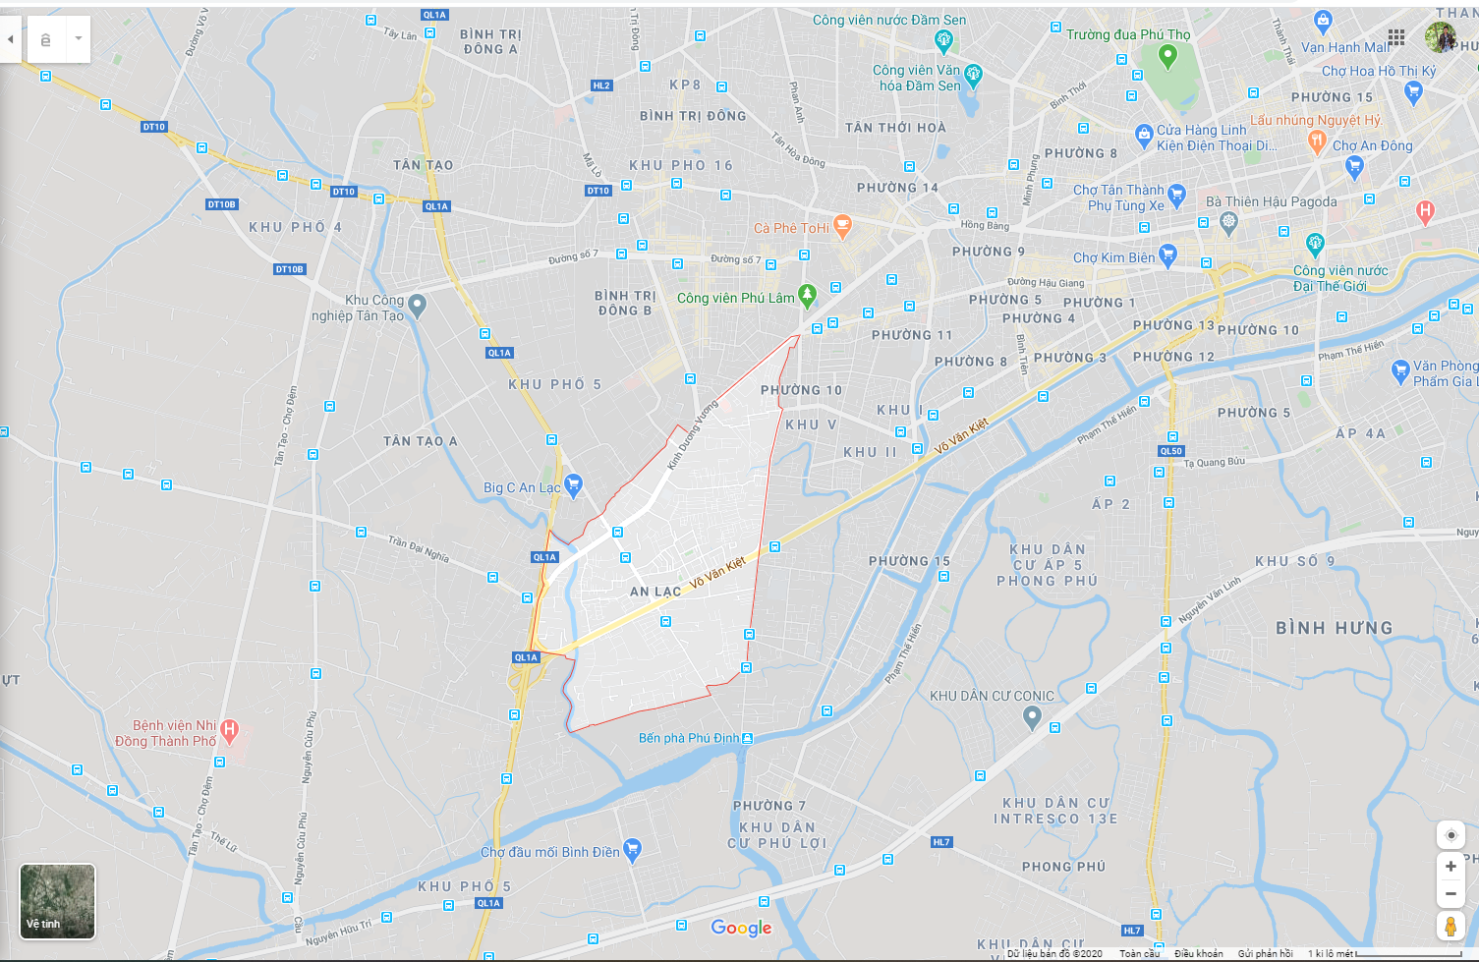
Discussion and Results
This wards is near HCMC downtown.
Border of District 10 which is high population and high density of administrative and career agencies
Võ Văn Kiệt Street and Kinh Duong Vuong Street are arterial roads in Ho Chi Minh City which is run through most of this wards area.
Lot of department, one industry park, 2 park in around this ward

Slide 14
Final Conclusion
We will open new coffee shop in AN LAC WARD with ward code 27460.

