Slide 1
NWC204 | CLASS AS2102 - GROUP 04
Lecturer: ThaoPY
FPT UNIVERSITY
ENTERPRISE NETWORK PROJECT PRESENTATION
Regional Logistics & Warehousing Network Architecture
Multi-site routed-port topology design, VLSM subnetting for >200 hosts, centralized core services deployment, and ACL security hardening.
PROJECT TEAM
Nguyen Vo Gia Huy (SE205167)
Duong Ba Trong (SE210504)
Huynh Thien Ha (SE211279)

Slide 2



EXECUTIVE SUMMARY
Project Objectives & Technical Constraints
Topic 2 | Base IP: 10.2.12.0/22
Multi-Site Architecture
Scalable Capacity (> 200 Hosts)
Core Mandated Constraints
Connects Head Office (HQ) and Warehouse (WH) site via a point-to-point Serial WAN link.
Detailed VLSM scheme isolating 7 distinct departmental subnets for optimal scalability.
STRICTLY NO VLANs or Layer 3 Switches. Each department connects to a dedicated physical Router port.
Assigned Network Block Range:
10.2.12.1 – 10.2.15.254 (Subnet Mask: /22)

Slide 3


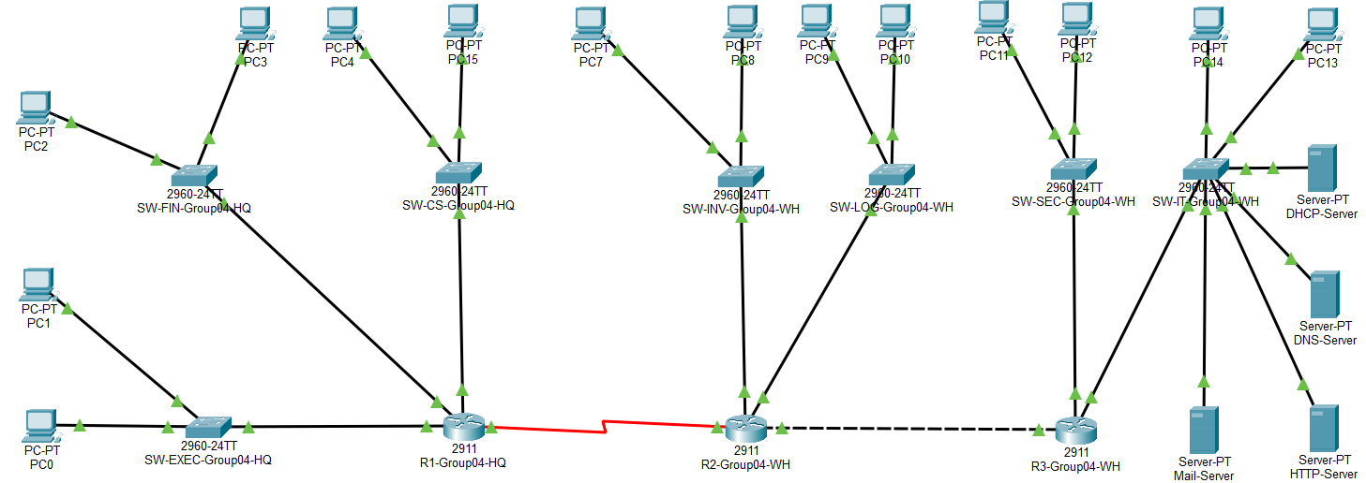
NETWORK ARCHITECTURE
Routed-Port Multi-Site Topology Diagram
Head Office Site (R1-HQ)
Houses 3 core departments: Executive Management (EXEC), Finance (FIN), and Customer Service (CS).
Warehouse Site (R2-WH & R3-WH)
R2 manages Inventory (INV) & Logistics (LOG). R3 secures Surveillance (SEC) & IT Server Room.
Inter-Router Connections
Point-to-Point Serial WAN link (HQ-WH) and internal Inter-Router backbone link (R2-R3).
* Each department connects directly to an individual physical Gigabit/FastEthernet Router interface via dedicated Cisco 2960 L2 Switches.

Slide 4
INFRASTRUCTURE INVENTORY
Hardware & Device Inventory Table
Device Type | Hostname(s) | Qty | Location / Subnet | Technical Role & Description
Cisco 2911 Router | R1-HQ, R2-WH, R3-WH | 3 | HQ & Warehouse Sites | Site gateways, WAN routing & inter-subnet communication
Catalyst 2960 L2 Switch | SW-EXEC, FIN, CS, INV, LOG... | 7 | 7 Departmental Subnets | Dedicated Layer 2 access switches for local LAN endpoints
Dedicated Servers | DHCP, DNS, HTTP, Mail | 4 | Server Room (R3-WH) | Centralized enterprise network core application services
Workstations | PC0 to PC15 | 14 | Distributed Subnets | Representative testing endpoints across departments
Routers R1 & R2 are equipped with HWIC-2T expansion modules to provide high-speed Serial WAN links.

Slide 5
IP ADDRESSING SCHEME
Optimized VLSM Subnetting Allocation Table
Site / Router | Department / Link | Hosts | Network ID | Subnet Mask | Default Gateway
R1-HQ | Executive Mgmt (EXEC) | 10 | 10.2.12.0/28 | 255.255.255.240 | 10.2.12.1
R1-HQ | Finance (FIN) | 30 | 10.2.12.16/27 | 255.255.255.224 | 10.2.12.17
R1-HQ | Customer Service (CS) | 30 | 10.2.12.64/27 | 255.255.255.224 | 10.2.12.65
R2-WH | Inventory Control (INV) | 100 | 10.2.12.128/25 | 255.255.255.128 | 10.2.12.129
R2-WH | Logistics Ops (LOG) | 50 | 10.2.13.0/26 | 255.255.255.192 | 10.2.13.1
R3-WH | Security Subnet (SEC) | 10 | 10.2.13.64/28 | 255.255.255.240 | 10.2.13.65
R3-WH | IT / Server Room (IT) | 14 | 10.2.13.80/28 | 255.255.255.240 | 10.2.13.81
WAN | Serial Link HQ-WH | 2 | 10.2.15.252/30 | 255.255.255.252 | 10.2.15.253
* VLSM Principle: Subnets are allocated from largest required host block (INV - 100 hosts) down to smallest (P2P WAN - 2 hosts) to eliminate IP address waste.

Slide 6


STATIC VS DHCP VERIFICATION
Workstation & Server IP Mapping Table
DHCP = Static IP Target
1. Client Workstations (Static & Dynamic DHCP Match)
2. Server Room Static IP Allocation
Host | Department / Location | Assigned IP Range | Subnet Mask | Gateway
PC0, PC1 | Exec Management (EXEC) | 10.2.12.34 - 35 | 255.255.255.240 | 10.2.12.33
PC2, PC3 | Finance (FIN) | 10.2.12.2 - 3 | 255.255.255.224 | 10.2.12.1
PC4, PC15 | Customer Service (CS) | 10.2.12.66 - 67 | 255.255.255.224 | 10.2.12.65
PC7, PC8 | Inventory Control (INV) | 10.2.12.130 - 131 | 255.255.255.128 | 10.2.12.129
PC9, PC10 | Logistics Ops (LOG) | 10.2.13.2 - 3 | 255.255.255.192 | 10.2.13.1
PC11, PC12 | Security Subnet (SEC) | 10.2.13.66 - 67 | 255.255.255.240 | 10.2.13.65
PC13, PC14 | IT / Server Room (IT) | 10.2.13.82 - 83 | 255.255.255.240 | 10.2.13.81
Server Name | Core Service | Static IP
DHCP-Server | Dynamic IP Service | 10.2.13.84
DNS-Server | Domain Resolution | 10.2.13.85
HTTP-Server | Intranet Web Portal | 10.2.13.86
Mail-Server | Internal Email | 10.2.13.87
Unified DNS Binding: All workstations (PC0 - PC15) receive 10.2.13.85 as their Primary DNS server under both Static and DHCP modes.
ACCURACY PROOF: Dynamic DHCP allocation in Weeks 5-8 yields exact IP addresses & Subnet Masks identical to the manual VLSM calculations.
Calculation Match: 100%

Slide 7



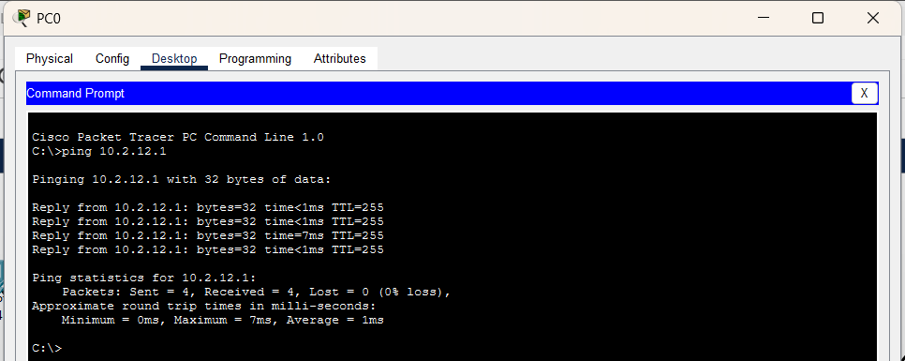

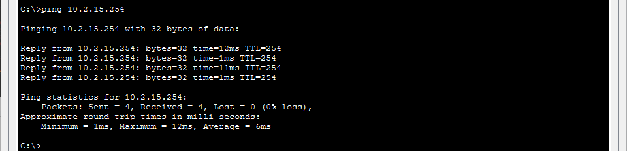
INITIAL BASELINE TESTING (WEEKS 1 - 4)
Static IP Reachability Verification (Pre-DHCP)
Case 1: Direct LAN Gateway (PC0 -> R1-HQ)
Case 2: P2P Serial WAN (PC0 -> R2-WH Serial)
Case 3: Inter-Site Cross-Regional (HQ -> Server GW)
ping 10.2.12.1 (0% Loss)
ping 10.2.15.254 (0% Loss)
ping 10.2.13.81 (0% Loss)

Slide 8
CENTRALIZED SERVICES
Server Room Deployment & Core Infrastructure
DHCP Server
DNS Server
HTTP Web Server
Mail Server
IP: 10.2.13.84
IP: 10.2.13.85
IP: 10.2.13.86
IP: 10.2.13.87
Centralized dynamic IP assignment across all 7 departmental subnets using DHCP Relays.
Internal domain name resolution mapping logistics-group04.com to Web Server.
Corporate Intranet portal for cargo tracking and internal warehouse administration.
Internal SMTP/POP3 mail service hosting the enterprise domain @group04.com.
SUBNET LOCATION
All servers reside statically in Server Room Subnet: 10.2.13.80/28 (R3-WH Gateway: 10.2.13.81)

Slide 9
IP CONFIGURATION MIGRATION
DHCP Relay Agent Mechanism (ip helper-address)
// Sample DHCP Relay Config on R1-HQ
Phase 1: Baseline PING Verification
Weeks 1 - 4
R1-Group04-HQ(config)# interface g0/0/0
Assigned static IP addresses to verify physical line links and cross-site routing reachability.
R1-Group04-HQ(config-if)# ip address 10.2.12.1 255.255.255.240
R1-Group04-HQ(config-if)# ip helper-address 10.2.13.84
Phase 2: Dynamic DHCP Migration
Weeks 5 - 8
// Sample DHCP Pool Config on Central Server
Enabled DHCP Relay Agent on default gateways to forward local broadcast requests as unicast packets to central DHCP Server.
Pool Name: EXEC_POOL
Default Router: 10.2.12.1
DNS Server: 10.2.13.85
* Utilizing DHCP Relay Agents eliminates manual IP configuration for >200 endpoints, centralizing administration in the Server Room.

Slide 10
NETWORK SECURITY
Baseline Hardening & Access Control Lists (ACLs)
Baseline Hardening (Routers & Switches)
Advanced ACL Controls
Minimum Password Length: security passwords min-length 10
Extended ACL (Applied on R3-WH)
Encrypted Secret Password: enable secret Class12345!
Blocks Security/Surveillance subnet (10.2.13.64/28) from reaching Server Room (10.2.13.80/28).
SSH v2 Enforcement: Disabled insecure Telnet on all VTY lines.
Brute-Force Protection: login block-for 120 attempts 3 within 30
Standard ACL (Applied on R1-HQ)
Unused Ports Shutdown: Explicitly shut down all unused physical ports.
Restricts remote SSH management access solely to authorized IT management hosts (10.2.13.82).
Adheres to the Principle of Least Privilege: Restricting access rights to bare minimum necessary operational levels.

Slide 11
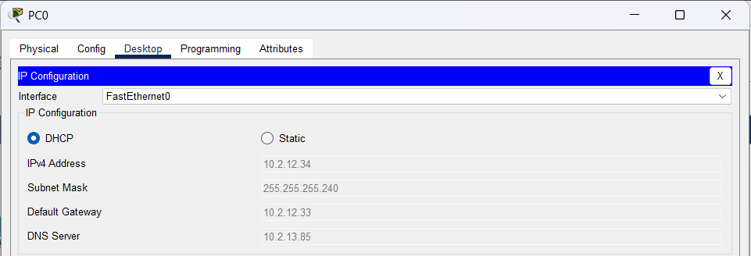

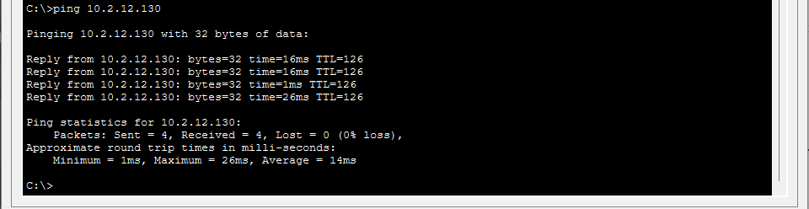

TESTING & VERIFICATION (1/2)
Dynamic IP Allocation & Cross-Site Connectivity
1. DHCP Request Successful (PC0 at HQ)
1. Cấp IP Động DHCP Thành Công (PC0 - HQ)
2. Cross-Site Ping Reachability (HQ to WH Gateway)
2. Ping Liên Chi Nhánh Cross-Site (HQ -> WH GW)
IP: 10.2.12.34 | GW: 10.2.12.33 | DNS: 10.2.13.85
IP: 10.2.12.34 | GW: 10.2.12.33 | DNS: 10.2.13.85
Reply from 10.2.13.81: bytes=32 time=3ms (0% Loss)
Reply from 10.2.13.130: bytes=32 time=3ms (0% Loss)
Verified 100% end-to-end IP connectivity between Head Office and Warehouse Server Room via Serial WAN.

Slide 12
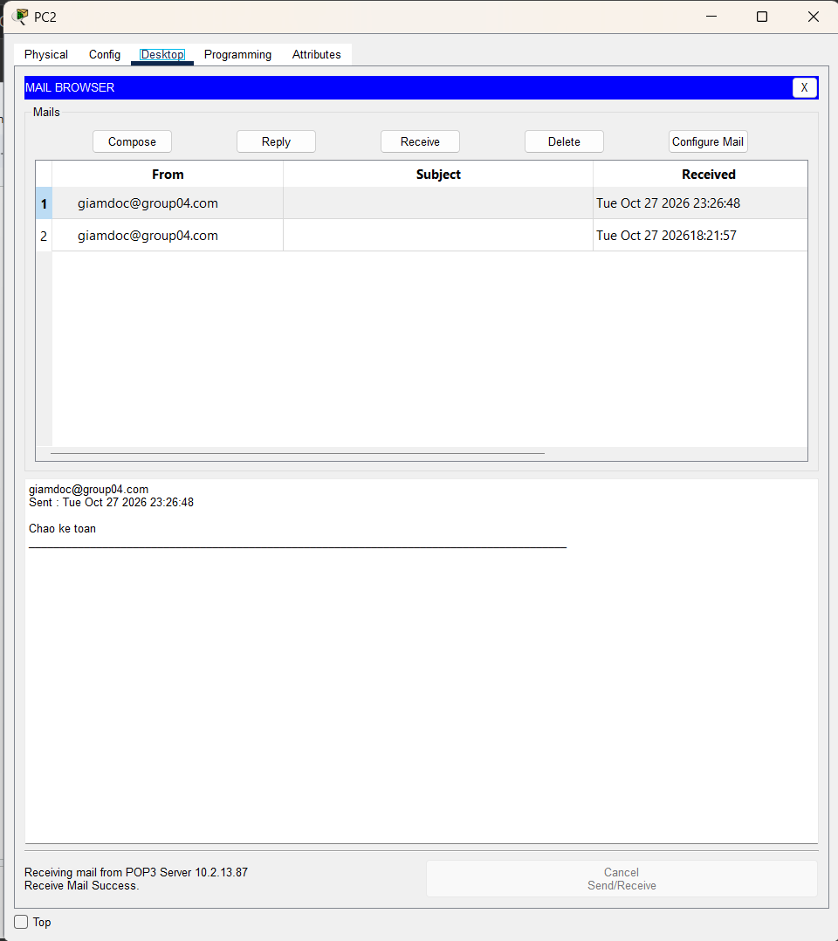
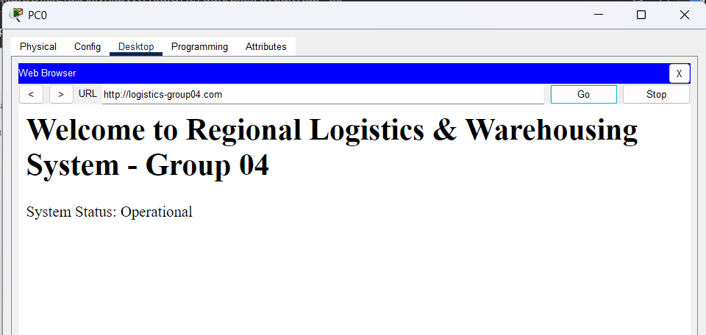
TESTING & VERIFICATION (2/2)
Intranet Web & Corporate Email Testing
2. Gửi/Nhận Email Giữa Giám Đốc & Kế Toán
1. DNS Resolution & Intranet Portal Access
1. Phân Giải DNS & Truy Cập Web Intranet
2. Cross-Site Email Transmission
http://logistics-group04.com -> HTTP Server (10.2.13.86)
http://logistics-group04.com -> HTTP Server (10.2.13.86)
giamdoc@group04.com -> ketoan@group04.com (Send Success)
giamdoc@group04.com -> ketoan@group04.com (Success)
All Layer 7 application services (HTTP, DNS, SMTP, POP3) confirmed fully operational across all departmental endpoints.

Slide 13

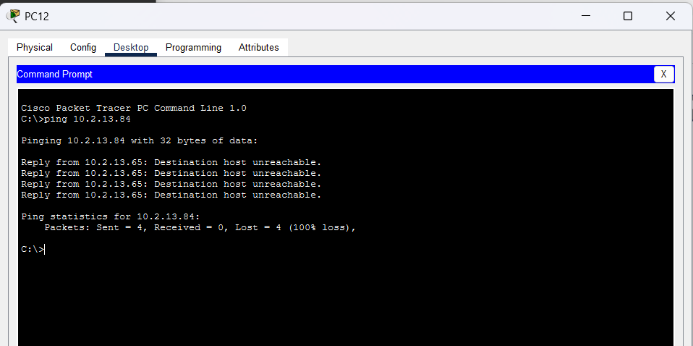

SECURITY VERIFICATION
ACL Rule Denial Verification (Block Enforcement)
Test Case Execution
Initiate ICMP Echo from PC12 in Security Subnet (10.2.13.67) targeted to 10.2.13.84 (DHCP Server).
Command Output Result
Reply from 10.2.13.65: Destination host unreachable.
Packets: Sent = 4, Received = 0, Lost = 4 (100% loss)
Extended ACL on R3-WH successfully blocks unauthorized surveillance endpoints from reaching the enterprise Server Room.

Slide 14
CONCLUSION & DEFENSE READINESS
100% DELIVERABLES ACHIEVED
100%
200+
Constraint Compliance
Host Capacity
Zero VLANs or Layer 3 Switches used, strictly adhering to physical router interface mandates.
Efficient VLSM subnetting supporting 7 subnets with generous expansion headroom.
THANK YOU FOR YOUR ATTENTION!
Group 04

