Slide 1

Evolutionary Games and Spatial Chaos Martin A. Nowak & Robert M. May

Slide 2
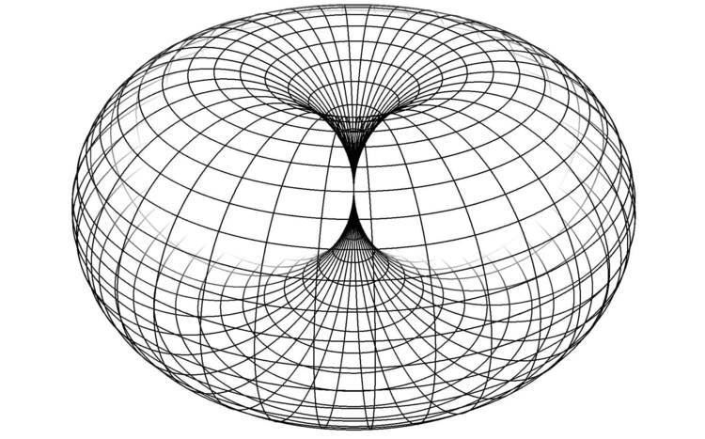
The spatial PD game
Two kind of players: those who always cooperate, C, and those who always defect, D.
We place those players on a two dimensional nxn lattice (grid), each lattice site is occupied either by a C or a D.
In each round of the game (each generation), the players play the PD game with nearest neighboring sites (here 8) and with one's own site (thus we define these sites as a territory – a 3x3 grid).
The score for each player is the sum of the payoffs in these encounters with neighbors.
At the start of the next generation, each lattice-site is occupied by the player with the highest score among the previous owner and the immediate neighbors.
Boundaries are fixed but we can also define the lattice as a torus.
Conclusions we will deduct remain true if players interact only with the four orthogonal neighbors in square lattices or self-interactions are included.

Slide 3
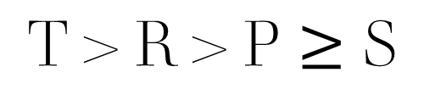
The Prisoner's Dilemma (PD) Game
 | C | D
C | R = 1 | S = 0
D | T = b >1 | P = 0
$$\text{T}\text{ > }\text{R}\text{ > }\text{P}≥\text{S}$$

Slide 4
Chaos in the Spatial PD game
The dynamical behavior of the system depends on the parameter b.
[b > 1.8] 2x2 or larger cluster of D will continue to grow at the corners.
[b < 1.8] big D cluster will shrink
[b < 2] 2x2 or larger cluster of C will continue to grow
[b > 2] C clusters do not grow
[2 > b > 1.8] C clusters can grow in regions of D and vice versa
Chaos persists in shifting patterns C → D, D → C, D → D, C → C

Slide 5
Some Examples
Color assignments:
C → C blue
D → D red
D → C yellow
C → D green
fc = frequency of cooperators
limT→inf fc = 12log2 – 8 = 0.318 can be proven
Although this approximation always works when we have 10% random D and 1.8<b<2 we don’t know why it does so!

Slide 6
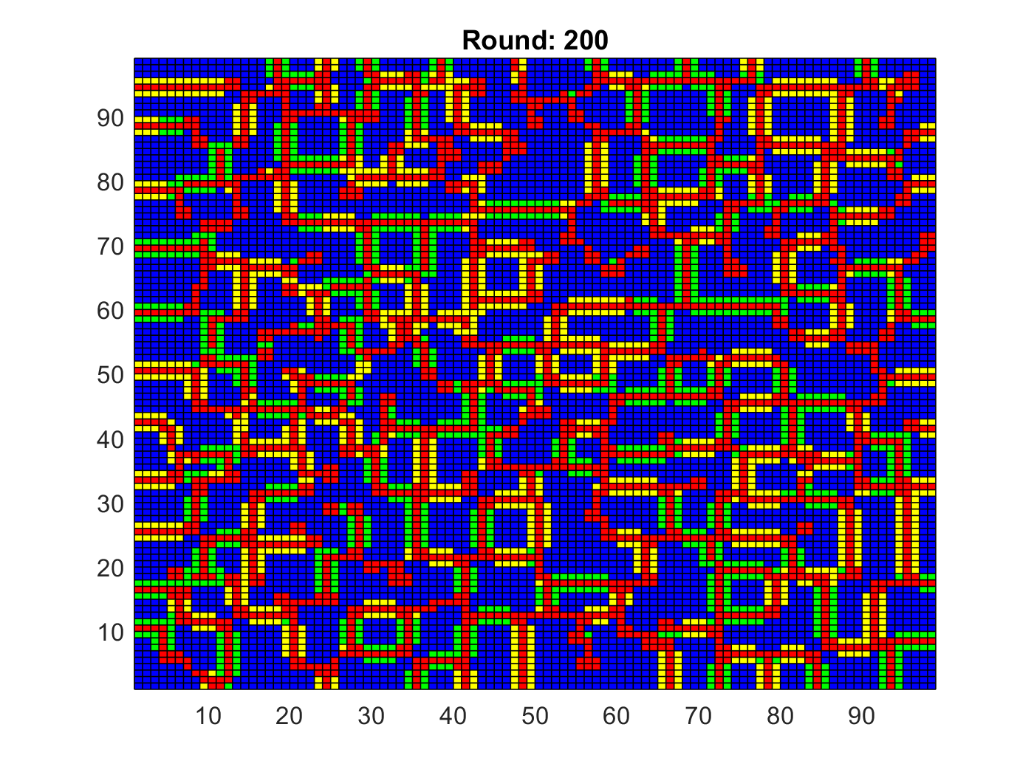
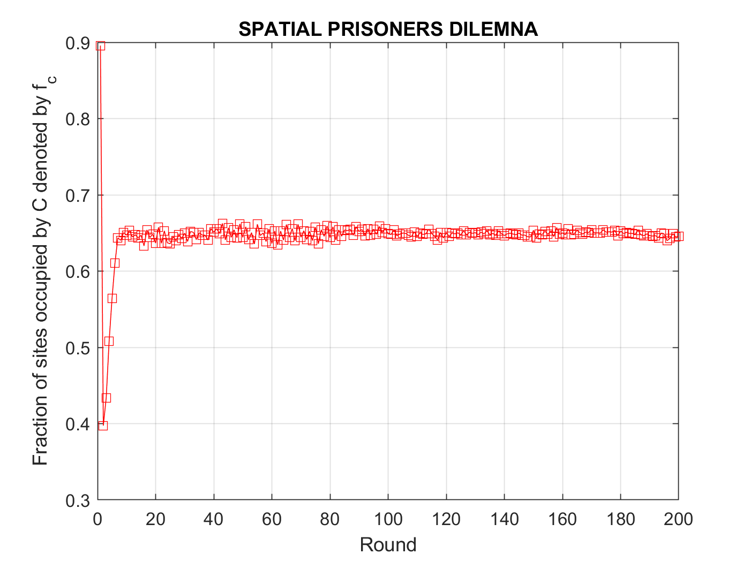
10 % D randomly at 99x99 lattice T=200, b=1.6

Slide 7
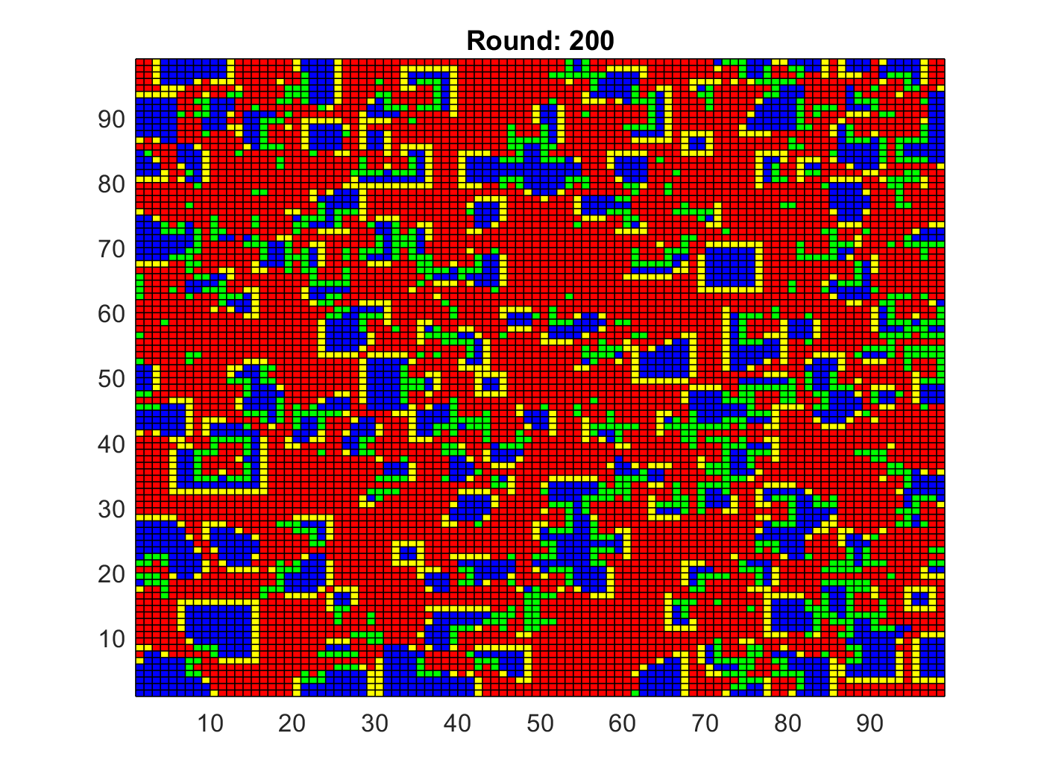
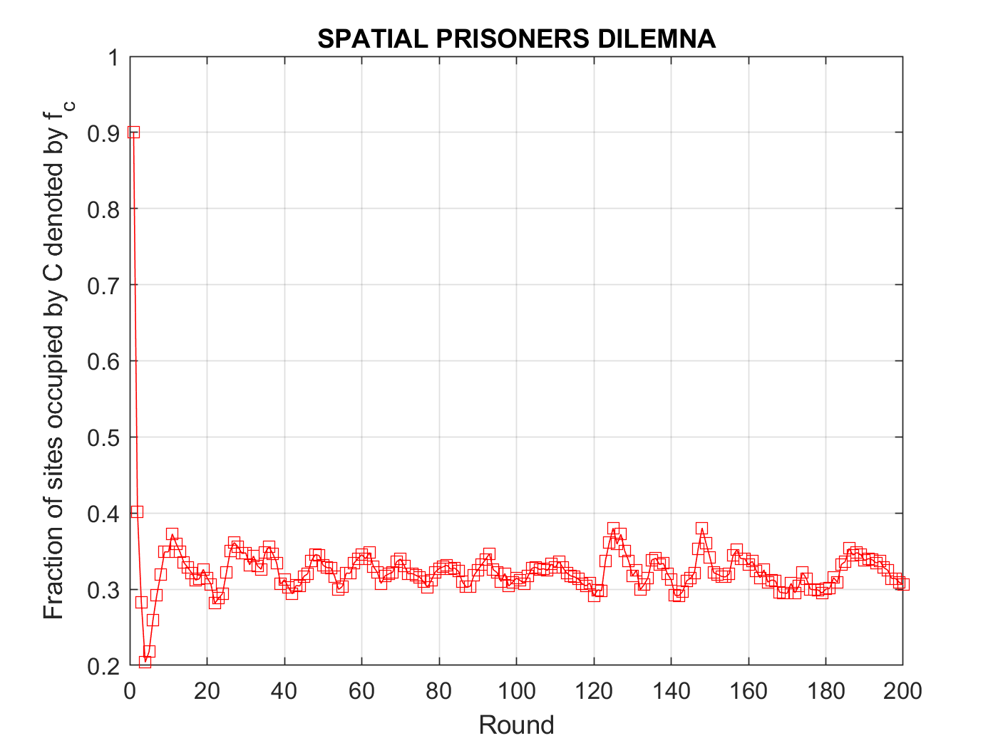
10 % D randomly at 99x99 lattice T=200, b=1.9

Slide 8
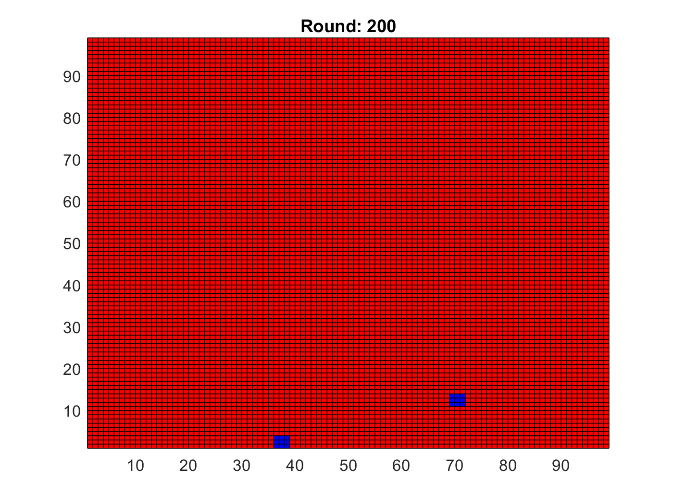
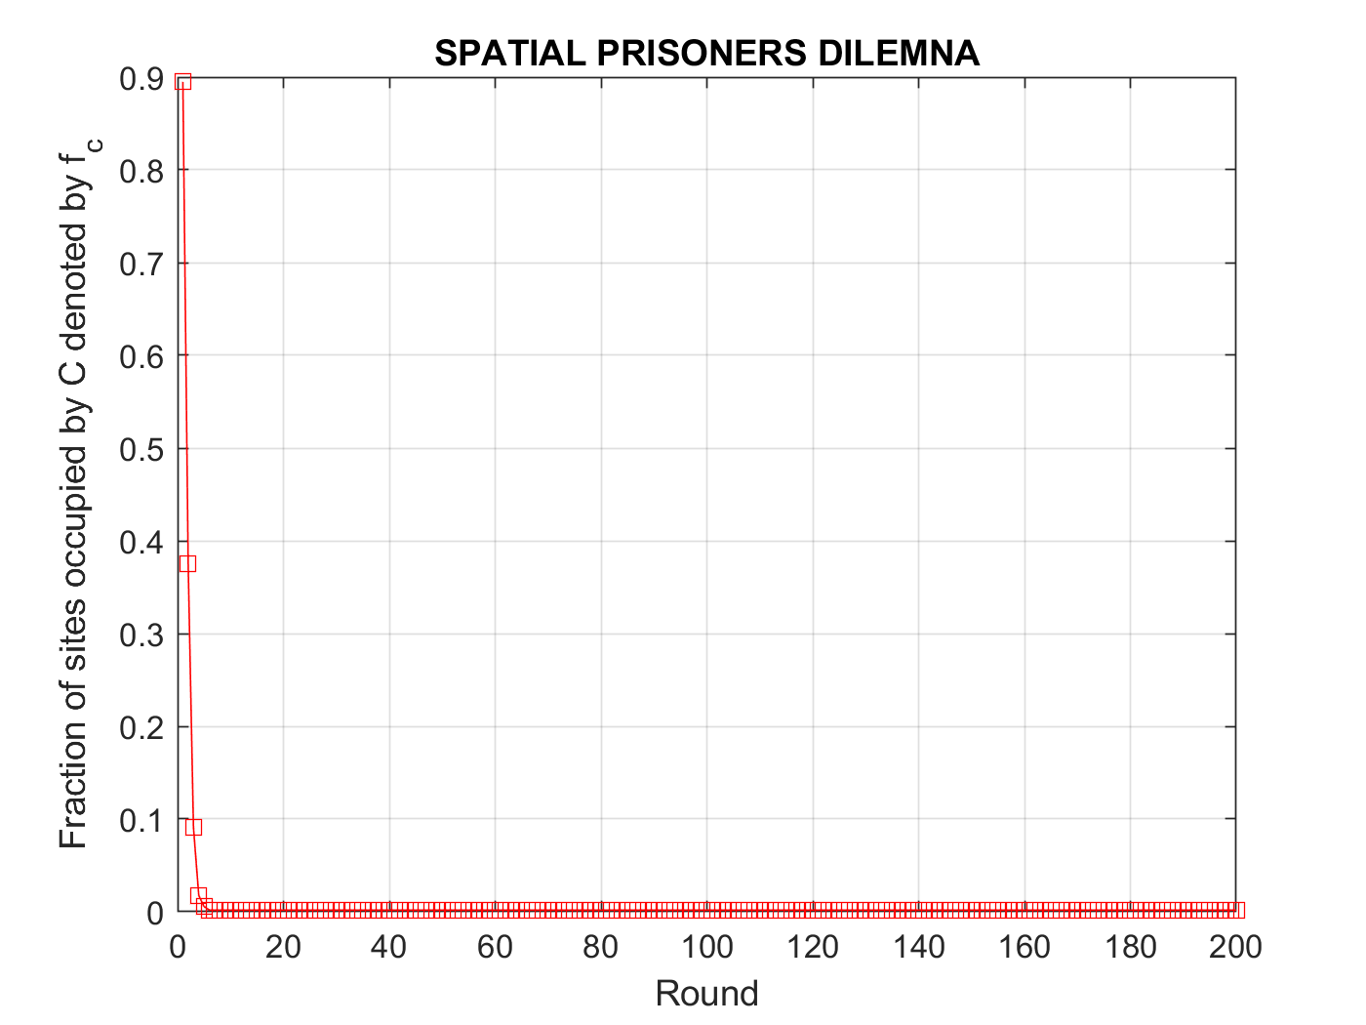
10 % D randomly at 99x99 lattice T=200, b=2.5

Slide 9
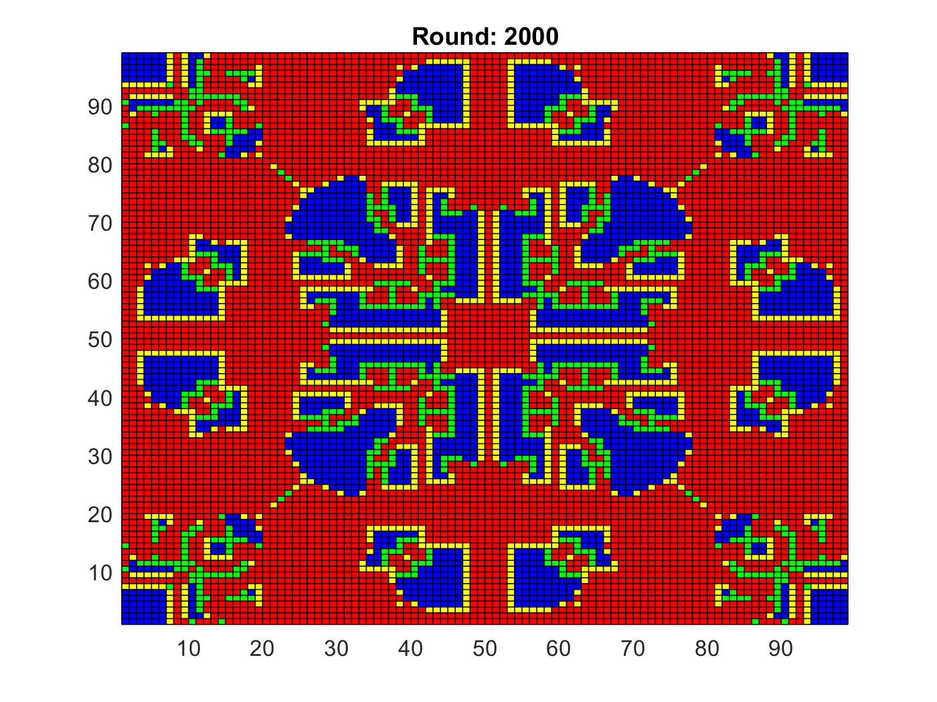
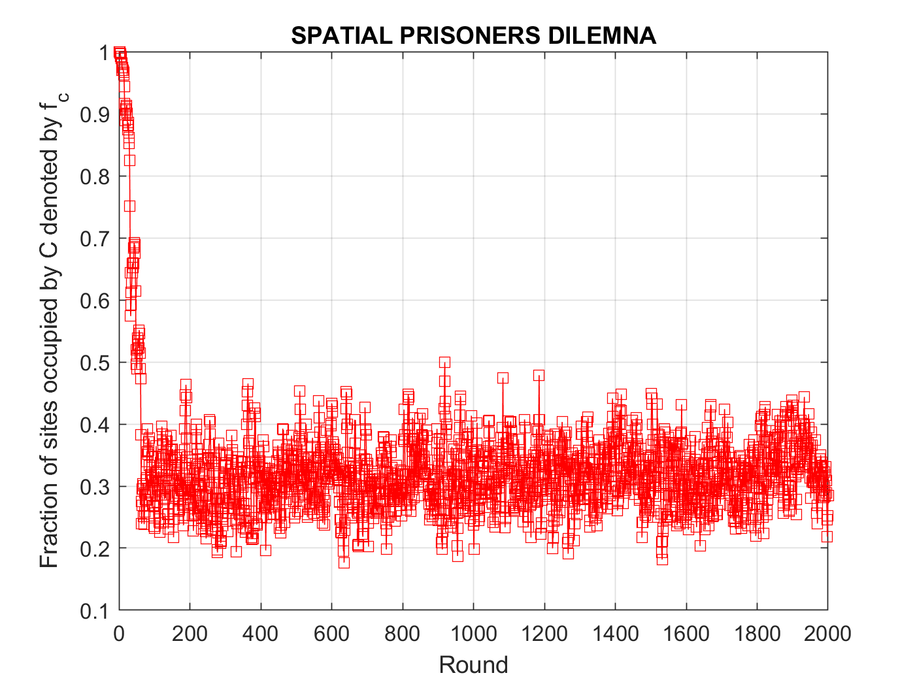
1 D at the center of the 99x99 lattice T=2000, b=1.9

Slide 10
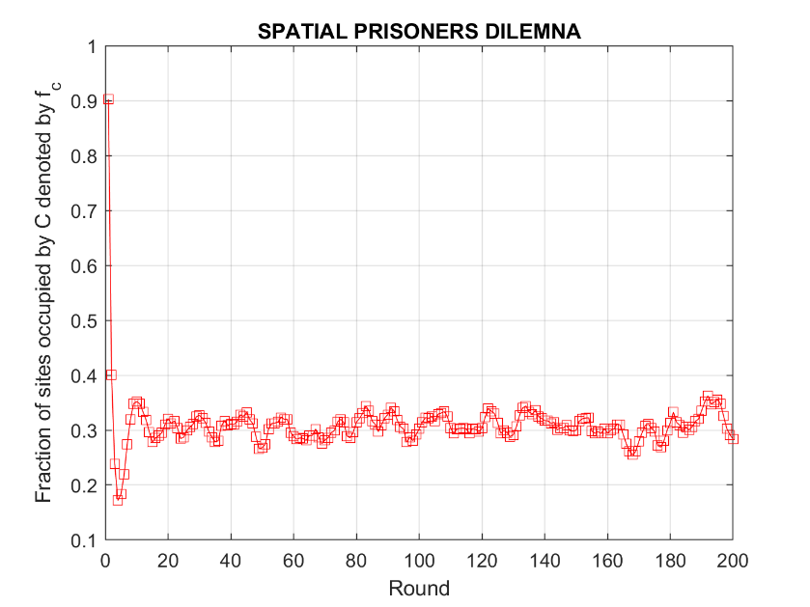
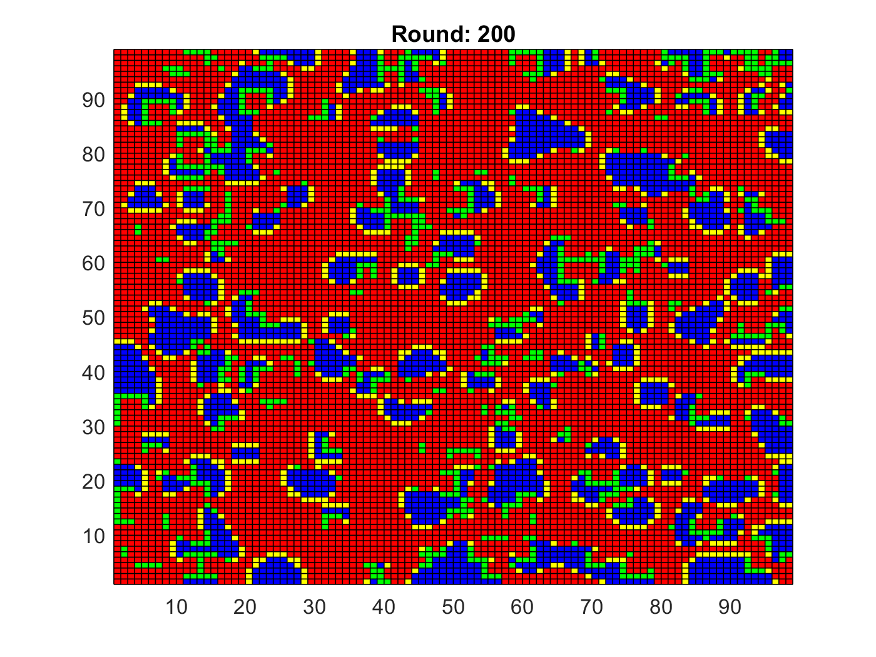
8 Neighbours (thus self interaction exluded)
“Interesting Region" is 5/3>b>8/5 (here b=1.62 with 10% random D)
Similar symmetric patterns
fc → 0.299

Slide 11
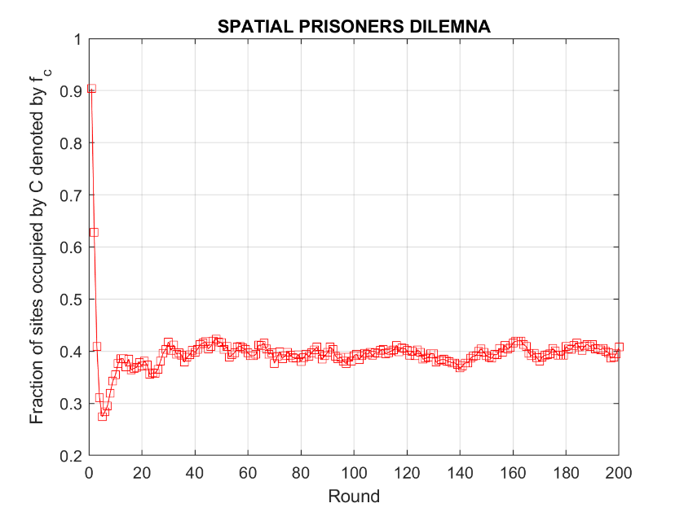
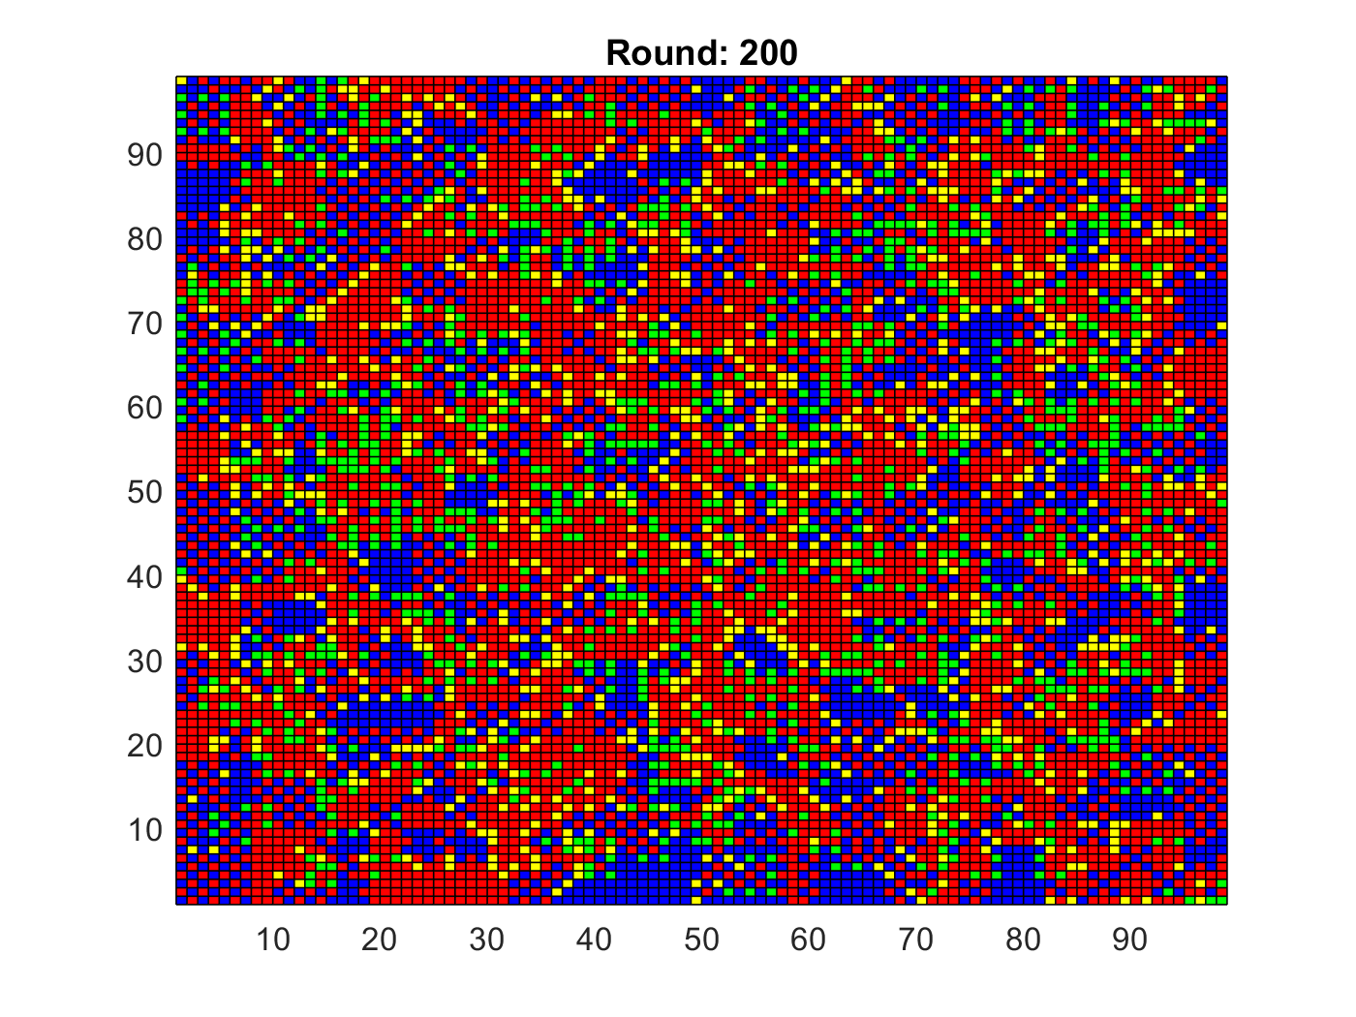
5 Neighbours (including self)
“Interesting Region” is 2>b>5/3 (here b=1.8 with 10% random D)
Similar symmetric patterns
fc → 0.374

Slide 12
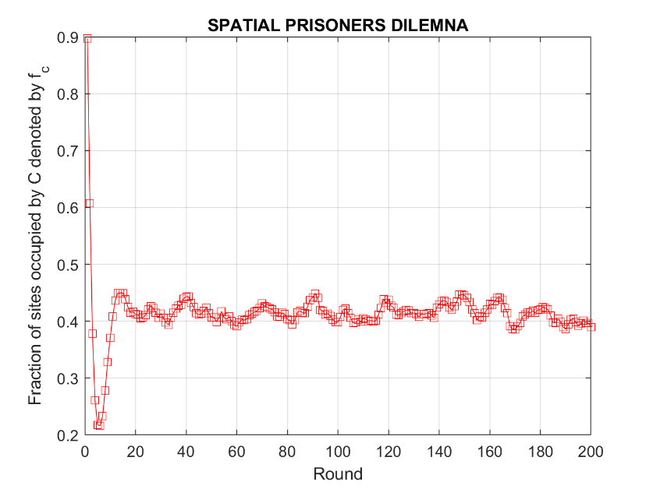
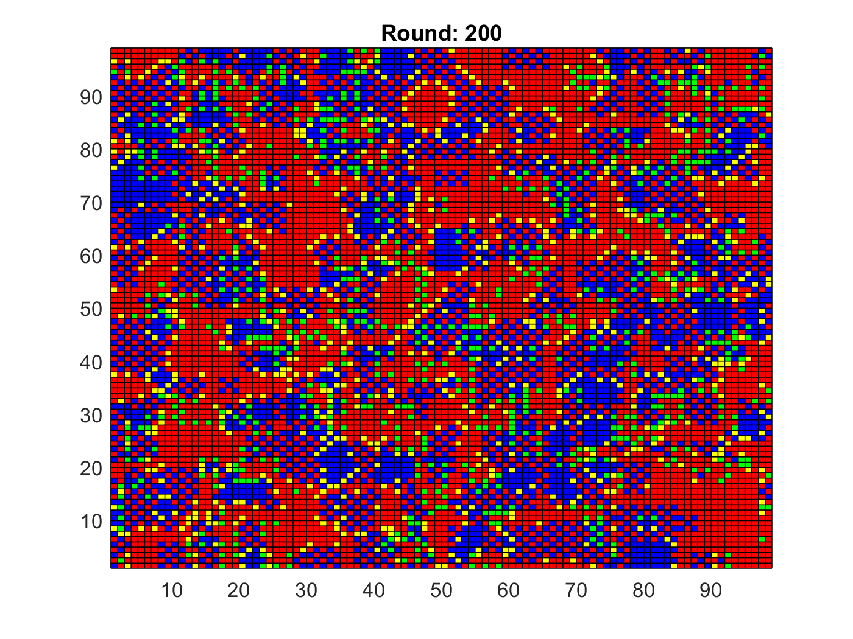
4 Neighbours (thus self interaction exluded)
“Interesting Region” is 3/2>b>4/3 (here b=1.4 with 10% random D)
Similar symmetric patterns
fc → 0.374

Slide 13
Conclusions and Applications
Although the details of the patterns depend on the value of b, a wide range of values leads to chaotic patterns whose nature is almost always independent of the initial proportions of C and D.
Such deterministically generated spatial structures may model and describe pre-biotic evolution of cooperation (among molecules, cells or organisms) as well as Turing models and 2-state Ising models.

Slide 14
Demetriou Marios Giakoumoglou Nicos Manouselis Panteleimon

