Slide 1
Who Are The Billionaires ? Introduction to the World’s Billionaires
Becoming Billionaire 101
Project Leader : Gia Liu Data Collector : Ezra Salomon Data Cleaner : Navjeet Ghuman Data Analyst : Kevin Tian

Slide 2
Billionaire Features
Who?
Worth?
Industry?
Country?
Gender?
Age?

Slide 3
What You Will Learn … …
Billionaires Around The Globe
01
02
Billionaires in the US
03
Correlations
04
Prediction

Slide 4
Where Are Most Billionaires From ?
United States
cumulative billionaires worth 4577 billion
China
cumulative billionaires worth 1805 billion
India
cumulative billionaires worth 637 billion
see world map

Slide 5
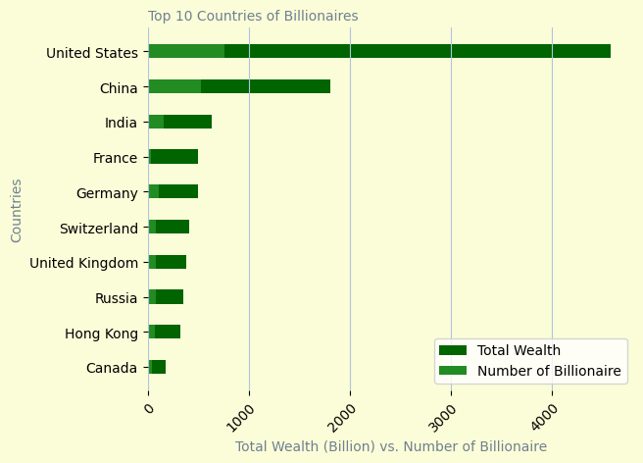
Top 10 Countries of Billionaires Around The Globe
(China)

Slide 6
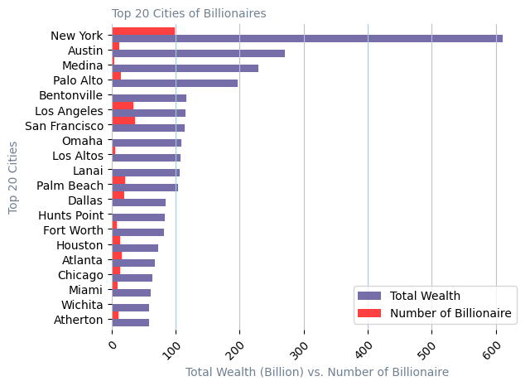
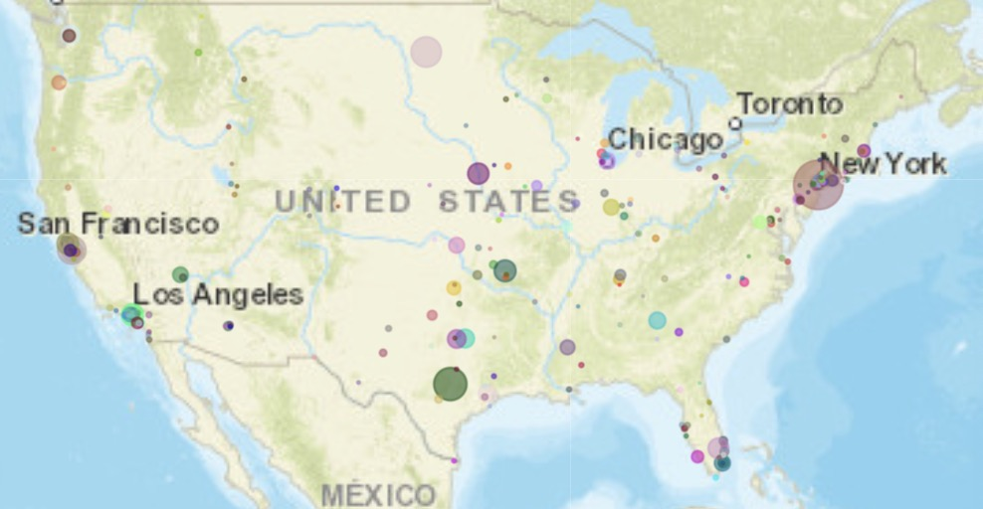
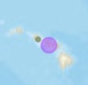
Top 20 Cities of Billionaires in the US

Slide 7
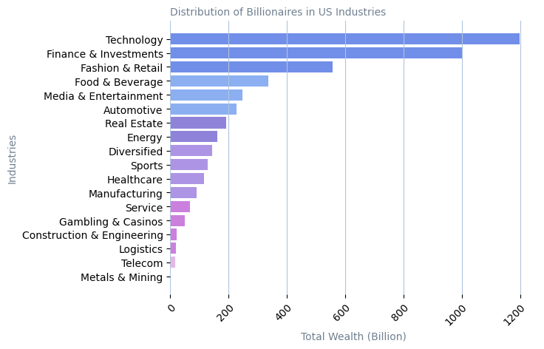
Tech, Finance and Retail are Top Billionaires industries

Slide 8
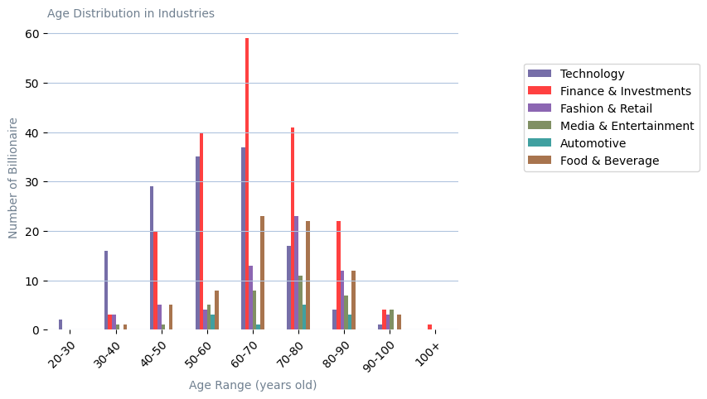
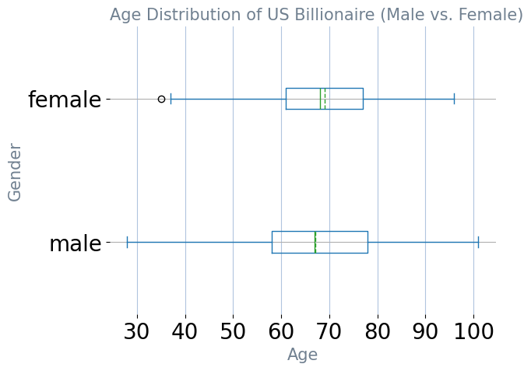
Age Distribution of Each Industry In US
Finance & Investments
Technology

Slide 9
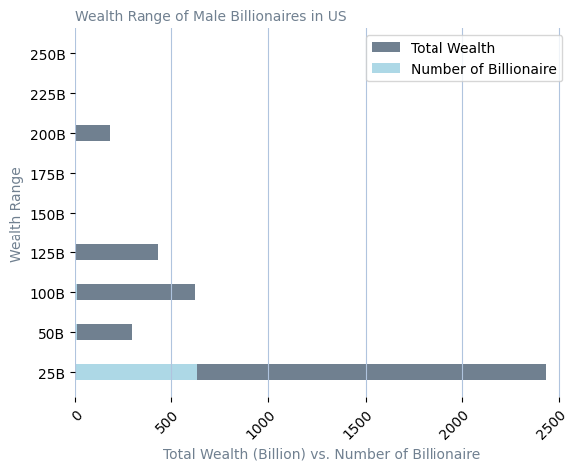
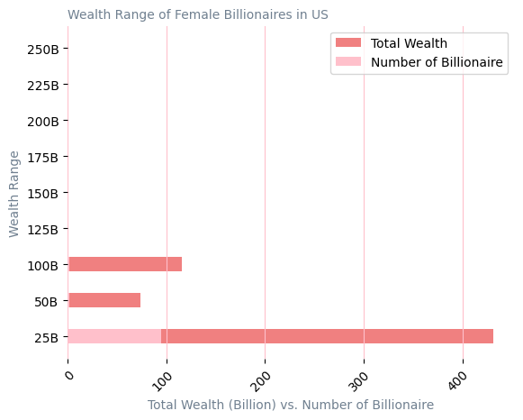
A Ratio of 7:1 In Gender Distribution

Slide 10
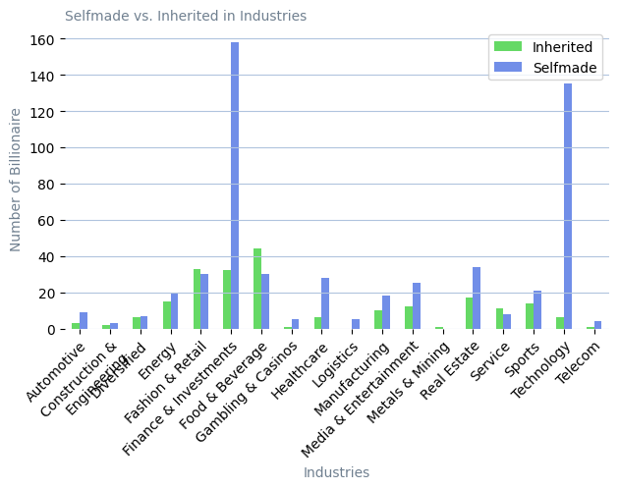
Most Billionaires are Self-made, however … …
LVMH
L’Oreal
Walmart
Nutella
Heineken
Red Bull
Hotels
Education
Logistics

Slide 11
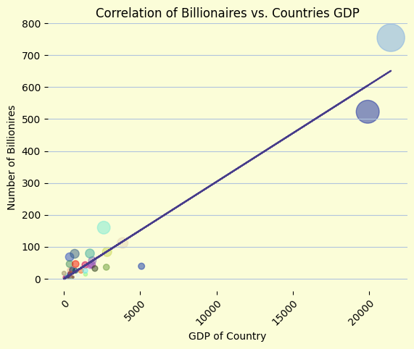
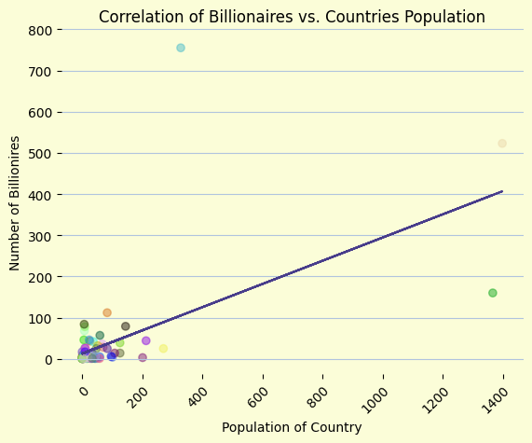
Correlations with GDP and Population
Correlation : 0.97
Correlation : 0.60

Slide 12
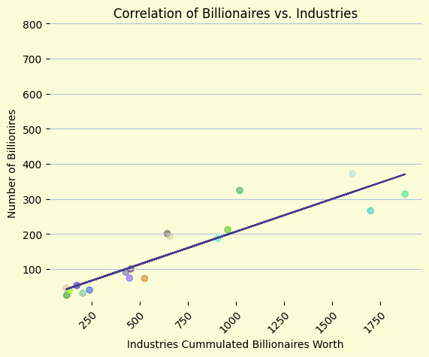
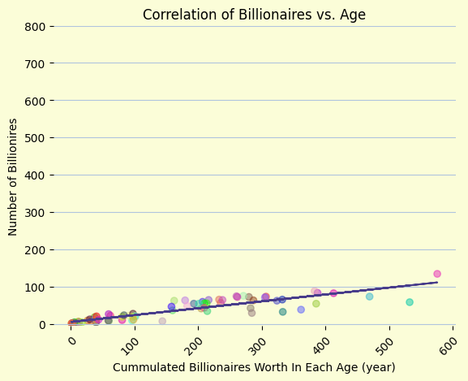
Correlations with Age and Industry
Correlation : 0.92
Correlation : 0.89

Slide 13

If You Were A Billionaire, How Much Would You Worth… …?
--- INPUT---
Country's GDP
Gender
Age
Industry
Let’s Predict :
Jump to DEMO !!!

Slide 14
Thank You

