Slide 1
Who Are The Billionaires ? Introduction to the World’s Billionaires
Becoming Billionaire 101
Project Leader : Gia Liu
Data Collector : Ezra Salomon
Data Cleaner : Navjeet Ghuman
Data Analyst : Kevin Tian

Slide 2
Billionaire Features
Who?
Worth?
Industry?
Country?
Gender?
Age?

Slide 3
What You Will Learn … …
Billionaires Around The Globe
01
02
Billionaires in the US
03
Correlations
04
Prediction
A brief introduction to the distribution of billionaires in the world
Introduction to billionaires in the US
The factors that correlates to billionaires
What if you were a billionaire... …
Presented by Group 6 : Gia Liu / Kevin Tian / Ezra Salomon / Navjeet Ghuman

Slide 4
World Map
United States
cumulative billionaires worth 4577 billion
China
cumulative billionaires worth 1805 billion
India
cumulative billionaires worth 637 billion
see world map

Slide 5
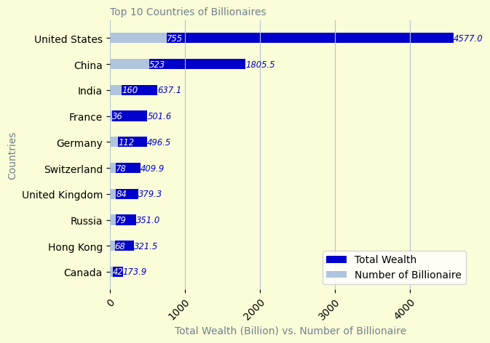
Billionaires Around The Globe
Presented by Group 6 : Gia Liu / Kevin Tian / Ezra Salomon / Navjeet Ghuman

Slide 6
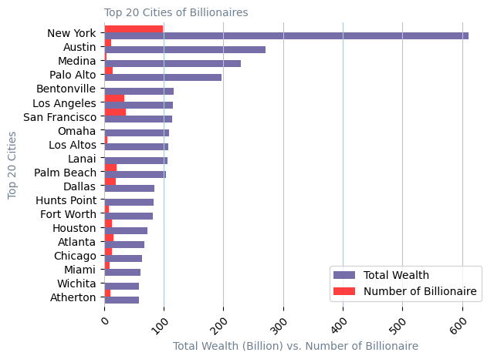
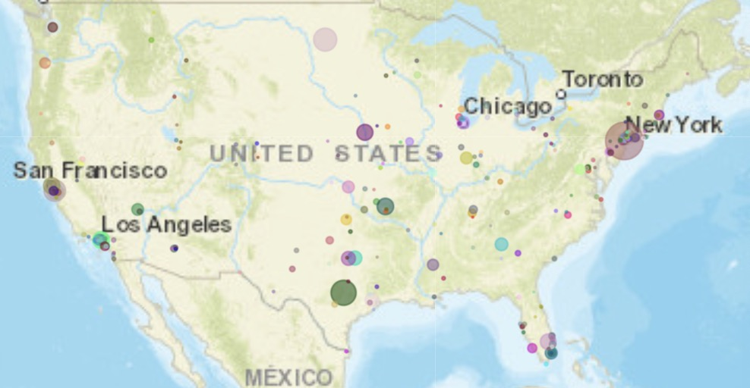
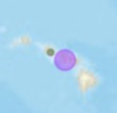
Billionaires in the US

Slide 7
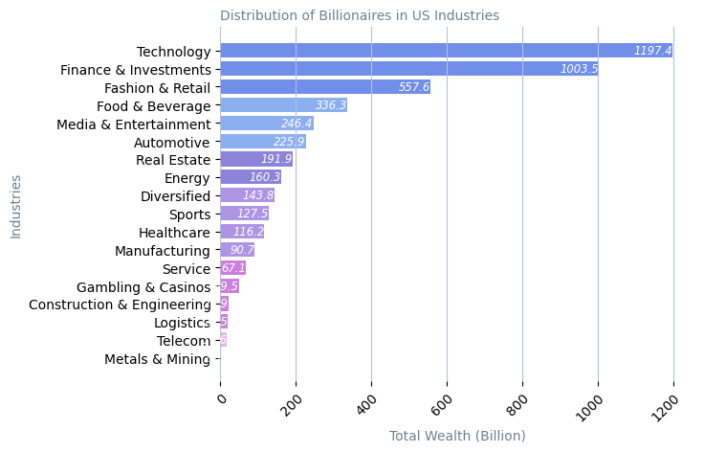
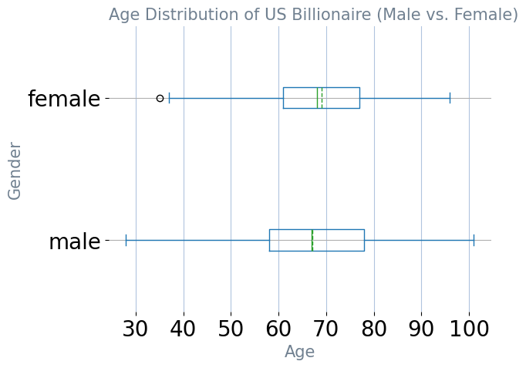
The Industries of Billionaires in US

Slide 8
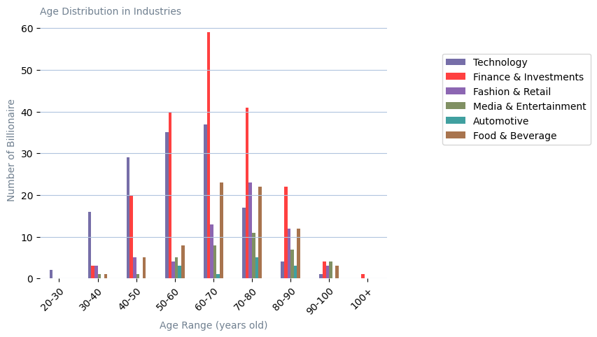
Age And Industry in US
Finance & Investments
Technology

Slide 9
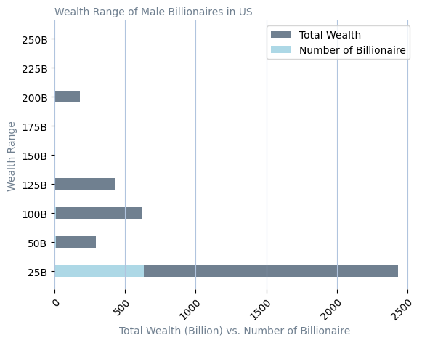
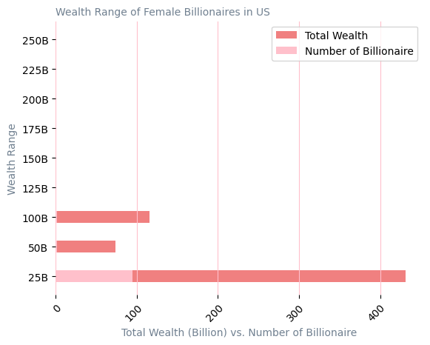
Gender and Wealth in US
Male : Female = 7:1

Slide 10
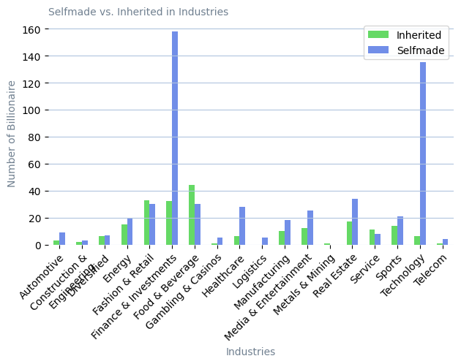
Self-made Billionaires in Industries
LVMH
L’Oreal
Walmart
Nutella
Heineken
Red Bull
Hotels
Education
Logistics

Slide 11
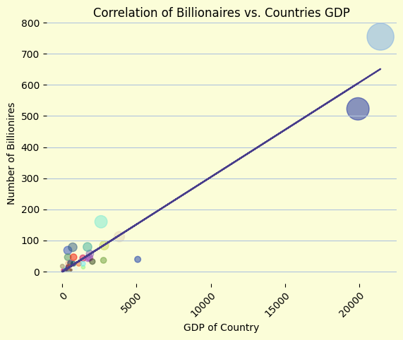
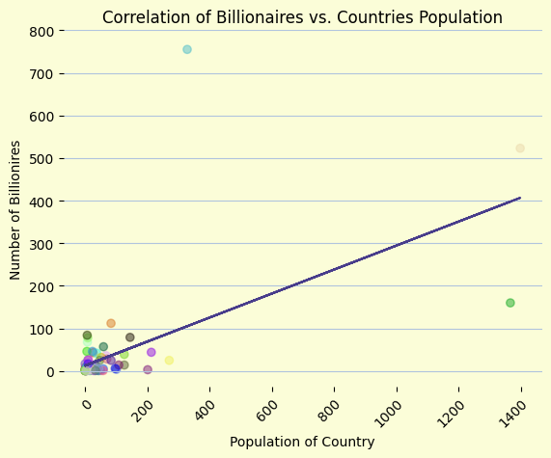
Correlations with GDP, Population, Age, Industry
Correlation : 0.97
Correlation : 0.60

Slide 12
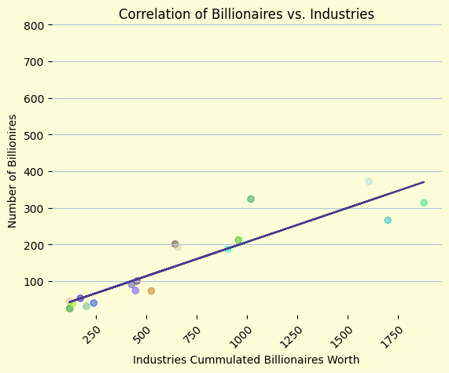
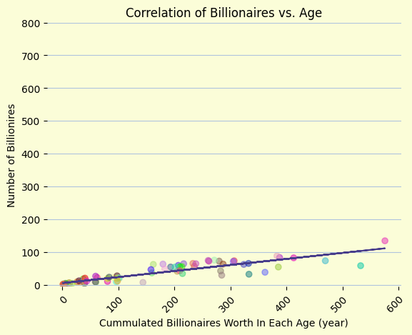
Correlations with GDP, Population, Age, Industry
Correlation : 0.92
Correlation : 0.89

Slide 13

If You Were A Billionaire, How Much Would You Worth… …?
--- INPUT---
Country's GDP
Gender
Age
Industry
Let’s Predict :
Jump to DEMO !!!

Slide 14
Thank You

Slide 15
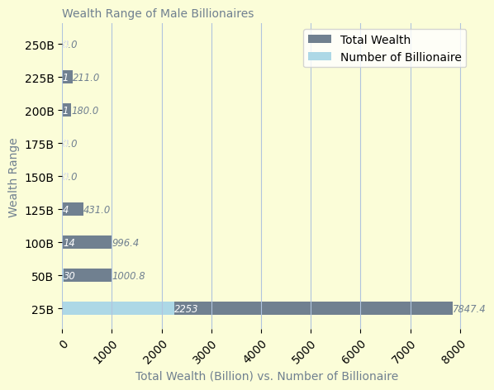
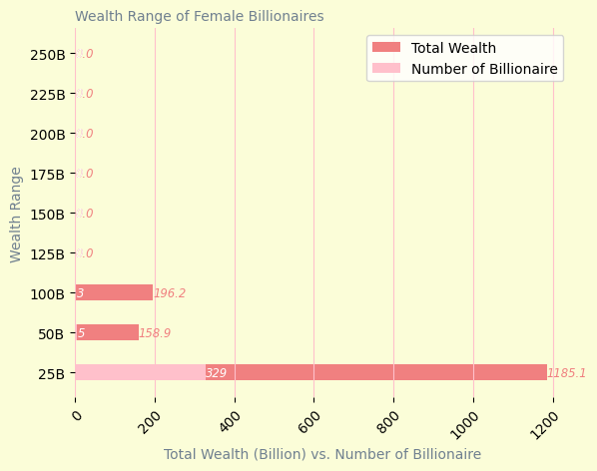
Gender And Wealth

Slide 16
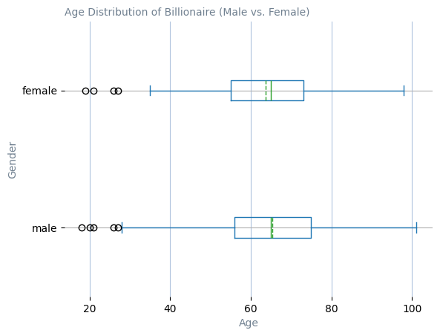
Age And Wealth
Mean for Male : 65.35 Median for Male : 65 Mean for Female : 63.67 Median for Female : 65

