Slide 1
Domain Specific Modelling Languages in Bigraphs
Gian Perrone
18 February 2013

Slide 2
Outline
Modelling and Motivation
Bigraphs
Bigraphical Languages
Refinement
Tools and Verification
Modular Construction
Conclusion

Slide 3
Objectives
Convince you that modelling is an important activity
Convince you that bigraphs are a good tool for constructing models and modelling languages
Summarise the contributions of my thesis

Slide 4
Modelling and Motivation
Part 1

Slide 5
Explanation
We construct models to explain or understand artifacts and processes of the world around us

Slide 6
Modelling
A system can be too complex to understand or analyse directly
A model can be a simplification or an abstraction
… or simply a blueprint that can be analysed prior to constructing something larger
Compare: mental models, sketches, blueprints, mathematical models

Slide 7
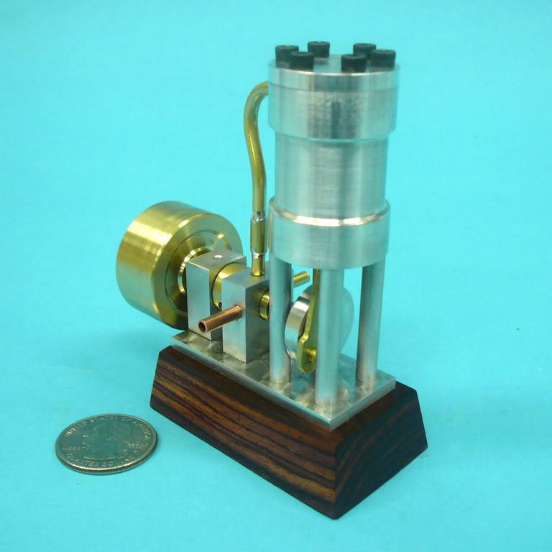
1973 Model Steam Engine
Source: homemodelenginemachinist.com

Slide 8
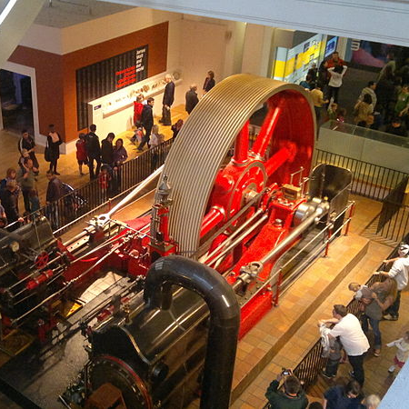
1903 Mill Engine
London Science Museum
Source: Wikimedia Commons

Slide 9
Simplifying Assumptions
When testing the aerodynamic properties of a plane, it’s not necessary that the seats be comfortable.
A model may ignore or simplify some properties in order to focus attention on the interesting or important properties
Control, approximate, or obscure some factors in order to understand the interplay and functioning of others

Slide 10
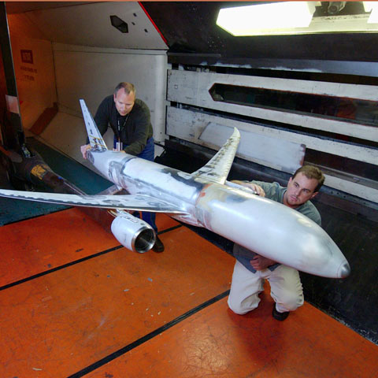
Simplifying assumptions
Source: Boeing.com

Slide 11
Abstract Models
Those are concrete models of concrete things (e.g., planes, steam engines) with obvious modelling techniques
What about abstracted models of entire systems that don’t necessarily have a concrete presence in the world?
Or which only have a partial presence in the world?
e.g, Software, financial systems, social interactions, computer networks, transport systems

Slide 12
Communicating Systems
Most interesting systems involve communication and interaction
Claim: We struggle to understand communicating systems at scale
Software systems are some of the most complex systems we build today
e.g., a simple banking transaction must communicate with multiple parties.

Slide 13
Communicating Systems
Simplifying assumption: build models that capture only interaction and communication
We don’t care why a system communicates, merely that it can communicate in certain ways
Effective way to model software, business processes, systems biology, financial transactions, network protocols, …

Slide 14
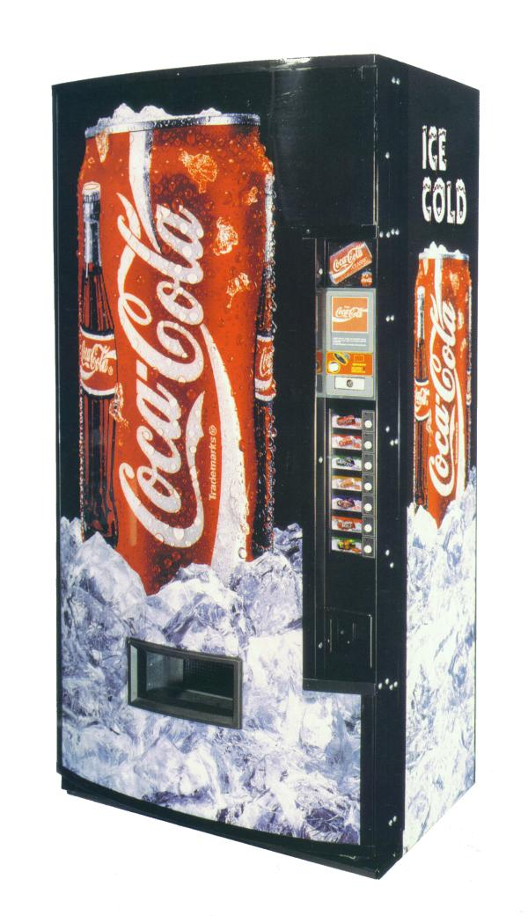
A Vending Machine
Source: Coca-Cola Archive

Slide 15
Another Vending Machine
“A vending machine is a machine which dispenses items such as snacks, beverages, alcohol, cigarettes, lottery tickets, cologne, consumer products and even gold and gems to customers automatically, after the customer inserts currency or credit into the machine.” (Wikipedia)

Slide 16
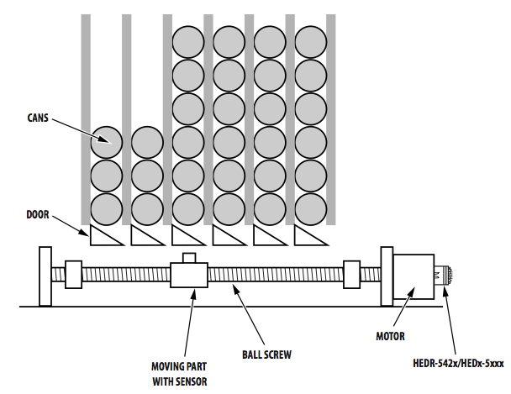
Another Vending Machine
Source: Avago Technologies

Slide 17
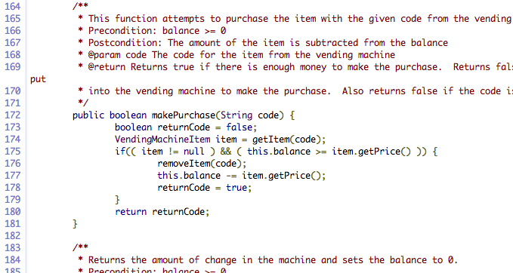
Another Vending Machine

Slide 18
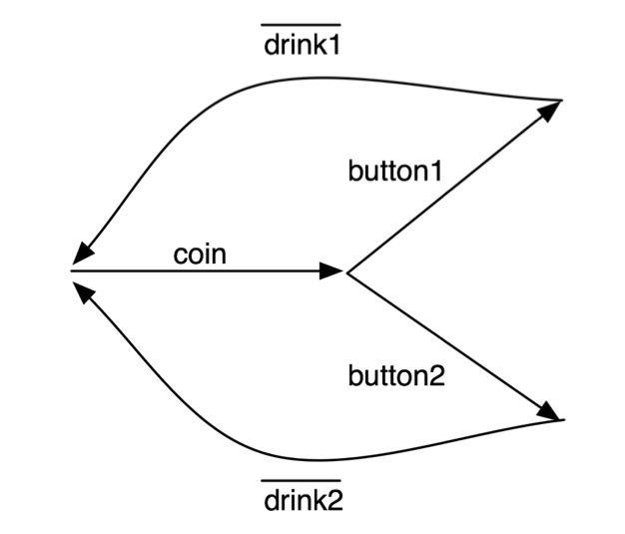

Another Vending Machine

Slide 19
Process Languages
Modelling interaction and communication gives rise to very small process languages
A few common constructs:
Send a message (e.g., push a button, dispense a drink)
Receive a message (e.g., receive a button press, receive a coin)
Choose between different possible actions (choose a drink)
Combine two processes in parallel
Mathematically precise description of behaviour

Slide 20
Process Languages
General purpose (sometimes…)
Structured and precise
Assumes different participants (processes) can reliably and instantaneously send messages to one another using channels
Understand the overall behaviour of many processes behaving together in terms of their individual and composite behaviour

Slide 21
A Buyer

Slide 22
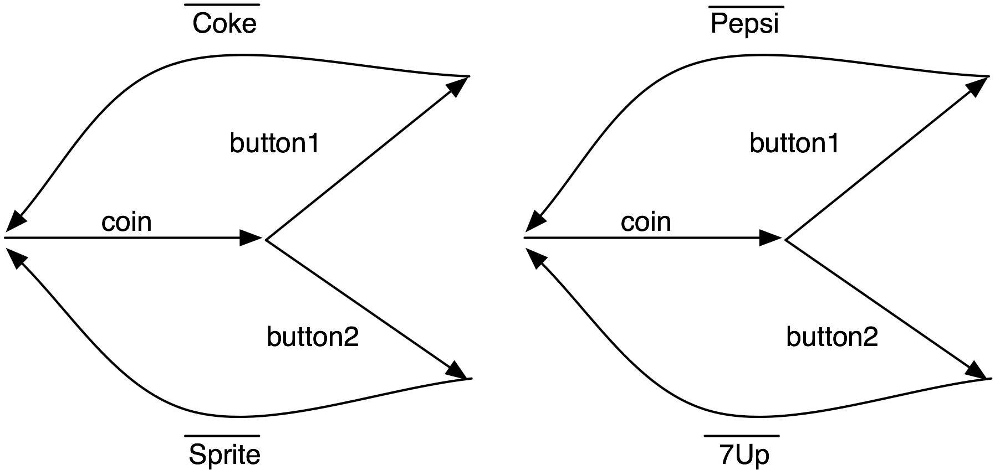
Two Vending Machines

Slide 23
Process Languages
Dozens in common use
Hundreds of variations
e.g., CCS, CSP, ACP, Actor Model, Pi-calculus, Petri nets, cham, Action calculi, …
Endless proliferation of new variations and languages

Slide 24
Proposing a New Process Language
Define syntax and semantics
Prove a handful of interesting properties
Use it once to solve a particular problem
Claim generality
Publish the paper
Forget about it forever
Go to Step 1

Slide 25
Proposing a New Process Language
New process languages are used to specialise to a given domain
Not cynical – there are good reasons to specialise to a domain!
Instead of trying to stop proliferation of new languages, we should support reuse
… and provide better ways of specialising languages to a given domain
Ephemeral, disposable process languages for every occasion – specialised to a domain.

Slide 26
Domain-Specificity
Moving the language constructs with which we can express models closer to the domain of interest makes models better!
Familiar (natural) language is good!
Domain-experts are not necessarily modelling experts
Instead, describe models in the language of the domain
Business processes in the language of the business
And systems biology in the language of biologists
And security protocols in the language of security experts
The outcome is often of more interest to the domain-expert than the mechanism of the process itself

Slide 27
Domain-Specificity at work
When describing vending machines, we want to talk about drinks and coins and buttons
When a car, we want to talk about wheels and drivers and roads
Domains have different sets of entities they wish to describe
And the meaning of the same entities can change between domains!

Slide 28
Objective
Make it easier to specialise a modelling language to a domain
Promote re-use of components between modelling languages
Make it easier to use modelling languages
… which leads us to…

Slide 29
Bigraphs
Part 2

Slide 30
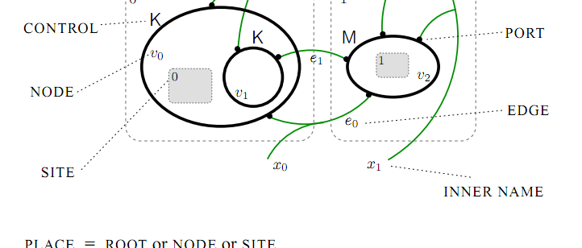
A Bigraph
Source: Milner, R. The Space and Motion of Communicating Agents (2009)

Slide 31
Bigraphs
Formal, mathematical objects
Represent orthogonal notions of locality and connectivity
Which are ubiquitous in modelling activities
Locality: physical environments, logical containment, tree structures, filesystems, ownership
Connectivity: association, relationships, networks, name binding

Slide 32
In the internet cafe
Draw picture (location: in the same room, connectivity to many different social networks, computer networks etc)
The reveal: it’s a bigraph

Slide 33
Bigraphs
Unambiguous, formal visual presentation
A categorical presentation in terms of interfaces
Reaction semantics
A single bigraph defines the state of some system
A set of reaction rules describe how the system may behave and evolve over time

Slide 34
Bigraph example
Picture here bean factory tins moving between components

Slide 35
Reaction Rules
Picture here

Slide 36
Reaction
Picture results

Slide 37
BMC
Presenting bigraphs in a way that is familiar to process calculus experts.
Introduce signatures, sortings, reaction rules

Slide 38
Bigraphical languages
Part 3

Slide 39
Defining a language
Syntax: What is the structure of sentences in the language?
Our syntax consists of: Tins, Soap, Component, Lid, Beans, Logo
Semantics: What do these sentences mean?
How do the components operate on the Tins, Beans, Lids, Soap etc. to transform raw materials to finished products?

Slide 40
Bigraphical Languages
Syntax: Signatures + Sortings
What constructors and values are available?
How may these be combined to form valid expressions?
How may names interact and be shared?
Semantics: Reaction rules
Given a state of a system, what does the system look like after we evaluate one step of an expression?
Captures exactly the properties we need to define a language

Slide 41
Bigraphical Languages
Example (addition + multiplication)

Slide 42
Refinement
Part 4

Slide 43
Equivalence
Refinement is a ubiquitous activity in software engineering
Given a high-level specification, move towards an eventual implementation
Preserving behaviour and properties of interest at every step

Slide 44
Vertical Refinement
Given a language L1, and a model M constructed in that language…
For another language L2, is M still a meaningful model?
Does it still capture the properties of interest?
Does it exhibit any extra, undesirable behaviour in this new setting?
This is captured by enforcing a vertical refinement relation between the languages L1 and L2

Slide 45
Observation
Reeves and Streader (2008) use notions of what we can observe of all entities of a language to demonstrate vertical refinement
For many process languages, “observation” is obvious (i.e., the inputs and outputs that the process sends and receives)
Bigraphs have no primitive notion of input or output, so we can’t rely on it to construct a useful notion of observation

Slide 46
Observation continued
We use an entire model (bigraph) as a single observation
Many observations, related by steps of reaction form a trace of a process
And all such traces of all processes of a language characterise completely the behaviour present in that language
Which allows us to relate the behaviour of one language to that of another

Slide 47
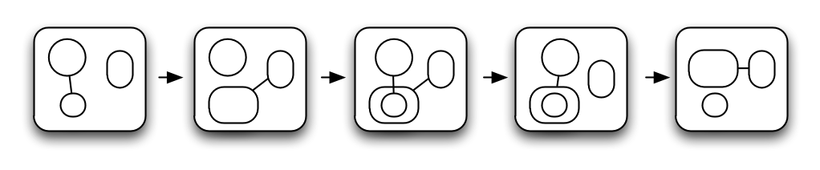
A Trace

Slide 48
A Trace

Slide 49
A Trace

Slide 50
A Trace

Slide 51
A Trace

Slide 52
Safe Vertical Refinement

Slide 53
Safe Vertical Refinement

Slide 54
Safe Vertical Refinement
Abstract
Abstraction Functor
Concrete

Slide 55
Safe Vertical Refinement
Abstract
Abstraction Functor
Concrete
Vertical Refinement

Slide 56

Safe Vertical Bigraphical Refinement
Safety: “Nothing bad will happen”
For a BRSes A and C, and abstraction functor F : C → A
Parameterised by an abstraction functor that allows us to pick the appropriate observations for the task at hand

Slide 57
Making it easier
The guarantee that our abstraction functor preserves behaviour (reaction) need not be simple to establish
But if it preserves reaction rules and active contexts, we have an abstraction functor that will give rise to a safe vertical refinement
Which guarantees the concrete system is a valid implementation of the abstract system
This has found use in the work of others (e.g., Henson et al., “FollowMe: a bigraphical approach”, 2012).

Slide 58
Live Vertical Refinement
Liveness is more subtle, and often ignored in refinement literature (or considered a special case of safety)
Essentially the guarantee that “something good will happen eventually” (Lamport)
Our vertical refinement notion can also ensure that a concrete implementation preserves enough behaviour from the abstract system to guarantee liveness

Slide 59
Verification and Tools
Part 5

Slide 60
BigMC
Provide a tool that allows one to check properties of bigraphical models
By defining a single bigraphical language, we gain a tool for any model expressed in that language
BigMC was a prototype tool designed to achieve this
Also has been used to simulate and experiment with bigraphs

Slide 61
Example: Dining philosophers
Give example from paper

Slide 62
The state explosion problem
Potentially infinitely many distinct states to explore
… which will run forever if we just try to check them
What can we do better? Attempt to use the semantic clues provided by the system designer in defining reaction rules
Approximate (conservatively) the causation relation between reaction rules, groups of reaction rules, and the properties of interest
Attempt to address the question: which of these rules could cause us to reach a state that would violate our property?

Slide 63
Computing Causation
Prior art: Højsgaard & Krivine (2011)
Gives a nice characterisation of how rules may interfere with one another
But not necessarily easy to compute!
We presented a simple heuristic that approximates reaction rule causation for rules obeying a few simple structural conditions
Simple and fast to compute, based on examining the place graph only

Slide 67
Modularity
Part 6

Slide 71
Conclusion
Part 7

Slide 72
Conclusion

Slide 73
Conclusion

Slide 74
Conclusion

Slide 75
Thanks
Supervisors:
Thomas Hildebrandt
Søren Debois
Supported by: The Danish Research Agency (grant no.: 2106-080046) and the IT University of Copenhagen (the Jingling Genies project)

