Slide 1
Domain Specific Modelling Languages in Bigraphs
Gian Perrone
18 February 2013

Slide 2
Modelling and Motivation
Part 1

Slide 3
Explanation
We construct models to explain or understand

Slide 4
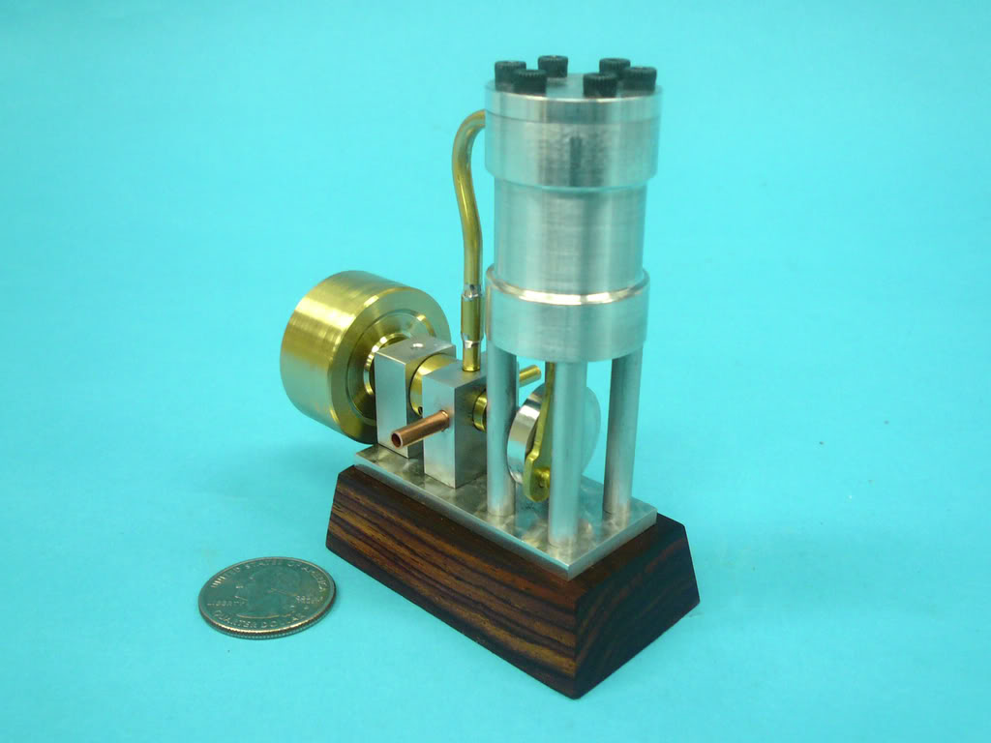
1973 Model Steam Engine
Source: homemodelenginemachinist.com

Slide 5
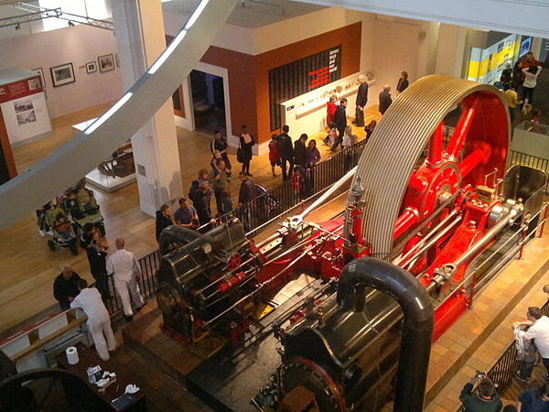
1903 Mill Engine
London Science Museum
Source: Wikimedia Commons

Slide 6
Modelling
A system can be too complex to understand or analyse directly
A model can be a simplification or an abstraction
… or simply a blueprint that can be analysed prior to constructing something larger

Slide 7
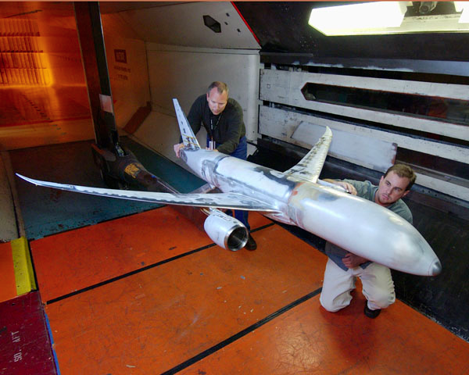
Simplifying assumptions
Source: Boeing.com

Slide 8
Simplifying Assumptions
When testing the aerodynamic properties of a plane, it’s not necessary that the seats be comfortable.
A model may ignore or simplify some properties in order to focus attention on the interesting or important properties

Slide 9
Communicating Systems
Software systems are some of the most complex systems we build today
We struggle to understand them
These systems must communicate persistently in order to achieve outcomes
e.g., a simple banking transaction must communicate with multiple parties.

Slide 10
Communicating Systems
Approach: build models that capture interaction and communication
We don’t care why a system communicates, merely that it can communicate in certain ways
Effective way to model software, business processes, systems biology, financial transactions, network protocols, …

Slide 11
Process Languages
Modelling interaction and communication gives rise to very small process languages
A few common constructs:
Send a message
Receive a message
Choose between different possible actions
Combine two processes in parallel
Mathematically precise description of behaviour

Slide 12
Process Languages
General purpose (sometimes…)
Structured and precise
Assumes different participants (processes) can reliably and instantaneously send messages to one another using channels
Understand the overall behaviour of many processes behaving together in terms of their individual and composite behaviour

Slide 13
Process Languages
Dozens in common use
Hundreds of variations
e.g., Pi-calculus, CCS, CSP, ACP, Actor Model, Petri nets, cham, Action calculi, …
Endless proliferation of new variations and languages

Slide 14
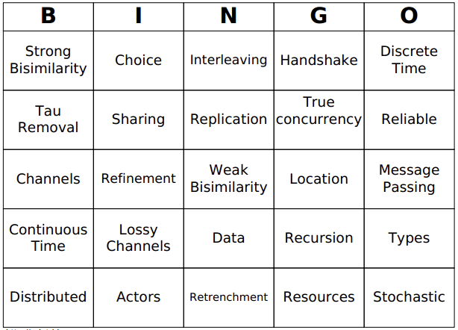
Process Language Bingo

Slide 15
Proposing a New Process Language
Define syntax and semantics
Prove a handful of interesting properties
Use it once to solve a particular problem
Claim generality
Publish the paper
Forget about it forever
Go to Step 1

Slide 16
Proposing a New Process Language
New process languages are used to specialise to a given domain
Not cynical – there are good reasons to specialise to a domain!
Instead of trying to stop proliferation of new languages, we should support reuse
… and provide better ways of specialising languages to a given domain
Ephemeral, disposable process languages for every occasion!

Slide 17
Domain-Specificity
Moving the language constructs with which we can express models closer to the domain of interest makes models better!
Domain-experts are not necessarily modelling experts
Instead, describe models in the language of the domain
Business processes in the language of the business
And systems biology in the language of biologists
And security protocols in the language of security experts
etc etc.

Slide 18
Bigraphs
Part 2

Slide 19
Bigraphical languages
Part 3

Slide 20
refinement
Part 4

Slide 21
Verification and tools
Part 5

Slide 22
modularity
Part 6

Slide 23
Conclusion
Part 7

