Slide 1
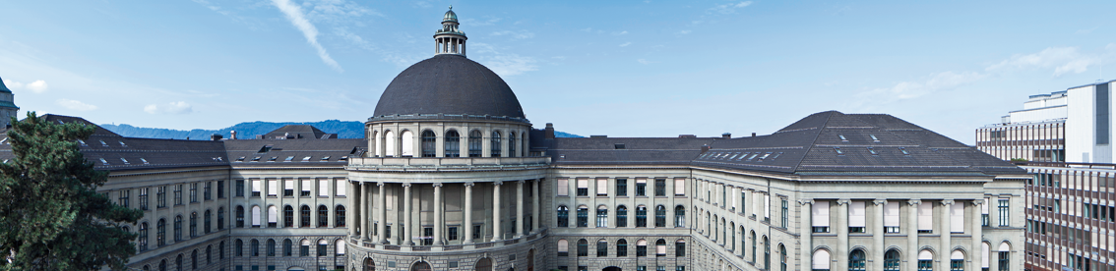
Reconstructing the World* in Six Days *(As Captured by the Yahoo 100 Million Image Dataset)
3D Vision Paper Presentation by Varin Buff, Gian-Andrea Heinrich, Björn Joos, Robin Stähli

Slide 2
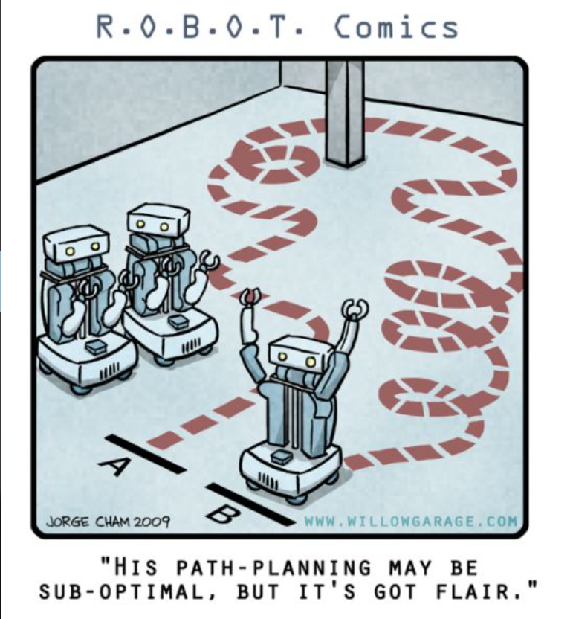
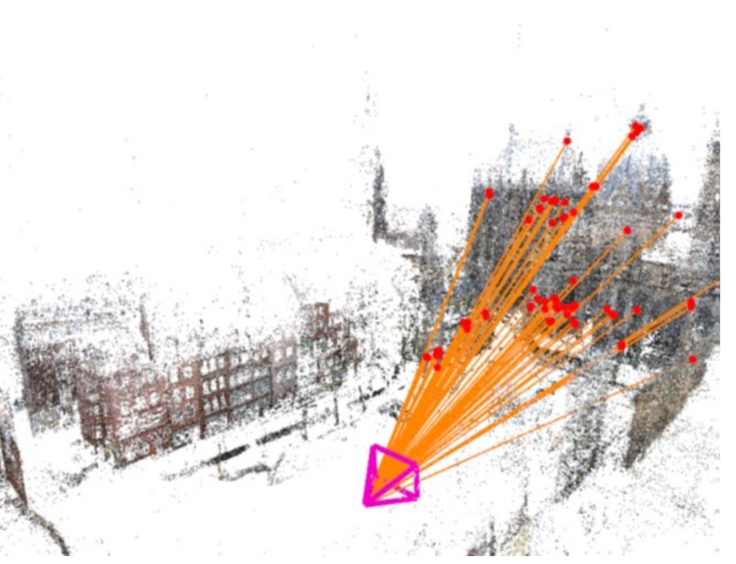
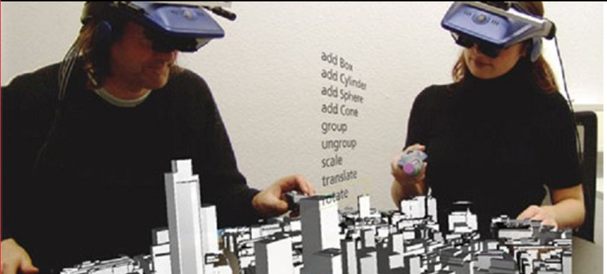
Why is it important?
Major goal over decades
Tremendous amount of image data
Fast increasing
Many Applications
Virtual Reality
Image based localization
Autonomous Navigation
Etc.
)
Notes:
Modeling the world from images has been a major Goal for Computer Vision
Fast growing. (Approx 10% of all pics were made last year)

Slide 3
Challenges
Data Robustness
Compute & Storage Scalability
Registration Comprehensiveness
Model Completeness
Notes:
• Data Robustness: Enable the modeling from unorganized and heterogeneous Internet photo collections. • Compute & Storage Scalability: Achieve efﬁciency to meet the true scale of Internet photo collections
• Registration Comprehensiveness: Identify as many camera-to-camera associations as possible.
• ModelCompleteness: Build3Dscenemodelsthatare as extensive and panoramic as possible.

Slide 4
Other Works
Frahm et al.
Agarwal et al.
Nister and Stewenius
Havlena et al.
Klinger et al.

Slide 5
Novelties
Higher Performance
Scalable
Higher Model Completeness
No knowledge of geo-location needed

Slide 6
References Part 1
http://nerei.org/wp-content/uploads/2016/07/Nerei-Virtual-reality-Environments-612x278.jpg (13.08.2018)
https://cdn.instructables.com/FMK/1ZLS/J283520X/FMK1ZLSJ283520X.MEDIUM.jpg (13.08.2018)
https://sites.google.com/site/yorkyuhuang/_/rsrc/1455602233247/home/research/computer-vision-augmented-reality/image-based-relocalization-in-slam/image_camerapose.jpg (13.08.2018)

