Slide 1
Cluster Merging
Problem: Two or more clusters can be similar
Solution: Merging
Merging Clusters

Slide 2
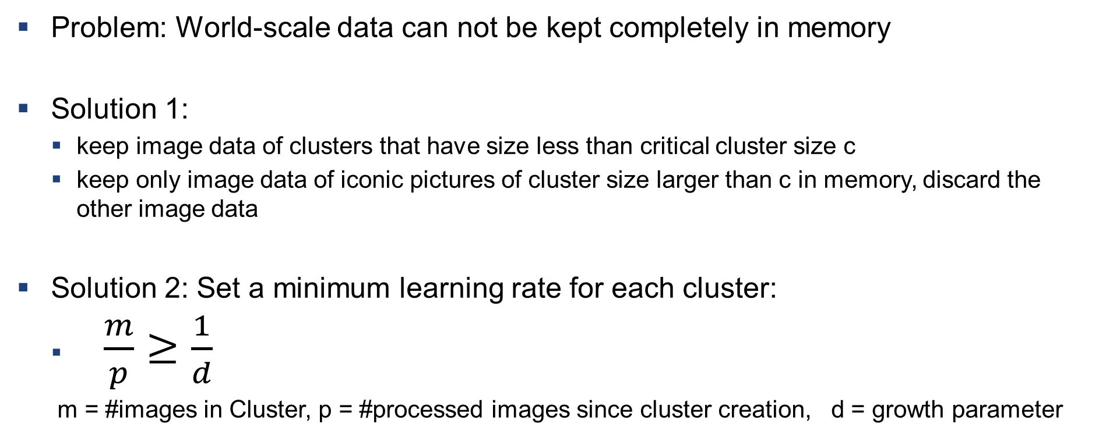
Data Management
Problem: World-scale data can not be kept completely in memory
Solution 1:
keep image data of clusters that have size less than critical cluster size c
keep only image data of iconic pictures of cluster size larger than c in memory, discard the other image data
Solution 2: Set a minimum learning rate for each cluster:
$\frac{m}{p}≥\frac{1}{d}$
m = #images in Cluster, p = #processed images since cluster creation, d = growth parameter

Slide 3
Structure From Motion (SfM)
Search for connections
Skeletal SfM of Scene
Register remaining connecting images with P3P
iconic images
search for connections
connecting Images

Slide 4
Cluster Merging
Problem: Two or more clusters can be similar because of
Image retrieval failures
limited computing budget as discussed before
Solution: Merging
Merging strategy: Maximize average iconic-to-cluster image ratio.
Keep better iconic image

Slide 5
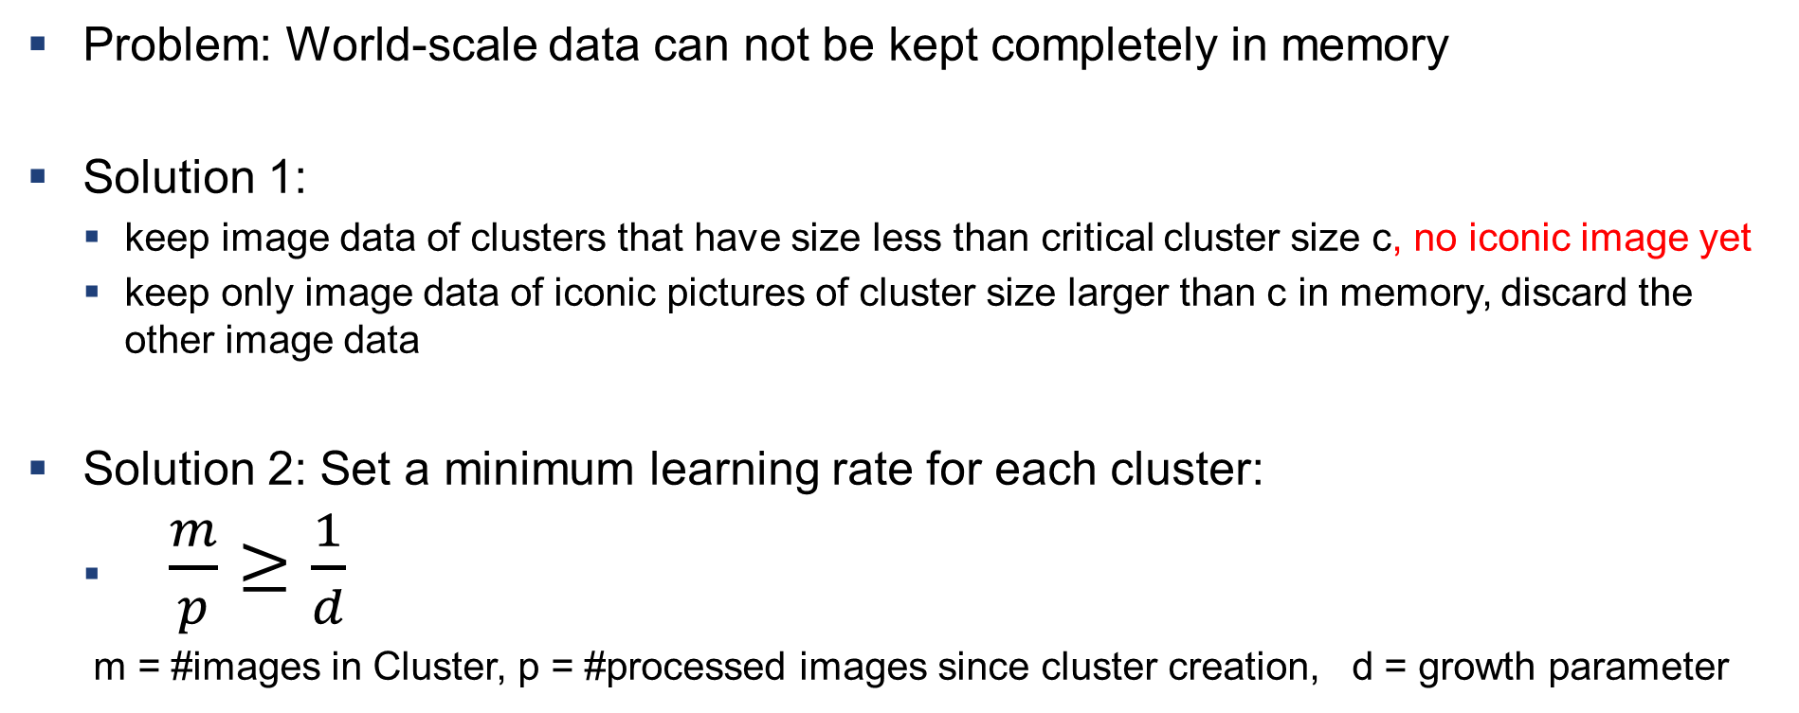
Data Management
Problem: World-scale data can not be kept completely in memory
Solution 1:
keep image data of clusters that have size less than critical cluster size c, no iconic image yet
keep only image data of iconic pictures of cluster size larger than c in memory, discard the other image data
Solution 2: Set a minimum learning rate for each cluster:
$\frac{m}{p}≥\frac{1}{d}$
m = #images in Cluster, p = #processed images since cluster creation, d = growth parameter

Slide 6
Structure From Motion (SfM)
DIAGRAM OUT OF TEXT
Previously found clusters as a base
No need for SfM to perform cluster or iconic image matching
Iconic images do not match densly, adding most connecting images to connect as many clusters as possible
Seperate hierachical SfM process for every connected component
Greedy strategy: algorithm to choose iconic images MAYBE NEW SHEET
P3P
Matrix M with only iconic Images
Matrix M with iconic and subset of connecting images

Slide 7
P3P
Perform Perspective 3-Point algorithm on components
After creation of skeleton populate skeleton with more connecting images
Put connected components togheter

