Slide 1
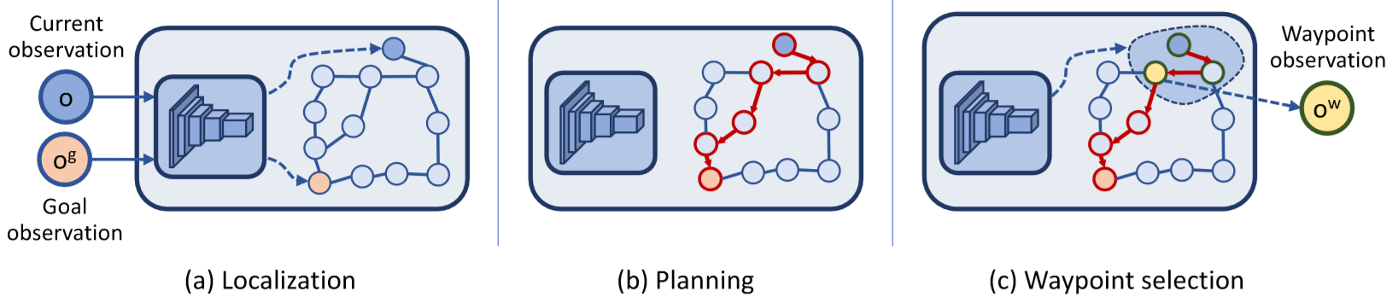
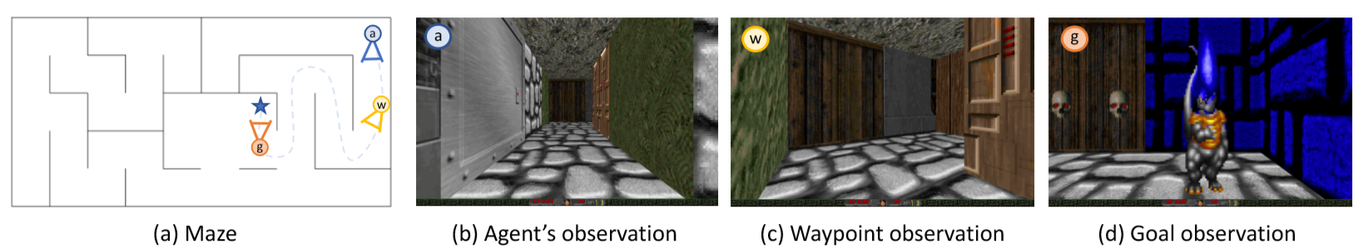
Semi-Parametric Topological Memory Approach for Navigation [1] Nikolay Savinov, Alexey Dosovitskiy, Vladlen Koltun
Waypoint observation
Navigating in Vizdoom mazes just by “watching” a video from this maze
Only 5 minutes of footage needed
Non-metric approach → comparable to animal brains [2]
Deep network retrieves nodes from the observations
Up to three times higher success rate than representative state of the art baselines
Scheme of the functioning principle of SPTM
The Principle shown in the working surroundings

Slide 2
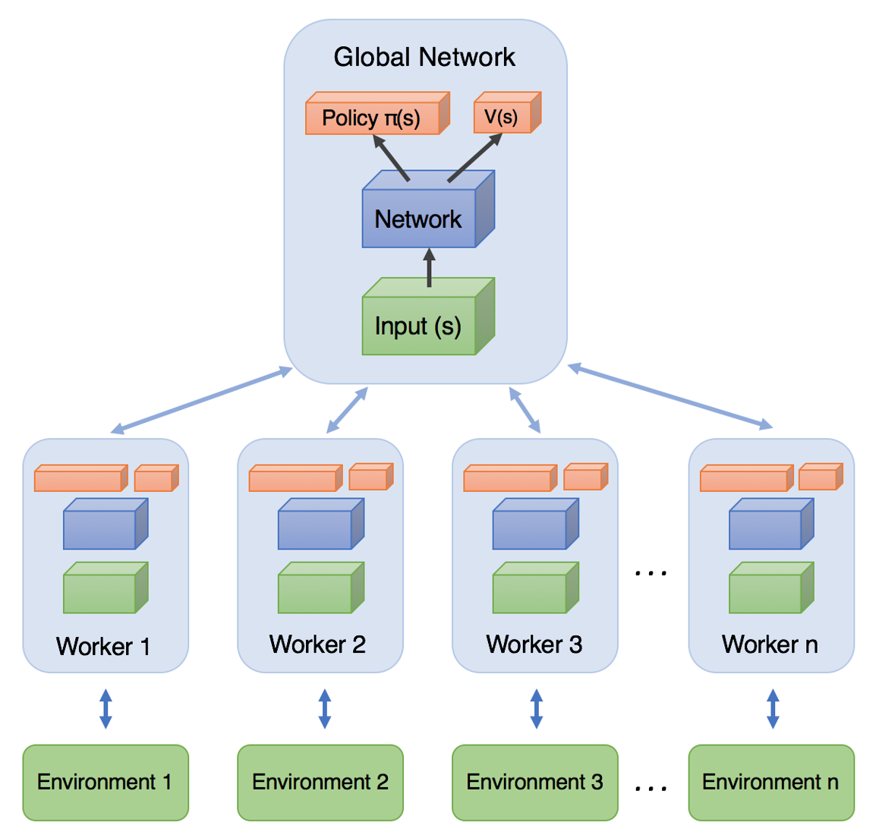
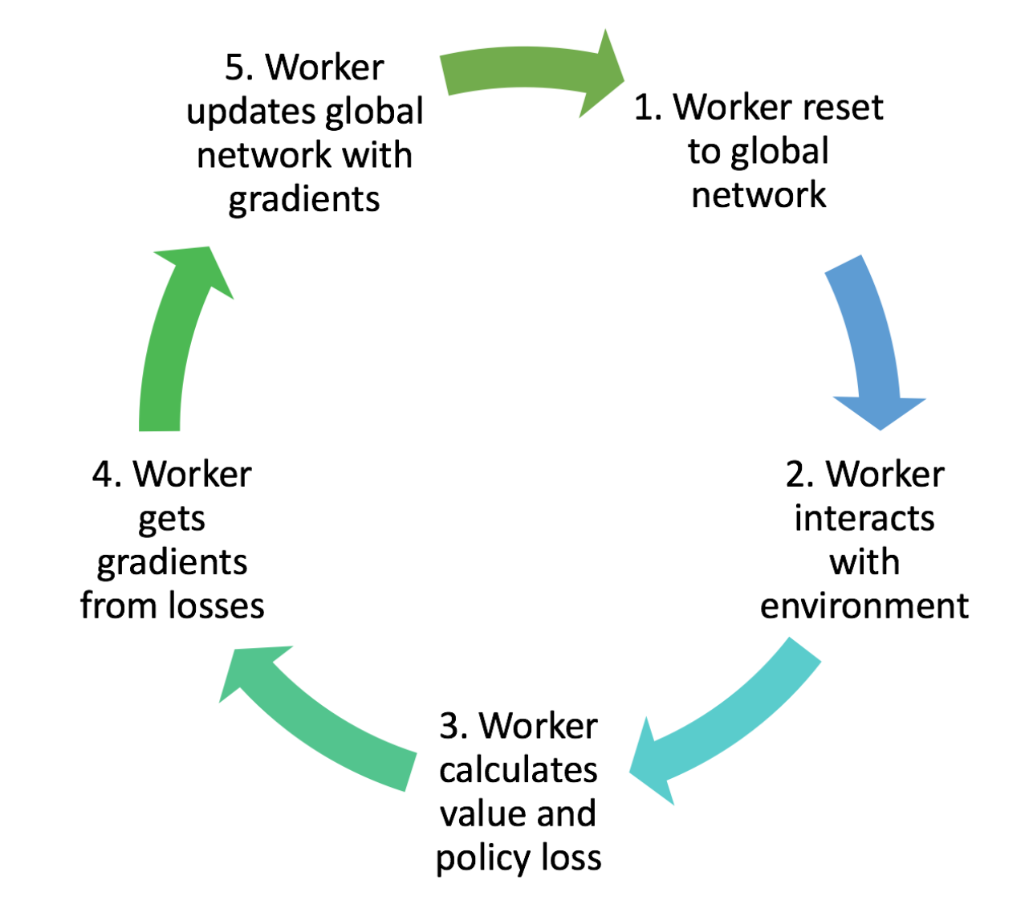
Our Task
Working into the topic
Get a training/testing environment running as described by Savinov et al. [1]
Evaluate and compare an agent using the A3C [2] algorithm to the SPTM approach and the base lines in Savinov et al. [1]
As crowning touch if there is time left we will do the same with the PPO [3] algorithm
Training Workflow and Diagramm of A3C high-level achitecture → Asynchronous Advantage Actor-Critic
Notes:
Für A3C gute Erklärung auf dem Link!
Erklärung für PPO dürfte zu viel sein

