Slide 1
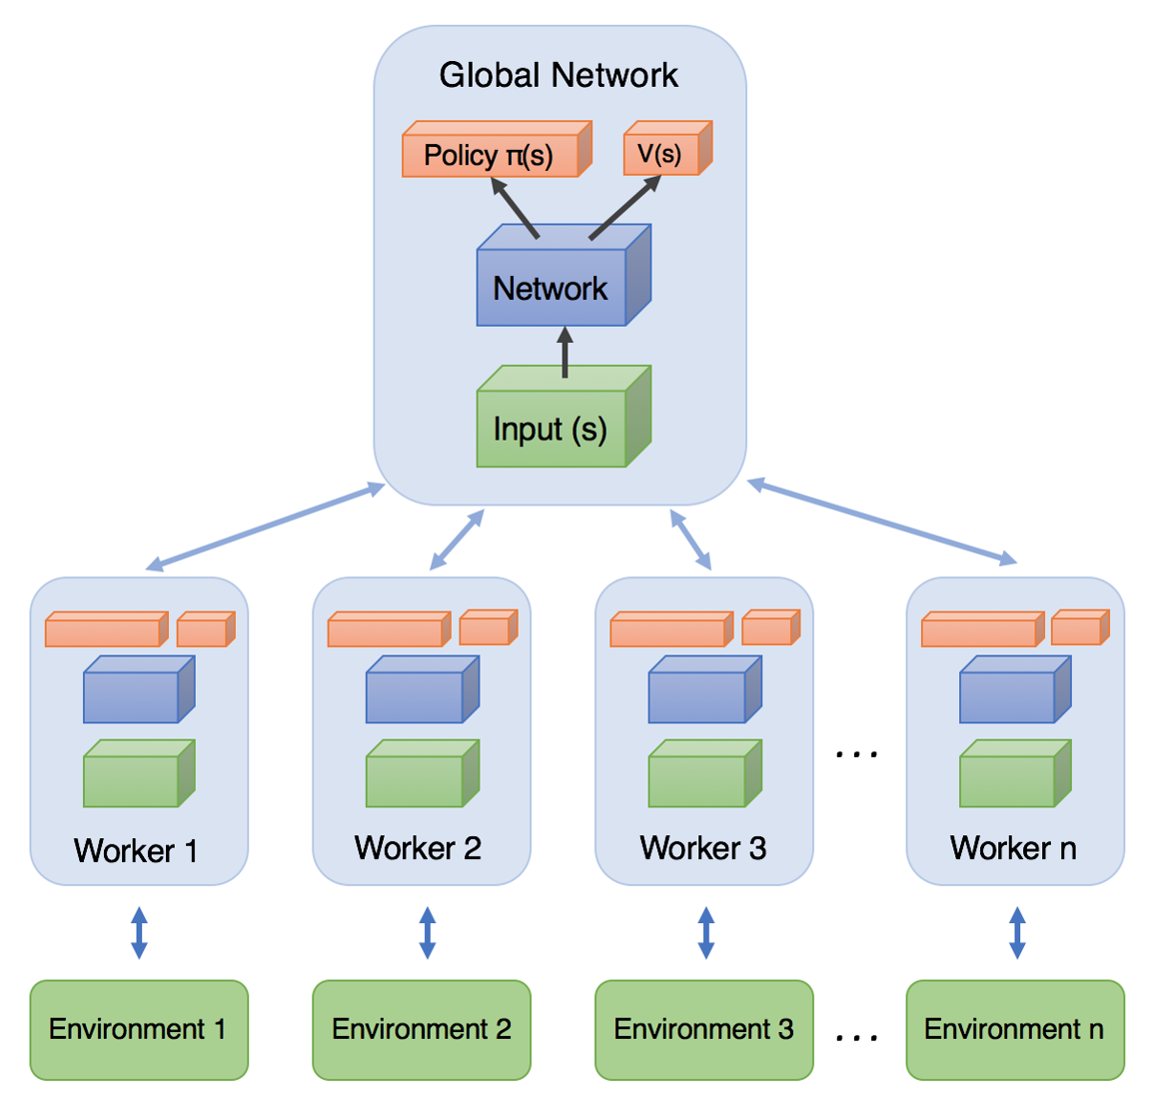
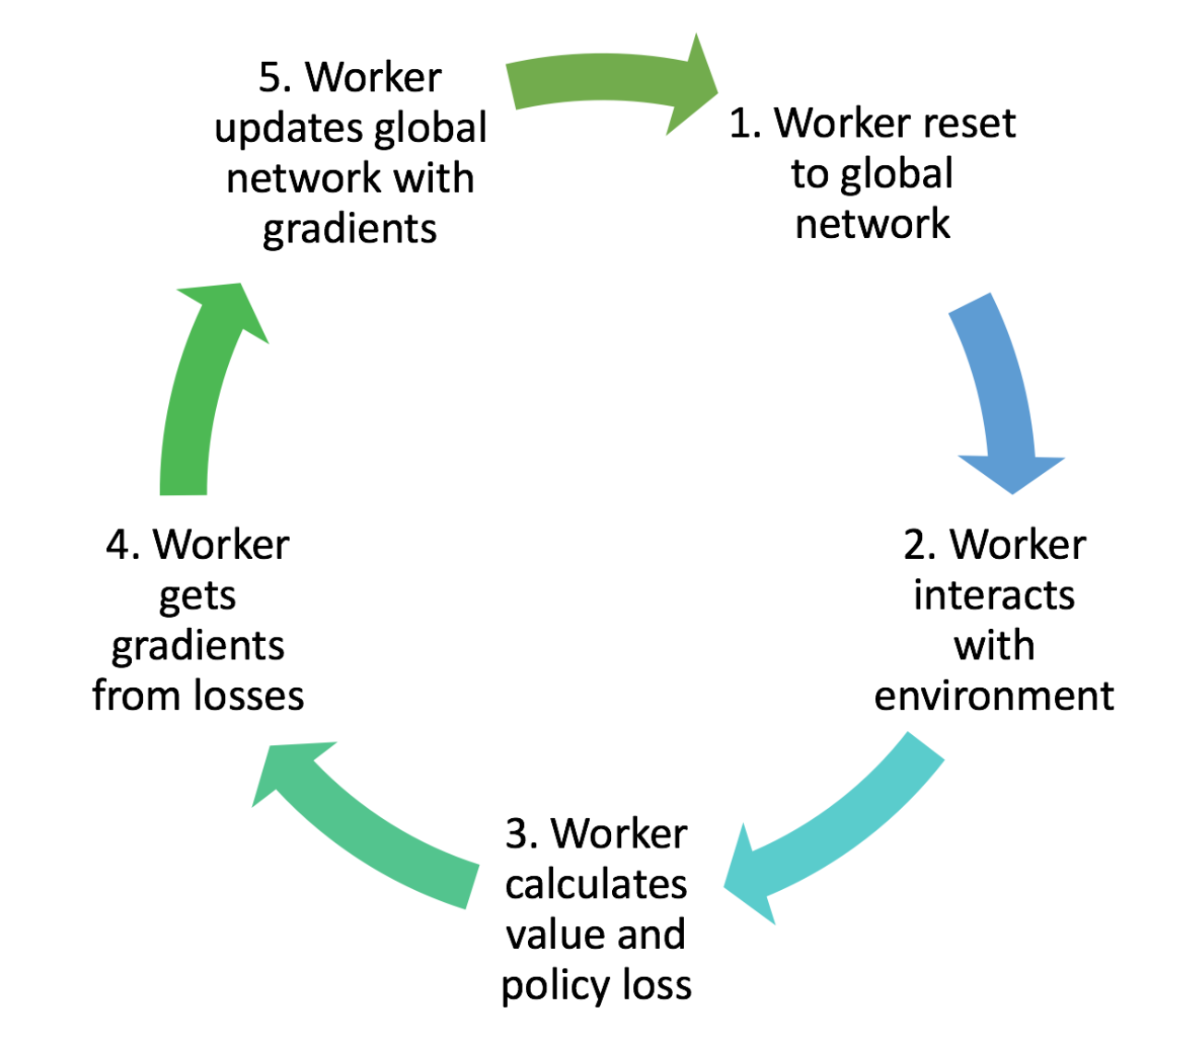
Our Task
Working into the topic
Get a training/testing environment running as described by Savinov et al. [1]
Evaluate and compare an agent using the A3C [2] algorithm to the SPTM approach and the base lines in Savinov et al. [1]
As crowning touch if there is time left we will do the same with the PPO [3] algorithm
Training Workflow and Diagramm of A3C high-level achitecture → Asynchronous Advantage Actor-Critic
Notes:
Für A3C gute Erklärung auf dem Link!
Erklärung für PPO dürfte zu viel sein

Slide 2
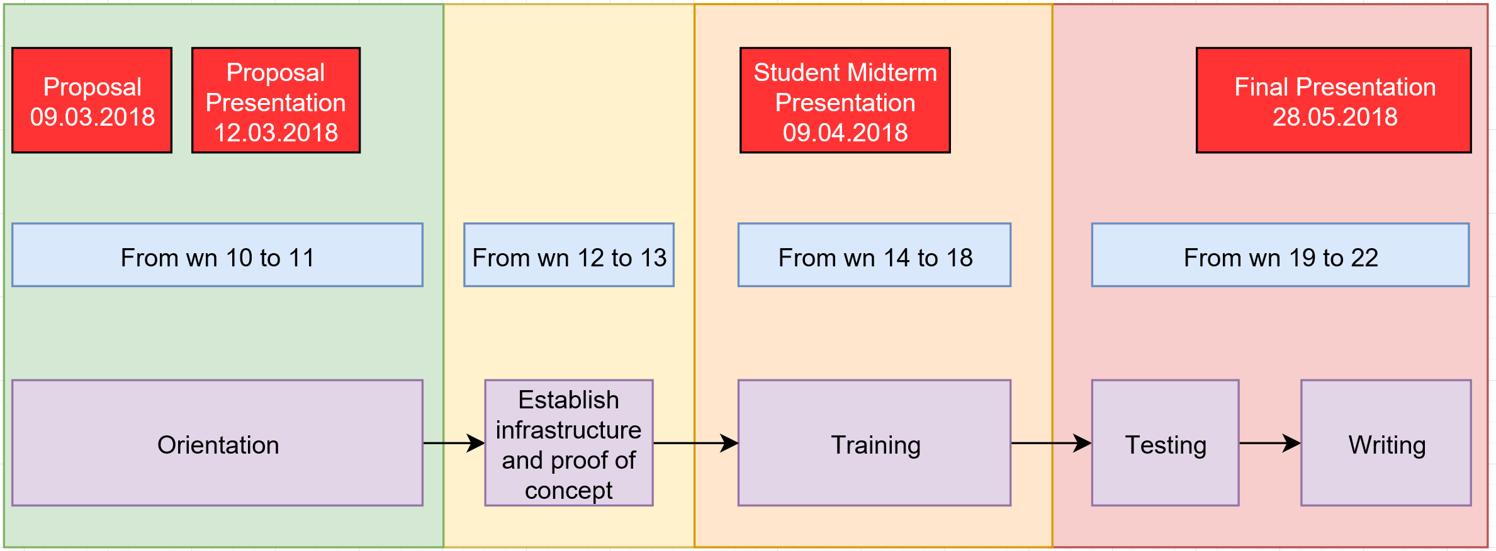
Work Packages and Timeline
Division into two main tasks
Infrastructure Group
Deployment of software on Leonhard
Program interface to react between agent and ViZDoom environment
Providing support to the evaluation group
Evaluation Group
Implement A3C for our needs
Training: RL based “walking” & video
Validation: changed textures
Testing

Slide 3


Slide 4
Open Questions
How to save the current (GPU) state and recover it later on
Tensorforce/Tensorflow → API
A3C
PPO → PPO2 (GPU Version, approximately 3x faster)
Savinov’s SPTM software package [1]
[1] https://github.com/nsavinov/SPTM (11.03.18)

