Slide 1
Intrinsic Motivation
CGS 616

Slide 2
The MDP framework
An MDP is the tuple {S,A,R,P}
Set of states (S)
Set of actions (A)
Possible rewards (R) for each {s,a} combination
P(s’|s,a) is the probability of reaching state s’ given you took action a while in state s

Slide 3
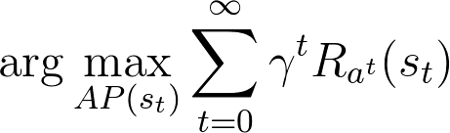
Solving an MDP
Solving an MDP is equivalent to finding an action policy AP(s)
Tells you what action to take whenever you reach a state s
Typical rational solution is to maximize future-discounted expected reward

Slide 4
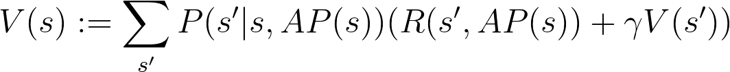
Solution strategy
Notation:
P(s’|s,a) is the probability of moving to s’ from s via action a
R(s’,a) is the reward received for reaching state s’ via action a
Update value and action policy iteratively
https://towardsdatascience.com/getting-started-with-markov-decision-processes-reinforcement-learning-ada7b4572ffb

Slide 5
MDP→RL
In MDP, {S,A,R,P} are known
In RL, R and P are not known to begin with
They are learned from experience
Optimal policy is updated sequentially to account for increased information about rewards and transition probabilities
Model-based RL
Learns transition probabilities P as well as optimal policy
Model-free RL
Learns only optimal policy, not the transition probabilities P

Slide 6
Q-learning
Derived from the Bush-Mosteller update rule
Agent sees a set of states S
Possesses a set of A actions applicable to these states
Does not try to learn p(s, a, s’)
Tries to learn a quality belief about a state-action combination Q: S X A → Real

Slide 7
Q-learning update rule
Start with random Q
Update using
Parameter α controls the learning rate
Parameter λ controls the time-discounting of future reward

Slide 8
Q-learning
Agent sees a set of states S
Possesses a set of A actions applicable to these states
Does not try to learn p(s, a, s’)
Tries to learn a quality belief about a state-action combination Q: S X A → Real

Slide 9
Q-learning update rule
Start with random Q
Update using
Parameter α controls the learning rate
Parameter λ controls the time-discounting of future reward
s’ is the state accessed from s
a’ are actions available in s’

Slide 10
Q-learning algorithm
Initialize Q(s,a) for all s and a
For each episode
Initialize s
For each move
Choose a from s using Q (softmax/e-greedy)
Perform action a, observe R and s’
Update Q(s,a)
Move to s’
Until s’ is terminal/moves run out

Slide 11
Q-learning update
The value of taking action a in state s
Q(s,.)
A
Q(s, a)
s
Select a using choice rule on Q

Slide 12
Q-learning update
s
a
s’
Select a using choice rule on Q
Take action a from state s
Observe r and s’

Slide 13
Q-learning update
Q(s’,.)
A
a₁’
a₂’
There are many possible a’ from the state you reach
s
a
s’
a₃’
Select a using choice rule on Q
Take action a from state s
Observe r and s’
Recall Q(s’,a’) for all a’ available from s’

Slide 14
Q-learning update
Q(s’,.)
a₁’
A
Q(s, a)
a₂’
Assume maximally rewarding action will be selected at s’
s
a
s’
a₃’
Select a using choice rule on Q
Take action a from state s
Observe r and s’
Recall Q(s’,a’) for all a’ available from s’
Update Q(s,a)

Slide 15
Q-learning example
Open AI gym’s frozen lake
Setup: agent is a character that has to walk from a start point (S) across a frozen lake (F) with holes (H) in some locations to reach G
Specific instantiation
S | F | F | F
F | H | F | H
F | F | F | H
H | F | F | G

Slide 16
Q-learning example
Agent starts with an empty Q-matrix
Action possibilities = {left, right, up, down}
Reward settings
H = -100
G = +100
F = 0
0 | 0 | 0 | 0
0 | 0 | 0 | 0
0 | 0 | 0 | 0
0 | 0 | 0 | 0

Slide 17
Q-learning example
Learning occurs via exploration episodes
One episode is a sequence of moves
Let’s work through one episode
0
S | F | F | F
F | H | F | H
F | F | F | H
H | F | F | G

Slide 18
Q-learning example
Learning occurs via exploration episodes
One episode is a sequence of moves
Let’s work through one episode
0
0
S | F | F | F
F | H | F | H
F | F | F | H
H | F | F | G

Slide 19
Q-learning example
Learning occurs via exploration episodes
One episode is a sequence of moves
Let’s work through one episode
0
0
S | F | F | F
F | H | F | H
F | F | F | H
H | F | F | G
0

Slide 20
Q-learning example
Learning occurs via exploration episodes
One episode is a sequence of moves
Let’s work through one episode
0
0
S | F | F | F
F | H | F | H
F | F | F | H
H | F | F | G
0
-80

Slide 21
Q-learning example
Learning occurs via exploration episodes
One episode is a sequence of moves
Let’s work through one episode
0
0
S | F | F | F
F | H | F | H
F | F | F | H
H | F | F | G
0
-80
-80

Slide 22
Q-learning example
Learning occurs via exploration episodes
One episode is a sequence of moves
Let’s work through one episode
0
0
S | F | F | F
F | H | F | H
F | F | F | H
H | F | F | G
0
-80
-80
+80

Slide 23
SARSA update rule
Start with random Q
Update using
Parameter α controls the learning rate
Parameter λ controls the time-discounting of future reward
s’ is the state accessed from s
a’ is the action selected in s’
Different from q-learning

Slide 24
SARSA algorithm
Start with random Q(s, a) for all s and a
For each episode
Initialize s
Choose a using Q (softmax/greedy)
For each move
Take action a, observe r, s’
Choose a’ from s’ by comparing Q(s’, . )
Update Q(s, a)
Move to s’, remember a’
Until s’ is terminal/moves run out

Slide 25
SARSA update
Q(s,.)
The value of taking action a in state s
A
Q(s, a)
s
Start with a selected in the previous iteration

Slide 26
SARSA update
s
a
s’
Start with a selected in the previous iteration
Take action a from state s
Observe r and s’

Slide 27
SARSA update
Q(s’,.)
A
a₁’
a₂’
There are many possible a’ from the state you reach
s
a
s’
a₃’
Start with a from the previous iteration
Take action a from state s
Observe r and s’
Recall Q(s’,a’) for all a’ available from s’

Slide 28
SARSA update
Q(s’,.)
A
a’
a’ is selected using the choice rule
s
a
s’
Start with a from the previous iteration
Take action a from state s
Observe r and s’
Recall Q(s’,a’) for all a’ available from s’
Select a’ using choice rule on Q
Update Q(s,a)

Slide 29
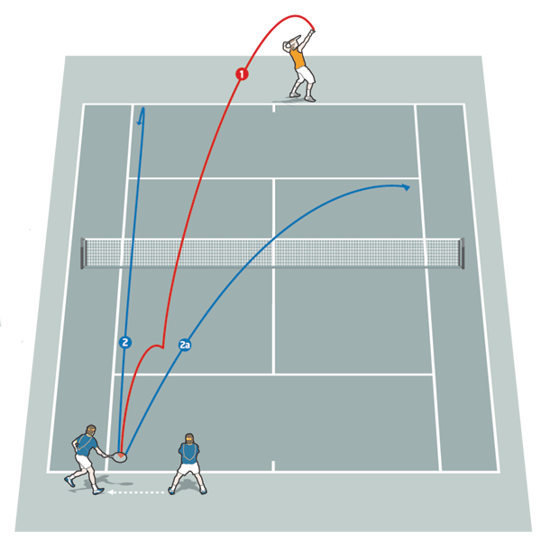
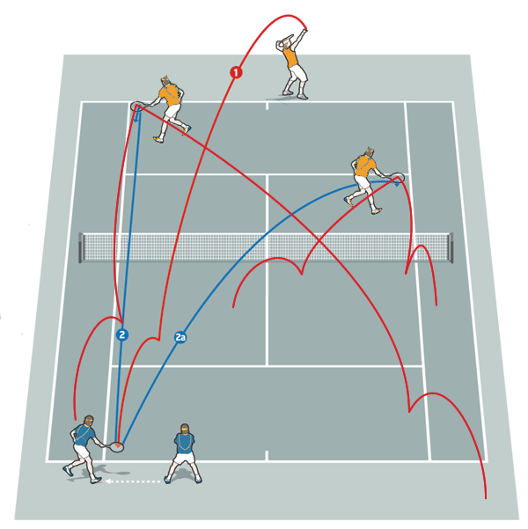
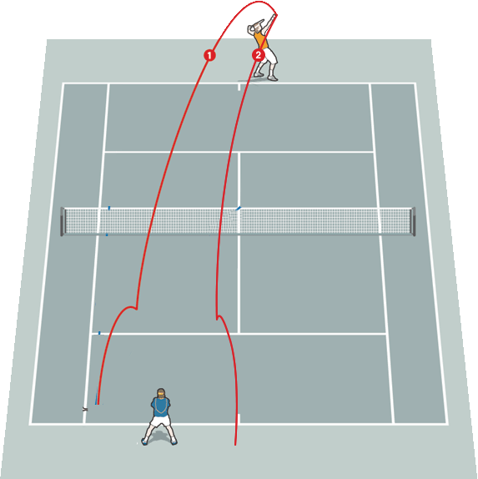


The Exploration/Exploitation Trade-off
Exploration is essential to forego immediate rewards and discover longer range high reward plans

Slide 30
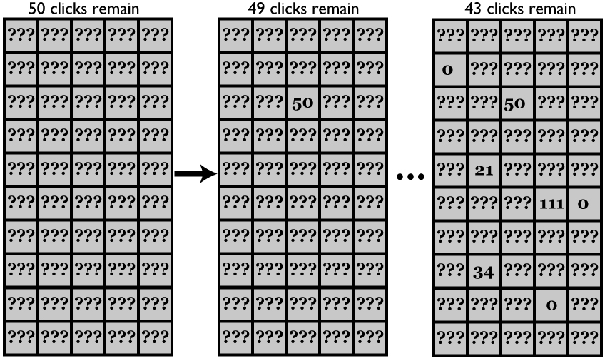
Find the best task
INSTRUCTIONS
You have 50 clicks total.
Click the squares ij to
uncover points Rij
At each step choose:
EXPLOIT and earn Rij*(clicksremain)
SEARCH and earn nothing
Notes:
Five different reward distributions, designed to elicit very different levels of aspiration, were tested in blocks of 60 games each (see Figure XXX). The order of the blocks was random between subjects (no two subjects received the same order) and no cue was provided to indicate that a change between environments had occurred.
300 games subjects were presented with a 10 row x 5 column grid. Initially the value of the 50 squares was unknown (represented by “???” - see Figure XXX). Subjects were instructed to click on a square with the mouse to uncover the value of the square and receive that number of points. Once a square was uncovered, the value remained visible for the entire game. Subjects were instructed that each game consisted of 50 choices. At each moment they could choose to either 1) sample a covered square to uncover its value and receive that number of points or 2) sample an uncovered square and receive that number of points. Their task was to accumulate as many points as possible. If subjects determined that they wished to use all of their remaining choices sampling an uncovered square, they could right click the square to do so automatically, rather than having to repeatedly click the square. Following each game subjects were shown the total points accumulated as well as the average points accumulated over the previous ten games.

Slide 31
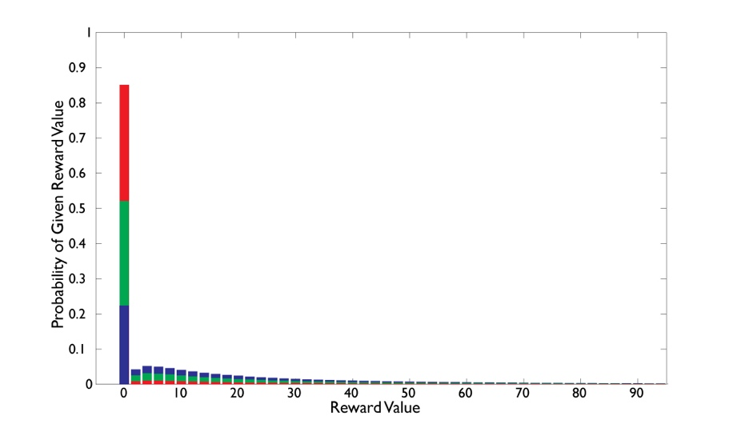
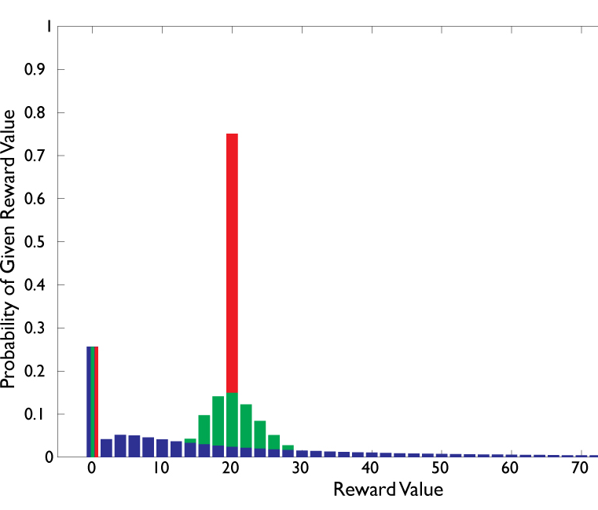
Six Reward Distributions
Density Manipulation
Variance Manipulation
Subjects solved 300 boards
60 boards from a distribution in a block
5 blocks, one from each distribution type randomly mixed
WITH NO INDICATION OF A SWITCH

Slide 32

Key Knowledge: distribution of max
Chances of sampling a large
reward go up with more samples
Density Manipulation
Sample=40
Variance Manipulation

Slide 33
Ideal Solution using model-based Bayesian RL
Ideal solution: Explore when max smaller than time-varying bound
Density Manipulation
Variance Manipulation
Low variance
Max
Explore
Expected Value of search relative to exploit
Q(x_{max},t,a = search) - Q(x_{max},t,a = exploit)
RED: Optimal decision criterion
BLUE: Expected Max value

Slide 34
Ideal solution
Ideal solution: Explore when max smaller than time-varying bound
Variance Manipulation
Mid variance
Explore
Max
Low variance
Expected Value of search relative to exploit
Q(x_{max},t,a = search) - Q(x_{max},t,a = exploit)
RED: Optimal decision criterion
BLUE: Expected Max value

Slide 35
Ideal solution
Ideal solution: Explore when max smaller than time-varying bound
Variance Manipulation
Explore
High variance
Mid variance
Max
Low variance
Expected Value of search relative to exploit
Q(x_{max},t,a = search) - Q(x_{max},t,a = exploit)
RED: Optimal decision criterion
BLUE: Expected Max value

Slide 36
Ideal solution
Density Manipulation
Variance Manipulation
High density
Mid density
High variance
Mid variance
Low density
Low variance
Note that the optimal bound ~ expected max reward after about 40 steps

Slide 37
Non-ideal predictions
Model-free RL (Q-learning)
Cannot learn – too few trials, disrupted by uncued distribution changes
Secretary problem
Reject first N – exploit at first value larger than max in first N
Exploration functions
Predicts different exploration
in the two conditions
Variance
Density

Slide 38
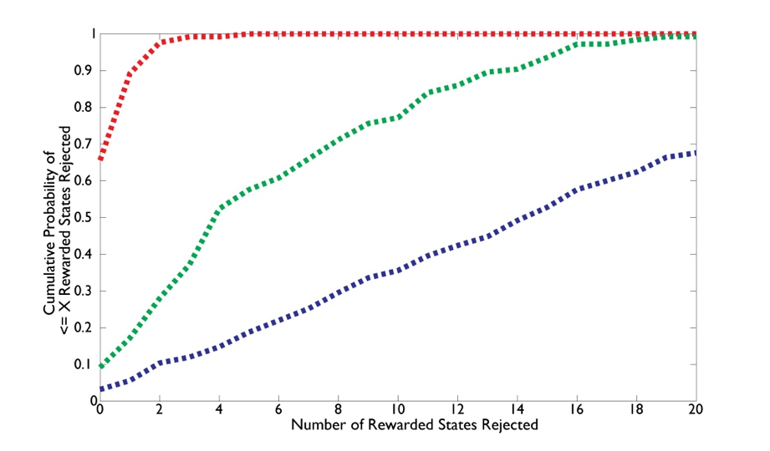
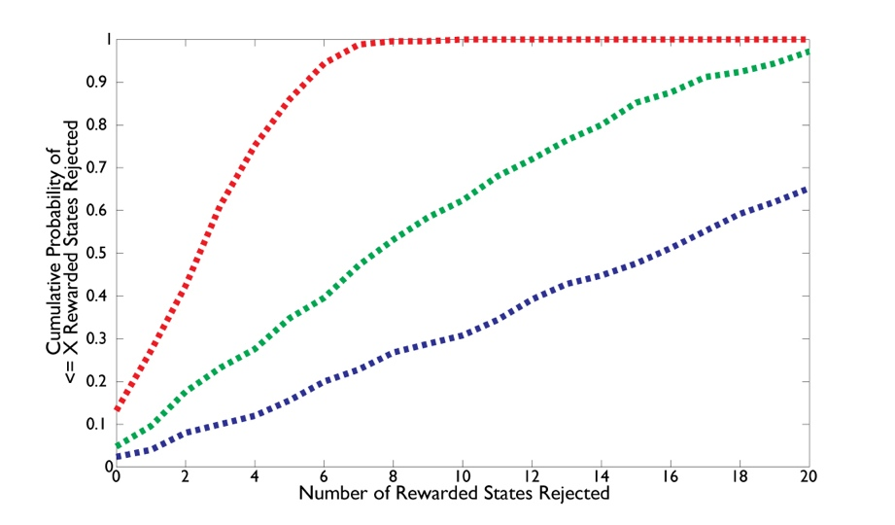
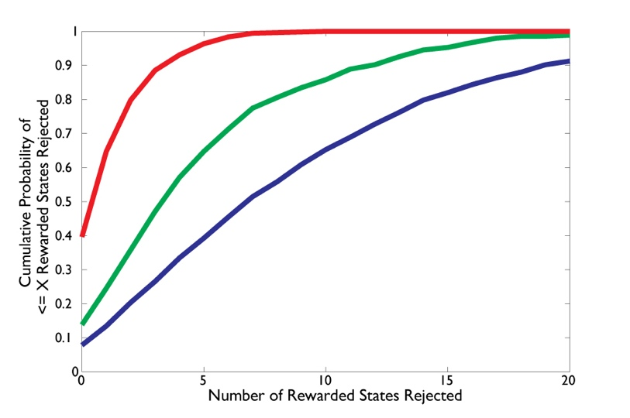
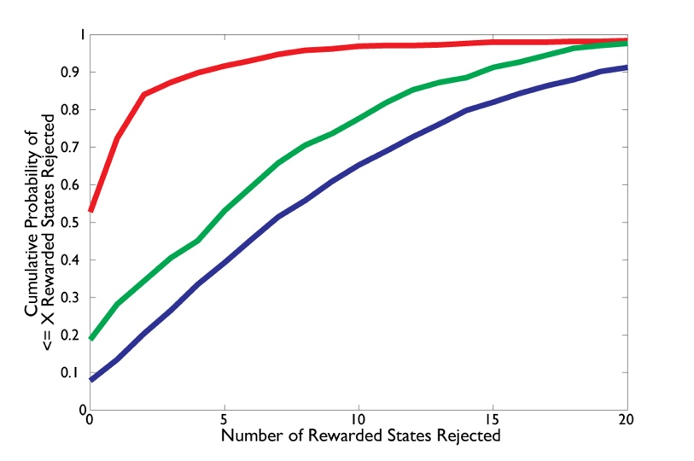
Ideal vs. Human exploration
Ideal vs. Human Exploration Functions
Density manipulation
Variance manipulation
IDEAL
HUMAN

Slide 39
Ideal vs. Human exploration
Ideal vs. Human Exploration Functions
Density manipulation
Variance manipulation
People make flexible use of higher order reward statistics to adjust exploration time -
without training
IDEAL
HUMAN

Slide 40

Reward as need information
Agent sequentially computes what to do, based on value feedback r it observes at each time step
The likelihood term has precisely the interpretation of utility
For choice, the information needed can be radically reduced
The posterior and prior beliefs p(x|{d}) reflect a rational agent’s preference to choose x out of all X based on its history of value observations

Slide 41
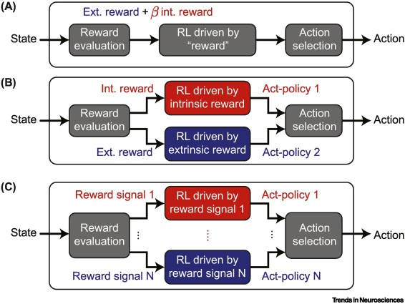
Open question
How do you model intrinsic curiosity in RL?

