Slide 1
The revolt of the public
CGS616

Slide 2
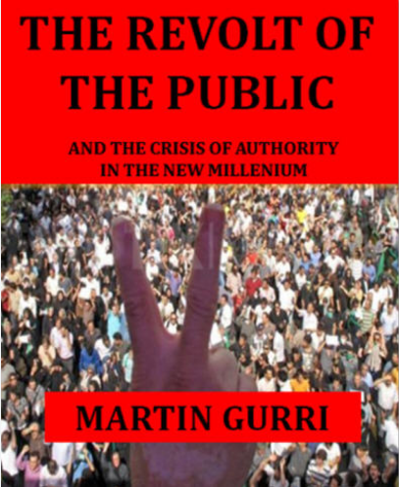
The revolt of the public
An ex-CIA analyst, Martin Gurri published ‘The revolt of the public’ in 2014
The proximate cause of his taking up this subject were the populist events of 2011 across the world
Some of this happened in India too
Today, we review his book

Slide 3
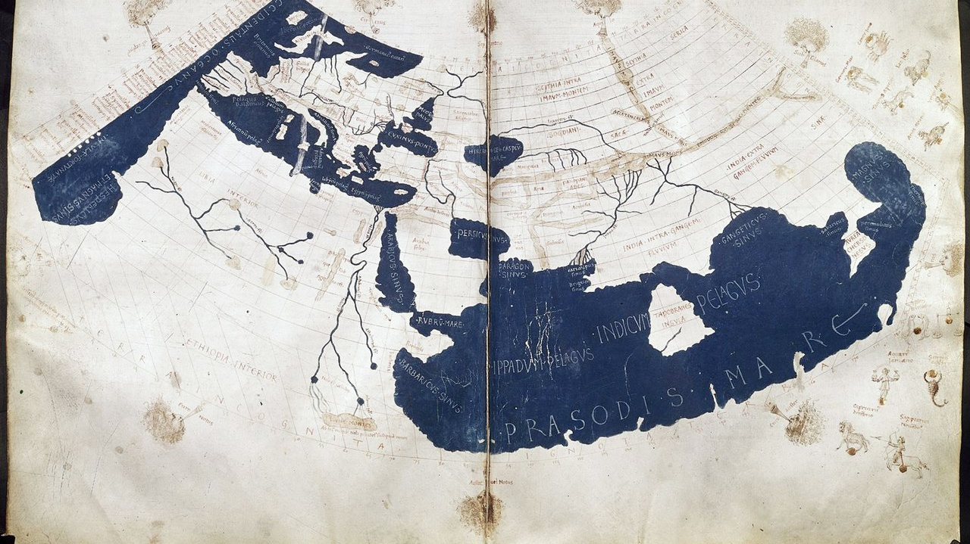
Limits of the public’s knowledge

Slide 4
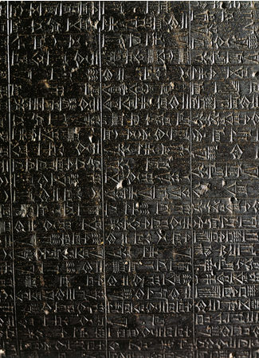

Legitimacy and authority
Historically, only the king’s scribes could create inscriptions
There were strict prohibitions on the public on owning tools of carving
Writing and reading were luxury goods

Slide 5
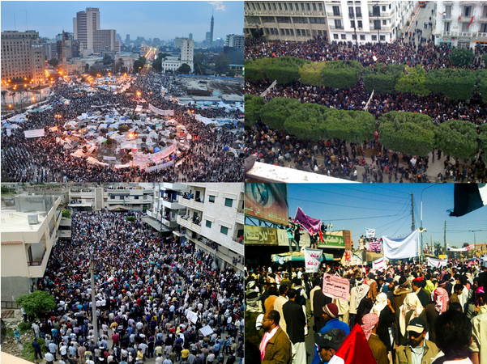
Fast forward to 2011
Across countries in the Middle East, but also in Spain, Chile, India, and the US
Large protests were sparked against government corruption
In a leaderless and decentralized manner
With no clear or stated goals
Mostly led by upper middle class citizens
Primarily organized via social media

Slide 6
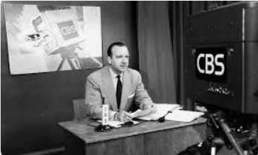
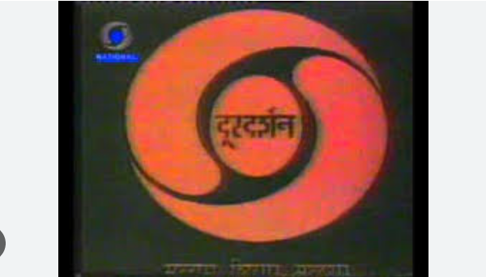
A time of stability
In the post WW2 years, governments possessed instruments to control the flow of information to the public
College education was vanishingly rare
GER for India in 1950: 0.4%
This ensured that only authoritative information was released, and public consensus was easy to maintain

Slide 7

A time of instability
In the mid-70s, information about government failures and misdeeds began to percolate into media
But this was still gated by limitations of media, and required whistleblowers and leaders

Slide 8
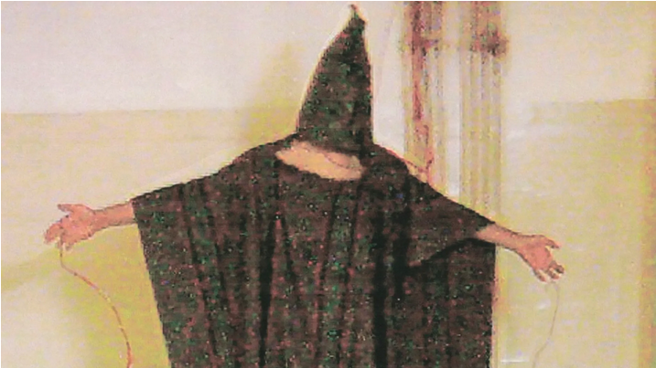
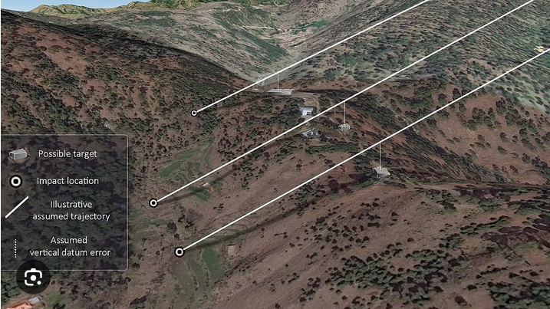
21st century information processing
Information about official mishaps are available in near real-time
Information can be quickly laundered through multiple sources, outside any specific national jurisdiction
No longer need specific whistleblowers or leaders

Slide 9
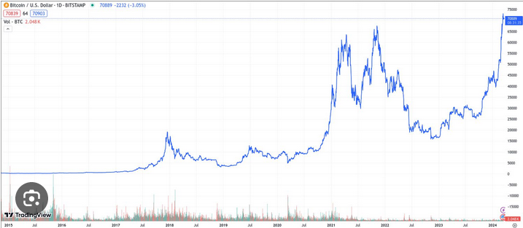
Consequences
Gurri calls our current government a kind of "zombie democracy“
The institutions of the 20th century - legislatures, universities, newspapers - continue to exist
But they are hollow shells, stripped of all legitimacy
Nobody likes or trusts them
They lurch forward, mimicking the motions they took in life, but no longer able to change or make plans or accomplish new things

Slide 10


Where next?
Democratized access to information reduces legitimacy
Solution: add undemocratic controls
Governments are trying hard
Outcome hangs in the balance

