Slide 1
Children’s experience of a digital world
CGS616

Slide 2
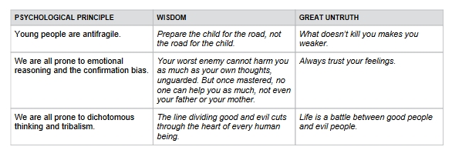
Coddling of the American Mind
https://www.anxiousgeneration.com/resources/collaborative-review-docs

Slide 3

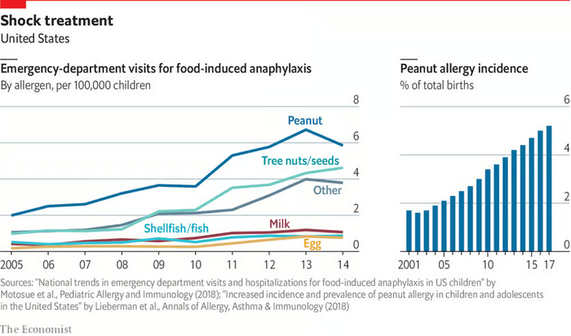
Antifragility
Peanut butter banned in schools
Children thrive when they are exposed to real risks and learn to manage them.

Slide 4
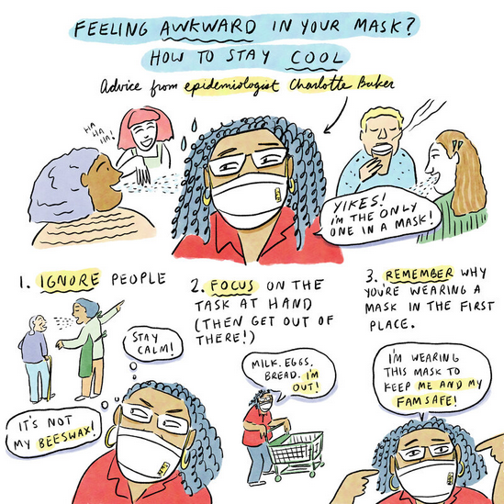
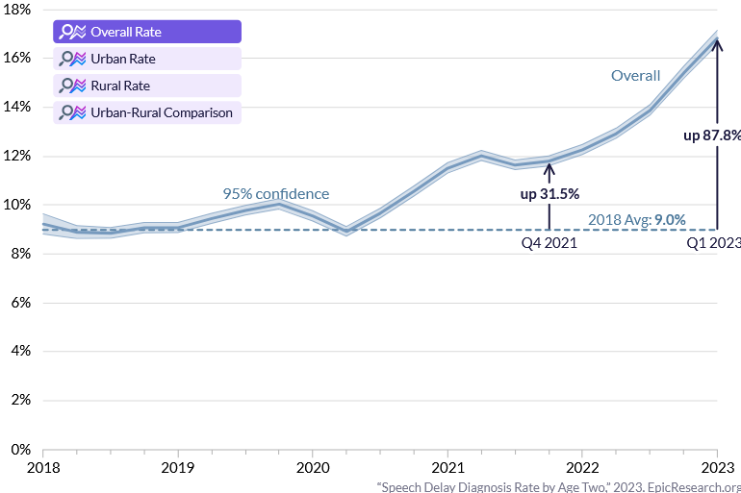
What’s the harm in being cautious?

Slide 5
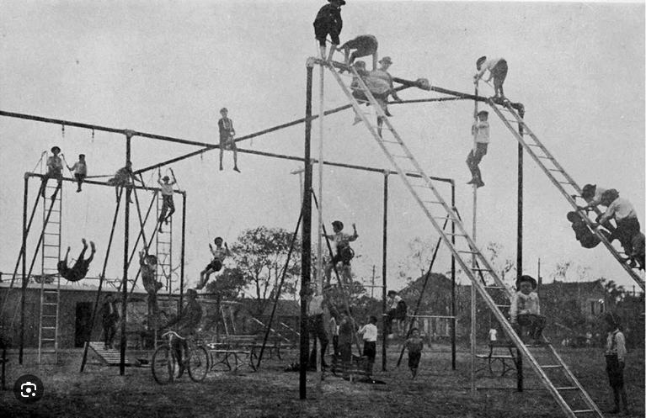

Modern kids don’t get to play

Slide 6
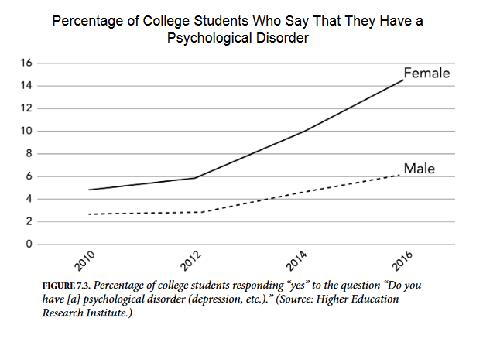
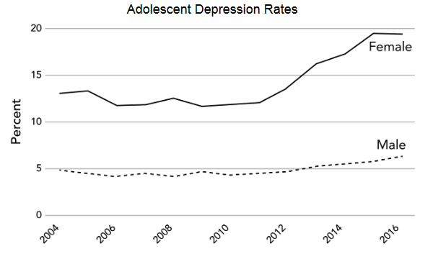

They get therapy instead

Slide 7
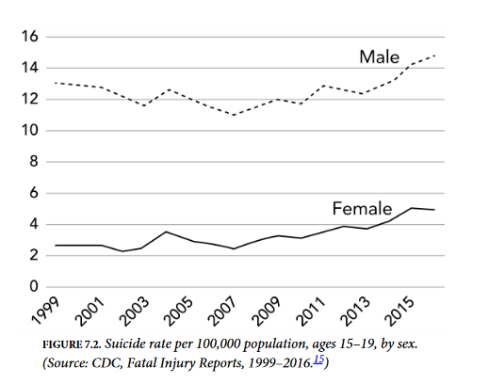
And it looks like they need it

Slide 8
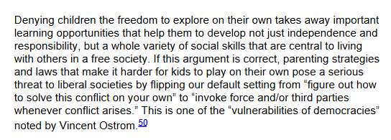
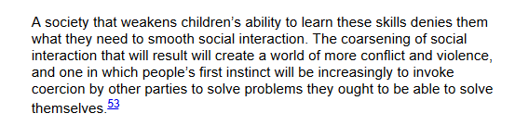
What happens when you don’t play?
Children play to stress their bodies and minds under relatively safe conditions
Through play, they learn to deal with
Physical fear
Social fear
Disputes
Social infractions

Slide 9
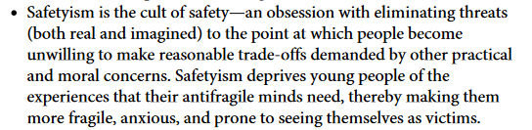
Safetyism

Slide 10
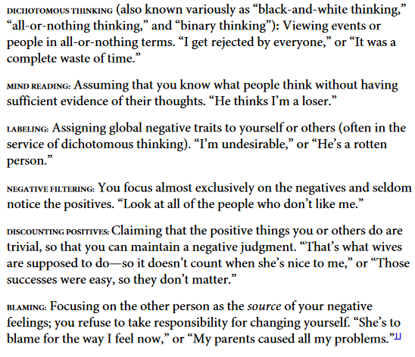
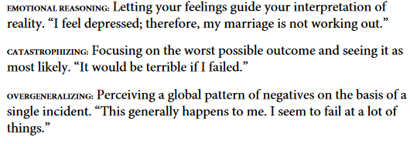
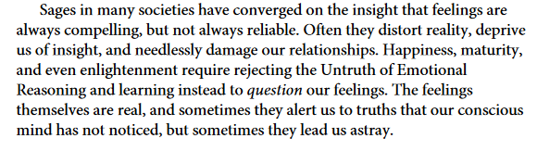
Equating feelings with reality

Slide 11
The fabric of digital sociality
Anonymity was a powerful force in the early days of the internet
The moment the internet became social, establishing identity became important
Digital safety is a paramount concern
Financial protection
Reputation protection
Community protection
Mental health protection
What counts as hate speech, and what does staying safe on the internet mean?

Slide 12




Hate speech and misinformation
Is offending peoples’ sentiments the same as putting them in danger?

Slide 13
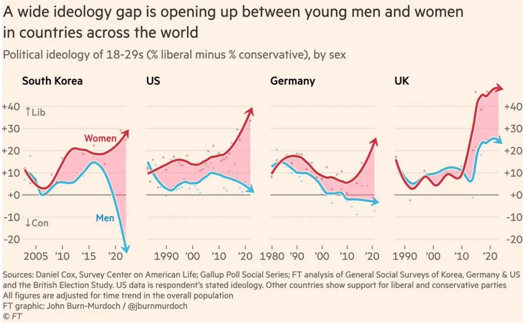

Tribal polarization

Slide 14
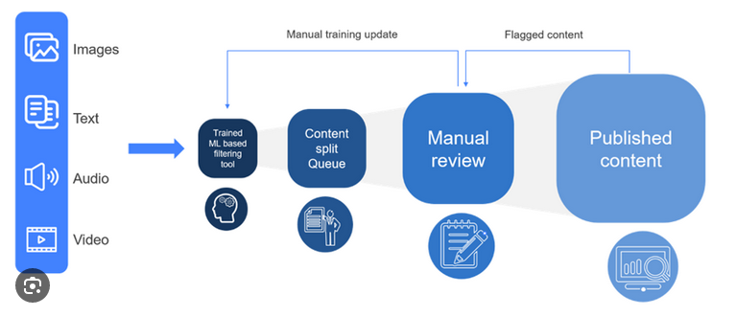
Manicheanism in digital societies
In-group bias is a powerful motivator in human behavior
Low barriers to movement produces clusters of homogeneity in culture and society
Adversarial arguments across groups are dominated by extreme viewpoints
Commercial metrics of digital platforms are incentivized towards higher engagement
Traditional systems of moderation do not scale to web-scale conversations
Result: a red queen’s race between provocation and censorship
Disembodied conversations in the digital space produce polarized opinions about people

Slide 15
Coddling of the American Mind
https://www.anxiousgeneration.com/resources/collaborative-review-docs

Slide 16
So what?
This would be part where we do an HCI tech solutionism pantomime
Kids are depressed? Let us create AI agents to talk to them. Therapists are scarce, you know.
People curse on social media? Let us create automated content moderation and introduce e-KYC for social media accounts.
Screens produce social isolation for introverted young people? Let us add parental controls on screen time.
Young people fight for social status and position in digital space? That’s cyberbullying. Call the cops.
According to Lukianoff and Haidt, these solutions worsen the problem

Slide 17

Unplugging
Many commentators argue for age limits on social media usage
But children cannot survive being unplugged when adults and society stay plugged in
So do we pull the plug on the whole digital living experience?
Would that bring about Calhoun rat universe outcomes?

