Slide 1
Gamification
CS616

Slide 2
What is gamification?
Introducing elements of games into human-computer interactions
Examples
Benefits
What are games?
What are the characteristic elements of games?
Why are they elements of games?
How to include game elements in an application?

Slide 3

Play
Seen in higher mammals, including man

Slide 4
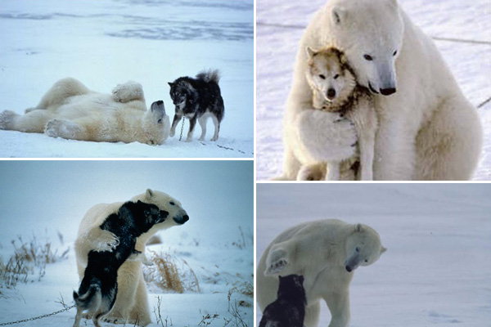
Play
Prominent account → way of exploring body locomotor capabilities safely (Berghonel et al., 2015)

Slide 5
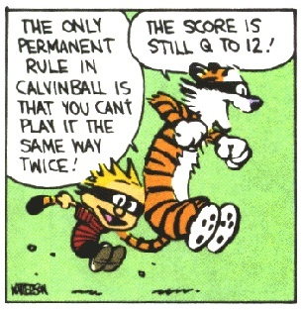
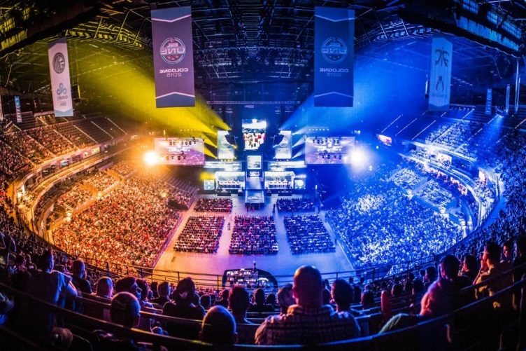
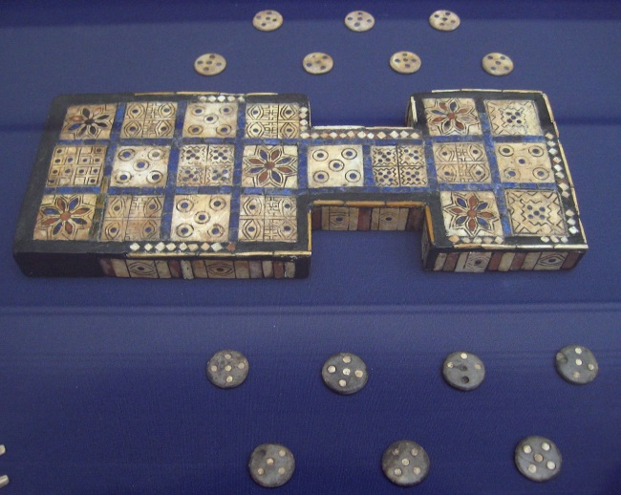
Games
Play with rules
As old as civilization
Big business
>$100B revenues
Taken way too seriously

Slide 6
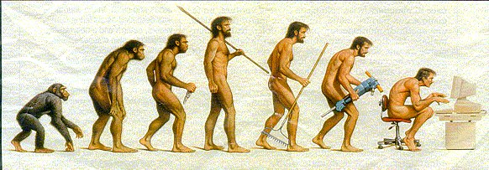
Video games
Progression from physical to mental games
Multiple genres
Big business
>$75B revenues last year

Slide 7
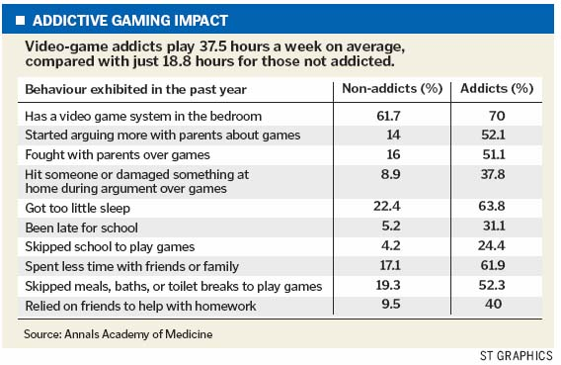
Taken way too seriously
S Korea and China now have official laws and mechanisms to stop <18 players from playing more than 3 hours at a stretch

Slide 8
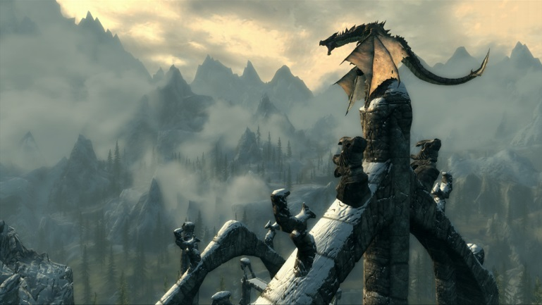
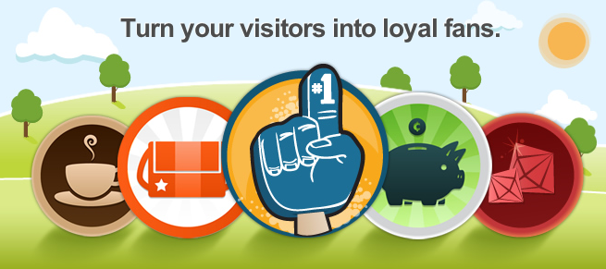
Gamification vs games
Games contain
Narrative
Rules
Dexterity
Control
Interaction
Gamification uses
Need for closure
Sunk costs
Score accumulation
Social competition
Sense of progress

Slide 9
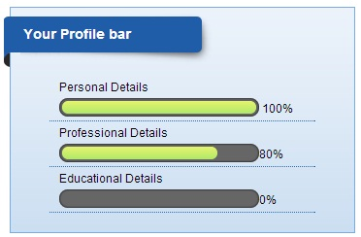
Need for closure
Need for closure can be measured as a personality trait (Neuberg et al., 1997)
High in decisive people, inverse correlation with OPEN
High NFCC → likelier to search using attributes
Massively consequential for consumer behavior (Choi et al., 2008)

Slide 10
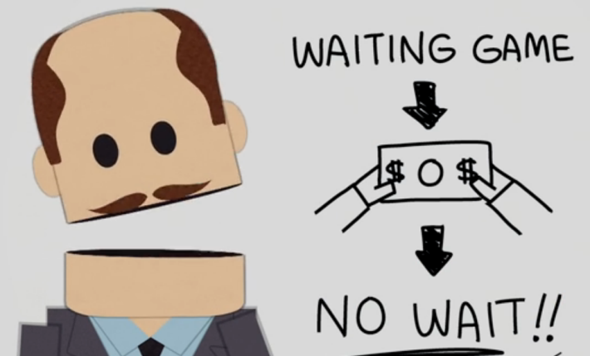
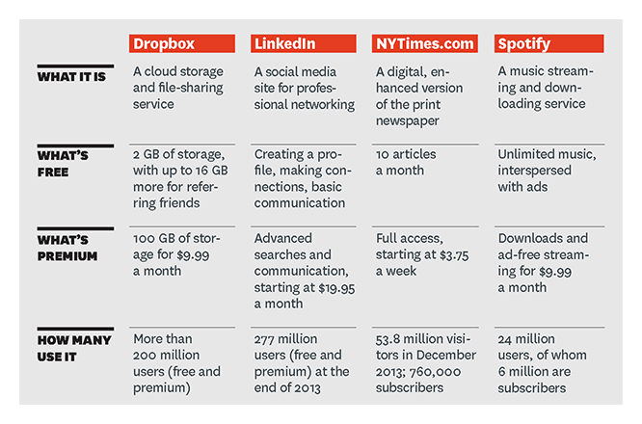
Sunk costs
Offer something for free
Make it important to the user
Start charging
Borrowed from freemium games

Slide 11
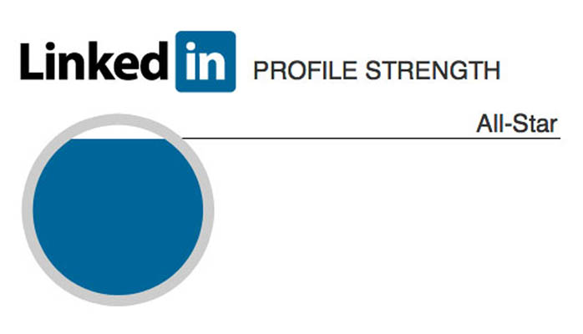
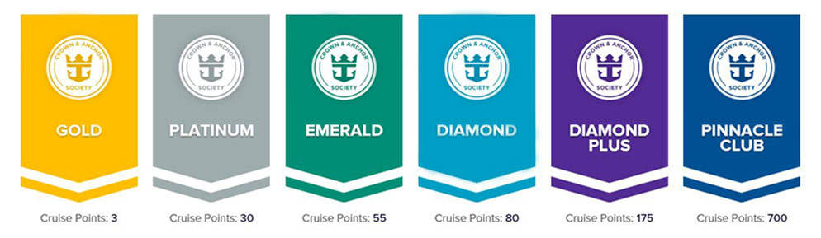
Score accumulation
Create progressively harder to achieve levels
Make them matter
Align with business objectives

Slide 12
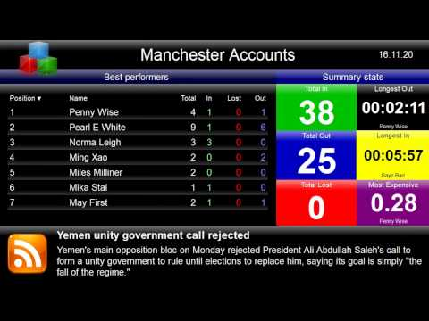
Social competition
Use leaderboards, percentile scores
Can choose between public and private displays
Frequently used in call center and service sector operations
Effective if associated with real-world outcomes

Slide 13
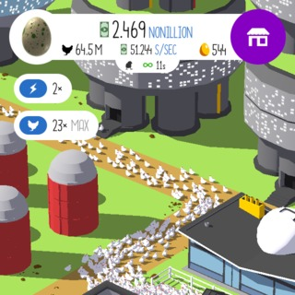
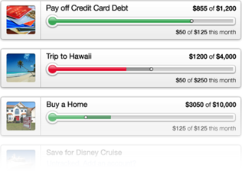
Sense of progress
Draws on self-determination theory
Intrinsic motivation
Autonomy
Competence
Relatedness
Implemented using PR highlights, goal tracking etc.

Slide 14

Example: Foursquare
Case study 1: Foursquare
A mobile game, a way of exploring cities, a way of telling friends where you are, and a way of tracking where friends have been and who they have been co-located with

Slide 15
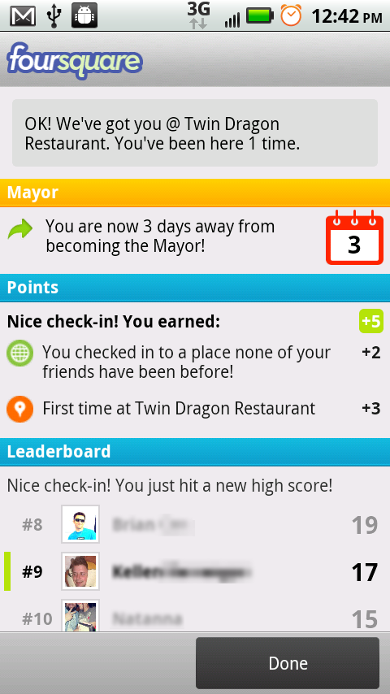
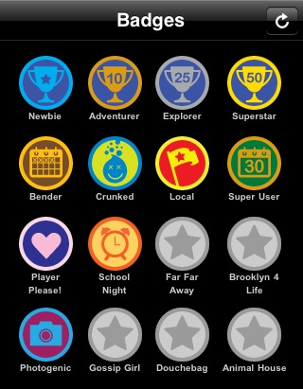
Example: Foursquare
Game mechanics: points, badges,
leadership board
Motivation drivers: collecting,
achievement

Slide 16
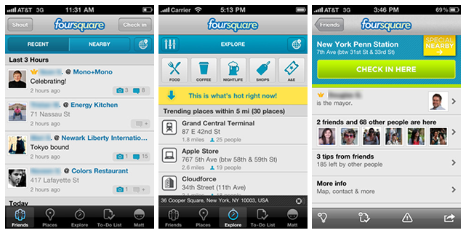
Example: Foursquare

Slide 17
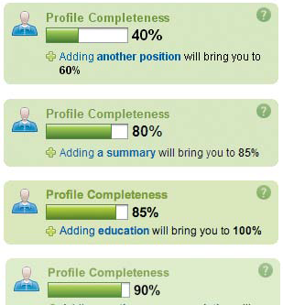
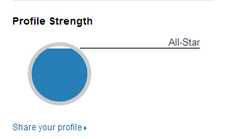
Example: LinkedIn
Case study 2: LinkedIn
Game mechanics: Progress indicator
Motivation driver: Feedback

Slide 18
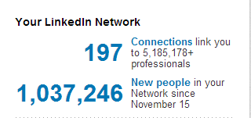
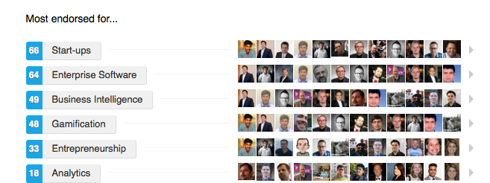
Example: LinkedIn
Game mechanics: network indicator
Motivation driver: Connecting, feedback
Game mechanics: endorsement buttons (communal discovery)
Motivation driver: Achievement, feedback

Slide 19
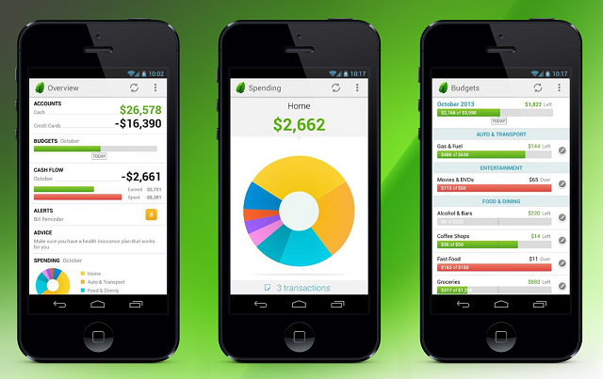
Example: Financial apps
Mechanism: Closure, progress

Slide 20
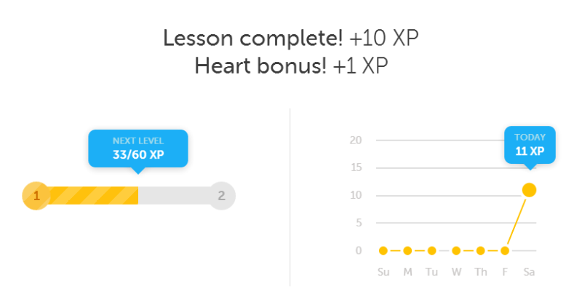
Example: E-learning/MOOCS

Slide 21
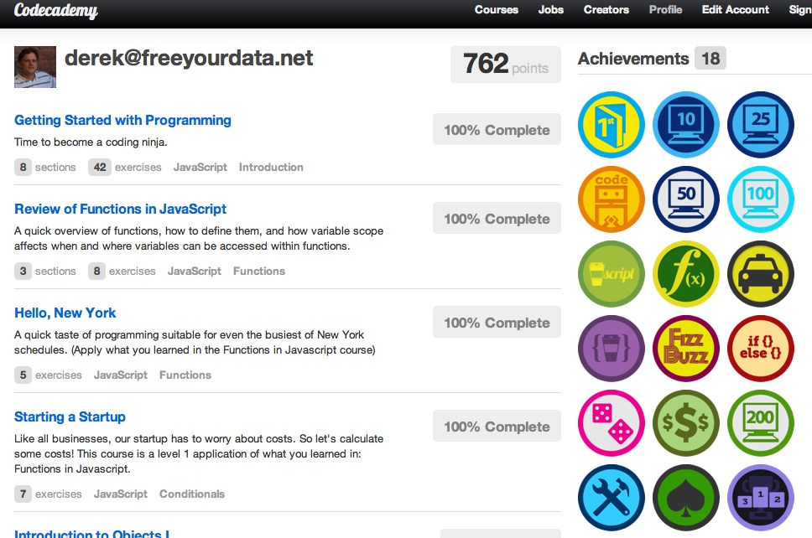
Example: Online self-learning

Slide 22
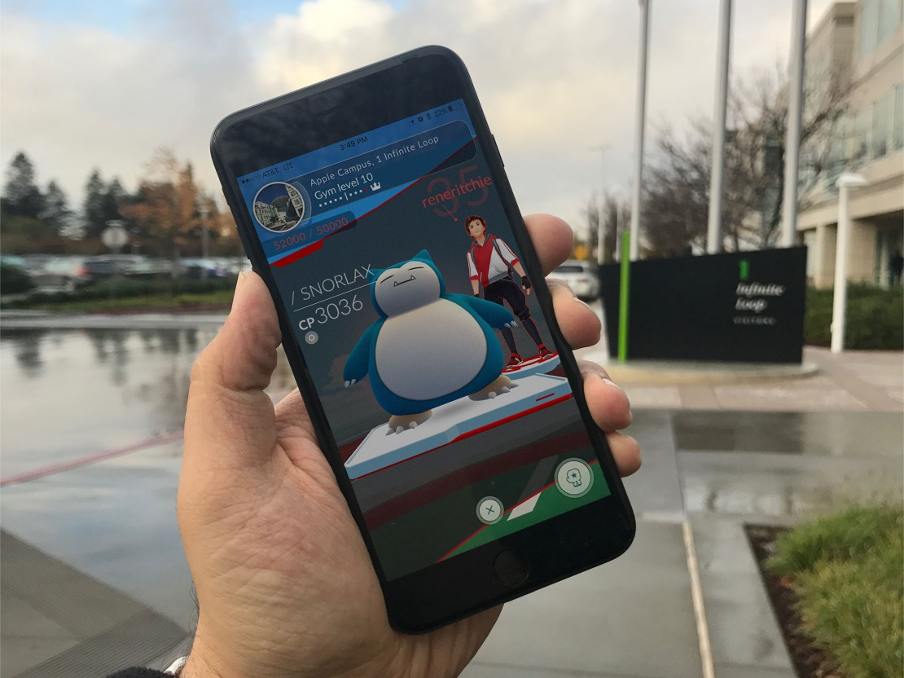
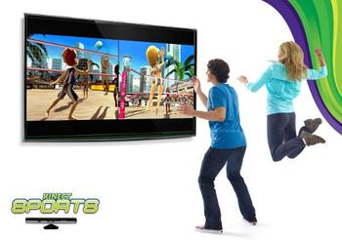
Example: exergaming
*Most downloaded game in history
* Fastest game to net $1B in revenue

Slide 23
Summary - gamification
Use UI elements to trigger human primary rewards
Associate reward-satisfaction with business requirements
Can improve traffic/retention by large amounts
Most useful in situations where true value to the user is long-term
Exercise
Learning something complicated
Gamification provides short-term surrogate rewards to keep them motivated
Frequently abusive and addictive
Always ask, who benefits from this?

Slide 24
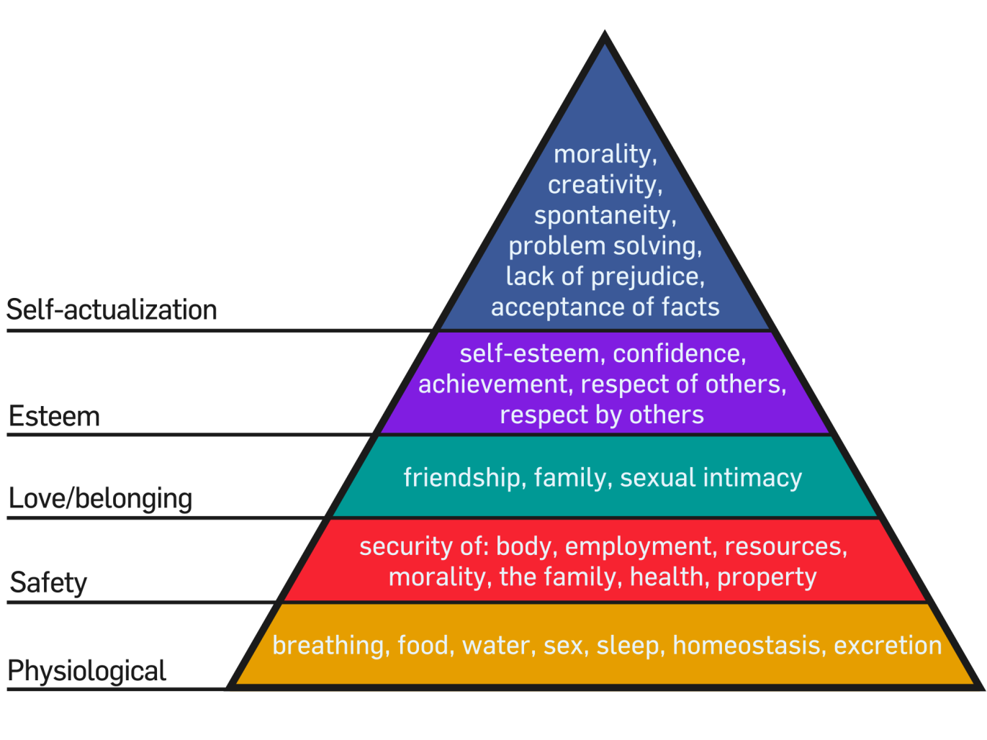
Focused at the top of the needs pyramid
Gamification
Games
Play

