Slide 2

Indian Institute of Technology Kanpur

Slide 3
In Collaboration
with

Slide 4

National Program on Technology Enhanced Learning (NPTEL)

Slide 5
Presents

Slide 6
Introduction to the Psychology of Bilingualism & Multilingualism
Dr. Ark Verma,
Assistant Professor of Psychology,
Department of Cognitive Science,
IIT Kanpur

Slide 7
Age of Acquisition Effects in Second Language Learning

Slide 8
Can we learn a second language late in life?
While a lot of individuals may have an opportunity to learn a second language early in life, let's say by going to an English medium school.
However, a sizeable number of people get the opportunity to learn a second language late in life, through occupation, or immigration.
As we were discussing earlier, is learning a second language late in life difficult? And How?

Slide 9
Indeed, researchers have studied age-of-acquisition effects for second language acquisition and use and have discovered several interesting insights into the same.
Let’s begin with a seminal study conducted by Johnson & Newport (1989) which examined the critical period hypothesis for second language acquisition.
More specifically, they considered two versions of the hypothesis:
the exercise hypothesis: early in life humans have a superior capacity for acquiring languages, but if the capacity is not adequately exercise, it will disappear or decline with maturation.
The maturational state hypothesis: early in life, humans have a superior capacity for acquiring languages, but the ability declines with maturation.

Slide 10
Both versions of the hypothesis make different predictions for second language learning, more specifically
while the exercise hypothesis predicts that if individuals have acquired the first language at an early age, the ability to learn a second language would stay intact for the rest of the life
the maturational state hypothesis predicts that, regardless of whether a first language is acquired early in life, the language learning capacity would continue to decline with age as a consequence of maturational changes in a child’s brain.

Slide 11
Johnson & Newport reasoned that in order to prove the maturational state hypothesis they would need to provide evidence that the ability to learn language decreases over time and also evidence of a discontinuity in the age function that can be related to the ending period of brain maturation.
They tested these ideas in a study where they examined L2 speakers’ knowledge of English morphology and syntax.
Different aspects of morpho-syntactical knowledge of English were tested , 12 in all, for instance, its past-tense information, plural systems, determiners and use of auxiliaries etc.
All of the 46 participants in the study, were Chinese and Korean native speakers, who had immigrated to the United States between the ages of 3 – 39. Their age at first arrival to the US were considered as their first exposure to English or their age-of-acquisition.

Slide 12
Johnson & Newport (1989) included only L2 speakers who attended university or had obtained a university degree and had been immersed in English for at least 5 years, to ensure that all the participants had reached their final stage of proficiency in their L2 (English).
Further, a group pf 23 English native speakers were also included to provide a measure of the baseline measure.
Further, the experimental task involved grammatical judgment to each of the 276 spoken English sentences presented by means of an audiotape, each sentence testing for a specific type of morphosyntactic knowledge.

Slide 13
The results showed a strong relationship between the age of arrival in the US and their grammatical knowledge (r = -.77), wherein the early arrivals performed better than late arrivals.
More specifically, the best performance was shown by the earliest arrivals (between the ages of 3-7), whose performance was very similar to the native English speakers, but the performances of the three older age groups (8-10, 11-5, and 17-39) performed worse compared to the native speakers.
Also, the three groups differed significantly from one another, with the early arrivals in these age groups outperforming the later arrivals.
These results supported in essence th idea of a critical period.

Slide 14
To test the affects of brain maturation on the participants eventual proficiency of their acquired L2, Johnson & Newport (1989) divided their participants into two age groups: participants with AoA 3-15 years and those with AoA 17-39 years.
Indeed, the former group 3-15 years showed much higher correlation (r= -.87) than the latter group of 17-39 years showed a lower correlation (r= -16).
Additionally, a notable result was that there was much lower variance in the performance of the younger AoA group than the older one.
The authors deduced that their results supported the maturational state version of the critical period hypothesis.

Slide 15
The Age Function in Second Language Learning
Two more studies (Birdsong & Molis, 2001 & DeKeyser, 2000) have also tried to replicate Johnson & Newport’s (1989) study using the same experimental materials but testing L2 English speakers with other L1 backgrounds.
Interestingly, neither of these two studies exactly replicated the findings from Johnson & Newport.
However, DeKeyser (2000) on examining L2 English speakers with Hungarian as their L1, concluded that his data agreed with the findings of the original study, and also in support for the maturational state hypothesis.

Slide 16
However, in contrast data from Birdsong & Molis (2001), who tested native speakers of Spanish pointed out discrepancies between their findings and those of the Johnson & Newport (1989)’s study, for instance they suggested that factors other than a bounded period of special language learning ability early in life might bring about the age-of-acquisition effects.

Slide 17
Zooming in, DeKeyser (2000) noted some concerns from the design of Johnson & Newport (1989)’s study:
In their study the minimal length of residence of the participants in the US had been only 5 years, which may not have been long enough for the participants to have reached the ultimate level of L2 proficiency.
Also, their age of arrival had been confounded with the participants’ age at test taking, implying basically that the older test taskers may have performed worse because of diminished attention skills and not because of their late learning of L2.
Finally, the differential ability to remain concentrated all through the long test session that may also have caused the poor performance of the older adults.

Slide 18
DeKeyser (2000) tried to address some of these concerns in their study by increasing the minimal length of residence in the US to 10 years, correcting for chronological age in the data analysis, and also reduced the test items from 276 to 200.
Additionally, DeKeyser (2000) also administered a language-learning aptitude test to test for whether their participants had any individual differences amongst in their language learning abilities, even before the test ~ the fundamental difference hypothesis (Bley-Vroman, 1988), which could explain the large variability in the scores of the late learners of L2.

Slide 19
the fundamental difference hypothesis posits that while children utilize an innate language learning mechanism that may have allowed for implicit and unconscious learning, adults second language learners need to resort to explicit, conscious, learning strategies that rely on individuals general problem-solving capacities, including their ability to reflect on the structure of the targeted language.
Individuals who are good at these general problem-solving abilities, and who posses high verbal – analytical skills, may therefore eventually attain a higher level of proficiency of their intended L2, and those lower on the spectrum of these abilities may never be able to attain a very high level of proficiency in their L2.

Slide 20
Let’s look at the results:
In agreement with DeKeyser (2000)’s hypothesis, individuals with better verbal analytical skills amongst the late learners were able to compensate for the fact that the innate language learning device was inaccessible, these were the few late arrivals who could actually obtain grammaticality-judgment scores within the range observed for the early arrivals.
Indeed, among the participants who arrived at the age of 17 or more, the correlation between the grammaticality-judgment score and the verbal ability score was significant (r = 0.33).
For the early arrivals (before age 16), the correlation was nonsignificant (= 0.07), implying that verbal ability plays no roles when a secnd language is learned at a young age.

Slide 21
Another interesting finding was that when all participants were considered together, DeKeyser (2000) observed a strong negative correlation between the age of arrival and the grammaticality test score ( r = -0.63).
Interestingly the correlation was not significant if the participants were divided into groups of those who arrived before and after the age of 16, i.e., -0.26 for the early arrivals and -.04 for the late arrivals.
Note that the absence of the age effect in the group of early arrivals constitutes a challenge to the critical period hypothesis, as the maturational account of the critical period hypothesis predicts a negative correlation between the age of arrival and grammatical performance among early arrivals.

Slide 22
Further, the hypothesis predicts the occurrence of specific discontinuities in the age function that can directly be related to maturational change. More specifically, it predicts the (“stretched Z”; Birdsong, 2005) age function.

Slide 23
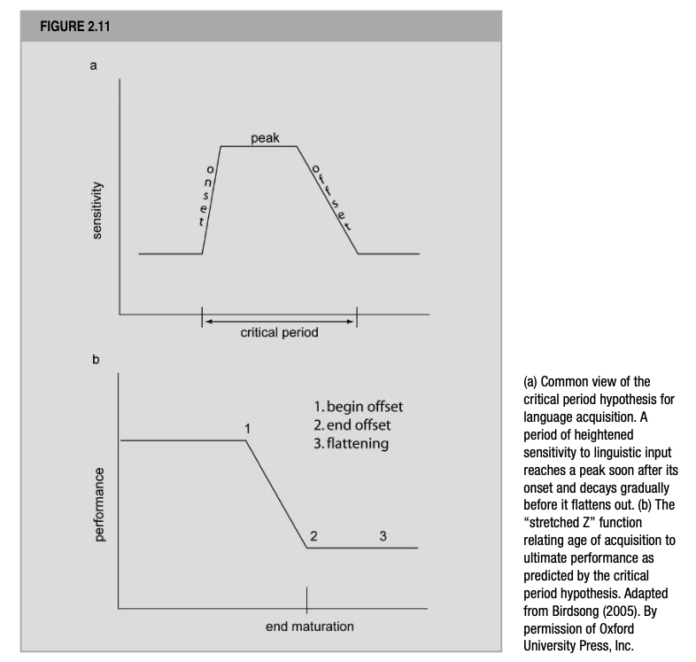
De Groot (2012). Language and Cognition in Bilinguals and Multilinguals. Psychology Press. Page 67.

Slide 24
This view of the hypothesis holds at some point early in life, and maybe already soon after or at birth, humans experience an increased sensitivity to linguistic input that takes a small time to reach its peak, which after some time declines gradually and then flattens out when brain maturation is completed.
As per this version of the hypothesis, if the learner were immersed in the L2 environment during the full period of highest sensitivity, nativelike efficiency will eventually be attained.
However, if acquisition starts late and only coincides with the part of the period of the peak sensitivity, continuing into the stage during which sensitivity is gradually declining, or it only starts somewhere in the middle phases, nativelike L2 performance will never be achieved.

Slide 25
Finally, if immersion starts when brain maturation is completed, the learner has missed the opportunity to profit from the heightened sensitivity and L2 learning has to come about through other means.
To conclude, the critical period hypothesis predicts an age function that includes the two discontinuities visualized in Fig 2.11 (b), although DeKeyser (2000)’s data do not meet these requirements, because the grammaticality-judgment scores of his early arrivals did not correlate with arrival age, despite the fact that the participants within that group differed from one another in the extent to which they had been able to profit from the hypothesized period of heightened sensitivity.

Slide 26
There are, however, some studies that have documented counter-evidence to the critical period hypothesis.
One interesting study was conducted by Birdsong & Molis (2001), who conducted a replication of Johnson & Newport (1989)’s study using the same methods and the same materials used by them; the only difference being that in the current study, the participants’ native language was Spanish.
Although Birdsong & Molis (2001) could obtain one discontinuity in the age function; the shape of the age function differed substantially from the one that is actually predicted by the critical period hypothesis.

Slide 27
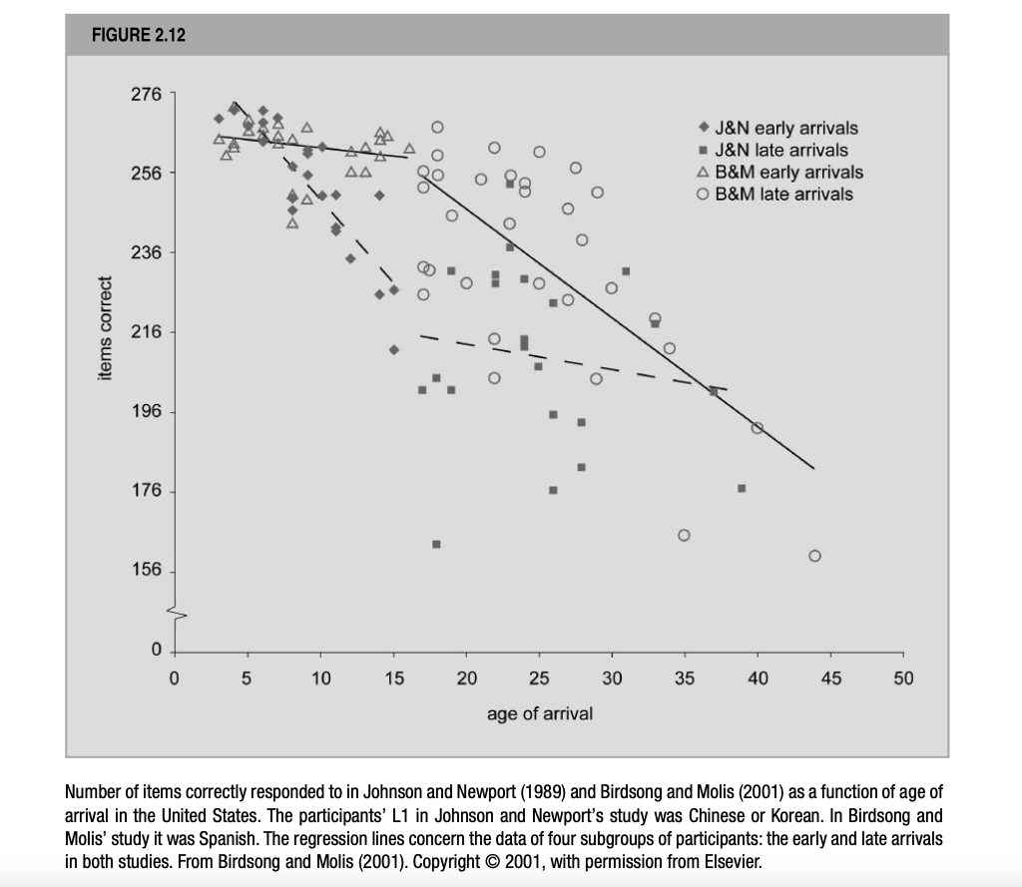
De Groot (2012). Language and Cognition in Bilinguals and Multilinguals. Psychology Press. Page 69.

Slide 28
Zooming in, when considering the group of participants as a whole, they obtained the same correlation between arrival age and grammatical skill as with Johnson & Newport (1989), i.e., r = -0.77.
However, further analyses of the data when dividing the participants into two groups (before and after 16 years of age), showed very different patterns of results than obtained by Johnson & Newport (1989).
While the former study had a significant negative correlation of -0.87, it was a nonsignificant -.24 in the current study; similarly, while it was a nonsignificant -.16 in the former study, it was a significant -.69 for the current study.
Note, that this is a reversed pattern.

Slide 29
Birdsong & Molis (2001)’s data deviated from those predicted by the hypothesis in three aspects:
the early arrivals showed little difference between them in terms of ultimate grammatical performance, although among the they differed greatly in the number of years their L2 acquisition coincided with the period of peak and heightened sensitivity to linguistic stimulation, assumed by the theory.
Secondly, an effect of age of arrival was obvious in the group of late arrivals, even though L2 immersion of all the participants in this group had started after the closure of the putative critical period, i.e. after 15 years of age.
Finally, there seems to be no endpoint to the age-related decline in final-state performance of the late arrivals; implying that the second discontinuity predicted by the hypothesis was missing in the age function obtained by this study.

Slide 30
Based on these observations, Birdsong & Molis (2001) rejected the critical period hypothesis.
An interesting finding of note from the study was that the incidence of near-native performance differs greatly between the two studies, in the sense that it is much higher and Birdsong & Molis’s study.
The authors suggested that the closer structural similarity between Spanish and English than between both Chinese and Koran on the one hand and English on the other may have caused this difference between the two studies.

Slide 31
Further studies, for e.g. one by Hakuta et al., (2003) showed that final L2 proficiency of individuals also depended on not only age-of-arrival, but also educational level.
Other sources of counterevidence would be:
Nativelike ultimate attainment in late L2 learners.
Non-nativelike ultimate attainment in early L2 learners.

Slide 32
In summary…
The critical period hypothesis predicts a pattern of discontinuities in the age functions that does not materialized for behavioral data.
Further, it falsely predicts that after many years of using the L2 all early learners, but no late learners should perform at nativelike levels.
Finally, one should consider that if there is a period of special sensitivity to linguistic stimulation during some bounded period in early life that determines eventual language learning, it is interesting why educational levels and structural similarity between L1 & L2 should matter at all.

Slide 33
Drawing from these discrepancies, Singleton (2005) opines that
“the CPH cannot be plausibly regarded as a scientific hypothesis either in the strict Popperian sense of something which can be falsified […] or indeed in the rather looser logical positivist sense of something that can be clearly confirmed or supported […]”

Slide 34
References
De Groot, A. M. (2011). Language and cognition in bilinguals and multilinguals: An introduction. Psychology press.

