Slide 2

Indian Institute of Technology Kanpur

Slide 3
In Collaboration
with

Slide 4

National Program on Technology Enhanced Learning (NPTEL)

Slide 5
Presents

Slide 6
Introduction to the Psychology of Bilingualism & Multilingualism
Dr. Ark Verma,
Assistant Professor of Psychology,
Department of Cognitive Science,
IIT Kanpur

Slide 7
Speech Production in Bi/Multilinguals - I

Slide 8
How do bilinguals speak in one of their two known languages?
Speech production is one of the fundamental skills that a lot of us take for granted, it is the performance of all the learnings that we have undertaken since birth (as discussed in the lectures of the previous week!).
But is it any difficult or more complicated for bi/multilingual as compared to monolinguals? And How?

Slide 9
To begin with…
majority of human communication occurs via speech.
speech includes a range of steps from conceptualising an idea that the speaker wishes to convey - the speaker produces a set of behaviours that change the physical environment, i.e., create a pattern of sound waves - an acoustic signal - that is available to the listeners.
the listener then, analyses the acoustic signal to decipher words - & match those words to the concepts, already stored in the mind - and thus understand what the speaker meant to say.

Slide 10
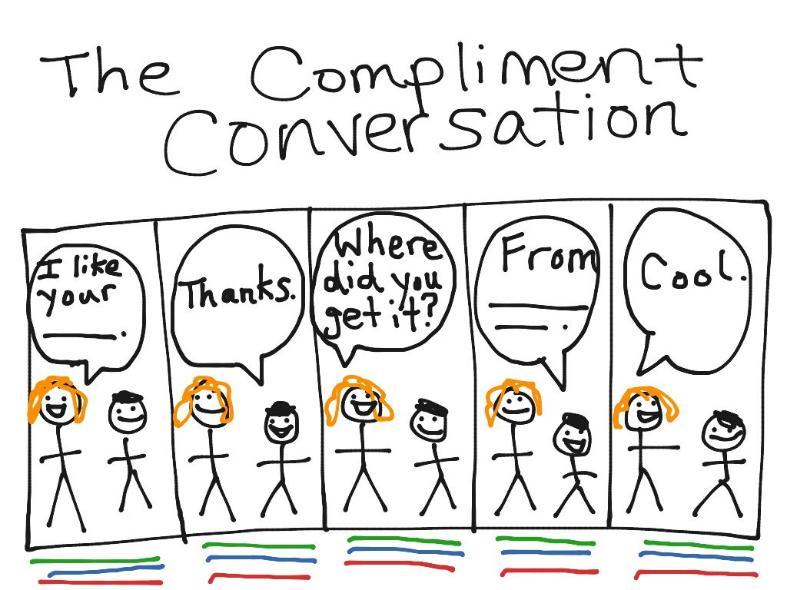

Slide 11
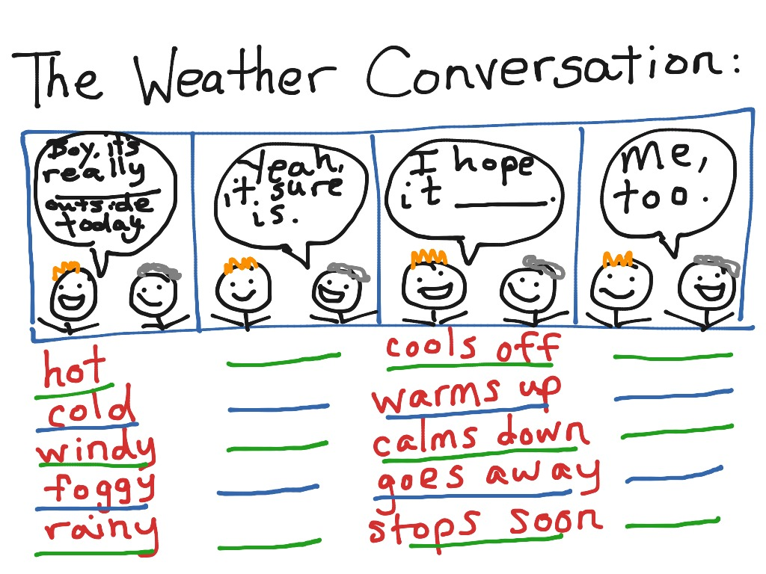

Slide 12
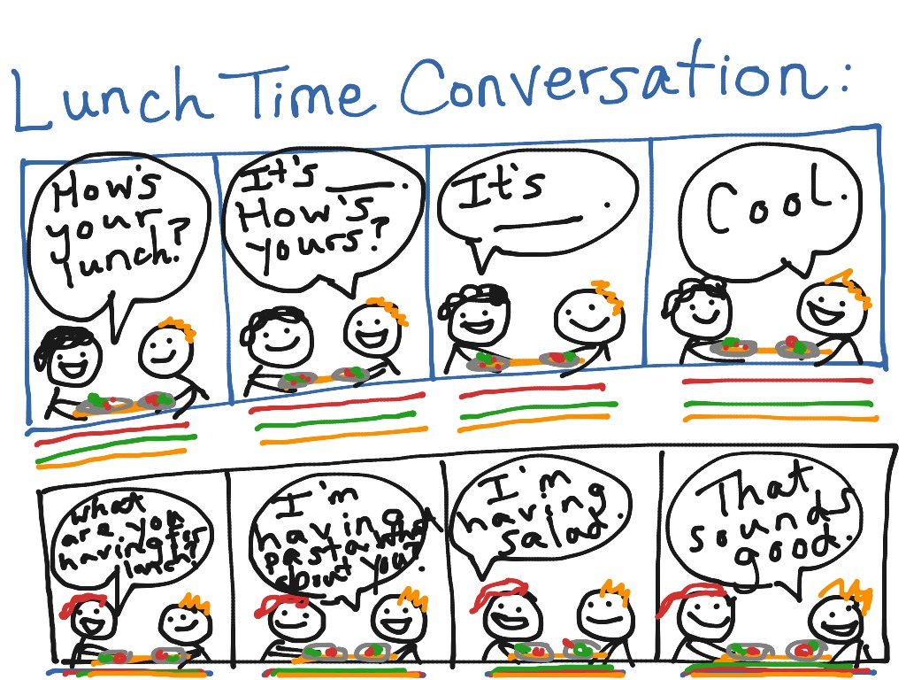

Slide 13
Some questions to ponder…
What steps need to be taken to retrieve the linguistic representations one needs to convey the idea?
How does one organise those representations?
How are those representations translated into a form that the motor system can use to generate the actual, physical gestures that create speech sounds?

Slide 14
So…
Speech production requires at least three kinds of mental operations (Griffin & Ferreira, 2006):
conceptualisation - thinking of something to say!
formulation - figuring out a good way to express the idea, given the tools in your language.
articulation - moving muscles to produce sounds that can be perceived by the listener.

Slide 15
An influential approach to explain the said processes is Levelt’s Production Theory - WEAVER++ -

Slide 16
Levelt’s Theory of Speech Production (Levelt et al., 1999, p.3)

Slide 17
speech production is viewed as involving a sequence of mental processes.
each mental process accomplishes a subgoal & the output of one mental process provides the information needed for the next mental process.
each box in the fig 2.1, indicates a kind of mental process. for e.g. “conceptual preparation…” refers to choosing the idea (s) you want to express, at the same time ensuring that you have words for those in your language.

Slide 18
the output of this process, a lexical concept, is an idea for which your language has a label (Levelt et al., 1999).
Let us take an example: the concept of a female horse is expressed by the word mare. but English language does not have a word that expresses the concept female elephant.
To express, the latter idea you need to select and combine two different lexical concepts (female, elephant).

Slide 19
But, can all ideas be neatly expressed with individual words?
Not always, we need a stage of processing that takes our (non - linguistic) ideas and finds the lexical/linguistic forms that we can use to express those ideas.
The lexicalisation process therefore serves the process as the interface between non - language thought processes and the linguistic systems that produce verbal expressions that convey those thoughts.

Slide 20
When you language does have a word for the idea that you wish to convey, the activation of
a lexical concept i.e. an idea that can be expressed in a word, will lead to
lexical selection: when a language has a number of different words that are close in meaning to the idea that you wish to express, a number memory representations do get activated, one of which have to be selected for production, that process is called lexical selection & it gives a lemma as an output.
lemma is a mental representation that reflects an intermediate stage between activating an idea and activating the speech sounds that you need to express the idea (Kempen & Hujibers, 1983).
the lemma incorporates information about word - meaning & syntax.

Slide 21
Once, there is an activated set of lemmas, the process of activating the sound codes that we need to speak begins.
first, we undertake a process called morphological encoding.
morphemes are basic units of language representation, morphological processing is important because words appear in different forms depending on aspects of their meaning as well as grammatical aspects of the sentences in which they appear.

Slide 22
Levelt (1989) notes that each word we know has a morphological specification that tells us how that word behaves when it is placed in a sentence.
the morphological specification for the word eat includes, “that it is a root form & that it’s past - tense inflection is ate.”
the form of the word, its morphological specification (ate, eats, eating), changes depending on what precise role the lemma is playing in the sentence.

Slide 23
having selected a set of morphemes to produce, morphological encoding activates the speech sounds (phonemes) we need to plan the articulatory movements that will create the speech signal.
the speech sounds one produces, depends on the morphemes that one has activated & also these have to be organised n the right sequence to ensure that right sounds are produced in the right order.

Slide 24
So,
Concepts -> Lemmas -> Morphological Specification -> Morphemes -> Speech sounds (Phonemes)

Slide 25
Once, you have the morphemes slotted into the right positions you can activate the individual speech sounds (phonemes).
what we normally think of as a word is referred to as a lexeme. To produce the lexeme, we need to activate a set of phonemes (speech sounds) and organise them into groups for production.

Slide 26
Now, when we speak, phonemes need to be organised into larger units, as we speak in syllables.
producing each syllable requires a coordinated set of actions, & each set of actions needs to be planned.
before we speak, we need to figure how to map the activated sets of phonemes onto a set of syllables. This latter process is called syllabification.

Slide 27
Syllabification involves two subcomponent processes:
activating a metrical structure & inserting individual speech sounds (phonemes) into positions in the metrical structure.
the metrical structure consists of a set of syllable sized units; in addition to specifying the number of syllables that you need, the metrical structure indicates the relative emphasis or loudness each that each syllable should receive.
e.g. the word banana has an accent on the second syllable; the word Panama has an accent on the first syllable.

Slide 28
So, the metrical structure for banana would be represented as “σ σ′ σ,” and the metrical structure for Panama would be represented as “σ′ σ σ.” Each σ symbol stands for a syllable, and the ′ mark indicates which syllable in the string should be accented. Once the metrical structure has been laid down, individual phonemes can be inserted into positions within each syllable.

Slide 29
Evidence that syllabification is a real mental process that intervenes between morphological processing & articulation can be found in studies of the way people speak.
for e.g. consider the word escorting. It has two morphemes, i.e. escort & ing. when people actually speak escorting, they usually produce it in three segments, which sound something like, “ess”, “core” & “ting”.
that means that the syllabification processes in production have placed the /t/ phoneme together with the /ing/ morpheme, rather than with the root morpheme escort.

Slide 30
So, we do not simply activate morphemes, activate the phonemes that go with each morpheme, & produce them in sequence.
Instead, after the morphemes are activated, we calculate the best way to organise the sequence of phonemes into syllables, and it is the syllables that actually serve as the basis of production.
That is true, even when the processes responsible for calculating syllables lump together phonemes from different words. for e.g. in “He will escort us.” one would actually say something like, “ess - core - tuss”.

Slide 31
So, while we need morphemes & words to plan what to say, speech does not simply involve activating the speech sounds in individual words; instead, the speech planning system activates a set of morphemes and words, and then it figures out the best way to organise the morphemes and words into a set of syllables.
Sometimes the syllables, respect the morpheme and word boundaries, but often times they do not.
In Levelt & Wheeldon’s words (1994), “Speakers do not concatenate citation forms of words, but create rhythmic, pronounceable metrical structures that largely ignore word boundaries.”

Slide 32
The output of the syllabification process is a set of phonological words.
In the WEAVER++ model, a phonological word is a set of syllables that is produced as a single unit. So, while “escort” & “us” are two different lemmas & two different words; when they are actually spoken, they come out as a single phonological word, “ess - core -tuss”.
Acc. to the WEAVER++ model, you can begin to speak as soon as you have activated all of the syllables in a given phonological word.

Slide 33
Further, while you plan each utterance by activating a number of lemmas & morphemes simultaneously; you plan the actual speech movements (articulation) one phonological word at a time.
Also, you plan the movements you need to produce each phonological word, one syllable at a time, in “left - to -right” fashion, i.e. you activate the phonemes for the syllable that you need first (“ess”) before you activate phonemes for the syllables that you will need later on.

Slide 34
People can do this phoneme - monitoring task very accurately, and they respond a little bit faster if the target phoneme comes from the beginning of the word than if the target phoneme comes from the middle or the end of the word (Wheeldon & Levelt, 1995).

Slide 35
To summarise, how the WEAVER++ model works,
production begins with a set of ideas that the speaker wishes to express.
in the next step, those ideas are tied to lexical concepts, because the language may have specific words for some of the ideas, but may require combinations of words to express other ideas.
after a set of lexical concepts has been activated, lemmas that correspond to the lexical concepts become activated.

Slide 36
activating lemmas, provides information about the morphological properties of the words, including information about how words can be combined.
after a set of morphemes has been activated and organised into a sequence, the speech sounds that are required can be activated and placed in a sequence.
phonological encoding involves the activation of a metrical structures and syllabification.
the outcome of this process is a set of phonological words consisting of a sequence of syllable sized frames.

Slide 37
During phonetic encoding, the speech production system consults a set of stored representations of specific syllables. The system activates the appropriate syllable representations and places them in the appropriate positions in the frame.
This representation is used by the motor system to create a phonetic gestural score, which is the representation used by the motor system to plan the actual muscle movements that will create the sounds that the listener will perceive as speech.

Slide 38
Levelt’s Theory of Speech Production (Levelt et al., 1999, p.3)

Slide 39
References
De Groot, A. M. (2011). Language and cognition in bilinguals and multilinguals: An introduction. Psychology press.
Traxler, M.J. (2012). Introduction to Psycholinguistics: Understanding Language Science. Blackwell Publishing Ltd.

