Slide 2

Indian Institute of Technology Kanpur

Slide 3
In Collaboration
with

Slide 4

National Program on Technology Enhanced Learning (NPTEL)

Slide 5
Presents

Slide 6
Introduction to the Psychology of Bilingualism & Multilingualism
Dr. Ark Verma,
Assistant Professor of Psychology,
Department of Cognitive Science,
IIT Kanpur

Slide 7
Speech Production in Bi/Multilinguals - III

Slide 8
Bilingual Speech Production in Action
While in the previous two lecture, I took you in some details of the speech production process (albeit for monolinguals) and we discussed that the models may need to be tweaked to account for bilingual speech production.
In this lecture, lets dive in a bit deeper and see how bilinguals produce speech given their two (or more) languages.
An interesting illustration of the same has been offered by Kroll, Sumutka & Schwartz (2005) for bilingual picture naming.

Slide 9
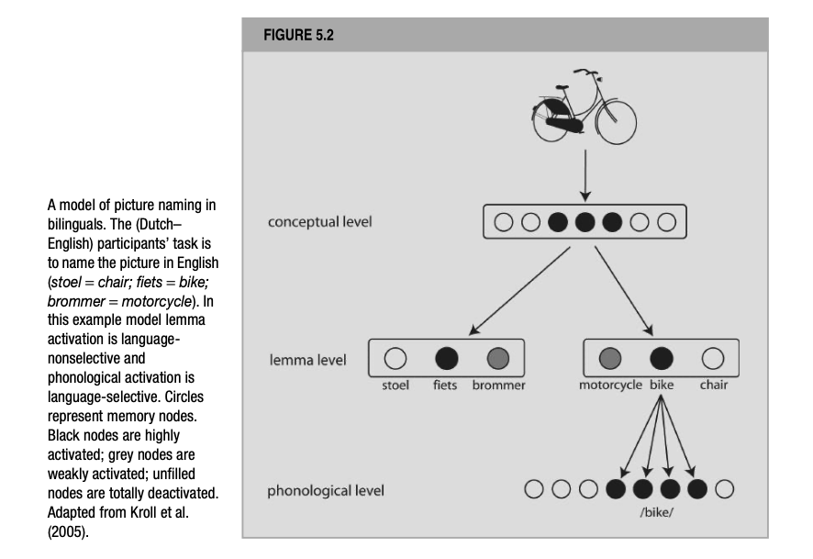
De Groot (2012). Language and Cognition in Bilinguals and Multilinguals. Psychology Press. Page 230.

Slide 10
Picture naming is one the simplest tasks used to experimentally elicit speech by word production researchers, as it involves processes closely resembling to conceptualization, formulation and articulation as discussed earlier.
More specifically, the process of picture naming, has been proposed to consist of the following sequential operations: computation of the visual percept, the activation of an appropriate lexical concept, the selection of a target word from the mental lexicon, phonological encoding, phonetic encoding and finally articulation (Levelt et al., 1998).

Slide 11
Zooming in, the perceptual analysis of a target picture, would result in the activation of “nodes” in the conceptual memory that would specify a certain meaning of the target word (to-be-named word). Each of these activated nodes specified one meaning aspect or conceptual feature of the target word ( for e.g., animate vs. inanimate).
Further, following from Levelt’s model (1989) and De Bot (1992) and De Bot & Schreuder (1993)’s suggestions, these activated conceptual components would form the preverbal message. Here, the aspects of a given word’s meaning would be distributed over several more elementary meaning units, in form of a distributed representation.

Slide 12
Going forward, these conceptual components would feed down their activation to the lemma level, using unidirectional links, where each word is represented as a single, non-decomposed entity.
Importantly, here the activation is not restricted to the lemmas from only the target language (the one in which the participants have been asked to name the picture), and the lemmas in the non-target language are activated as well. Thus, lemma activation is language non-selective.
From the lemma level, activation spread unidirectionally to phonological units, where the phonological word form is represented in a pattern of activation over a number of nodes, each representing a part of the sound of a word, for instance, one phoneme.

Slide 13
According to Kroll et al., (2005) model, the activation of phonological units happens for the most activated word from the target language and for none of the words from the non-target language, implying that the phonological activation is language – selective.
Processing assumptions at various levels in the current model, as well as in some others have been subject to disagreements and deviations.
For instance, while Levelt’s model proposes unidirectional movement of activation (from top to bottom) some other monolingual models (Dell, 1986) assume forward as well as backward spreading of activation, hence postulating bidirectional connections between levels of representation, conceptual->lemma->phonological levels.

Slide 14
Also, instead of non-decomposed representations at the lemma level as in Kroll et al., (2005)’s model, some authors (Dell, 1986; Butterworth, 1989) assume that the semantic aspects of a lexical entry is componential or decomposed.
Such a view can explain the activation of several candidates at the lemma level that have matching meaning components with the target lemms (say, all fruits, or pet animals).
This would lead to several lemmas being activated by the preverbal message.
Models holding the non-decomposed view of lemma representation, activations of multiple semantically related lemmas is explained in terms of spreading activation in a lexical-semantic network wherein semantically related/similar lemmas are connected and activated one shall activate others as well.

Slide 15
According to this account, the lemmas of words semantically related words are therefore not directly activated by the preverbal message, but indirectly, following prior activation of the target word’s lemma.
Interestingly, assuming the existence of both the existence of prelexical conceptual elements as well as lexical-semantic conceptual elements, the latter being part of a lexical entry’s lemma, seems to involve a doubling of memory components.
Following which, more recent work proposes that lemmas do not contain both the lexical items semantic and syntactic information (as in Levelt’s model) but only contain syntactic information about the target lexical item.

Slide 16
Alfonso Caramazza (1997) offers a more radical solution based on evidence from a diverse set of neuropsychological studies, when he proposes an independent network model wherein lemmas are dismissed altogether.
More specifically, Caramazza (1997)’s model proposes that a word’s phonology is independent from access to syntactic information. A word’s syntactic make-up is not prepared prior to, but independently from, specifying its phonology.
In the model proposed by Caramazza (1997), activation from a lexical-semantic network flows down directly to both phonological lexemes and to a network of syntactic features, and from the phonological lexemes on to segmental phonological information (i..e, units that represent phonemes).

Slide 17
Also, direct connections are postulated between the phonological lexemes and the syntactic features network.
Such a setup is considered independent because the activation of lexemes is no longer mediated by activation of syntactic information.
So, the model proposes componential instead of non-decomposed word meanings, although these lexical meaning components are activated because of prior conceptual processing remains unspecified.

Slide 18
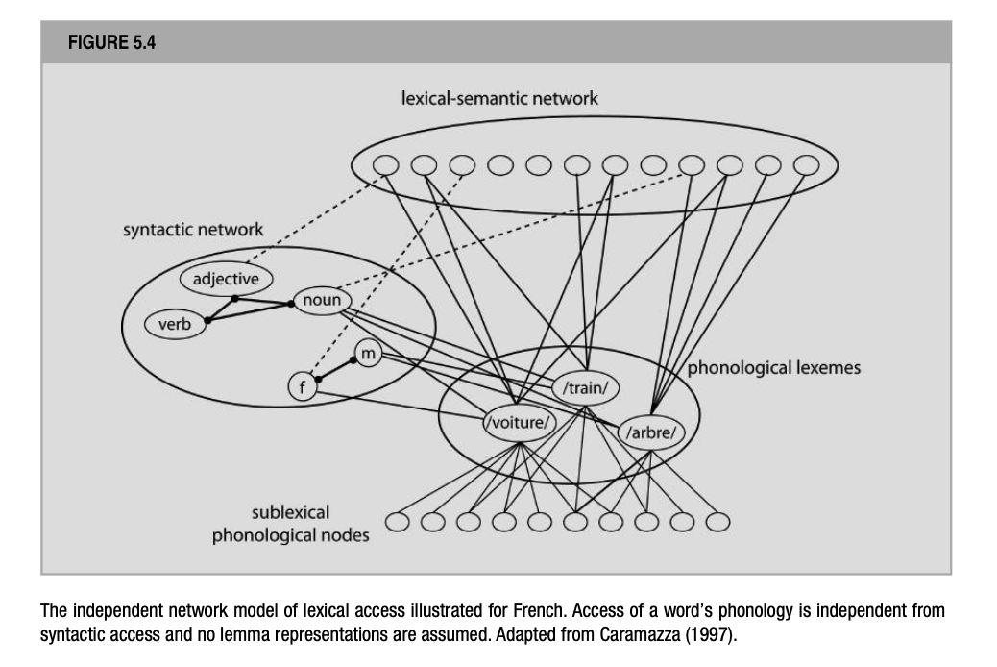
De Groot (2012). Language and Cognition in Bilinguals and Multilinguals. Psychology Press. Page 233.

Slide 19
Finally, in models of speech production sometimes the processing assumptions may not be explained in detail and thus have a potential of getting confused, for instance a model of bilingual picture naming (Costa et al., 2000) representing naming for cognate and non-cognate lexical items may be taken to resemble Kroll et al., (2005)’s model but have slightly different processing assumptions.

Slide 20
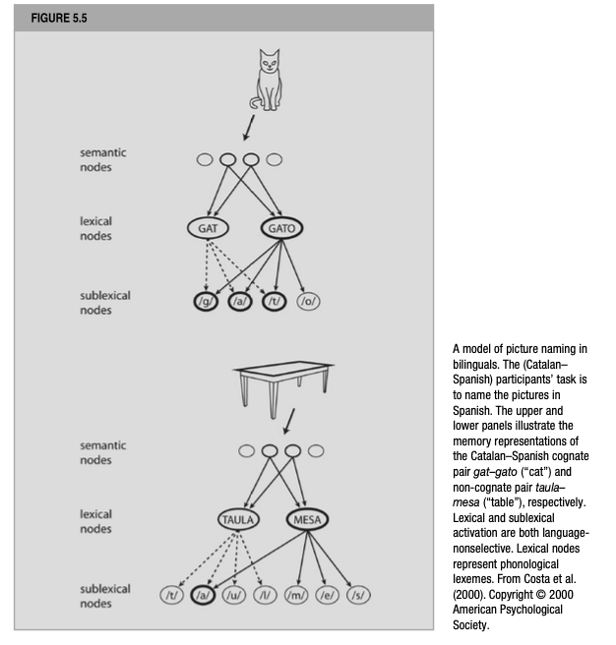
De Groot (2012). Language and Cognition in Bilinguals and Multilinguals. Psychology Press. Page 235.

Slide 21
Finally, there has been a dispute about whether the conceptual message contains information about lexical semantics or a preverbal conceptual structure.
More specifically, the dispute in question is whether word meanings exist separately from more general conceptual knowledge.
While Levelt’s model assumes such to be the case, and other researchers have put forward this view as well. For instance, the distinction between lexical semantics and general, non-linguistic, conceptual knowledge forms the basis of the three-store hypothesis (Paradis, 2004).
De Bot and Schreduer (1993) have also distinguished between the two.

Slide 22
Francis (1999, 2005) have put forward a more simplified view of the relationship between general conceptual knowledge and lexical-semantic concepts:
all humans' posses ( a non-linguistic) conceptual system consisting of a large set of conceptual elements. Semantics is involved when this conceptual system maps onto language or, more precisely instantiates language.
According to this view, word meanings do not exist separately from a knowledge store that contains non-linguistic conceptual information but are represented by subsets of units in this store.
This way the same conceptual element in the sore may serve as a component part of the meaning of many words: any word meaning is identified with a subset or a particular pattern of activation across the entire conceptual system.

Slide 23
References
De Groot, A. M. (2011). Language and cognition in bilinguals and multilinguals: An introduction. Psychology press.

