Slide 2

Indian Institute of Technology Kanpur

Slide 3
In Collaboration
with

Slide 4

National Program on Technology Enhanced Learning (NPTEL)

Slide 5
Presents

Slide 6
Introduction to the Psychology of Bilingualism & Multilingualism
Dr. Ark Verma,
Assistant Professor of Psychology,
Department of Cognitive Science,
IIT Kanpur

Slide 7
Speech Production in Bi/Multilinguals - III

Slide 8
Bilingual Speech Production in Action
An interesting question pursued in bilingual speech production research has been whether it is language selective or language non-selective.
Meaning whether the speakers activate the steps of speech production in a language selective way or that the steps of speech production take place for both of the bilinguals’ known languages.
A bunch of studies have employed the picture – word interference paradigm to investigate this:
Where a picture is accompanied by a distracter word and the influence of the distracter on picture naming performance is measured.
This paradigm was first used by Rosinki, Glinkoff and Kukish (1975).

Slide 9
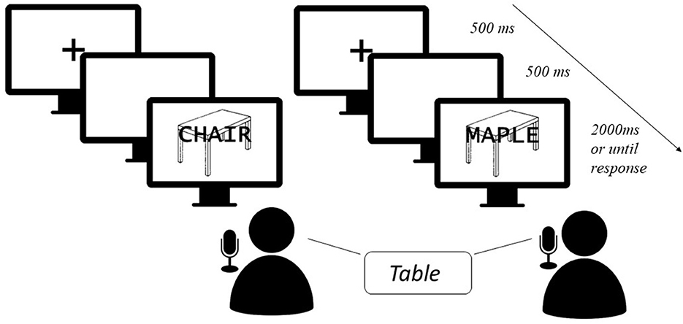
Sa-Leite et al., (2023) A cautionary note on the studies using the picture-word interference paradigm: the unwelcome consequences of the random use of in/animates. Frontiers in Psychology, 14,

Slide 10
In a study by Ehri & Ryan (1980), it was demonstrated that English-Spanish bilinguals named pictures more slowly in both of their languages, if a word from the non-target language was superimposed over the picture as compared to when a neutral distracter (XXXXs) was superimposed.
Similarly, in another study (Magiste, 1984) with German-Swedish bilinguals, with varying proficiency levels in Swedish, the same interference effect was observed. Notably, the size of the interference effect depended on the relative proficiency in the two languages: the stronger the non-target language, the larger the interference effect.

Slide 11
Looking more closely: locus of interference in the picture-word interference effect.
Broadly in the monolingual version of this task, researchers have looked to investigate the processes of lemma selection and phonological encoding by manipulating the type of distracter words presented with the picture, and the time lapsed between the presentation of the picture and the distracter word.
The two could be presented simultaneously i.e., 0 SOA condition, distracter presented earlier than picture, i.e., negative SOA condition and the distracter following the picture, i.e., positive SOA condition.

Slide 12
Sa-Leite et al., (2023) A cautionary note on the studies using the picture-word interference paradigm: the unwelcome consequences of the random use of in/animates. Frontiers in Psychology, 14,

Slide 13
Across various studies that have employed the paradigm, both visual and auditory distracter words have been used.
The main dependent variable being the latency of picture naming: the time between the onset of the picture and the voice onset of the participants naming response.
Overall, 5 different types of distracters have been used: a word depicting the same picture: identical; semantically related to the picture: semantic; phonologically related to the picture: phonological; phonologically related to a word that is a semantically related to the picture: phonological-semantic; unrelated to the picture’s name: unrelated.

Slide 14
Typically, semantic distracters have been shown to slow down the picture-naming response, whereas phonologically related distracters have been shown to facilitate the naming response.
The former effect has been attributed to competition between the lemmas of both, the picture and the distracter which slow down the naming process, although the effect is moderated by the time difference between the presentation of the picture and the distracter, i.e., when the distracter preceded the picture (negative SOA condition).
The latter has been attributed to boosted activation of the phonological elements that need to be encoded, for naming. Also, these facilitatory effects were obtained when the picture and distracter were presented simultaneously or when the picture was presented earlier than the distracter, but not when the picture preceded the distracter.

Slide 15
The locus of these effects needs to be understood in the context of the steps involved in picture & distracter naming.
For instance, picture naming starts with the perceptual analysis of the picture, followed by activation of the conceptual nodes and then towards the phonological encoding steps, whereas the distracter word naming starts from the phonological encoding stage and works upwards towards the conceptual activation stages so that the same can be named.
the point at which these two coincide decide the nature of the interference effect: for semantic interference: the distracters will need to be presented early for the conceptual node activation stages to coincide and for phonological facilitation the distracter will need to be presented late, while the phonological encoding of the picture is already underway.

Slide 16
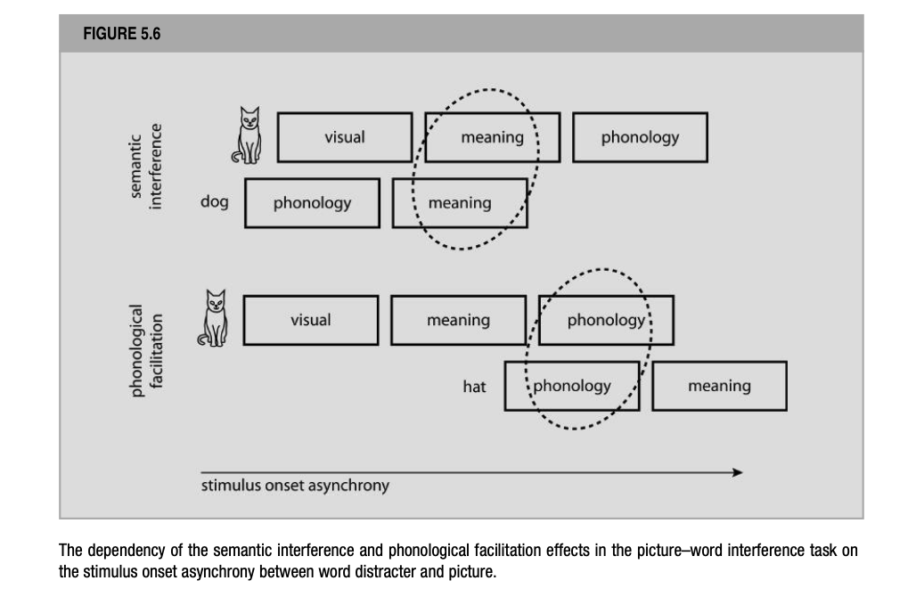
De Groot (2012). Language and Cognition in Bilinguals and Multilinguals: An Introduction. Psychology Press. Page 237.

Slide 17
Bilingual Studies: Picture-Word Interference Task
Hermans et al., (1998) used the distracter methodology to examine whether bilingual word production is language-nonselective.
Basically, they sought to investigate whether, if bilinguals are asked to name pictures in their L2, the representations of the translational equivalents in their L1 become activated or not.
Further, if so, the authors were interested to investigate whether the activation of translational equivalents stops at the lemma selection levels.

Slide 18
The participants of this study were Dutch-English bilinguals, who were highly proficient in English, although dominant in Dutch.
Each picture was to be named in L2 English (let’s say mountain), and they were presented with an auditory distracter, which could be of four types: semantic: valley; phonological: mouth; phonological relatives of the Dutch translation (e.g., bench for berg), and completely unrelated to the picture’s name (e.g., present).
Two experiments with varying SOA were run: distracters preceded the onset of the picture by 300 ms (SOA -300) or 150 ms (SOA -150), coincided with the onset of the picture (SOA 0), or followed the picture 150 ms after the latter’s onset (SOA +150 ms).

Slide 19
However, in the two experiments, the critical difference was that in one of them the distracters were all English words, whereas in the other the distracters were Dutch words.
This way in the second experiment, the hypothesis about whether the semantic cohort activated by the picture includes Dutch translational equivalents, but also semantic neighbors of these Dutch translation equivalents (e.g., dal for valley).

Slide 20
Coming to the results:
The experiment with English distracters showed a facilitation effect of phonological distracters (e.g., mouth) in all four SOA conditions, suggesting that phonological encoding of the picture’s name already starts during an early stage of lexical access.
The semantic distracters showed an inhibitory effect (e.g., valley), except in the condition where the distracters followed the picture (SOA +150).
Interestingly, phonological translation distracters (e.g., bench) slowed down picture naming, but only when the distracter presentation coincided with the picture (SOA 0), implying the co-activation of the picture’s L1 names.

Slide 21
The authors interpreted that this evidence of language non-selective word production could have been more robust, but was small due to pronunciation differences between Dutch words and English words.
Hence, they had run the second experiment with only Dutch words, as the Dutch phonological translations certainly shared more phonology with the Dutch names of the pictures.
In the second experiment, the phonological translation distracters exerted an inhibitory effect in all except (SOA +150) condition. Interestingly, this time the effect of the phonological distracters disappeared in three of the four SOA conditions. This was probably because now the overlap between the Dutch phonological distracters and the English picture names would have reduced too much to cause any facilitation.

Slide 22
However, in this experiment as well the effect of the semantic distracter was found, providing evidence that the semantic cohort activated by the picture also included the lemmas of semantically related words to the translational equivalent.

Slide 23
Considering these results, Hermans et al., (1998) discussed three types of production models for bilingual speech production: the discrete two stage models, the unidirectional cascade models, the interactive activation models.
Specifically, the authors concluded that the results of the study did not fit the predictions of any of these production models.
However, the results did indicate that at some point during picture naming in the weaker L2, the picture’s translation in L1 is also activated. Implying that bilingual word production is language non-selective. Although the evidence could not tease apart, whether the system is non-selective at the level of lemma selection or phonological encoding.

Slide 24
An interesting caveat from Hermans et al., (1998) study was the fact that words from the non-target language also compete with lexical nodes from the target language, during preparation for production.
Contrary to this proposal, Costa et al., (2003) have argued that while there may be activation in the non-target language system not all of it competes with the elements from the target language but is ignored.
They propose that the selection process for lemmas is language selective and that only activated words from the target language compete for selection & further production.
The idea is that although elements from both, the target & the non-target language can get activated during word production but only lexical items from the target language compete for selection.

Slide 25
The production model assumed by Costa and his colleagues, postulates discrete semantic nodes, lexical nodes, and sub lexical nodes; wherein each lexical node represents a word’s complete phonological form, and each sub lexical node represents a component of a word’s phonology, e.g., a phoneme.
In such a model, activation at the semantic level flows directly to the phonological (lexical) nodes.

Slide 26
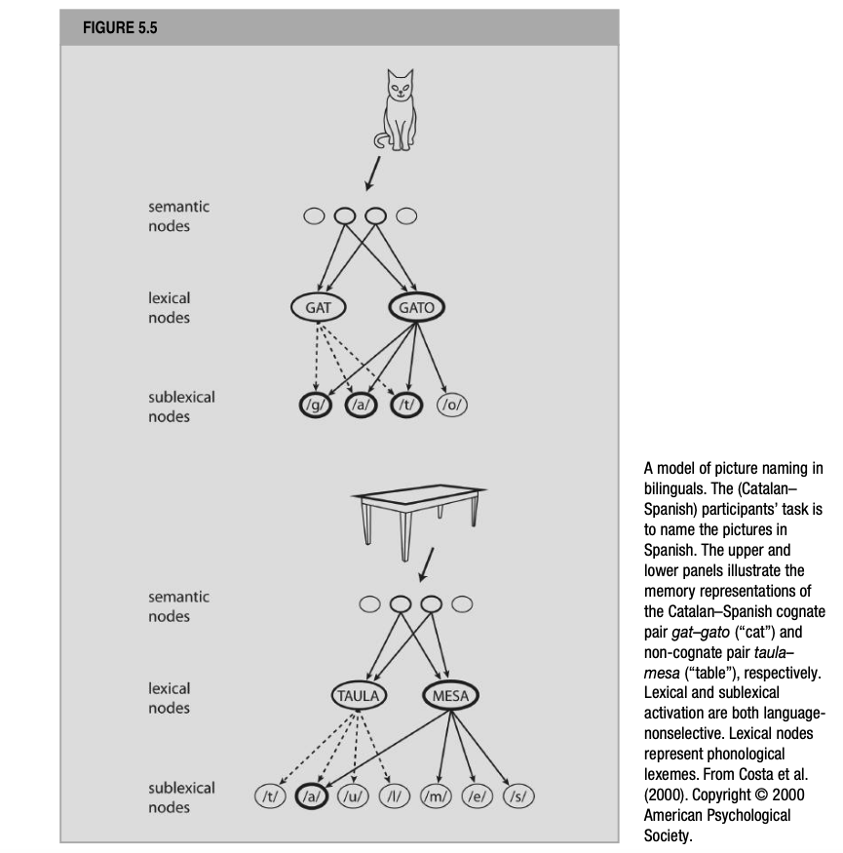
De Groot (2012). Language and Cognition in Bilinguals and Multilinguals: An Introduction. Psychology Press. Page 235.

Slide 27
To delve a bit deeper in the same, Costa et al., (1999) carried out a study employing the picture-word interference task.
The participants were highly proficient, balanced, Catalan-Spanish bilinguals who named pictures in their L1(Catalan).
The distracters were presented visually rather than aurally.
Implying that the visual distracter will first activate phonology only indirectly, via activated orthographic lexical and sublexical nodes. Consequently, the SOA range suitable to test the above theoretical distinction between discrete two-stage and unidirectional cascade models of speech production should differ between studies that present visual vs. auditory distracters.

Slide 28
A new feature of the current study was that it added a new distracter condition, i.e., the identity condition, wherein the distracter was the name of the picture in the target language or in the non-target language.
For instance, a picture of a table to be named in L1(Catalan) was accompanied by the visual word taula or its L2 (Spanish) translation mesa.
The researchers begin with testing the assumption that the most highly activated lexical node is selected from the set of activated lexical nodes and that the ease with which a target node is selected, depends upon the level of activation of the non target competitors.
Costa et al., hypothesized that for bilinguals, activation at the semantic level of representation may activate lexical nodes in both languages simultaneously, but only the activated lexical nodes of the target language may be considered for selection.

Slide 29
So, the authors divided the question of whether bilingual word production is language-selective or language non-selective into two parts:
Do or do not activated semantic nodes transmit their activation to lexical nodes in both languages? and if they do
Do the activated lexical nodes of both language compete for selection or does the selection process only consider the activated lexical nodes of the target language?

Slide 30
In this context, the identity condition, especially its cross-language version may provide the means to answer both these questions.
For instance, if the participants can switch off the non-target language completely, no effect of presenting a distracter in the non-target language should emerge. This should happen if picture-naming time in the identity condition and in an unrelated control condition were the same.
On the other hand, a difference in picture-naming times between the identity condition and an unrelated condition would suggest co-activation of the lexical node in the non-target language.
Moreover, if such a difference exists, the direction of the effect would reveal the nature of the selection process: the language nonspecific selection hypothesis predicts longer times in the cross-language identity condition than in the unrelated condition whereas the language specific selection hypothesis predicts shorter times in the identity condition.

Slide 31
The same can be demonstrated with reference to the figure (next slide):
If lexical node activation is language selective, a picture of a table will first activate the corresponding semantic nodes and from there the lexical node representing Catalan taula but not the lexical node representing Spanish mesa.
In a language-selective activation account the cross-language identity distracter mesa may activate the corresponding semantic nodes (indirectly, through its orthographic nodes) but this activation may not be transmitted down to the phonological lexical nodes. Alternatively, it may also happen that the processing of a cross-language identity distracter is blocked altogether so that it also does not activate the corresponding semantic nodes.

Slide 32
If on the other hand, lexical node activation is language-nonselective, both the picture and the cross-language identity distracter mesa will first activate the corresponding semantic nodes; from there, the lexical nodes representing taula and mesa will both be activated, and both relatively highly because the level of activation in the activation-sending semantic nodes, coming from two sources, is relatively high.

Slide 33
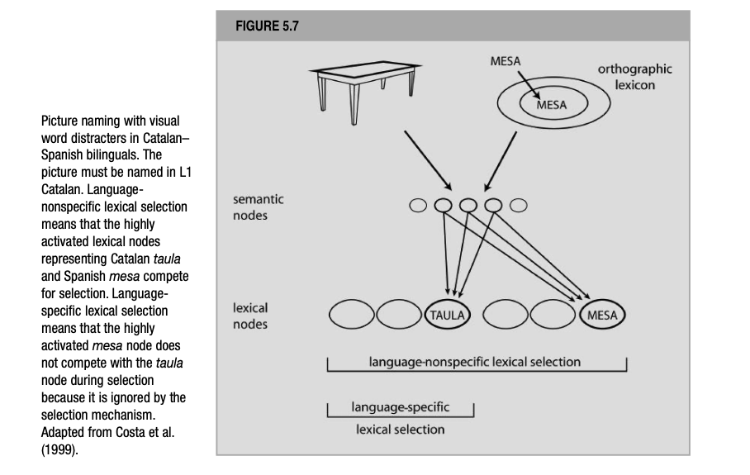
De Groot (2012). Language and Cognition in Bilinguals and Multilinguals: An Introduction. Psychology Press. Page 244.

Slide 34
Further, if the selection process is language-nonselective, both these highly activated nodes are considered for selection. Non-target mesa will act as a strong competitor in the selection process and slow down the picture naming response.
In contrast, if the selection mechanism is language-selective, i.e., only considering activated lexical nodes in the target Catalan, it will not suffer from the fact that Spanish mesa is also highly activated.

Slide 35
The data from their study agreed with the prediction that assumes language non-selective activation followed by language selective selection: Picture-naming times were shorter in the cross-language identity condition than in the unrelated control condition.
The fact that no null effect of distracter type (identical vs. control) was obtained suggest that lexical activation is language nonselective; but the fact that the observed effect was facilitatory and not inhibitory, is consistent with the idea that lexical selection is language selective.
Indeed, even a strongly activated lexical node in the non-target language does not slow down processing; and only the activated lexical nodes in the target language are considered for selection.

Slide 36
References
De Groot, A. M. (2011). Language and cognition in bilinguals and multilinguals: An introduction. Psychology press.

