Slide 2

Indian Institute of Technology Kanpur

Slide 3
In Collaboration
with

Slide 4

National Program on Technology Enhanced Learning (NPTEL)

Slide 5
Presents

Slide 6
Introduction to the Psychology of Bilingualism & Multilingualism
Dr. Ark Verma,
Assistant Professor of Psychology,
Department of Cognitive Science,
IIT Kanpur

Slide 7
Comprehension Processes in Bi/Multilinguals - II

Slide 8
Models of Language-Nonselective Lexical Access
One of the influential models that have sought to explain the process of bilingual lexical access has been the bilingual interactive activation (BIA) model developed by Dijkstra, Grainger & Van Heuven (Dijkstra & Van Heuven, 1998; Grainger, 1993; Grainger & Dijkstra, 1992, van Heuven, Dijkstra, & Grainger, 1998).
This was a connectionist computational model of visual word recognition in bilinguals and concerns an extension of the Interactive Activation (IA) model by (McClelland & Rumelhart, 1981).

Slide 9
The BIA model has been able to simulate the observed homograph effects in certain conditions, despite the fact that the model does not represent word meaning.
Also, the model has ben able to simulate the monolingual behavioral data that Mc Clelland & Rumelhart (1981) had modelled in their IA model.
The BIA model contains four levels of representational units or “nodes”, these levels represent visual letter features, letters, the orthographic forms of whole words, and language information, respectively.

Slide 10
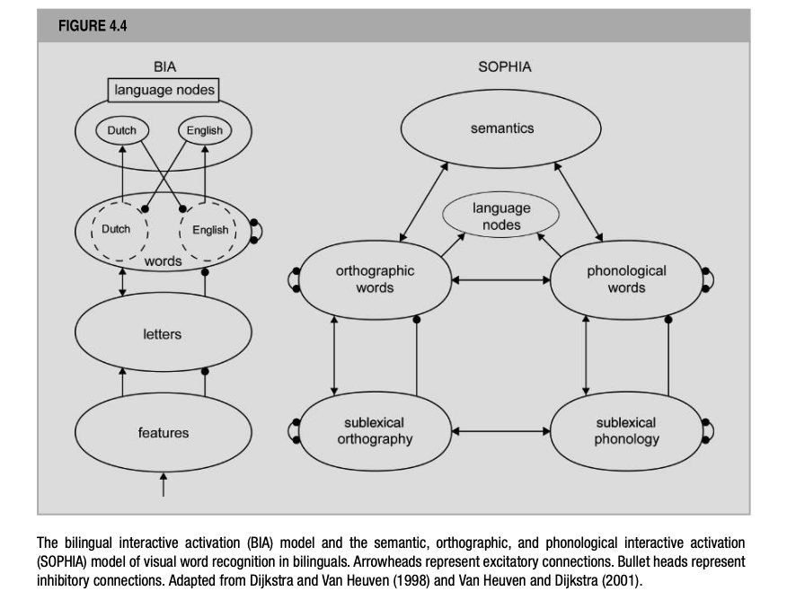
De Groot (2012). Language and Cognition in Bilinguals and Multilinguals: An Introduction. Psychology Press. Page 178.

Slide 11
More specifically, the bilingual’s two languages share the feature and letter nodes, whereas the word nodes are organized in language subsets, which are fully connected between the languages.
Also, the layer of language nodes contains just two nodes, one for each language.
The processing in this model is assumed to be interactive, in that representations at one particular level can influence (activate/inhibit) representations at an adjacent higher or lower level.
Activations are instantiated through excitatory connections whereas inhibitions are instantiated through inhibitory connections. Further, in addition to the excitatory and inhibitory connections between adjacent levels, the model also assumes inhibitory connections between all orthographic word form nodes, a phenomenon referred to as lateral inhibition.

Slide 12
When a visual word is presented, the BIA model first activates the feature nodes that correspond to the the input (horizontal, vertical, slanting lines, or curves).
The feature nodes, in turn feed activation into the layer of letter nodes, wherein it excites the nodes for letters that carry the activated features and inhibits the nodes for letter that do not carry the activated features.
Further, the activated letter nodes activate or inhibit word nodes, where the words that carry the activated letters get activated and the words that do not carry the activated letters get inhibited.
for instance, when the English word sand is presented to the model, it will activate the letters s, a, n, d via the feature level and in turn will activate the word node corresponding to target sand but also nodes for similar words like hand, sane and sank which share letters with the actual stimulus.

Slide 13
Also, the word nodes for less similar words like salt, wind, and sin will get activated too, but for a lesser extent, and their activation will be nullified through the inhibitory effect of the mismatching remaining letters.
Importantly, activated letter nodes will activate word nodes corresponding word nodes in both languages; and so, in a Dutch-English bilingual, the letter nodes that are activated will also excite word nodes for Dutch words like zand and mand.
Further, activated word nodes transmit activation to the language node of the corresponding language, at which moment the latter starts to inhibit word nodes of the other language.
Finally, all word nodes compete with one another in the recognition process, inhibiting each other through lateral inhibition, until the activation level in one of them exceeds a “recognition threshold”. It is at that moment that the input sand will be recognized.

Slide 14
In more detail, if and when the activation level of a word node reaches the recognition threshold is not only determined by the match between stimulus and word node inn terms of shared letters but by a number of other variables.
For instance, the number of activated word nodes that are competing with one another during the recognition process. ~neighborhood.
Also, the level of activation of the word node when it is in resting state, i.e., baseline activation which may differ on the basis of frequency of use/encountering the word.

Slide 15
Dijkstra & Van Heuven (1998) postulate two orthographic word node representations for interlexical homographs, one for each language; and both of these shall become activated when an interlexical homograph is presented to the system. On the contrary, if a non homograph is presented there will only be one word node that would reach a high level of activation. This particular difference is attributed as the cause of the homograph effect.
On the other hand, Dijkstra et al., (1999) alternatively proposed that interlexical homographs are not represented in two separate word nodes but share one and the same word node between the two languages, which is connected differently to the two languages. Although, this possibility was later discarded as it did not confirm with the obtained behavioral data.

Slide 16
It would seem that the BIA model can infact deal with the obtained out-of-context homograph effects, however, how would it account for different pronunciations of the homographs in the two languages?
As the BIA model does not contain phonological representations, it is not equipped to explain these effects.
Also, the BIA model would fail to account for the role of natural language meaning in ambiguity resolution since it does not have semantic representations.
For this reason, Dijkstra & Van Heuven (2001) proposed a different and slightly more elegant model, i.e., SOPHIA (Semantic, Orthographic, Phonlogical, Interactive Activation) model that encompasses all three levels of representation.

Slide 17
For this reason, Dijkstra & Van Heuven (2001) proposed a different and slightly more elegant model, i.e., SOPHIA (Semantic, Orthographic, Phonological, Interactive Activation) model that encompasses all three levels of representation.
The SOPHIA model carries two additional layers between the original letter and word levels: a level of orthographic clusters and a level of orthographic syllables. So, in all there are three orthographic units, one representing letters, another representing letter clusters smaller than syllables and the third representing syllables.
In this model, phonology is represented in four analogous levels of nodes that represent phonological units of different sizes.

Slide 18
De Groot (2012). Language and Cognition in Bilinguals and Multilinguals: An Introduction. Psychology Press. Page 178.

Slide 19
The processing assumptions of the SOPHIA are very similar to the BIA model, including those of excitation and inhibition of adjacent levels as well as inhibition at the same level of representation.
Here although, orthographic units can activate the phonological units and vice-versa. For instance, for a given word bird the orthographic node for this word would activate the corresponding phonological form /burd/.
Notably, SOPHIA is not just an extension of the BIA model, but differs crucially from the same in an important respect:
Whereas the BIA model has both excitatory and inhibitory connections from a language node to all the word nodes of another language, in this model, these connections have been removed.

Slide 20
Since these inhibitory connections served several important functions in the BIA model, their removal warrants alternative explanations. One of which has been offered via the language switching effect: the finding that words preceded by words of the same language are responded to faster than words preceded by words of another language.
While the SOPHIA model does not explicitly deal with he language-switching effect, a further rendition of the BIA, i.e., the BIA+ model tries to account for the same by adding a task/decision system to SOPHIA’s word identification system to account for the same.
According to Dijkstra & Van Heuven (2002), the task/decision system is sensitive to extra-linguistic influences (such as participants’ expectancies) whereas the word identification system is only affected by linguistic factors such as lexical, semantic and syntactic information.

Slide 21
Interestingly, how the authors have attributed the homograph effect changes in the newer model, i.e., the BIA+.
For instance, while in terms of the BIA model the homograph effects were attributed to the processes of activation and inhibition in the lexicon and its structural characteristics, i.e., lexicon internal locus in the BIA+ they are attributed mainly to external control, in the sense that the task/decision system responds flexibly to a number of variables such as task-specific requirements.

Slide 22
Moving forward, an important aspect of the functioning of the BIA model has been the memory representations of the so-called neighbours of the stimulus word, which seem to get excited irrespective of their language membership.
According to the BIA model, a complete form overlap between the input and the information specified in the word nodes is not required for a word node to become activated upon input, and hence words having partial overlap with the input, i.e., neighbors like hand and sank also get activated. This neighborhood effect has also been known to affect word recognition performance.
For instance, monolingual neighborhood studies have shown that the time of visual word recognition for words depends on the word’s frequency and the number of competing neighbors.

Slide 23
Such findings have also motivated bilingualism researchers to account for the neighborhood effect, although the pertinent question has been whether neighbors from one or both languages become activated for a bilingual.
Incidentally, a set of cross-language neighborhood studies have provided support to this idea.
For instance, Grainger & Dijkstra (1992) used French-English bilinuals to perform an English lexical decision task to three types of English target words, presented visually: patriot words that had more neighbors in the target language, i.e., English; traitor words that had more neighbors in the non-target language, i.e., French and neutral words having equal number of neighbors in both languages.
The three groups of words were matched for frequency.

Slide 24
The data showed that there was indeed an influence of the relative number of neighbors: participants were fastest in the patriot condition, followed by neutral and the slowest in the traitor condition.
In another study by Bijelac-Babic, Biardeu, & Grainger (1997), conducted with Frencg-English bilinguals, French target words preceded by orthographically similar masked primes were responded to more slowly than targets preceded by orthographically dissimilar primes. However, when prime and target were from different languages, this inhibitory effect was only observed for bilinguals.
The combination of results were taken to suggest that the source of the orthographic priming effect was lexical; however, for bilinguals the effect extended for orthographically similar words in the non-target language too.

Slide 25
These findings together suggest that there is a level of co-activation in a non-target language too, although it may be moderated by a bilingual’s degree of command over the non-target language.

Slide 26
References
De Groot, A. M. (2011). Language and cognition in bilinguals and multilinguals: An introduction. Psychology press.

