Slide 2

Indian Institute of Technology Kanpur

Slide 3
In Collaboration
with

Slide 4

National Program on Technology Enhanced Learning (NPTEL)

Slide 5
Presents

Slide 6
Introduction to the Psychology of Bilingualism & Multilingualism
Dr. Ark Verma,
Assistant Professor of Psychology,
Department of Cognitive Science,
IIT Kanpur

Slide 7
Comprehension Processes in Bi/Multilinguals - IV

Slide 8
Does language non-selective encoding happen in spoken language comprehension as well?
So far in the previous lectures, we have seen evidence of parallel phonological activation of a bilingual’s two languages in the context of printed stimuli.
However, the primary context in these studies have been the investigation of phonological activation upon presentation of a orthographic form of the word which is indirect, some studies have also looked at whether parallel phonological activation could be investigated upon auditory presentation of stimuli.

Slide 9
A bunch of studies presenting auditory stimuli have used the eye-movement tracking paradigm initially developed by Tannenhaus, Spivey-Knowlton, Eberhard and Sedivy (1995) that allows the investigation of online language comprehension.
Herein, participants are presented with aural instructions to manipulate real objects on a visual display; during the task the participants wear a head-band with equipment that tracks their eye-movements while they are carrying out the instructions.
With the help of this technique, Tannenhaus et al., have gathered fine-grained temporal information about the process of spoken language comprehension.

Slide 10
The authors found that visual context affects the resolution of temporary syntactic ambiguities. For instance, when the participants were asked to “pick up the candy and put it above the fork”, the mean time to initiate an eye-movement to the target “candy” turned out to be longer when the display contained a distracter that shared initial phonology with the target, such as “candle” than when none of the distracters shared phonology with the target.
An interesting insight was that perception of a spoken word leads to activation of a bunch of candidates that share phonology with the perceived word and has been referred to as a “cohort” (Marslen-Wilson, 1987).
Hence, the visual context of the display was found to have an impact on the participants’ eye-movements while understanding and following the linguistic instructions.

Slide 11
Let’s look at some of these studies in more detail:
Marian & Spivey (2003) employed the eye-movement tracking paradigm referred to as the visual world paradigm in three bilingual studies to investigate whether the activated cohort also includes representations from the non-target language.
Participants in these studies included Russian-English bilinguals, having a weaker L2 (English). The participants were seated in front of a board with four objects in it, for e.g., a stamp.
They received spoken instructions such (in Russian L1 condition) put the stamp below the cross: poloji marku nie krestika (where marku is an inflected form of marka ~Russian for stamp). In the L2 English condition, the instructions were given in English.

Slide 12
In a between language-competitor condition, in addition to stamp, the board would carry an object whose name in the non-target language shares word-initial phonology with the target word (object).
For instance, with Russian marku as the critical stimulus word, one of the distracter objects was a marker.
The names of the remaining two (filler) objects on the board were dissimilar from both, the Russian and the English names of the target object.
Additionally, in a control condition, none of the three non-target objects’ names shared similarity with the name of the target object in either language. The authors also included a within-language competitor condition, with the target word and its competitor belonging to the same language (target: marker, competitor: marble).

Slide 13
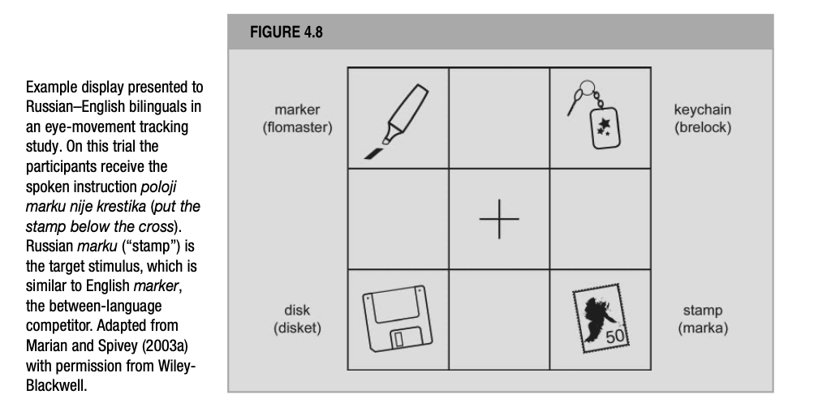
De Groot (2012). Language and Cognition in Bilinguals and Multilinguals: An Introduction. Psychology Press. Page 193.

Slide 14
The dependent variable was always the proportion of trials on which eye-movements were made to the competitor object in comparison to a filler object. These eye-movements suggest co-activation of this object’s name during the word recognition process.
The three studies conducted by Spivey & colleagues, differed from one another with respect to the care that was taken to prevent the participants becoming aware that they were taking part in a bilingual experiment.
In Spivey & Marian (1999) and Marian & Spivey (2003) the same bilingual participants participated in both a Russian L1 & an English L2 condition, in separate sessions. Therefore, it is possible that these participants suspected the bilingual nature of the experiments, which would have increased their activation level of both their lexicons.

Slide 15
Given, that the participants’ both lexicons were active, in order to be able to conclude that the recognition of spoken words is language- nonselective, evidence of cross-language competitor activation should ideally be collected under testing circumstances in which the participants have no idea they are participating in a bilingual experiment; which is when the participants would be in monolingual mode.
Marian & Spivey (2003) installed such a condition by testing different groups of participants, drawn from the same population in an English L2 and a Russian L1 experiment.

Slide 16
For the results, in all three studies, bilinguals showed both within-language and between-language competitor effects: they made more eye movements to within- and between-language competitors than to filler objects.
Control groups of monolingual English speakers showed competitor effects the within-language competition condition only, ruling out the possibility that the between-language effects in the bilinguals might have been an artifact of poor stimulus selection.
The within-language effects converged with Tannenhaus et al., (1995) results and with other evidence that during speech recognition a word input activates not only its own lexical representatives but also a whole set of lexical items similar to the target word.

Slide 17
The between-language effects demonstrated that the cohort of activated lexical representations included elements of both the target and the non-target language. This finding there indicates that spoken word recognition is also language – nonselective.
The between-language effects varied between the different studies.
Whereas Marian & Spivey (2003) and Spivey & Marian (1999) observed them in both languages, in the monolingual-mode condition (Marian & Spivey, 2003) they only materialized when the task was carried out in L2 English. This implied that the competitor’s interference was obtained from the stronger L1 onto the weaker L2, but not vice-versa.
The observed asymmetry is a robust phenomenon and has been replicated in later studies as well.

Slide 18
Understanding Language Non-Selective Phonological Activation Effects
While in the previous lectures, we have discussed SOPHIA, a model that includes phonological representations of different sublexical word units (phonetic features, phonemes, phoneme clusters).
In this model, when auditory input is presented, the corresponding phonological representations would first get activated, then the activation would be transmitted to the orthographic as well as other phonological nodes.
It is plausible that the model can account for some of the parallel phonological activation and the language non-selectivity observedin the studies so far.

Slide 19
Another model that could possibly account for language nonselective phonological encoding would be the Bilingual Interactive Model of Lexical Accesss (BIMOLA (Grosjean, 1997).
The BIMOLA model was developed specifically to account for spoken word recognition, this was developed as an extension of the TRACE model which was a monolingual model of spoken word recognition.
In this model, the auditory features, phonemes and spoken words are represented in three different layers.
Here the feature nodes are shared between the individual’s two languages, whereas the nodes representing the phonemes and whole word forms are organized into separate language subsets.

Slide 20
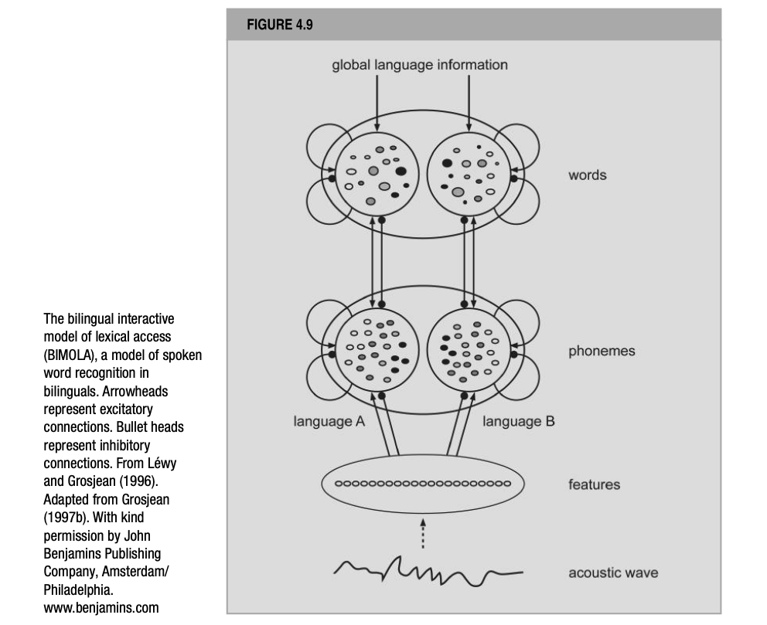
De Groot (2012). Language and Cognition in Bilinguals and Multilinguals: An Introduction. Psychology Press. Page 198.

Slide 21
Just like SOPHIA, in BIMOLA activated nodes at different levels can activate and inhibit nodes at the adjacent level, also there is within-level lateral inhibition.
However, BIMOLA restricts lateral inhibition to units (phonemes, words) of the other language (between subsets).
Also, in BIMOLA, the two word subsets receive a different amount of top-down pre-activation, based on external information that specifies the base-language.
Moving forward, once a word or a phoneme in a subset becomes activated it sends a small positive signal to the other words and phonemes, respectively, in the same subset. This way the subsets corresponding to the target language remain highly activated.

Slide 22
In such a set up, once the model receives an auditory input, it increases the activation of the phonological representations in both languages, first at the language-independent level of the phonetic features and from there higher up in the system.
The model has successfully been able to simulate two important effects:
the unit similarity effect: i.e., the phenomenon that a unit, for instance, a phoneme, presented in one language and sharing properties with a unit in the other language, will co-activate the latter.
The base language homophone effect: i.e., the phenomenon that words from the other language (i.e., the guest language) that have the close homophones in the base language are more difficult to process than other guest language words.

Slide 23
In summary…
There is ample evidence of the parallel phonological activation in both languages of a bilingual, both, through written and auditory input.
Both models, SOPHIA and BIMOLA are able to partially account for these effects, although since BIMOLA was specifically developed for spoken word recognition it seems to be the more favorable candidate.

Slide 24
References
De Groot, A. M. (2011). Language and cognition in bilinguals and multilinguals: An introduction. Psychology press.

