Slide 2

Indian Institute of Technology Kanpur

Slide 3
In Collaboration
with

Slide 4

National Program on Technology Enhanced Learning (NPTEL)

Slide 5
Presents

Slide 6
Introduction to the Psychology of Bilingualism & Multilingualism
Dr. Ark Verma,
Assistant Professor of Psychology,
Department of Cognitive Science,
IIT Kanpur

Slide 7
Language Control in Bi/Multilinguals - III

Slide 8
How do we shift between languages?: the language mode theory.
In the previous lecture, we saw that bilinguals need a system of language control to manage between the two active language subsets in order to alternate between the use of their two/or more different languages.
Also, as individuals interact in a variety of situations with different people on different topics and in different contexts, bilinguals are presented with decisions to make regarding the choice of language to speak in, depending upon these various factors.

Slide 9
Some of these factors include the context (place & topic of conversation), the listeners (their social stature, language preferences), the topic (formal, informal) and the speakers’ own proficiencies and preferences, also expertise with the given topic in a given language etc.
These factors put together involve important formulation decisions on part of a monolingual speaker himself/herself.
However, these factors predispose the bilingual speaker to make nuanced language choices, for instance, the choice of specific vocabulary and grammatical constructions that are appropriate in the given context.

Slide 10
Researchers have opined that these properties of the communicative context, play a part in determining not only the choice of language but also the incidence of code-switches and the fluency of a bilingual’s speech in a given scenario.
Grosjean, for instance, put forward the concept of a bilingual’s “language modes” to explain the apparently systematic linguistic behavior of the bilingual’s in a given discourse context.
The important underlying assumption in his theory is the idea that a bilingual’s language system is divided into two language subsets, one for each language and the fact that these subsets can be activated/deactivated as a whole and independently from each other.

Slide 11
Grosjean (1989,1994,1995) postulates that bilinguals typically find themselves at various points along a situational continuum, and depending upon these points, bilinguals engage different “speech/language modes”.
For instance, when they are interacting with a monolingual speaker, the bilingual would inevitably restrict themselves exclusively to the language this monolingual speaker understands. This has been referred to as engaging the “monolingual mode”.
On the other hand, when they are interacting with a speaker who is proficient in both of a bilingual’s languages, they would be prepared to communicate in either of their languages, and even flexibly mixing or shifting between the two as and when required. This has been referred to as engaging the “bilingual mode”.
These two conditions are considered as the opposite ends of the situational continuum that bilinguals move between during different types of conversational contexts.

Slide 12
Trying to cognitively understand the two modes:
One could look at the monolingual mode as a situation where the language of choice is maximally activated, and the non-target language for the given situation is almost fully deactivated.
Whereas, the during the bilingual mode is a situation where both languages of the bilingual are highly activated, although to different levels (jointly determined by the range of factors discussed earlier). This would allow the bilinguals with the luxury to choose between either of the two languages, at will, and the language thus chosen would become maximally activated for selection and production. This momentarily chosen language has been referred to as the “base language” or also “Language A” ; whereas the other language is referred to as the “guest language” or “language B”.

Slide 13
Moreover, the engagement of the monolingual mode would mean relatively fewer language switches and several hesitations when the chosen language is ill suited to express a particular conceptualized message easily, on the other hand, the engagement of a bilingual mode would mean highly fluent language use, and more systematic switches between the two known languages of the bilingual.
In later work, Grosjean (1997, 1998, 2001) also put forward the notion that the language-mode concept includes two factors:
The choice of the base language and its communicative repertoire, given a particular setting.
And the state of activation of each of the two languages at any given point in time.

Slide 14
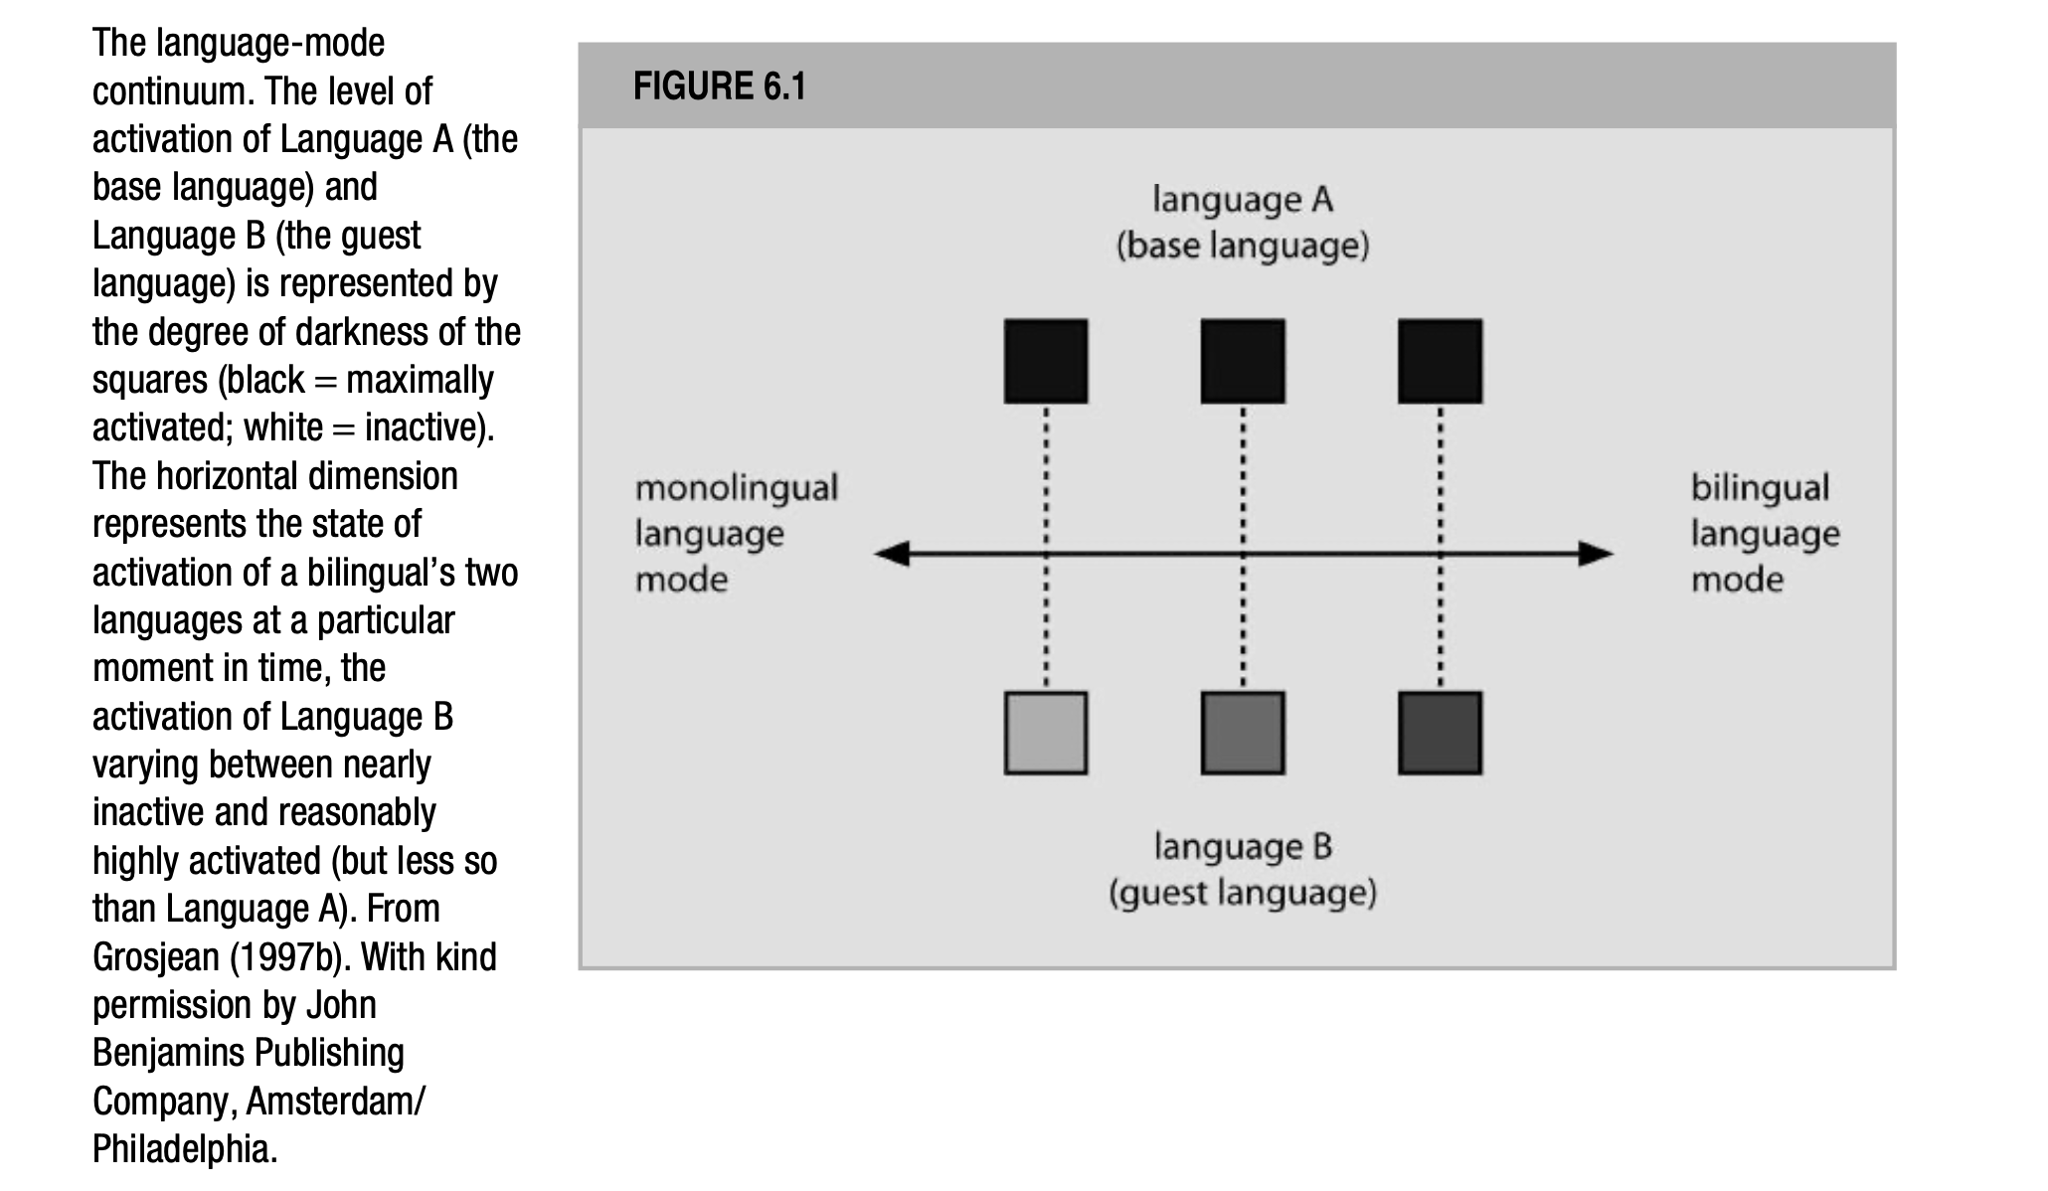
De Groot (2012). Language and Cognition in Bilinguals and Multilinguals: An Introduction. Psychology Press. Page 290.

Slide 15
As apparent in the figure, there are three states across the situation continuum. In all of these, Language A i.e., the base language is activated the most; the states actually differ in the levels of activation of Language B, i.e., the guest language.
For instance, the guest language is most deactivated at the monolingual language mode whereas it is (almost) comparably activated at the other end when the bilingual language mode is engaged.
Another interesting point of note in this discussion, is that the bilingual’s choice of the base language, and their position on the so-called situational continuum, often does not involve a deliberate, or conscious thought process but rather emerges automatically from the given conversational context, probably in light of the factors that we discussed earlier.
So unintentional/automatic switches and flexible language use is most certainly the more ecological behavior as opposed to what has been implicated in lab-experiments.

Slide 16
Moving further, the language mode theory (Grosjean, 1998) follows the assumptions as:
It assumes that the base language is chosen prior to the beginning of a conversation – a choice that determines the activation settings of the language system. This follows the assumption of “proactive control” of their language system by bilinguals. However, the language choices are not rigidly specified, and can fluctuate or flexibly adapt to the demands of the communicative setting and hence the control is also not exclusively proactive.
Secondly, the language mode theory assumes a global control. More specifically, the engaged mode would influence the level of activation of all elements within a language subset at the same time.

Slide 17
Further, the language mode theory assumes both external and internal locus of control, as both, the intention to speak as well as the type of linguistic input received by the individual can exercise an influence onf the levels of activation of the two language subsystems.
Finally, as per the language mode theory, the system of language control exerts its effects on the activation of all the entities stored within the language system proper and not on the output from the system.

Slide 18
All in all, the language mode theory can certainly account for the situation dependency of the number of code-switches in, and the fluency of bilingual speech etc., it does not present a lot of clarity about how the relative activation of the two language subsystems is related to the speech data:
More specifically, it has been proposed that the bilingual in adherence to the demands of the communicative context, shall adopt a monolingual/bilingual language mode. The adopted mode will then govern the particular speech pattern that occurs and the degree of speech fluency. The same speech pattern then leads to the conclusion as to what mode the speaker is actually in.
Hence, this reasoning seems circular and underspecified.

Slide 19
Lets try and look at some evidence in the context of language mode theory.
Grosjean (1997), in an experiment closely mimicking the circumstances of natural communication, presented French-English bilinguals, fluent in both languages with stories in French and asked them to summarize the same in spoken French.
In one condition (French), the participants were told that were addressing the person who had just arrived in the United states and spoke only French at home, although they could read and write English, but had trouble speaking it.
In another condition (Bilingual A), the participants were told that the person they had to address had lived in the US for 7 years, worked for a French government agency, and only spoke French at home.
In the third condition (Bilingual B), they were informed that the person they had to address had lived in the US for 7 years, , working for a local firm, had French & American friends and spoke both languages at home.

Slide 20
On the other hand, the topics that were described by the French stories, either concerned situations in France or typical American activities.
The stories in the latter condition were referred to as “bilingual stories” and contained a number of code-switches into American, at pleaces where a code-switch might naturally occur.
The dependent variables were the number of French and English syllables that were uttered in the summaries provided by the participants, and the number of hesitations they contained.

Slide 21
From the results, it was apparent that the participants were indeed able to adjust themselves to the addressee profiles provided by the experimenter.
When they were to address the French interlocutor, more French and fewer English syllables were uttered and more hesitations occurred than when they were to address the bilingual B.
When they were speaking to bilingual A, they produced an intermediate pattern of results.
These data were taken to imply that the instructions had influenced the participants’ beliefs about the three adressees:
that the French interlocutor was not yet fluent enough in English, that bilingual A was probably fluent in English but did not appreciate language switching and that bilingual B, was fluent in English and did not mind any language switches.

Slide 22
Hence, to adapt to the communicative demands of the different addressees the participants had adapted their speech to match the bilingual profile of these addressees.
These differences could also be used to explain the variations in the number of hesitations, across the different conditions.:
For instance, given the profiles of the French addressee and bilingual A, the participants attempted to even express the English expressions from the bilingual stories in French, and hence lots of hesitations were caused in these two conditions, compared to when the participants were conversing with bilingual B.
Also, it was observed that the participants used a larger number of French syllables in the French addressee condition, and a little lesser with bilingual A and the least with bilingual B.

Slide 23
With respect to the language-mode continuum, the observed data suggest that when talking to the French addressee and bilingual B, the participants positioned themselves on the two disparate ends of the situational continuum, engaging the monolingual and the bilingual modes, respectively.
However, when interacting with bilingual A, the participants positioned themselves intermediately.
The topic of the stories also played a part, wherein the bilingual stories produced about 10 times as many English syllables as the monolingual stories.

Slide 24
In summary…
Evidence certainly suggests that bilingual speakers can adapt themselves flexibly to the communicative demands of a given scenario, and the same is moderated by a range of dynamic variables in natural settings.
The system of language control thereby allows them to shift swift between languages and almost automatically meet the demands of a communicative setting.

Slide 25
References
De Groot, A. M. (2011). Language and cognition in bilinguals and multilinguals: An introduction. Psychology press.

