Slide 2

Indian Institute of Technology Kanpur

Slide 3
In Collaboration
with

Slide 4

National Program on Technology Enhanced Learning (NPTEL)

Slide 5
Presents

Slide 6
Introduction to the Psychology of Bilingualism & Multilingualism
Dr. Ark Verma,
Assistant Professor of Psychology,
Department of Cognitive Science,
IIT Kanpur

Slide 7
Language Control in Bi/Multilinguals - IV

Slide 8
Language Control: Just activation? or inhibition as well?
So far we have seen a proactive model of language control that was manifested in Grosjean’s Language Mode theory.
The model serves as an illustration of how bilingual’s dynamically adapt to the communicative demands of a situation and manage their behavior accordingly.
Another very important theoretical proposal in this area if that of an inhibitory control system that allows bilinguals to “suppress” activations in the non-target language.

Slide 9
Indeed, researchers have opined that an account of linguistic performance is incomplete without a description of a control system that enables the target language use, as and when intended.
One of the prominent researchers in this area has been David Green, who has emphasized the importance of efficient and unobstructed control operations in fluent language use and also of sufficient resources to be used in these processes.
An emerging view form Green’s proposal has been that processes involved in bilingual language control may resemble control processes that are implicated in other situations as well, such as when a response has to be selected from within a few alternatives or has to be suppressed given a specific scenario.

Slide 10
Consequently, several researchers have suggested that a theory of bilingual control may be embedded within a more general theory of control of action.
Some of these theories have envisioned bilingual language control as a process wherein the inadvertent selection of a competitor in the contextually inappropriate language may be prevented by a process of “reactive inhibition” or “reactive suppression” of the competitor.
This has been a prominent view that has reflected in atleast 2-3 decades of work from the 1990’s and underlies many theoretical positions taken by David Green as well as the research work from Ellen Bialystok’s lab.

Slide 11
Let’s therefor have a closer look at the inhibitory control model (Green, 1998).
The main construct in Green (1998)’s inhibitory control model is the supervisory attentional system, adopted from Norman & Shallice’s (1986) theory on control of behavior.
The SAS has been envisioned as a resource-limited control structure that is involved in the planning, regulation, and verification of non-routine voluntary actions and that is assumed to be housed in the prefrontal regions of the brain.
More importantly, it can be thought of as a subsystem of a larger control system in which simple, well-learned actions are carried out automatically by ready-made memory structures that specify action sequences called “schemas”.

Slide 12
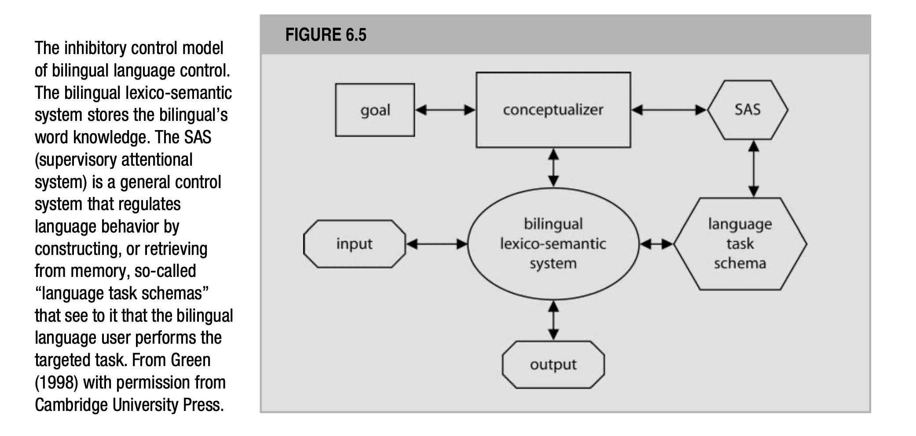
De Groot (2012). Language and Cognition in Bilinguals and Multilinguals. Psychology Press. Page. 308.

Slide 13
Further, the SAS supervises the routine running of the schemas and intervenes when necessary (for e.g., to prevent action slips).
The SAS can accomplish the same by altering the activation levels of the running schemas. It must be noted that Green, uses the term “schema” not only in reference to the ready-made structures in the long term memory, that have resulted from past experiences and that underlie, automatic routine behavior, but also for “mental devices or networks that individuals may construct or adapt on the spot in order to achieve the task demands” of any specific scenario.
In this sense, a task schema may be akin to participants understanding the instructions in a bilingualism experiment that allows them to modify their linguistic behavior as needed.

Slide 14
Further, task schemas for tasks that have been previously performed (e.g. reading aloud) can be retrieved from memory as such or modified online, and schemas for tasks that are novel (e.g., lexical decision) may be constructed on the spot.
Further, in Green’s model is the “conceptualizer” which has been envisioned as the non-linguistic system that develops conceptual representations from information in long term memory.
It is motivated by a goal to achieve some effect through the use of language. For instance, the intention to produce a word in a specific language.

Slide 15
Also, the bilingual-lexico-semantic system is viewed as a part of actual language system and and is supposed to store the bilingual’s word knowledge, for instance knowledge about word forms and meanings in the two languages.
Another important concept in Green’s inhibitory control model is the “lemma”, which specifies a word’s syntactic properties such as its gender and is assumed to be used in both production and comprehension tasks.
Each lemma is supposed to contain a language tag specifying the word’s language membership.
For instance, during word production, conceptual information from the conceptualizer activates lemmas in the lexico-semantic system proportional to the degree of information shared between the conceptual representations and the lemmas in the lexico-semantic system.

Slide 16
Further, two important characteristics of Green’s inhibitory control model need to be pointed out:
First, the inclusion of an explicit control mechanism, i.e., the SAS that regulates language behavior by retrieving or setting up task schemas that specify in what way the language system must be used to perform the expected task.
And second, is the process of reactive, local suppression of contextually inappropriate lexical elements.
For instance, when the goal is to perform a particular task, the SAS installs the relevant language task schema. This schema would then control behavior in specific ways: as altering the activation levels of the lemmas within the lexico-semantic system and by inhibiting pending outputs from that system.

Slide 17
As an example, when the bilingual is required to name pictures in their L2, the relevant schema is activated and enables task performance by increasing the activation levels of the lemmas with an L2 language tag in the lexico-semantic system, and decreasing the activation levels of the lemmas with the L1 language tag by reactively inhibiting imminent L1 outputs from the system.
The degree of reactive inhibition applied shall be proportional to the level of activation in the non-target language’s lexical items: the more active a lemma in the non-target language, the more it will be inhibited.
Consequently, suppression will be stronger in circumstances where L2, the often weaker language is the language of output, because the dominant L1 language’s lexical items will need to be suppressed.

Slide 18
So, it seems that according to Green, control can be exerted, on one hand, proactively and globally, by adapting the activation levels of all lemmas in both the language subsets before task performance starts, and on the other hand, reactively and locally, by suppressing the activation in the lemmas of the words from the non-response language that may still be trying to slip through.
De Groot (2012) suggests that technically, the model can do without proposing proactive control altogether, as well.

Slide 19
An interesting study that provided a lot of support to Green’s inhibitory control model has been the study by Meuter & Allport (1999).
These authors asked their participants to name Arabic numerals in either their L1 or L2, under the paradigm of the language switching task.
Interestingly, in this study, Meuter & Allport (1999) measured participants response times for every single trial, switch and non-switch; in order to be able to test their “relative strength hypothesis” according to which the two languages of a bilingual are not equally strong.
The switching cost was expected to be larger for a switch trial for a switch into the stronger L1 than for a switch into the weaker L2.

Slide 20
Now, Meuter & Allport (1999) had derived this prediction from similar asymmetries observed in scenarios where the participants have to switch between an easy and a hard task, for instance between word reading by fluent readers and color naming.
The cost that has been found to be incurred during such switches is typically larger when the participants had to switch from the weaker (color naming) to the more dominant (word reading) task than with a switch in the reverse direction, i.e., from the dominant to the weaker task.
Such a counterintuitive effect has been explained in terms of differences required in the level of the non-target task, along with the concept of “task-set inertia”.
More precisely, to enable task performance the non-target task must be actively suppressed and the target task must be activated. The stronger the non-target task, the more suppression it will require.

Slide 21
Further, the concept of task-set inertia refers to the idea that the task set of previous trials must carry over into the current trial, and hence switching into a different task will inherently be difficult.
Meuter & Allport (1999) hypothesized that the language switching task implements the same general paradigm that requires switching between a more practiced task (L1 naming) and a less practiced task (L2 naming), and therefor predicted a similar asymmetry in their data.

Slide 22
Indeed, language switching into both languages incurred a cost, a finding that is similar to the earlier findings from Macnamara et al.,’s studies, and has also been replicated in later studies.
But more importantly, the predicted switching asymmetry was also observed: participants incurred more switching cost when switching into their L1, as opposed to when switching into their L2.
These findings supported the analogy taken by Meuter & Allport (1999) as a basis for their predictions.

Slide 23
Moreover, the findings and analyses were different in their scope from Macnamara and colleagues’ study as the latter had not calculated switch costs per trial and hence did not observe these asymmetries, it still confirmed in spirit the latter’s proposal that:
“language switching […] seems to require no psychological skill peculiar to bilingualism, but rather a skill which is equally applicable in a larger number of operations in which persons are asked to switch modes of response rapidly” (Macnamara et al., 1968, pp 213-214).

Slide 24
Moving on, given that the observed asymmetries in switching are a consequence of the participants’ practice/proficiency with the involved tasks, researchers proposed that they should disappear in cases where the participants are equally proficient in both tasks.
Indeed, in studies where balanced bilingual participants were used for the language switching tasks, both by Meuter & Allport (1999) and other researchers (Costa & Santesteban, 2004) the asymmetries in switch costs did indeed disappear.

Slide 25
However, on looking more closely, Costa & Santesteban (2004) considered an alternative explanation for the absence of the switching asymmetries observed with balanced bilinguals.
They proposed that balanced bilinguals may be employing a qualitatively different sort of a selection mechanism, one that does not require the use of reactive inhibition.
They tested this proposal by looking at the switching behavior of early, balanced proficient, Spanish - Catalan bilinguals who were learners of yet another language (L3), in a switching task involving their L1 & L3.
Now, according to the reactive suppression account, the switching costs should have re-emerged.
However, contrary to this prediction, the switch costs were equally large when switching into L1 or into L3.

Slide 26
Based on this finding, the researchers concluded that language selection in participants highly proficient in at least two languages might not come through reactive suppression, rather through a control mechanism that only takes lexical elements of the response language into consideration for the selection process, and ignoring the activated lexical elements in the non-target language.
Later studies, indeed supported the language selective selection hypothesis (Costa et al., 2006).
Interestingly, in a study with quadrilinguals, researchers discovered that there are boundary conditions to the language specific selection mechanism as well.
For instance, they proposed that for the language specific selection mechanism to be operative, at least a high command of one of the languages is needed.

Slide 27
Finally, to account for these complex pattern of results, Costa & colleagues tentatively hypothesized that for a language specific selection mechanism to be roped in, words must be solidly embedded in the language specific lexicons.
In absence of such a condition, participants would need to resort to the reactive suppression strategies again leading to the re-emergence of switch cost asymmetries.
Interestingly, when Gollan & Ferreira (2009) conducted a language switching experiment where participants were allowed to either name an object in English or Spanish, the response pattern observed for unbalanced and balanced bilinguals was very similar, and did not support the idea of reactive inhibition.

Slide 28
In summary
Looking at the research observed so far, it is clear that bilinguals certainly benefit from a control system that may manifest differently depending upon the experimental situations and task demands.
However, the nature of the control system, i.e., whether it recruits reactive or proactive control or a generic selection mechanism is still far from clear and needs to further investigated.

Slide 29
References
De Groot, A. M. (2011). Language and cognition in bilinguals and multilinguals: An introduction. Psychology press.

