Slide 2

Indian Institute of Technology Kanpur

Slide 3
In Collaboration
with

Slide 4

National Program on Technology Enhanced Learning (NPTEL)

Slide 5
Presents

Slide 6
Introduction to the Psychology of Bilingualism & Multilingualism
Dr. Ark Verma,
Assistant Professor of Psychology,
Department of Cognitive Science,
IIT Kanpur

Slide 7
Bilingualism & Multilingualism: Conceptual Issues - II

Slide 8
Through the different lenses
Bilingualism as a phenomenon has been of interest to different disciplines, including linguistics, psychology, neuroscience, sociolinguistics etc.
Different aspects of the phenomenon has interested these different stakeholders who have approached the issue through their specific methodological lenses.

Slide 9
Psycholinguistic Approaches
Psycholinguistic approaches of studying bilingualism mainly focus on the individual and his/her mental functions involved in acquiring and using more than one language.
There are several conceptions of a bilingual that have been discussed under this approach, for instance, Weinreich (1953)’s classification of bilinguals into three types:
Coordinative Bilingual: Wherein the concepts and the words depicting the concepts are separate for the two languages.
Compound Bilingual: Wherein the individual identifies the same concept with two different words.
Subordinative Bilingual: Wherein the individual accesses a concept using translation of a word from one language into another.

Slide 10
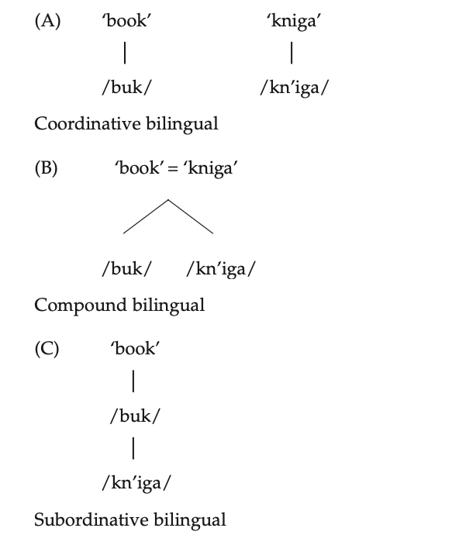
Figure Credit: Bhatia, T. K., & Ritchie, W. C. (Eds.). (2014). The handbook of bilingualism and multilingualism. John Wiley & Sons.
. Page 35

Slide 11
Weinreich’s typology of classifying bilinguals has also been interpreted as a manifestation of different levels of proficiency of bilinguals or at the different stages in their journey of becoming a bilingual.
More importantly, these are not to be interpreted as watertight or exclusive categories of bilinguals, but more like overlapping stages that a bilingual passes through.

Slide 12
Another important classification of bilinguals within the framework of psycholinguistics has been offered by Potter et al., (1984), wherein he proposed a theory of the how bilingual lexical knowledge may have been represented in the mind:
Concept Mediation Model: under this model, the idea is that words of both L1 and L2 are linked to an underlying amodal conceptual system.
Word Association Model: under this conceptualization, words of the L2 are understood through L1 lexical representations.

Slide 13
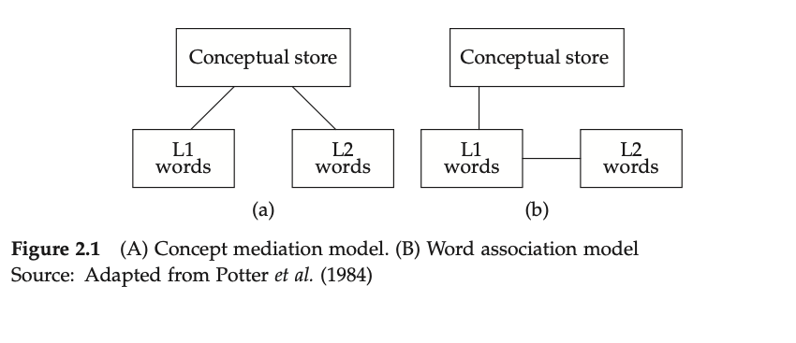
Figure Credit: Bhatia, T. K., & Ritchie, W. C. (Eds.). (2014). The handbook of bilingualism and multilingualism. John Wiley & Sons.
. Page 36

Slide 14
However , it must be noted that the relationship between the lexical representations of L1 & L2 may be mediated by proficiency levels of the individuals and also the stage of bilingualism they are at, as was true for Weinreich’s classification as well.
Later studies scrutinized evidence in favor/against these models and new insights were revealed, for instance, the revised hierarchical model(Kroll & Stewart, 1994).

Slide 15
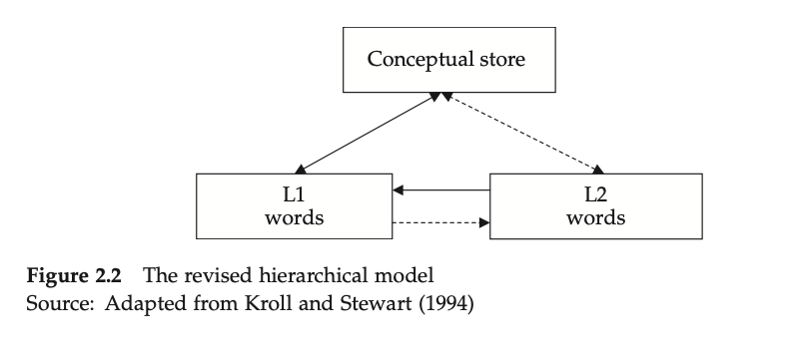
Figure Credit: Bhatia, T. K., & Ritchie, W. C. (Eds.). (2014). The handbook of bilingualism and multilingualism. John Wiley & Sons.
. Page 37.

Slide 16
However, as mentioned earlier, the choice of language that multilingual speakers make depends upon a variety of situations for instance, the setting of the conversation, the topic of conversation, the listener, the background of the listener and so on.
These choices therefore force a bilingual to swiftly change between different language modes depending upon these different factors.
These have been modelled in Grosjean (2001)’s language modes’ model.

Slide 17
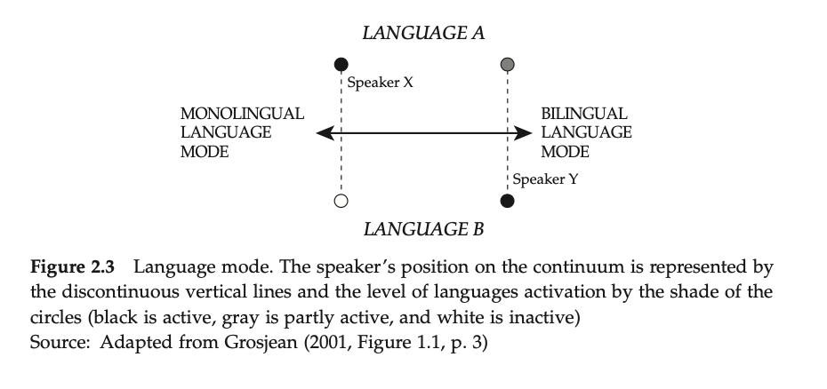
Figure Credit: Bhatia, T. K., & Ritchie, W. C. (Eds.). (2014). The handbook of bilingualism and multilingualism. John Wiley & Sons.
. Page 38.

Slide 18
Another model tracing the steps of a bilingual child through the different stages of language acquisition was presented by Volterra & Taeschner (1978) wherein the kids are supposed to pass through three stages of acquisition:
Stage I: initially, the child’s lexical system is composed of words from both the known languages.
Stage II: moving further, the child can distinguish between two different lexicons of the two languages, but still apply the same syntactic rules to both languages.
Stage III: by now the child’s linguistic system has differentiated the two language systems both in terms of the lexicon and syntax, but can now decide the speakers with which he interacts with in a given language.

Slide 19
These suggestions have given a rise to a debate about whether there exist separate systems for the two languages or a unified system composed of the two languages.

Slide 20
Linguistic Approach
Linguistic approaches to bilingualism typically focus on the structural changes in the languages that happen due to coming in contact with each other.
An idea is offered by Winford (2003), who offers a taxonomy of different contact situations, for instance:

Slide 21
Language maintenance, wherein one would expect lexical and structural borrowing ( for instance, influence of Sanskrit on Dravidian languages)
Language Shift (in language shift, one may expect the base language to either not change or change considerably due to contact with a different language, for instance influence on English by Irish speakers).
Language creation (here, typically due to prolonged contact between two languages, a new language may be the outcome for example Urdu, through contact of Hindi(khariboli) and Persian.

Slide 22
Besides, these contact situations languages certainly influence each other when they come in contact through an individual speaker or groups of speakers.
Some propose that bilinguals may have two discrete grammatical systems, use the knowledge of the two languages into use while they produce languages.
On the other hand, some researchers argue for a reconceptualization of a bilingual users’ grammatical system, wherein the tww grammatical systems interact with each other, and a code-mixed system of grammar is in use.

Slide 23
Sociolinguistic approaches
The sociolinguistic approaches to bilingualism and multilingualism have a different focus than the psycholinguistic and linguistic approaches both in terms of methodology and fundamental questions raised.
For instance, language choice is also understood as a matter of identity (Le Page & Tabouret-Keller, 1985).
Individuals assert their identity by choosing to express themselves in a given language, they identify with the history, traditions and culture associated with that language.

Slide 24
Through language choice, individuals define ‘self’ and ‘other’ within a broader sociopolitical context.
However, many other determinants of identity have also been proposed, for instance,
Labov (1972) takes it to be the speaker’s socio-economic class, gender, age, or place of origin.
Others like Cameron (1990) & Johnstone (1996) argued that identities are negotiated through social interaction.
While still others, such as Tajfel (1974) look at identity as an outcome of group processes and intergroup relations.

Slide 25
Scope of interdisciplinary enquiry

Slide 26
References
Bhatia, T. K., & Ritchie, W. C. (Eds.). (2014). The handbook of bilingualism and multilingualism. John Wiley & Sons.

