Slide 2

Indian Institute of Technology Kanpur

Slide 3
In Collaboration
with

Slide 4

National Program on Technology Enhanced Learning (NPTEL)

Slide 5
Presents

Slide 6
Introduction to the Psychology of Bilingualism & Multilingualism
Dr. Ark Verma,
Assistant Professor of Psychology,
Department of Cognitive Science,
IIT Kanpur

Slide 7
Language Acquisition in Bi/Multilinguals - II

Slide 8
Development of Bilingualism: Early Days
As mentioned in the previous lecture, various ingenious paradigms have been developed to track the development of language acquisition amongst infants.
These paradigms have boosted the the research into infants’ ability to perceive and understand language and consequently informed the researchers of how the same develops chronologically as the children grow up picking up language from their environment, along with their biological predispositions.

Slide 9
Some key findings…
Eimas and colleagues (1971) presented their 1- and 4-month-old infants with a number of machine-synthesized instances of /p/ and /b/, which are bilabial plosives, while manipulating the VOT values.
Note that research had shown that English speakers identify bilabial plosives of VOT values below +25 s as /b/ and above +25 as /p/.
In the current study, infants from each age group (1 month & 4 month) were divided into three subgroups:
one was familiarized with +20 ms VOT stimuli, and tested with the +40 ms stimuli.
These stimuli at the habituation and the test phases therefore fell at opposite ends of the VOT spectrum.

Slide 10
The second subgroup was habituated and tested with stimuli of either (-20ms and 0ms VOTs or with +40ms and +60ms VOTs).
Note that these stimuli fall on the same side of the phonemic categorization, i.e., the former towards /b/ and the latter towards /p/.
The third subgroup was used as a control group and was presented with the exact same stimuli during the habituation and the test phase.
What would you expect would be the performance of the three subgroups?

Slide 11
Eimas & coleagues (1971) that only the first subgroup demonstrated a release from habituation using the HAS paradigm, showing that they could recognize the phonemes presented across the VOT boundary.
i.e., they could perceive the difference between the two phonemes /b/ and /p/ - this ability to perceive differences in phonemes is referred to as categorical perception.
So, the authors concluded that much like adults infants are also capable of perceiving linguistically meaningful differences between speech sounds, that is they can perceive different phonemes which are the basic categories of sounds in a given language.

Slide 12
Several studies followed that of Eimas et al., (1971) and demonstrated that indeed infants have the ability to perceive contrasts between phonemes, and speech categories.
Given that infants as young as 1-month old can distinguish between distinct categories of speech sounds, researchers have suggested that categorical perception is an innate ability.
Must be noted that different languages have different phoneme categories, and given that this ability is innate, one could assume that infants would be sensitive to phoneme categories irrespective of the language.

Slide 13
Indeed, in a cross-linguistic study for 11 languages, Lisker and Abramson (1964) demonstrated that different languages slice up the VOT continuum differently to carve out different categories of phonemes.
Also, researchers (for instance Lasky et al., 1975) have shown that while the ability to perceive different phoneme categories is innate, infants are under 7 months of age are sensitive to phonemic contrasts not only for their native language (say Spanish) but also for phonemic contrasts that occur in other languages as well.

Slide 14
However, a closer look at the data from these experiments suggests that infants do not learn to perceive all of the the phonemic contrasts that occur in all natural languages, and the same is a function of the type of language exposure that the children have received.
Finally, it was also noted that the age of around 6.5 months was not sufficient to learn all of the phonemic contrasts of the native language as well, and few more months of language exposure might be required to master all of the contrasts even in the native language.

Slide 15
The innateness of categorical perception has been the source of a bit of a dispute amongst researchers, for instance,
Some scientists are of the view that categorical perception only applies to language and is not a property of general perception and that it is unique to humans (Eimas & Miller, 1991).
Whereas few others opine that categorical perception is not unique to the acquisition of language but is property of general perceptual abilities which is shared by few other species as well, such as chinchillas, macaques etc. (Kuhl & Miller, 1978).

Slide 16
The discussion along these lines typically raises few interesting questions pointed out by De Groot (2011):
Do humans continue to perceive phonetic contrasts that are meaningful in some languages but not in the native language? If not, by when does this ability to perceive contrasts in other languages start to decline?
How long does it take for humans to develop the ability to perceive all the contrasts that are meaningful in the native language but that were not innate?
Finally, for bilingualism, does the learning of phonemic contrasts of the native language and unlearning of contrasts of the non – native language, differ between monolinguals and bilinguals?

Slide 17
Lets’ zoom in…
According to the timeline of acquisition of linguistic abilities as envisioned by Kuhl (2004), infants under 6 onths of age can perceive phonemic contrasts of all languages.
After which, the ability for the perception of the phonemic contrasts of the non-native languages continues to declines and the ability to perceive contrasts specific to the native language increases (Werker et al., 1981).

Slide 18
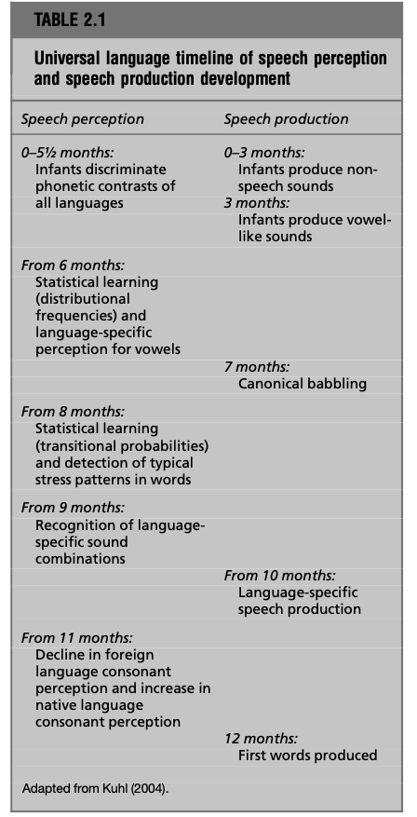
Figure: from De Groot, A. M. (2011). Language and cognition in bilinguals and multilinguals: An introduction. Psychology Press. Page 21.

Slide 19
Further, by about 11 months, infants have mostly lost the ability to perceive the phonemic contrasts of non – native languages almost completely, especially for consonants, although the ability to perceive contrasts for vowel sounds may last a little longer (Polka & Werker, 1994).
Kuhl (2004) points out that the same is a result of perceptual reorganization processes spurred mainly by linguistic experience.
The chronology also highlights the fact that around 9 months of age, the ability to perceive specific sequences of sounds in the native language, i.e., phonotactics gradually starts to emerge.

Slide 20
Researchers have noted that the decline in the ability to perceive non – native phonemic contrasts is not universal, in the sense that the ability to perceive some non – native contrasts, may still be retained till later ages.
This variability in the decline for the perception of non – native contrasts has been discussed in detail, by Best & Mc Roberts (2003) and the following proposals have been offered to understand the same:-

Slide 21
One account (Burnham, 1986) distinguishes between, fragile and robust phonemic contrasts, wherein the latter involves distinctions that are acoustically salient and occur across most languages, and the former are non – salient and occur only in few languages of the world.
Another account (Tees & Werker, 1984), suggests that non – native contrasts may continue to be perceived if they are allophones of similar phonemes in the ambient language environment, and are lost if that is not the case.
Finally, Best et al., (1994) offer the perceptual assimilation model (PAM) which postulates that individuals assimilate non – native phonemes within the native phonemes which they perceive as most similar, and form common categories, which then would continue to be perceived at later ages.

Slide 22
In Summary
Categorical perception of distinct phonemic categories is fundamental to ability of speech perception.
While infants become better with age at perceiving the contrasts of the native language, the ability of perceiving the contrasts from the non – native language continues to decline as they grow older, albeit the decline is not universal and complete.

Slide 23
References
De Groot, A. M. (2011). Language and cognition in bilinguals and multilinguals: An introduction. Psychology press.

