Slide 1
Deep Learning

Slide 2

Endsem Exam
Apr 28 (Sun), 8AM – Venue TBA
Only for registered students (no auditors)
Open notes (handwritten only)
No mobile phones, tablets etc
Bring your institute ID card
Syllabus:
All videos/slides on YouTube/GitHub by 26th Apr
DS content (slides, code) for DS 1 – 14.
See previous year’s GitHub for practice

Slide 3





Doing Deep Learning
Number of hidden layers, number of nodes in hidden layers are treated as hyperparameters
Number of output nodes is decided according to application
Regression: only one node, no activation
Binary classification: only one node with sigmoid activation
Multi-classification: $C$ nodes with softmax activation
Multi-label classification: $L$ nodes each with sigmoid classification
FC Layer
$$w$$
$$φ\left(x,H\right)$$
Hidden Layers
$$H$$
$$x$$

Slide 4


Doing Deep Learning
Final output of NN like $w^{⊤}φ\left(x,H\right)$
Loss function $ℒ\left(w,H\right)=\frac{1}{n}⋅\sum_{i=1}^{n}{ℓ\left(y_{i},w^{⊤}φ\left(x^{i},H\right)\right)}$
Training done using mini-batch SGD
Let’s call $θ≝\left(w,H\right)$
$θ^{t+1}←θ^{t}−∇_{θ}ℒ\left(θ^{t}\right)$
Careful application of chain rule – backprop
Step length chosen using Adam, NAG etc
Regularization done explicitly using regularizers and implicitly using dropout
FC Layer
$$w$$
$$φ\left(x,H\right)$$
Hidden Layers
$$H$$
$$x$$

Slide 5

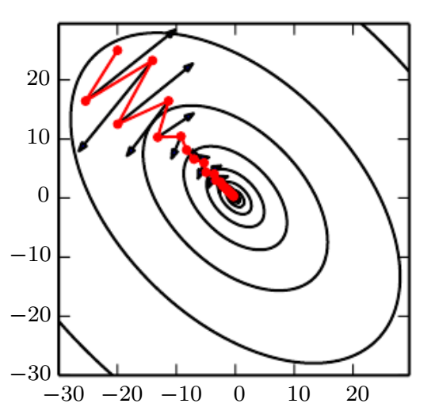


Adaptive Learning Rates
Simple GD, on the other hand, is only able to ensure $𝒪\left(1/ε\right)$ rate of convergence for differentiable convex functions in general. Thus, NAG is able to bring a quadratic reduction in run time!
Adaptive momentum-based methods popular (esp. for deep learning)
GD is known to experience oscillations even in a simple optimization problems such as least squares regression problem
These oscillations waste time and slow progress
Solution: introduce a “velocity” term to prevent GD from changing directions abruptly, thus avoiding oscillations $v^{t}={γ⋅v}^{t−1}+η⋅∇ℒ\left(θ^{t}\right)$ $θ^{t+1}←θ^{t}−v^{t}$
Nesterov’s accelerated gradient (NAG): pioneer method in the area of momentum methods
For differentiable convex problems, NAG ensures $ε$-convergence in just $𝒪\left(\sqrt{1/ε}\right)$ steps hence the name “accelerated” gradient

Slide 6

Adaptive Learning Rates
Adagrad (Duchi et al. 2011) – takes inspiration from Newton’s method
Recall: Newton’s method $θ^{t+1}←θ^{t}−{\left(∇^{2}ℒ\left(θ^{t}\right)\right)}^{−1}∇ℒ\left(θ^{t}\right)$
Key idea: replace $∇^{2}ℒ\left(θ^{t}\right)$ with a diagonal matrix $K^{t}$ – much cheaper
Use past updates to calculate $K^{t}$
$K^{t}=diag\left(k_{1}^{t}, …,k_{d}^{t}\right)$ where $k_{i}^{t}=\sqrt{ε+\sum_{τ=1}^{t}{{\left(g_{i}^{τ}\right)}^{2}}}$
If a coordinate got very vigorous updates in the past $\left|g_{i}^{τ}\right|≫0$, mellow its future updates
Reduces to $η_{t}≈η/t$ if all coordinates got roughly similar gradients in the past since then we would have had $k_{i}^{t}≈𝒪\left(t\right)$ for all $i∈\left[d\right]$
If some coordinate is static, not getting updated at all i.e. $g_{i}^{τ}≡0$ for all $τ$, then $k_{i}^{t}=\sqrt{ε}$ to prevent a divide-by-zero error when we take inverse of $K^{t}$

Slide 7

Adaptive Learning Rates
RMSProp (Hinton 2012) – apply momentum idea to Adagrad
$k_{i}^{t}=k_{i}^{t}=\sqrt{{ε+v}_{i}^{t}}$ where $v_{i}^{t}=γ⋅v_{i}^{t−1}+\left(1−γ\right)⋅{\left(g_{i}^{t}\right)}^{2}$
Adagrad sometimes forces step sizes to go down too much – this avoids that
Adam (Kingma and Ba 2014) – combine NAG and RMS-Prop
$g^{t}={\left(K^{t}\right)}^{−1}u^{t}$ where $K^{t}=diag\left(k_{1}^{t},…,k_{d}^{t}\right)$, $k_{i}^{t}=\sqrt{v_{i}^{t}}+ε$, and $u^{t}=γ_{1}⋅u^{t−1}+\left(1−γ_{1}\right)⋅g^{t}$ $v_{i}^{t}=γ_{2}⋅v_{i}^{t−1}+\left(1−γ_{2}\right)⋅{\left(g_{i}^{t}\right)}^{2}$
Also does some bias corrections (reweighting) on $K^{t}$ and $u^{t}$ (not shown above)
All these methods are readily available in libraries like PyTorch, TF etc

Slide 8

How to prevent overfitting?
Method 1: Regularize the weights
1.1: add an explicit regularization term $\arg{\min_{θ∈ℝ^{d}}{ℒ\left(θ\right)}}+λ⋅{\left\|θ\right\|}_{2}^{2}$
1.2: don’t allow any weight to get big (clip them) $\arg{\min_{{\left\|θ\right\|}_{∞}<r}{ℒ\left(θ\right)}}$
Most libraries implement these strategies themselves e.g. weight clipping
Sometimes even gradient coordinates are clipped to stabilize training
Method 2: Deliberately inject noise into the labels
For binary classification $y^{i}=0→y^{i}=ε$, $y^{i}=1→y^{i}=1−ε$
For regression problems, $y^{i}→y^{i}+ε^{i}$, where $ε^{i}∼𝒩\left(0,σ^{2}\right)$
Unlikely that a NN with limited # of nodes would be able to memorize noise
For NN setting these are just heuristics but when applied to nicer settings (e.g. linear models), label noise can be shown to be equivalent to regularization

Slide 9
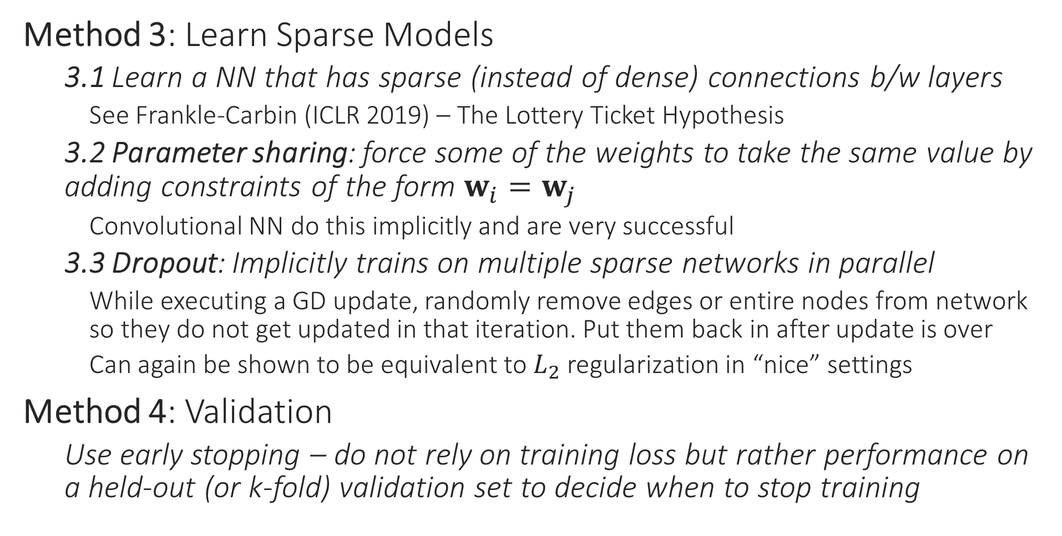
How to prevent overfitting?
Method 3: Learn Sparse Models
3.1 Learn a NN that has sparse (instead of dense) connections b/w layers
See Frankle-Carbin (ICLR 2019) – The Lottery Ticket Hypothesis
3.2 Parameter sharing: force some of the weights to take the same value by adding constraints of the form $w_{i}=w_{j}$
Convolutional NN do this implicitly and are very successful
3.3 Dropout: Implicitly trains on multiple sparse networks in parallel
While executing a GD update, randomly remove edges or entire nodes from network so they do not get updated in that iteration. Put them back in after update is over
Can again be shown to be equivalent to $L_{2}$ regularization in “nice” settings
Method 4: Validation
Use early stopping – do not rely on training loss but rather performance on a held-out (or k-fold) validation set to decide when to stop training

Slide 10
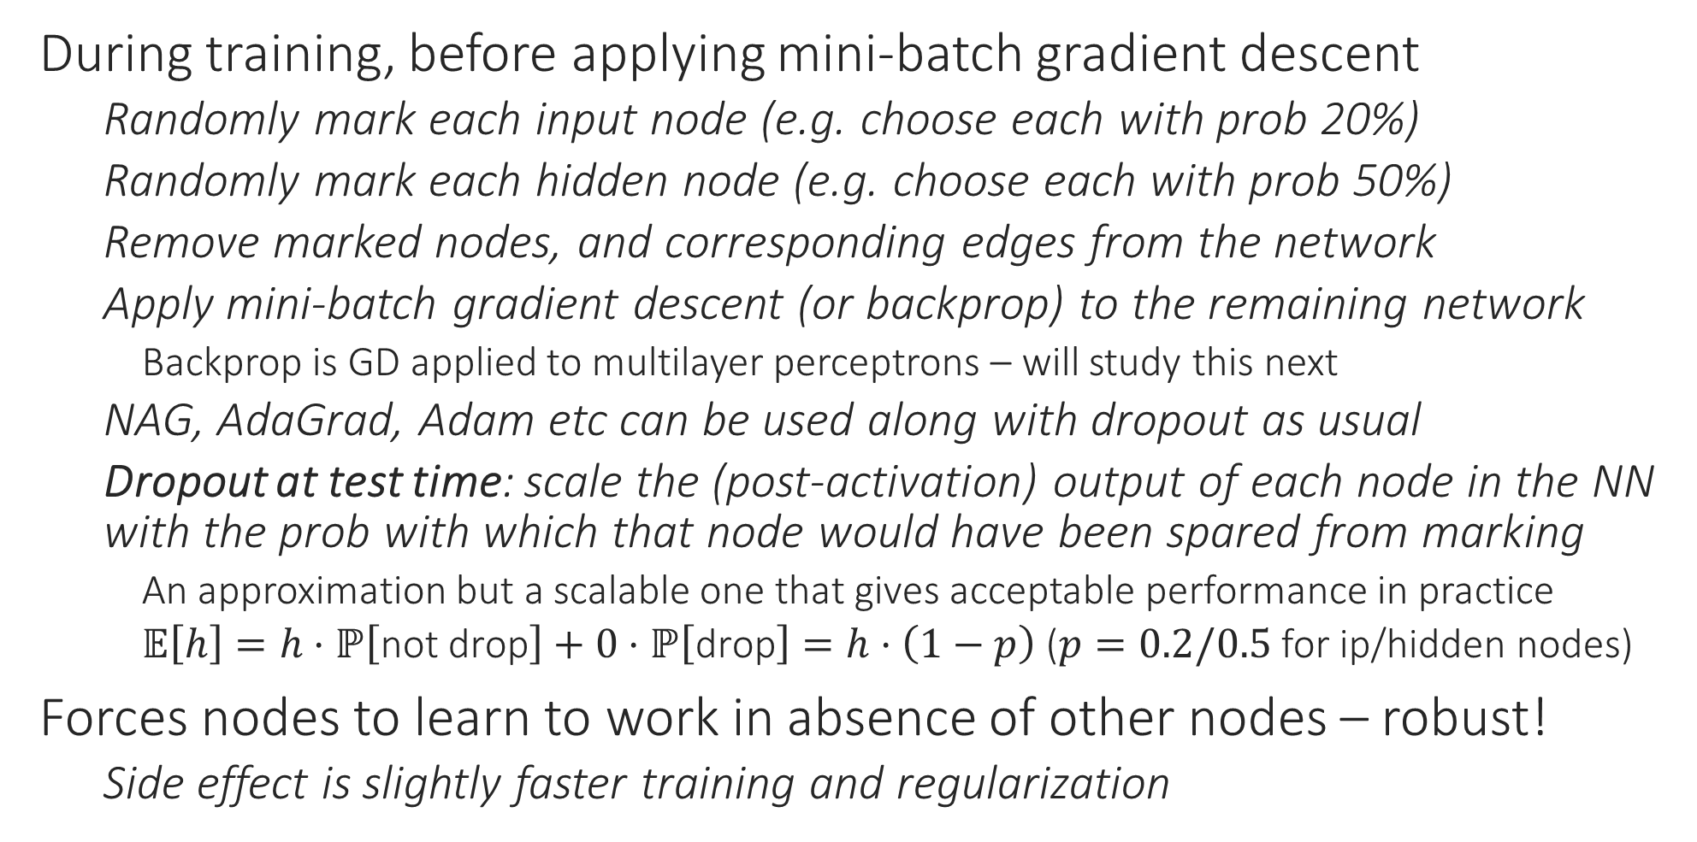
Dropout
During training, before applying mini-batch gradient descent
Randomly mark each input node (e.g. choose each with prob 20%)
Randomly mark each hidden node (e.g. choose each with prob 50%)
Remove marked nodes, and corresponding edges from the network
Apply mini-batch gradient descent (or backprop) to the remaining network
Backprop is GD applied to multilayer perceptrons – will study this next
NAG, AdaGrad, Adam etc can be used along with dropout as usual
Dropout at test time: scale the (post-activation) output of each node in the NN with the prob with which that node would have been spared from marking
An approximation but a scalable one that gives acceptable performance in practice
$𝔼\left[h\right]=h⋅ℙ\left[\text{not} \text{drop}\right]+0⋅ℙ\left[\text{drop}\right]=h⋅\left(1−p\right)$ ($p=0.2/0.5$ for ip/hidden nodes)
Forces nodes to learn to work in absence of other nodes – robust!
Side effect is slightly faster training and regularization

Slide 11
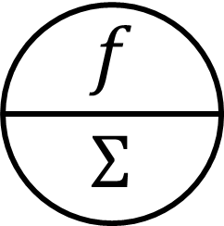



















Dropout at Work
$$id$$
$$id$$
$$id$$
$$id$$
$$id$$
16%
4%
4%
16%
16%
$$id$$
$$x_{1}$$
$$x_{2}$$
$$x_{2}$$
$$x_{1}$$
$$x_{1}$$
$$x_{2}$$
$$x_{1}$$
$$x_{2}$$
$$id$$
$$id$$
$$id$$
$$id$$
$$id$$
4%
4%
4%
4%
28%
$$x_{1}$$
$$x_{2}$$
$$x_{1}$$
$$x_{2}$$
$$x_{1}$$
$$x_{2}$$
In this toy example, 28% NN have no i/p nodes or no path connecting at least one i/p node to the o/p node i.e. cannot apply GD to them. For large networks, it is unlikely that sampling will result in such a disconnected network. In practice a large fraction of nodes do get retained

Slide 12
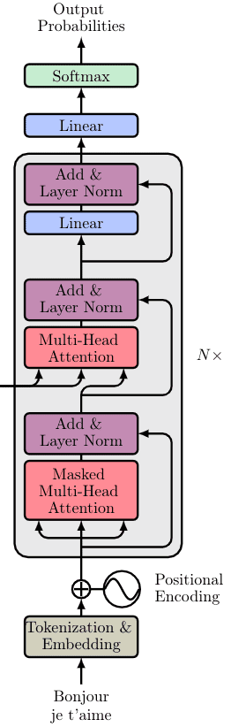
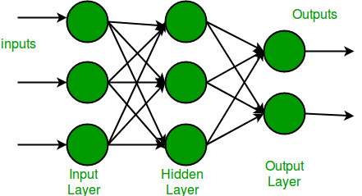
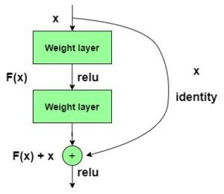
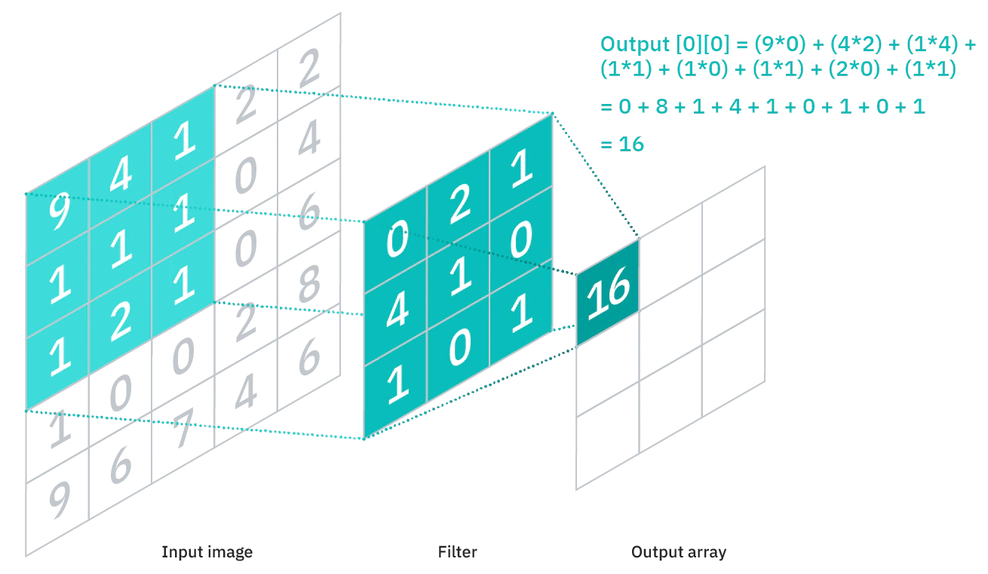

Popular layer types in deep learning
Features $φ\left(x,H\right)$ learnt by a deep network depend on the type of its hidden layers parametrized by $H$
perceptron layer
residual/skip layer
convolutional layer
transformer layer

Slide 13

Popular training strategies - pretraining
Entire network composed of $θ≝\left(w,H\right)$
Get $H$ from some other source
Huggingface, GitHub, previous year CS771 offerings ☺
Ensure $H$ was trained on a similar task as the one we are trying to solve
During train, freeze $H$ and only train $w$ – extremely fast!
Can also train $H$ jointly with $w$ – known as “fine-tuning” of $H$
Train only the top few layers of $H$ for speed
Can also train all layers of $H$ if pretraining task very different

Slide 14
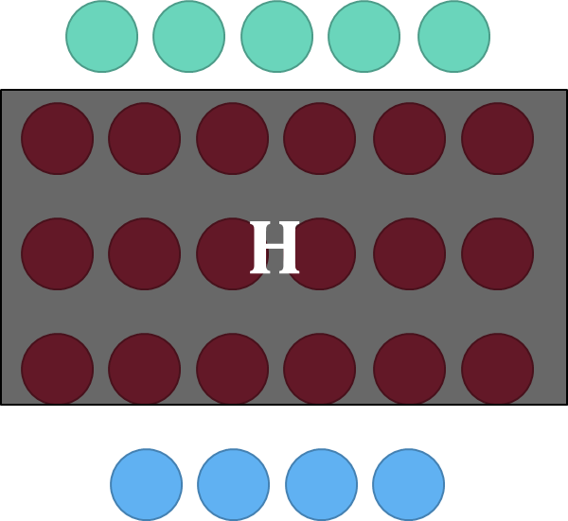





Popular (pre)training strategies – Siamese
Denote $d\left(i,j,H\right)≝$ ${\left\|φ\left(x^{i},H\right) −φ\left(x^{j},H\right) \right\|}_{2}$. Given a $C$-class problem, encourage $d\left(i,j,H\right)→0$ if $y^{i}=y^{j}$ else want $d\left(i,j,H\right)≫0$
Called Siamese models or two-tower models
Let $\left(i,j,k\right)$ be a triplet such that $y^{i}=y^{j}≠y^{k}$
Triplet loss function: ${\left[d\left(i,j,H\right)−d\left(i,k,H\right)+λ\right]}_{+}$
Contrastive loss function: $λ<Λ$
${\left[d\left(i,j,H\right)−λ\right]}_{+}+{\left[Λ−d\left(i,k,H\right)\right]}_{+}$
Popular in vision, recommendation, NLP
$$φ\left(x^{i},H\right)$$
$$φ\left(x^{j},H\right)$$
$$x^{i}$$
$$x^{j}$$

Slide 15

Popular (pre)training strategies – Cloze tasks
Very popular in training language models, graph models
Given an object, hide a portion and ask the NN to retrieve it
“I am wearing a green shirt” → “I am <MASK> a green shirt”
Also known as masked language modelling in NLP literature
Train network parameters $H$ so that
${\left\|φ\left(\text{I} \text{am}\text{ <}\text{MASK}\text{> }\text{a} \text{green} \text{shirt},H\right)−φ\left(\text{wearing},H\right)\right\|}_{2}→0$
Training often proceeds in Siamese style
To train graph models, can train network to predict neighbors

