Slide 1
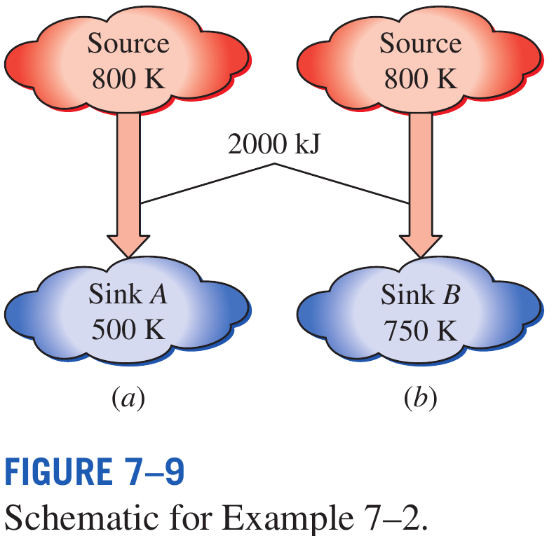
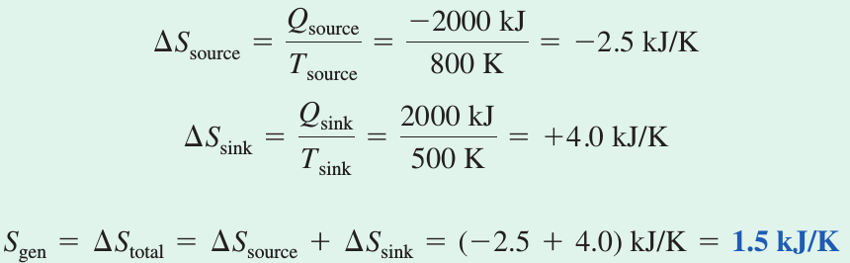
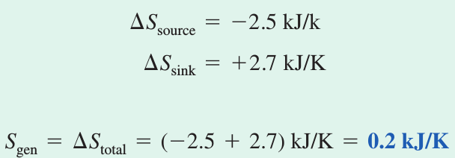
ENTROPY GENERATION DURING HEAT TRANSFER
PROCESSES
A heat source at 800 K loses 2000 kJ of heat to a sink at (a) 500 K and (b) 750 K. Determine which heat transfer process is more Irreversible.
Sink A
Sink B
In the limit of T_{sink} approaching T_{source}, S_{gen}=0 (reversible heat addition)

Slide 2
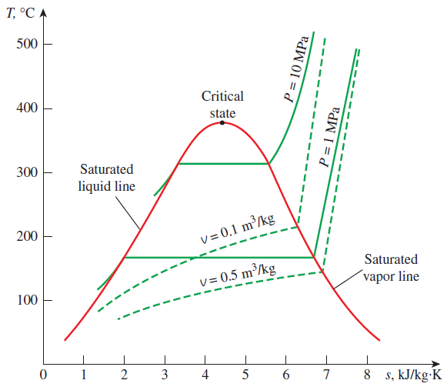
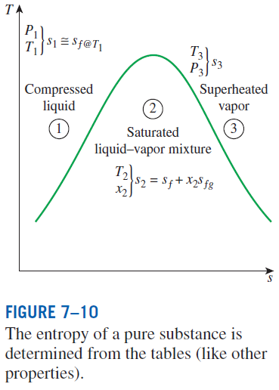

ENTROPY CHANGE OF PURE SUBSTANCES
Entropy is a property, and thus the value of entropy of a system is fixed once the state of the system is fixed.
Entropy change

Slide 3

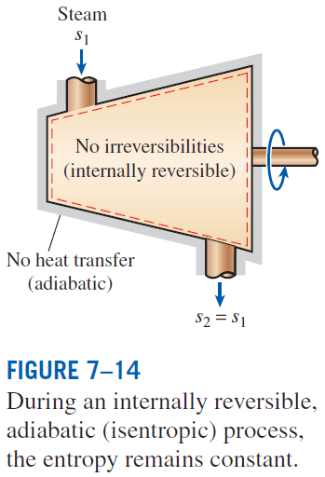
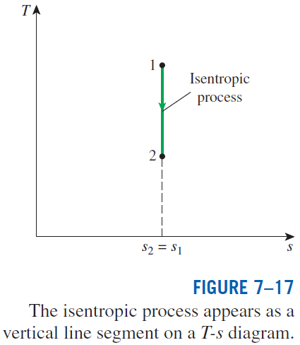
ISENTROPIC PROCESSES
A process during which the entropy remains constant is called an isentropic process.

Slide 4
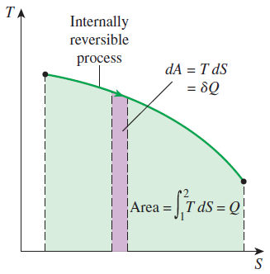
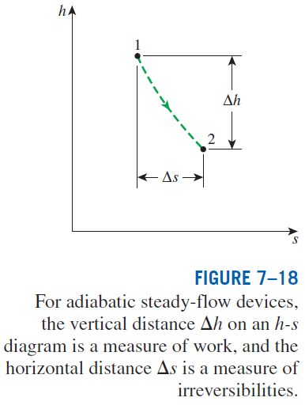

PROPERTY DIAGRAMS INVOLVING ENTROPY
On a T-S diagram, the area under the process curve represents the heat transfer for internally reversible processes.
Mollier diagram: The h-s diagram

Slide 5

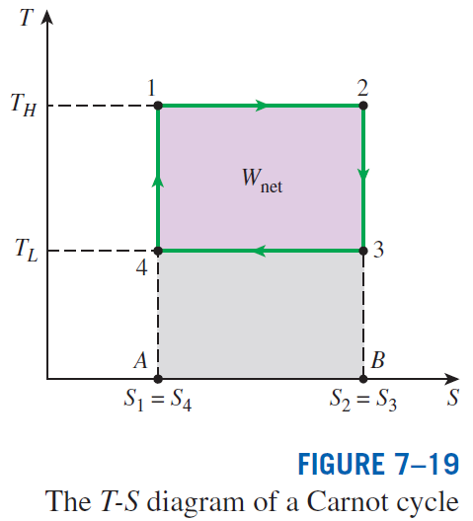

Slide 6
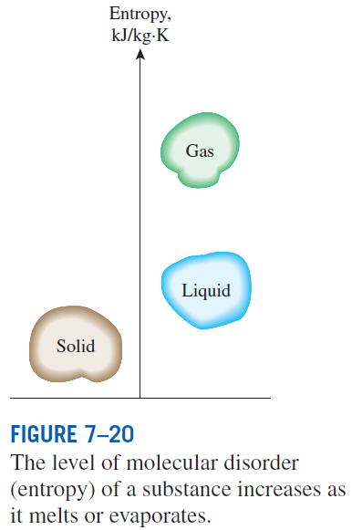


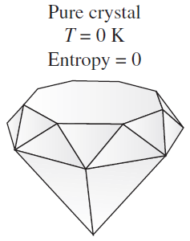
WHAT IS ENTROPY?
Boltzmann relation
W the total number of possible relevant microstates of the system
Gibbs’ formulation
p_{i} sum of all microstates’ uncertainties, i.e., probabilities
Boltzmann constant
A pure crystalline substance at absolute zero temperature is in perfect order, and its entropy is zero (the third law of thermodynamics).

Slide 7
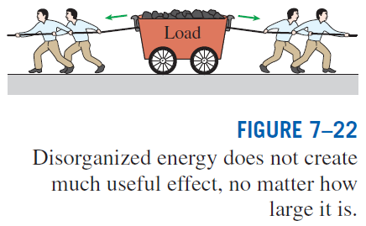
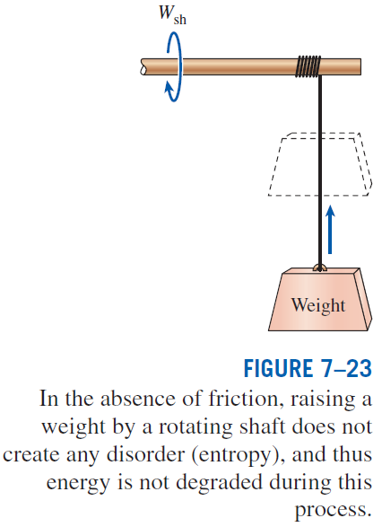

Slide 8
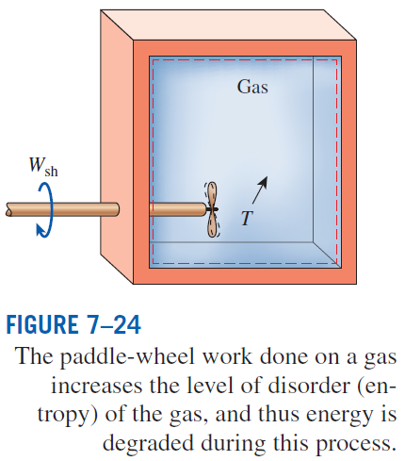
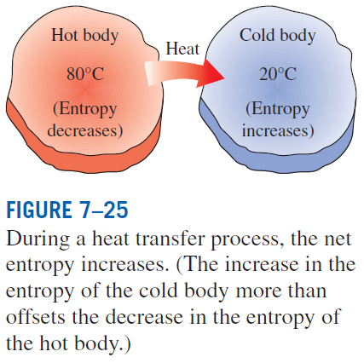

Slide 9


