Slide 1
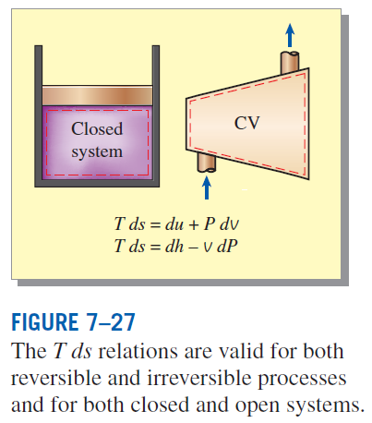



THE T ds RELATIONS
the first T ds, or Gibbs equation
the second T ds equation
Differential changes in entropy in terms of other properties

Slide 2

ENTROPY CHANGE OF LIQUIDS AND SOLIDS
Liquids and solids can be approximated as incompressible substances since their specific volumes remain nearly constant during a process.
Since for liquids and solids
For and isentropic process of an incompressible substance

Slide 3


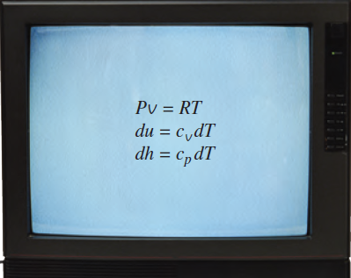

THE ENTROPY CHANGE OF IDEAL GASES
From the first T ds relation
From the second T ds relation

Slide 4
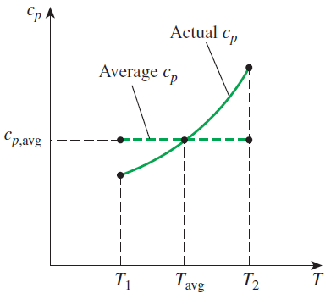
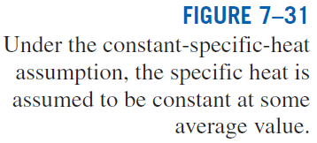
Constant Specific Heats (Approximate Analysis)
Entropy change of an ideal gas on a unit–mole basis

Slide 5
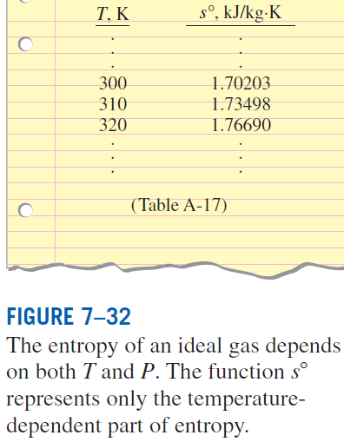

Variable Specific Heats (Exact Analysis)
We choose absolute zero as the reference temperature and define a function s° as
On a unit–mass basis
On a unit–mole basis

Slide 6
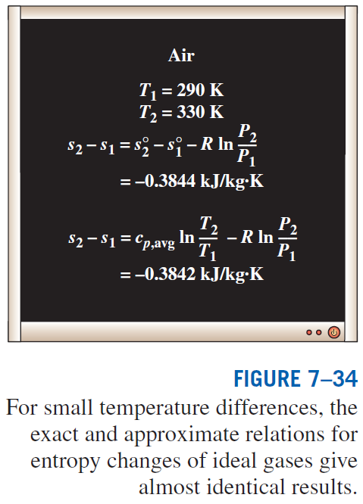

Slide 7
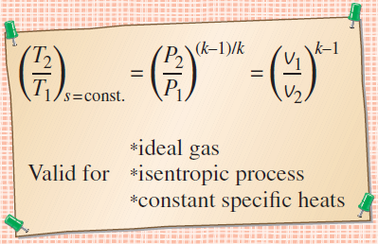
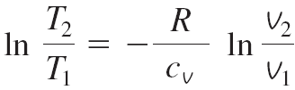
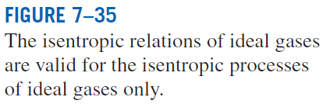
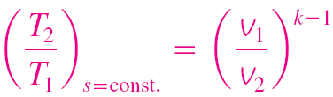
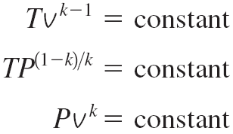
Isentropic Processes of Ideal Gases
Constant Specific Heats (Approximate Analysis)
Setting this eq. equal to zero, we get

Slide 8
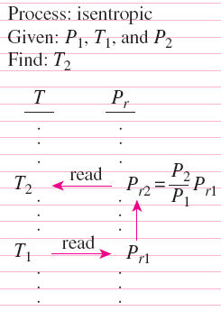


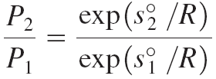
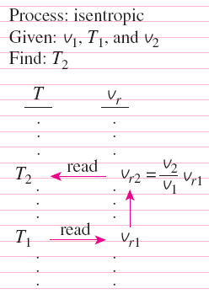
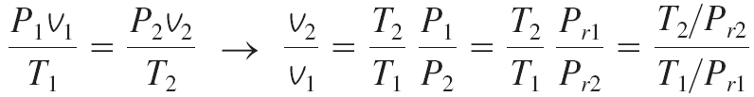
Isentropic Processes of Ideal Gases
Variable Specific Heats (Exact Analysis)
Relative Pressure and Relative Specific Volume
exp(s°/R) is the relative pressure P_{r}.
The use of P_{r} data for calculating the final temperature during an isentropic process.
The use of v_{r} data for calculating the final temperature during an isentropic process
T/P_{r} is the relative
specific volume v_{r}.

Slide 9
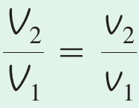
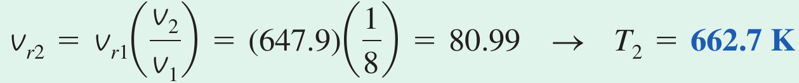
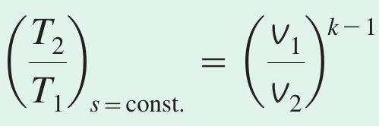
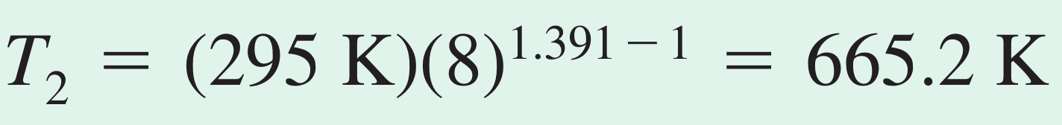
Example: Isentropic Processes of Ideal Gases
Air is compressed in a car engine from 228C and 95 kPa in a reversible and adiabatic manner. If the compression ratio V1/V2 of this engine is 8, determine the final temperature of the air.
For closed system
Alternative solution

Slide 10
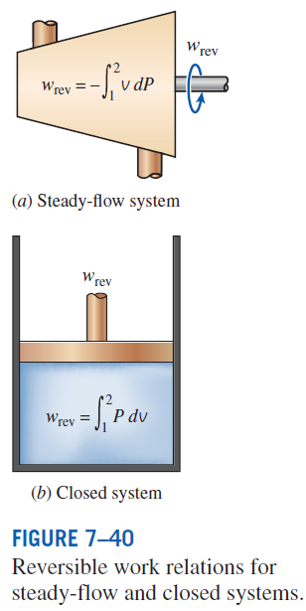
REVERSIBLE STEADY-FLOW WORK
When kinetic and potential energies are negligible
The larger the specific volume, the greater the work produced (or consumed) by a steady-flow device.
For the steady flow of a liquid through a device that involves no work interactions (such as a pipe section), the work term is zero (Bernoulli equation):

