Slide 1
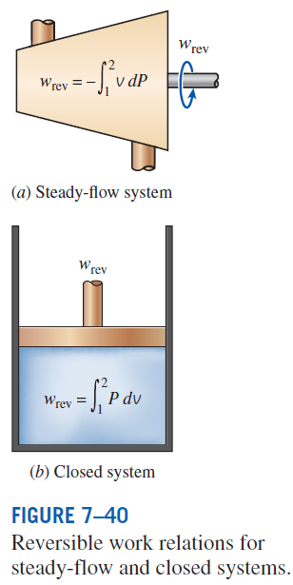
REVERSIBLE STEADY-FLOW WORK
When kinetic and potential energies are negligible
The larger the specific volume, the greater the work produced (or consumed) by a steady-flow device.
For the steady flow of a liquid through a device that involves no work interactions (such as a pipe section), the work term is zero (Bernoulli equation):

Slide 2
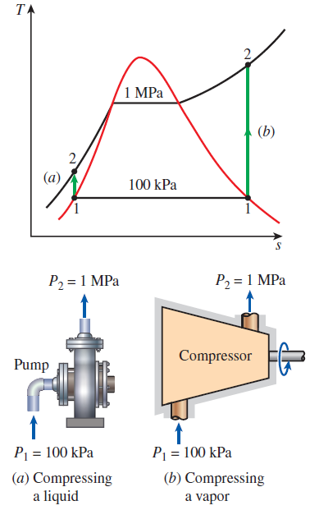
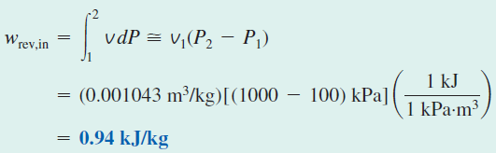


EXAMPLE: Compressing a Substance in the Liquid versus Gas Phases

Slide 3
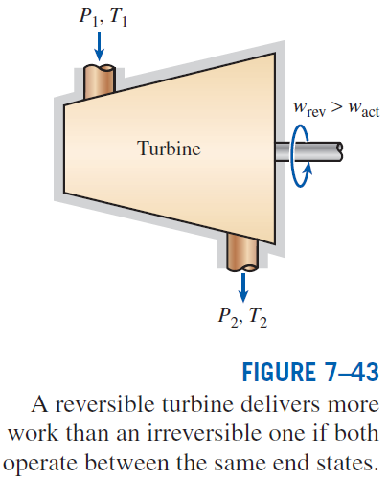


Proof that Steady-Flow Devices Deliver the Most and Consume the Least Work when the Process Is Reversible
Taking heat input and work output positive:
Actual
Reversible
Work-producing devices such as turbines deliver more work, and work-consuming devices such as pumps and compressors require less work when they operate reversibly.

Slide 4
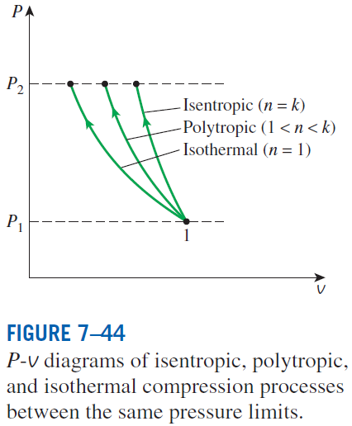
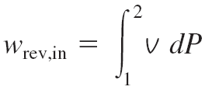
MINIMIZING THE COMPRESSOR WORK
When kinetic and potential energies are negligible
Isentropic (Pv^{k} = constant):
Polytropic (Pv^{n} = constant):
Isothermal (Pv = constant):
The adiabatic compression (Pv^{k} = constant) requires the maximum work and the isothermal compression (T = constant) requires the minimum. Why?

Slide 5
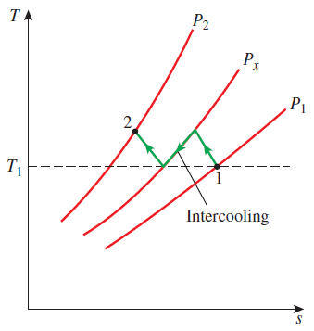
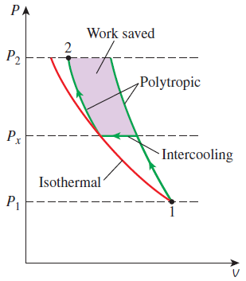

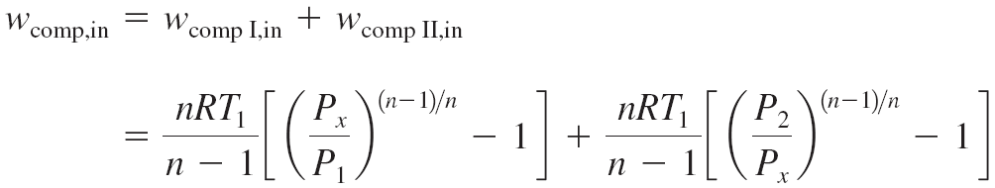
Multistage Compression with Intercooling
The gas is compressed in stages and cooled between each stage by passing it through a heat exchanger called an intercooler.
To minimize compression work during two-stage compression, the pressure ratio across each stage of the compressor must be the same.

Slide 6
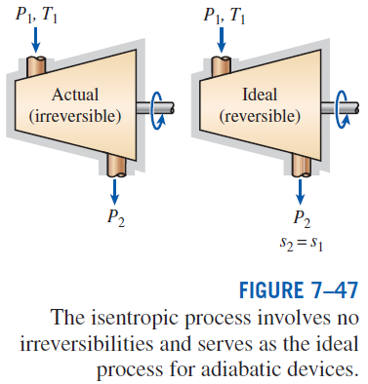
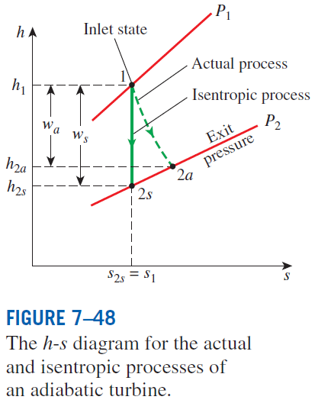

ISENTROPIC EFFICIENCIES OF STEADY-FLOW DEVICES
Isentropic Efficiency
of Turbines

Slide 7
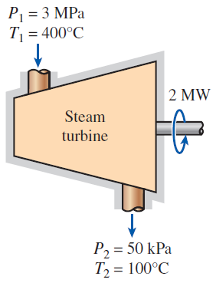
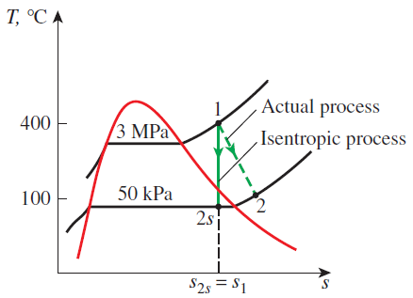

Slide 8
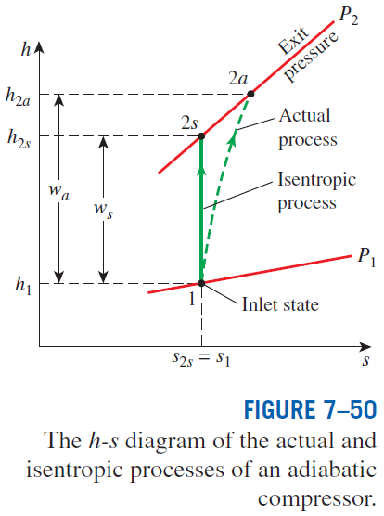

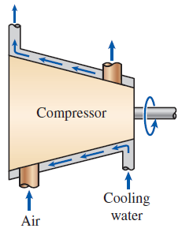
Isentropic Efficiencies of Compressors and Pumps
When kinetic and potential energies are negligible
For a pump
Isothermal efficiency
Compressors are sometimes intentionally cooled to minimize the work input.
Can you use isentropic efficiency for a non-adiabatic compressor?
Can you use isothermal efficiency for an adiabatic compressor?

Slide 9
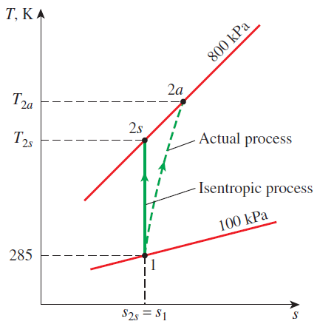
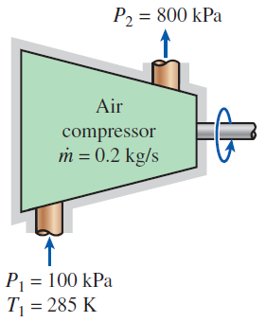

Slide 10
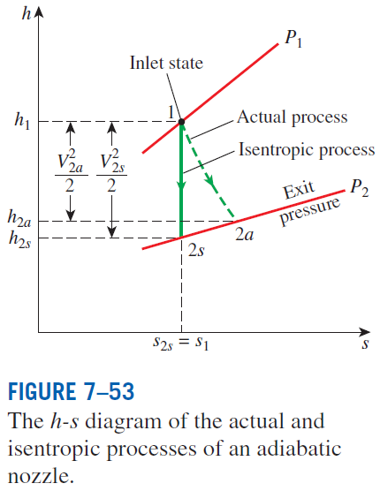
Isentropic Efficiency of Nozzles
If the inlet velocity of the fluid is small relative to the exit velocity, the energy balance is
Then,

Slide 11
