Slide 1
ENTROPY BALANCE
Entropy Change of a System, ∆S_{system}
When the properties of the system are not uniform
Energy and entropy balances for a system.

Slide 2
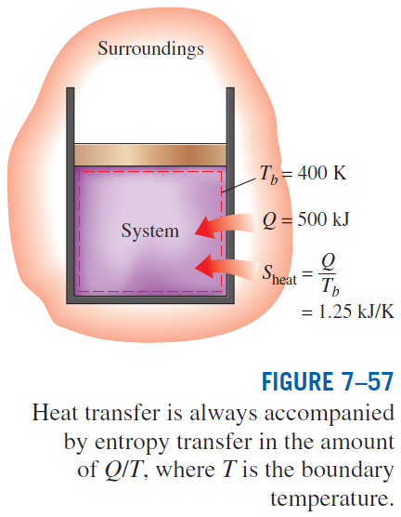
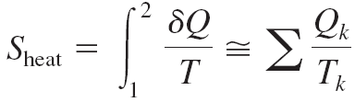
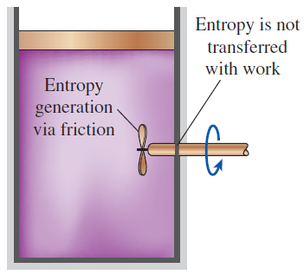
Mechanisms of Entropy Transfer, S_{in} and S_{out}
1 Heat Transfer
Entropy transfer by heat transfer:
Entropy transfer by work:
No entropy accompanies work as it crosses the system boundary. But entropy may be generated within the system as work is dissipated into a less useful form of energy.

Slide 3
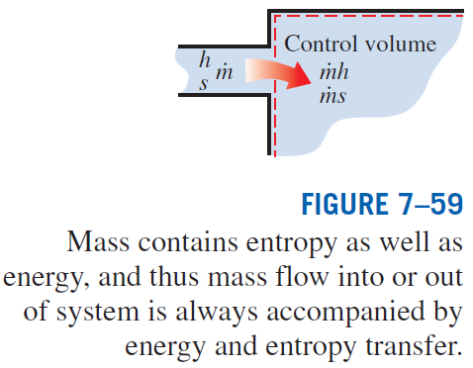
2 Mass Flow
Entropy transfer by mass:
When the properties of the mass change during the process

Slide 4
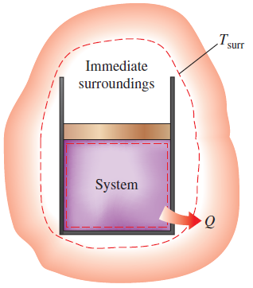
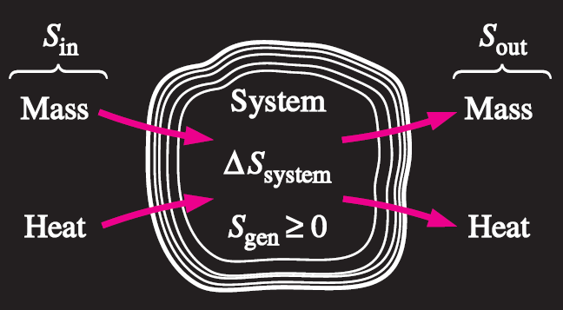
Entropy Generation, S_{gen}
Entropy generation outside system boundaries can be accounted for by writing an entropy balance on an extended system that includes the system and its immediate
surroundings.
Mechanisms of entropy transfer for a general system.

Slide 5
Closed Systems
The entropy change of a closed system during a process is equal to the sum of the net entropy transferred through the system boundary by heat transfer and the entropy generated within the system boundaries.

Slide 6

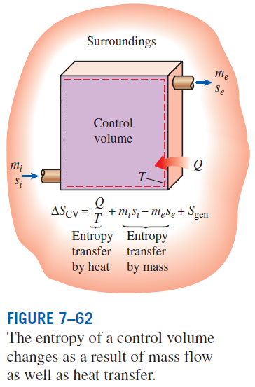

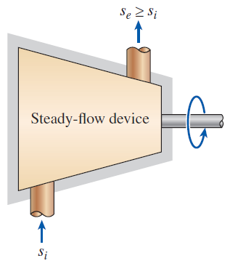
Control Volumes
The entropy of a substance always increases (or remains constant in the case of a reversible process) as it flows through a single-stream, adiabatic, steady-flow device.

Slide 7
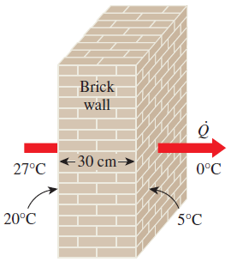
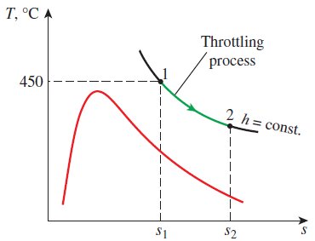
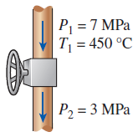
EXAMPLES
Entropy balance for heat transfer through a wall
Entropy balance for a throttling process

Slide 8
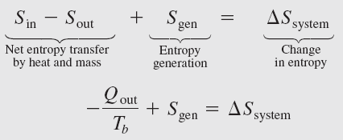
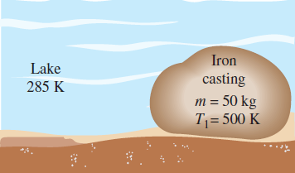
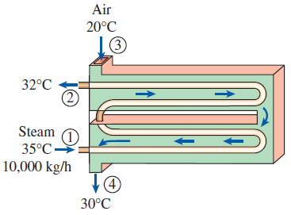

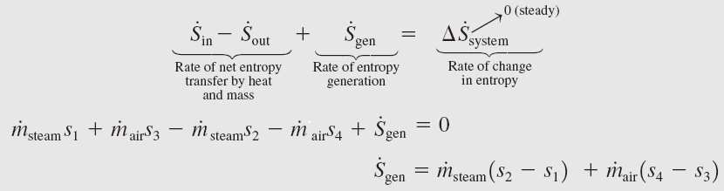
Entropy Generated when a Hot Block Is Dropped in a Lake
or
Entropy Generation in a Heat Exchanger

Slide 9
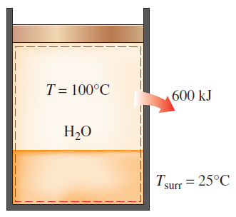
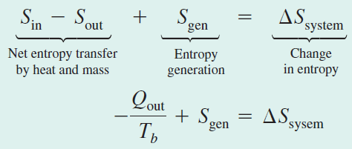


Entropy Generation Associated with Heat Transfer

Slide 10
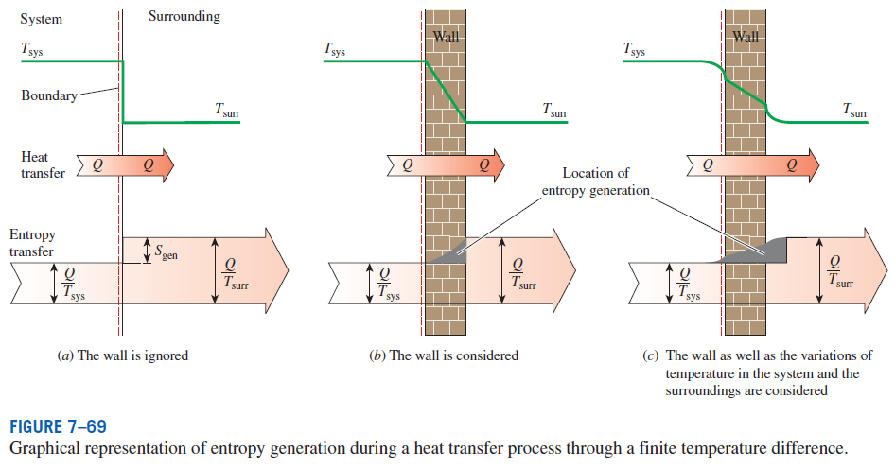
Entropy generation associated with a heat transfer process

Slide 11
Summary
Entropy
The Increase of entropy principle
Entropy change of pure substances
Isentropic processes
Property diagrams involving entropy
What is entropy?
The T ds relations
Entropy change of liquids and solids
The entropy change of ideal gases
Reversible steady-flow work
Minimizing the compressor work
Isentropic efficiencies of steady-flow devices
Entropy balance

