Slide 1
CHAPTER 8 EXERGY
Thermodynamics: An Engineering Approach
8th Edition Yunus A. Çengel, Michael A. Boles
McGraw-Hill, 2015
Adapted from the lecture slides by Mehmet Kanoglu Copyright © The McGraw-Hill Education.
Permission required for reproduction or display.

Slide 2
Objectives
Examine the performance of engineering devices in light of the second law of thermodynamics.
Define exergy, which is the maximum useful work that could be obtained from the system at a given state in a specified environment.
Define reversible work, which is the maximum useful work that can be obtained as a system undergoes a process between two specified states.
Define the exergy destruction, which is the wasted work potential during a process as a result of irreversibilities.
Define the second-law efficiency.
Develop the exergy balance relation.
Apply exergy balance to closed systems and control volumes.

Slide 3
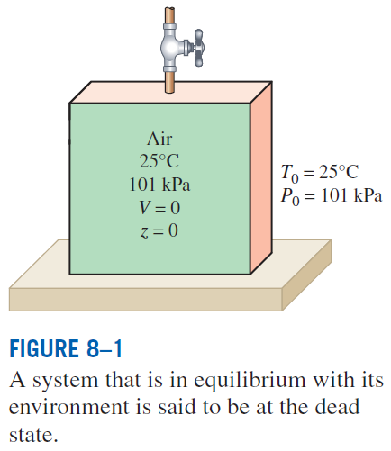
EXERGY: WORK POTENTIAL OF ENERGY
The useful work potential of a given amount of energy at some specified state is called exergy, which is also called the availability or available energy.
A system is said to be in the dead state when it is in thermodynamic equilibrium with the environment it is in.

Slide 4
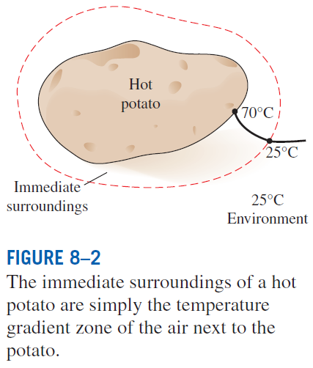
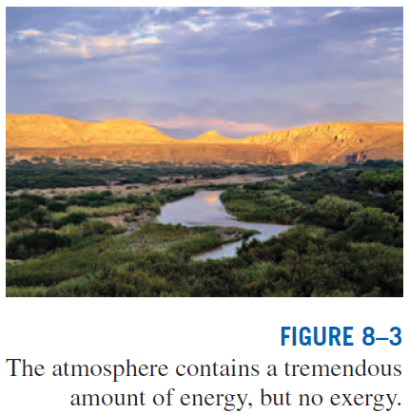
A system delivers the maximum possible work as it undergoes a reversible process from the specified initial state to the state of its environment, that is, the dead state.
This represents the useful work potential of the system at the specified state and is called exergy.
Exergy represents the upper limit on the amount of work a device can deliver without violating any thermodynamic laws.

Slide 5
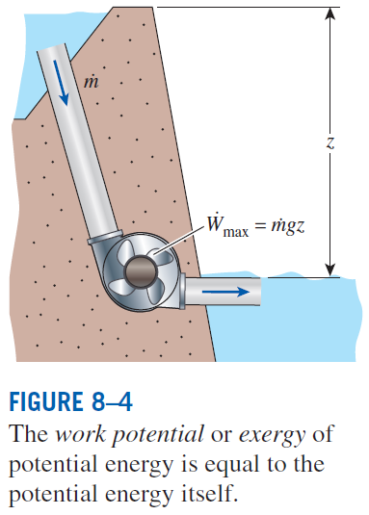
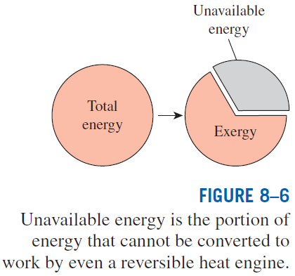
Exergy (Work Potential) Associated with Kinetic and Potential Energy
The exergies of kinetic and potential energies are equal to themselves, and they are entirely available for work.
Exergy of kinetic energy:
Exergy of potential energy:

Slide 6
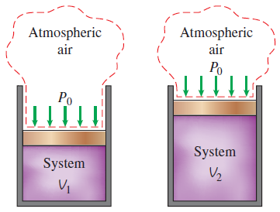

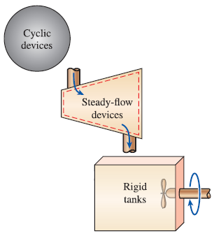
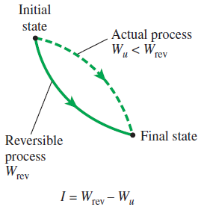
REVERSIBLE WORK AND IRREVERSIBILITY
Reversible work W_{rev}: The maximum amount of useful work that can be produced (or the minimum work that needs to be supplied) as a system undergoes a process between the specified initial and final states.
As a closed system expands, some work needs to be done to push the atmospheric air out of the way (W_{surr}).
The difference between reversible work and actual useful work is the irreversibility.
For constant-volume systems, the total actual and useful works are identical (W_{u} = W).

Slide 7
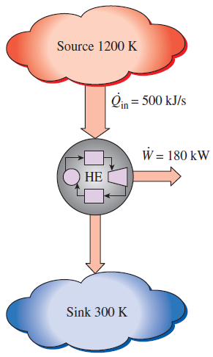


The Rate of Irreversibility of a Heat Engine

Slide 8


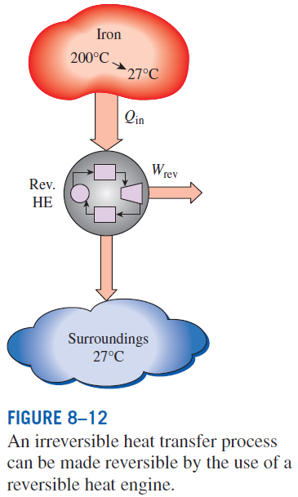
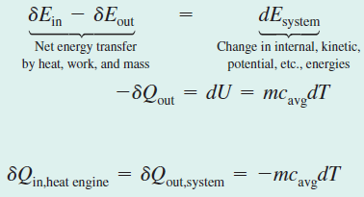
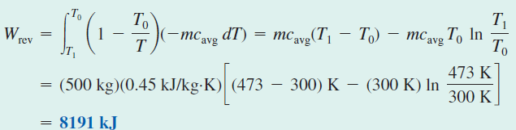
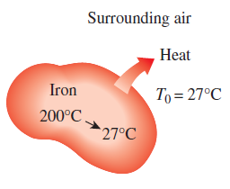
Irreversibility during the Cooling of an Iron Block

Slide 9
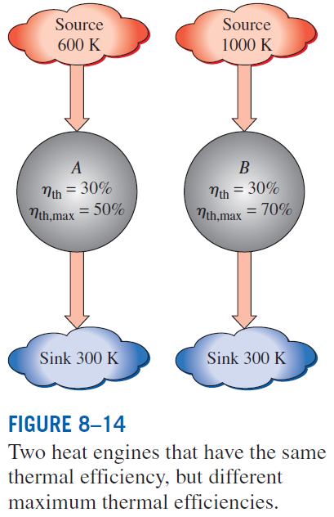
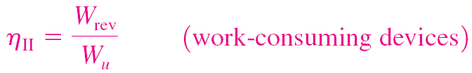
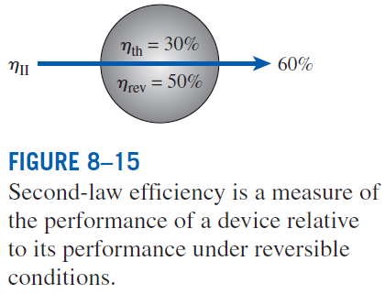
SECOND-LAW EFFICIENCY

Slide 10
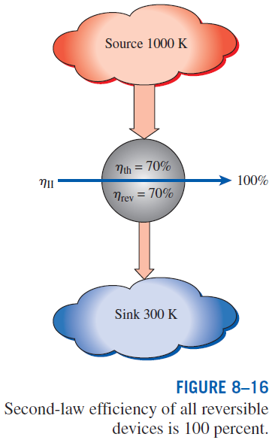

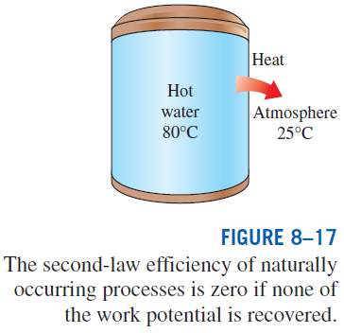
General definition of exergy efficiency:

Slide 11
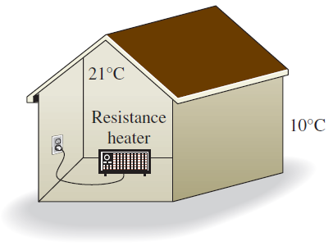






Second-Law Efficiency of Resistance Heaters

