Slide 1
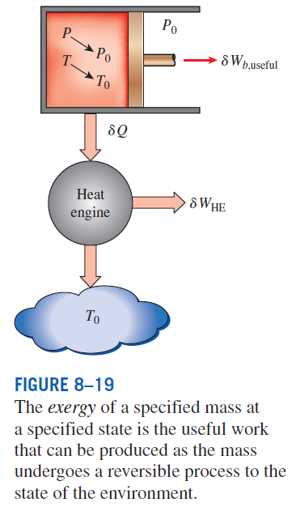
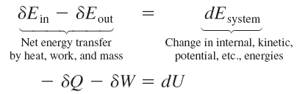


EXERGY CHANGE OF A SYSTEM
Exergy of a Fixed Mass: Nonflow (or Closed System) Exergy
Exergy of a closed system

Slide 2
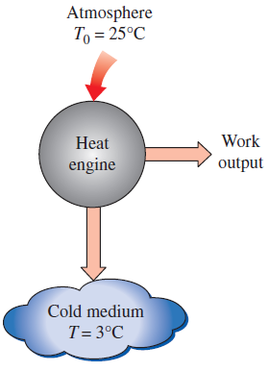
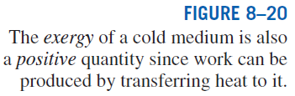
Closed system exergy per unit mass
Exergy change of a closed system
When the properties of a system are not uniform, the exergy of the system is

Slide 3
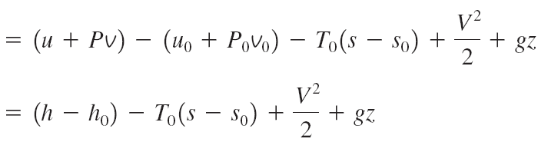
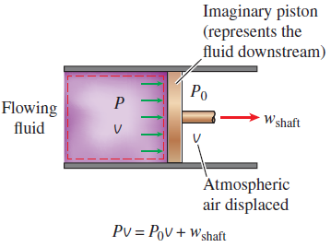
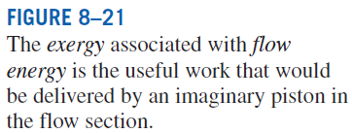
Exergy of a Flow Stream: Flow (or Stream) Exergy
Exergy of flow energy
Flow exergy
Exergy change of flow

Slide 4
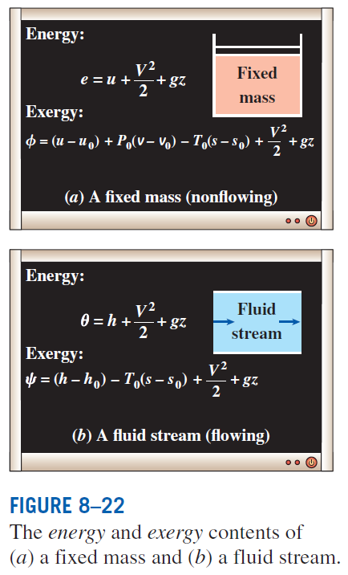

Slide 5
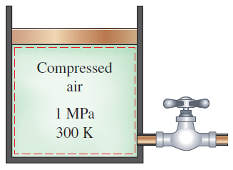
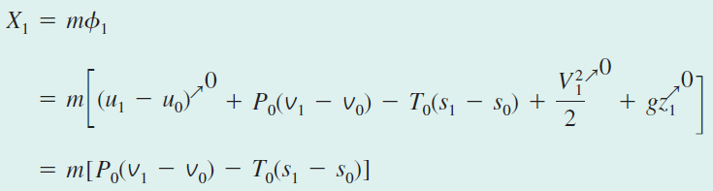
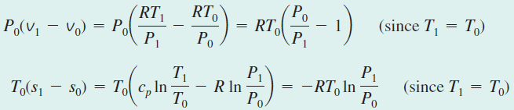


Work Potential of Compressed Air in a Tank

Slide 6
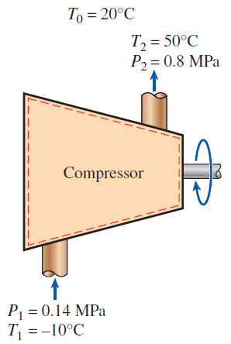

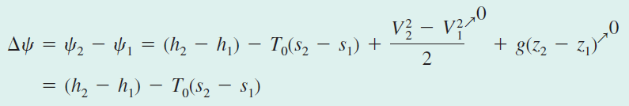
Exergy Change During a Compression Process

Slide 7
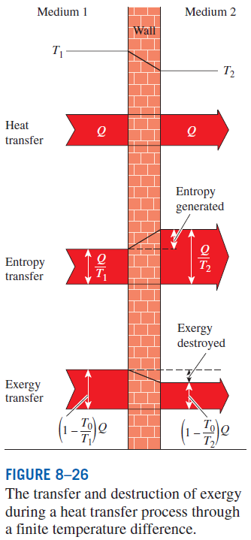
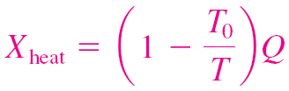
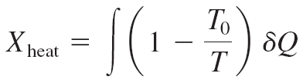
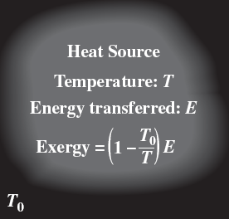
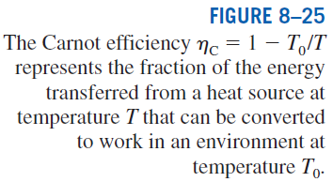
EXERGY TRANSFER BY HEAT, WORK, AND MASS
Exergy by Heat Transfer, Q
Exergy transfer by heat
When temperature is not constant

Slide 8
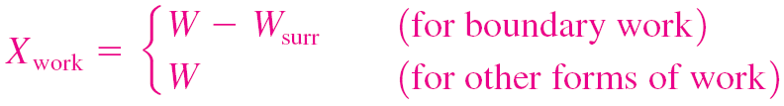


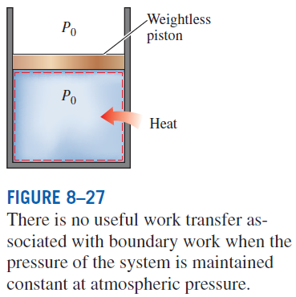
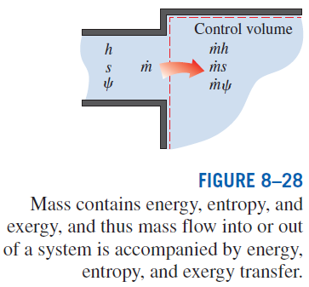
Exergy Transfer by Work, W
Exergy Transfer by Mass, m

Slide 9
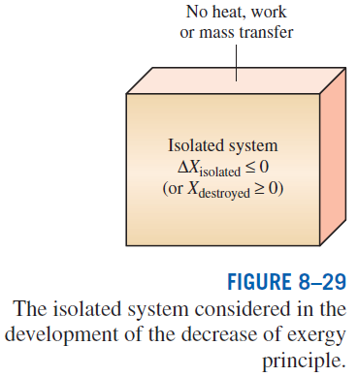
THE DECREASE OF EXERGY PRINCIPLE AND EXERGY DESTRUCTION
The exergy of an isolated system during a process always decreases or, in the limiting case of a reversible process, remains constant. In other words, it never increases and exergy is destroyed during an actual process. This is known as the decrease of exergy principle.

Slide 10
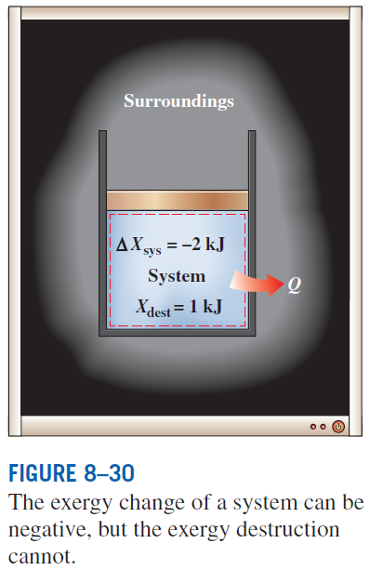
Exergy Destruction
Exergy destroyed is a positive quantity for any actual process and becomes zero for a reversible process.
Exergy destroyed represents the lost work potential and is also called the irreversibility or lost work.
Can the exergy change of a system during a process be negative?
Consider heat transfer from a system to its surroundings. How do you compare exergy changes of the system and the surroundings?

