Slide 1
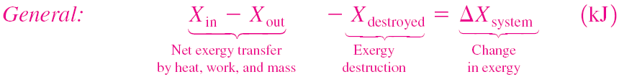
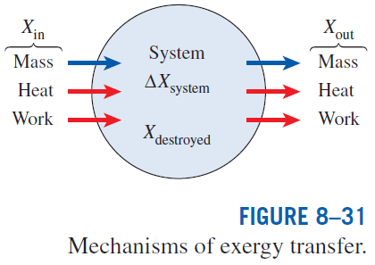
EXERGY BALANCE: CLOSED SYSTEMS
The exergy change of a system during a process is equal to the difference between the net exergy transfer through the system boundary and the exergy destroyed within the system boundaries as a result of irreversibilities.

Slide 2

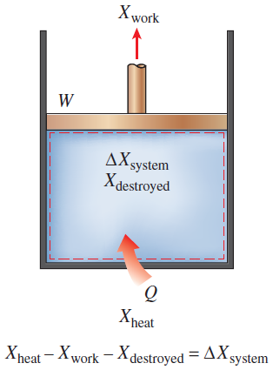
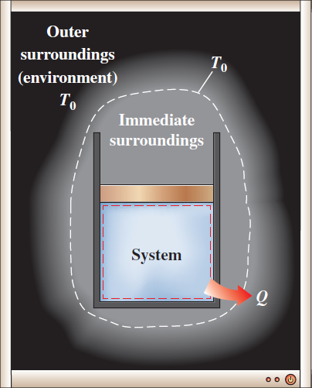
The heat transfer to a system and work done by the system are taken to be positive quantities.
Q_{k} is the heat transfer through the boundary at temperature T_{k} at location k.
Exergy balance for a closed system when heat transfer is to the system and the work is from the system.
Exergy destroyed outside system boundaries can be accounted for by writing an exergy balance on the extended system that includes the system and its immediate surroundings.

Slide 3

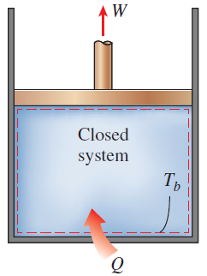



General Exergy Balance for Closed Systems

Slide 4
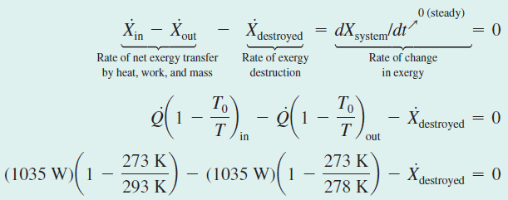
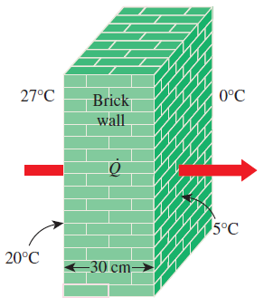

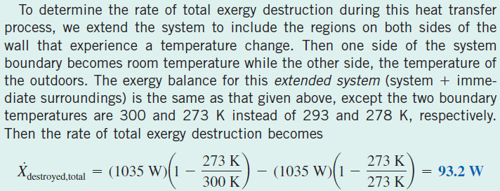
Exergy Destruction during Heat Conduction

Slide 5
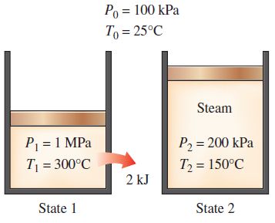
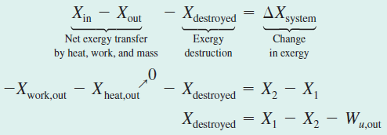


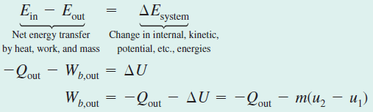

Exergy Destruction During Expansion of Steam
The exergy balance applied on the extended system (system + immediate surroundings) whose boundary is at the environment temperature of T₀ gives
Alternative method of exergy destruction calculation:

Slide 6
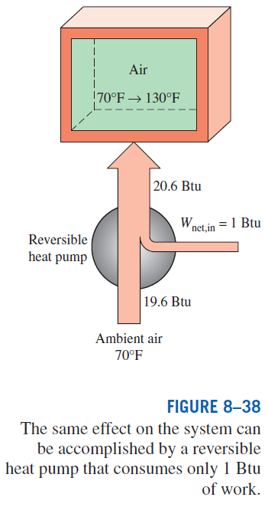



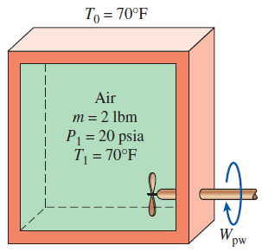
Exergy Destroyed During Stirring of a Gas
= 1 Btu
= 19.6 Btu

Slide 7
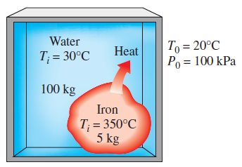
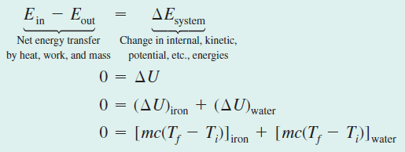
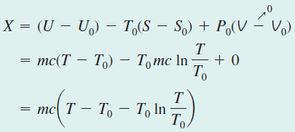
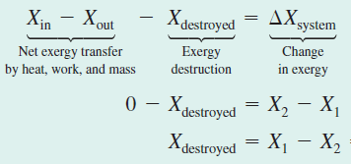
Dropping a Hot Iron Block into Water

Slide 8
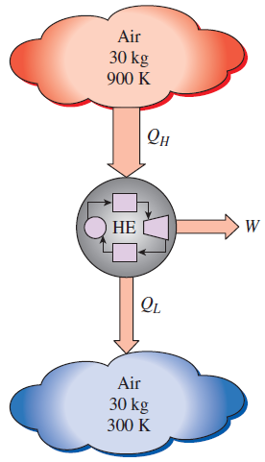
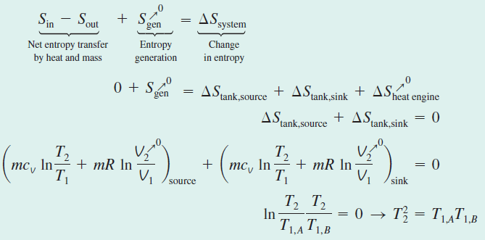




Work Potential of Heat Transfer Between Two Tanks

Slide 9
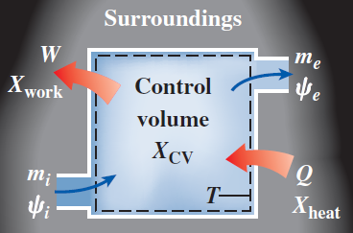
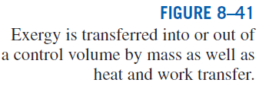
EXERGY BALANCE: CONTROL VOLUMES
The rate of exergy change within the control volume during a process is equal to the rate of net exergy transfer through the control volume boundary by heat, work, and mass flow minus the rate of exergy destruction within the boundaries of the control volume.

Slide 10

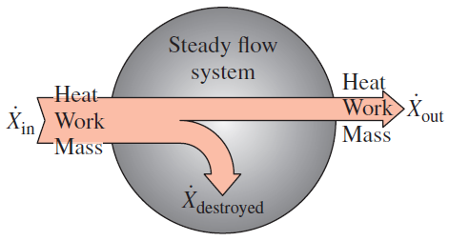
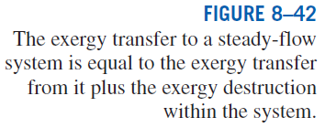
Exergy Balance for Steady-Flow Systems
Most control volumes encountered in practice such as turbines, compressors, nozzles, diffusers, heat exchangers, pipes, and ducts operate steadily, and thus they experience no changes in their mass, energy, entropy, and exergy contents as well as their volumes. Therefore, dV_{CV}/dt = 0 and dX_{CV}/dt = 0 for such systems.

Slide 11
Reversible Work
The exergy balance relations presented above can be used to determine the reversible work W_{rev} by setting the exergy destroyed equal to zero. The work W in that case becomes the reversible work.
The exergy destroyed is zero only for a reversible process, and reversible work represents the maximum work output for work- producing devices such as turbines and the minimum work input for work-consuming devices such as compressors.

Slide 12

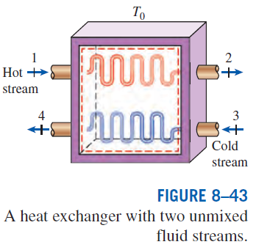
Second-Law Efficiency of Steady-Flow Devices
The second-law efficiency of various steady-flow devices can be determined from its general definition, η_{II} = (Exergy recovered)/(Exergy expended). When the changes in kinetic and potential energies are negligible and the devices are adiabatic:
Turbine
Compressor
Heat exchanger
Mixing chamber

Slide 13
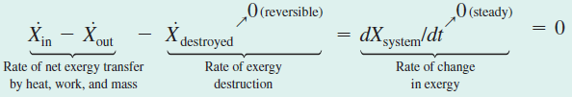
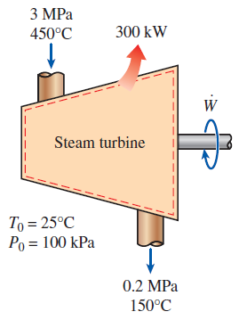
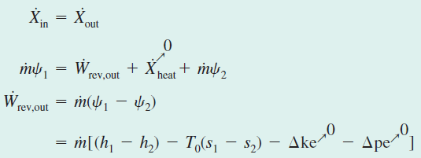


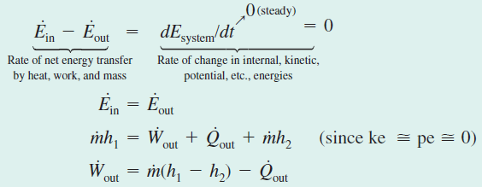
Second-law analysis of a steam turbine

Slide 14
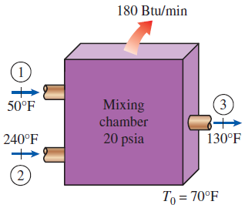
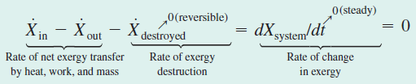
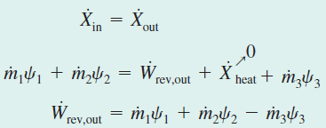


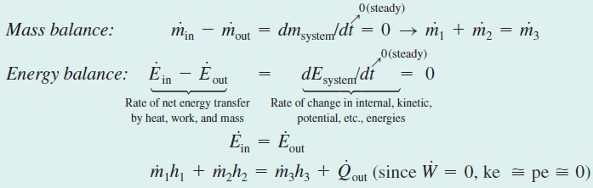

Exergy Destroyed During Mixing of Fluid Streams

Slide 15
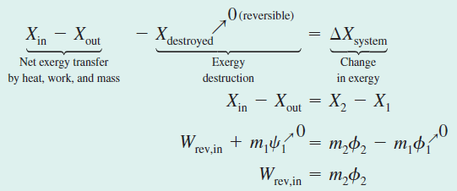
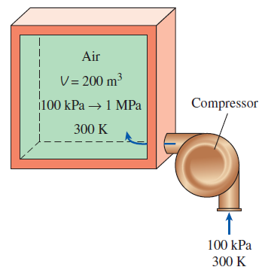
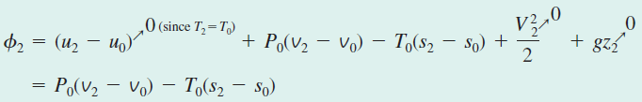



Charging a Compressed Air Storage System

Slide 16
Summary
Exergy: Work potential of energy
Exergy (work potential) associated with kinetic and potential energy
Reversible work and irreversibility
Second-law efficiency
Exergy change of a system
Exergy of a fixed mass: Nonflow (or closed system) exergy
Exergy of a flow stream: Flow (or stream) exergy
Exergy transfer by heat, work, and mass
The decrease of exergy principle and exergy destruction
Exergy balance: Closed systems
Exergy balance: Control volumes
Exergy balance for steady-flow systems
Reversible work
Second-law efficiency of steady-flow devices

